Slide 1
Question 1.Write a program to display the array element?
Ans. CODE:
#include <iostream>
using namespace std;
int main() {
const int SIZE = 5;
int array[SIZE] = {1, 2, 3, 4, 5};
cout << "Array elements are: ";
for(int i = 0; i < SIZE; i++) {
cout << array[i] << " ";
}
cout << endl;
return 0;
}

Slide 2
RESULT:
Array elements are: 1 2 3 4 5
=== Code Execution Successful ===

Slide 3
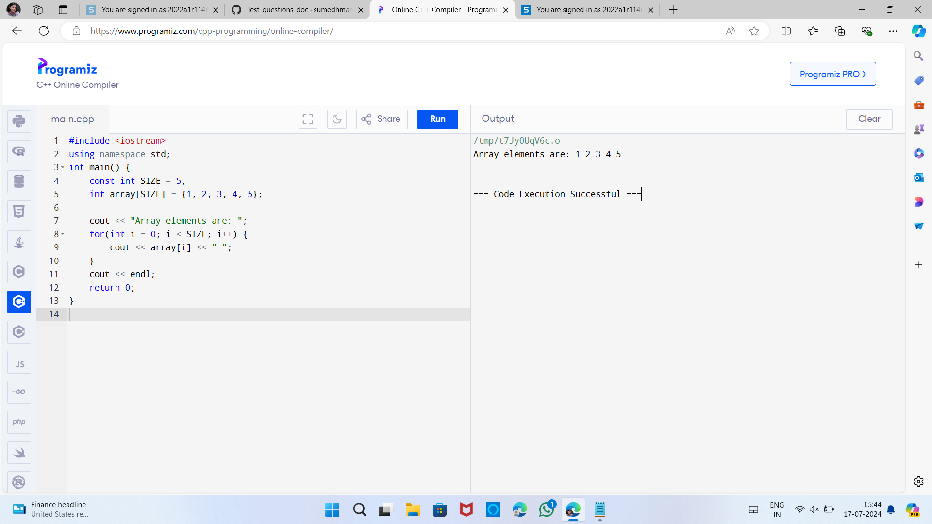

Slide 4
Question 2. Write a program to find the max element from the list?
Ans CODE:-
#include <iostream>
#include <vector>
#include <algorithm> // for std::max_element
int main() {
std::vector<int> numbers = {10, 5, 8, 20, 15}; // Example list of numbers
if (numbers.empty()) {
std::cerr << "The list is empty. Cannot find the maximum element." << std::endl;
return 1;
}
int maxElement = *std::max_element(numbers.begin(), numbers.end());
std::cout << "The maximum element in the list is: " << maxElement << std::endl;
return 0;
}

Slide 5
RESULT:-
The maximum element in the list is: 20
=== Code Execution Successful ===

Slide 6
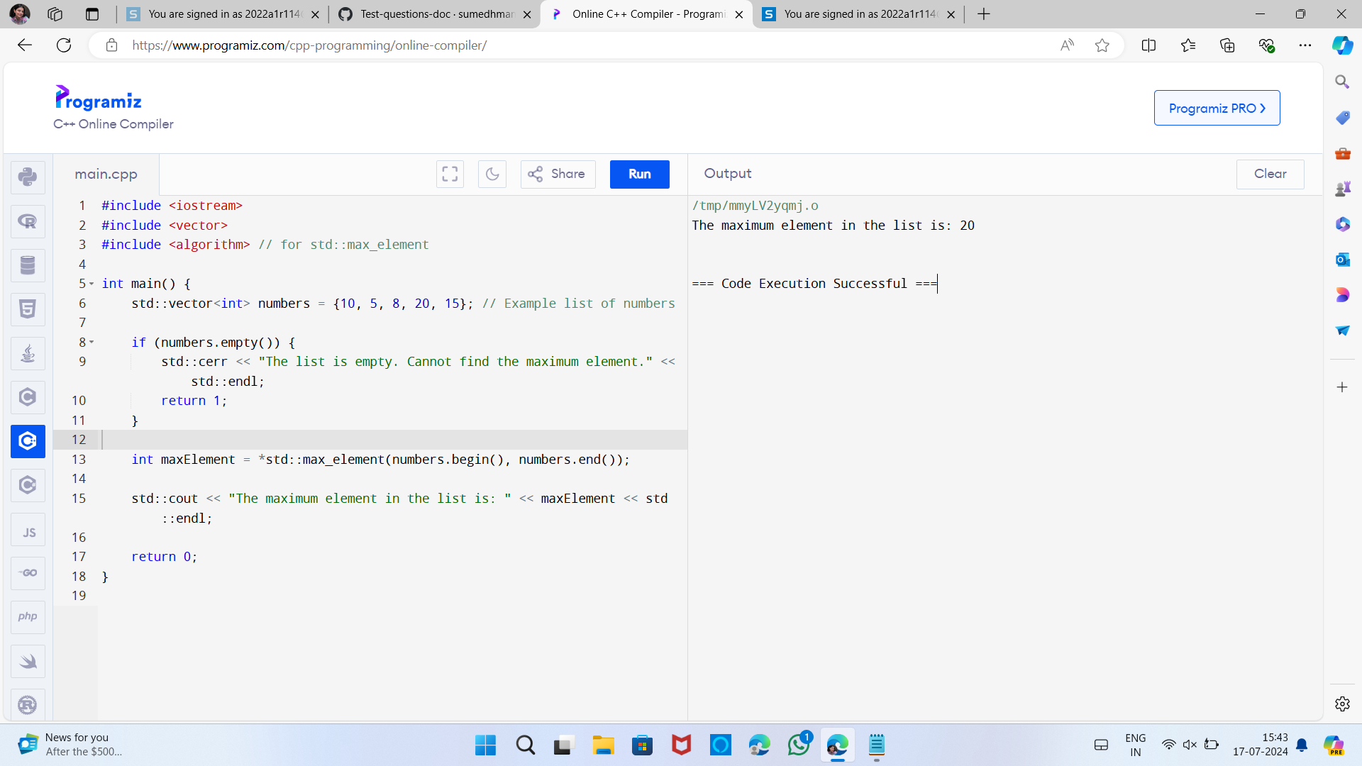

Slide 7
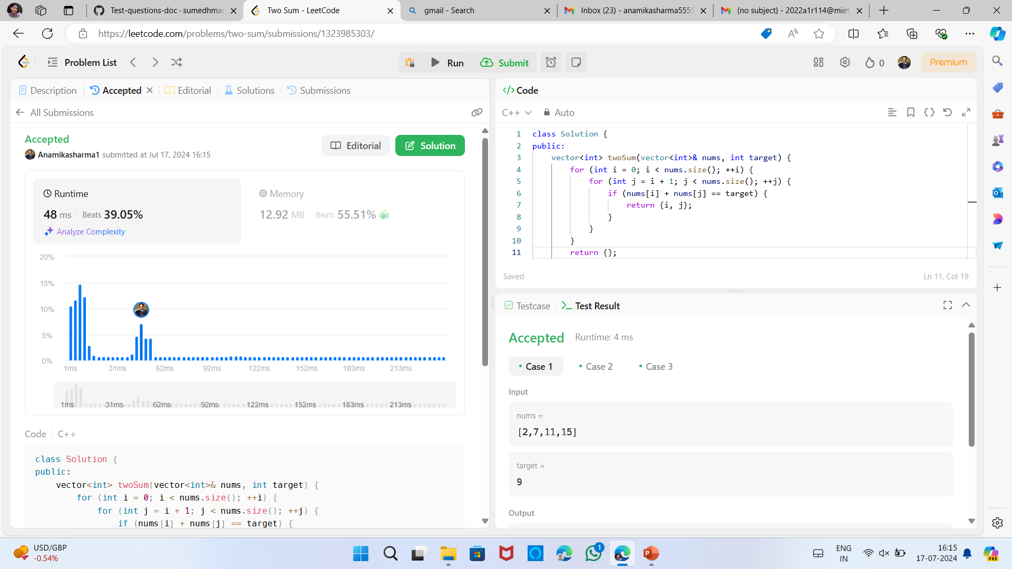
Ques4.

Slide 8
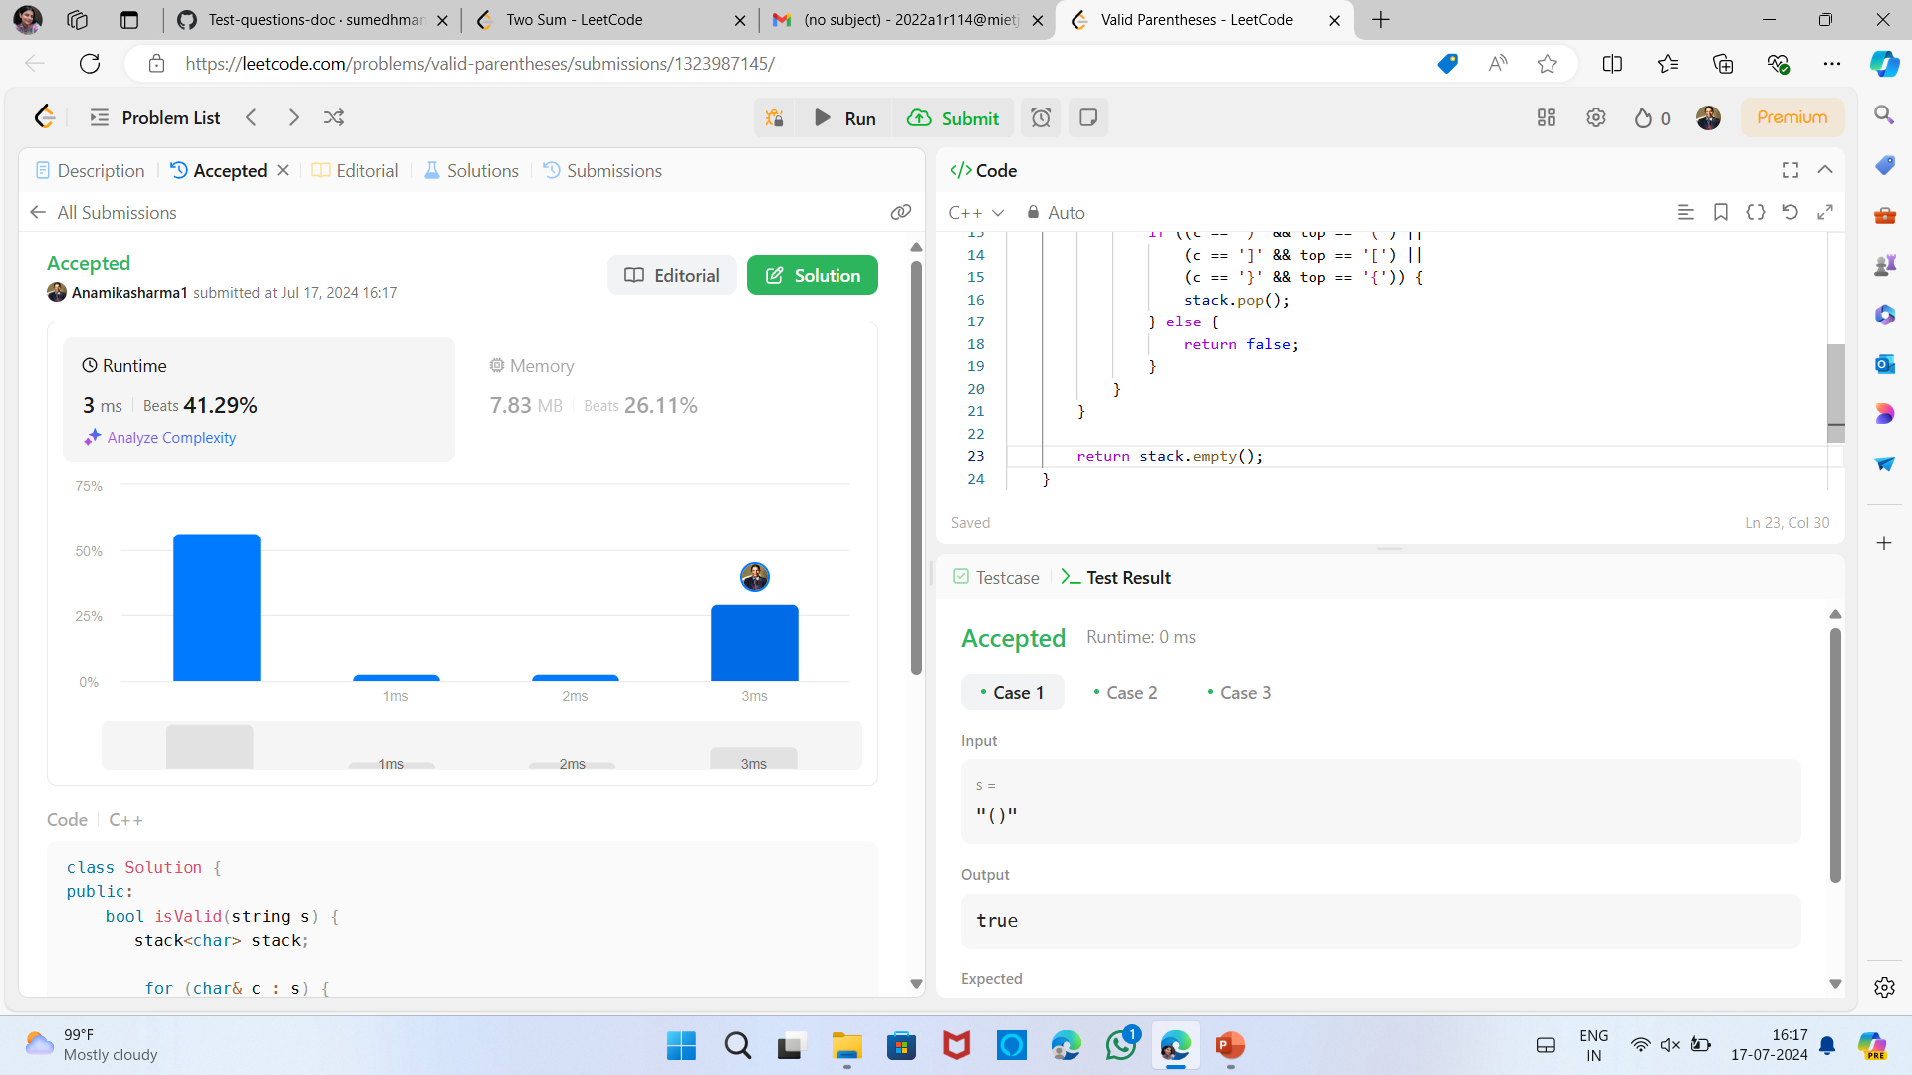
Ques5.

