Slide 1
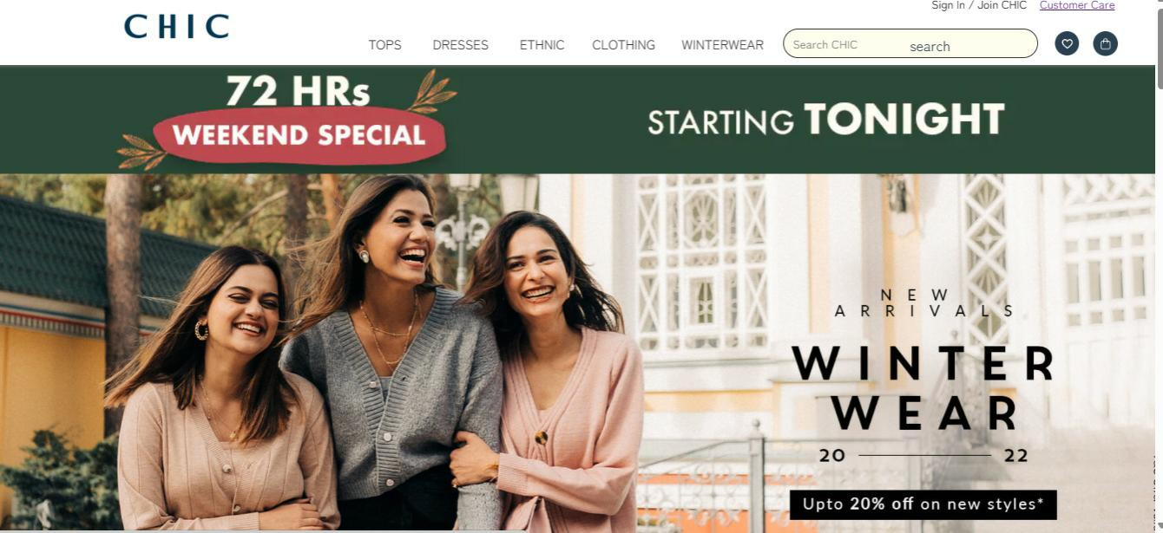
Chic Collections
"Convenience at Your Fingertips"

Slide 2
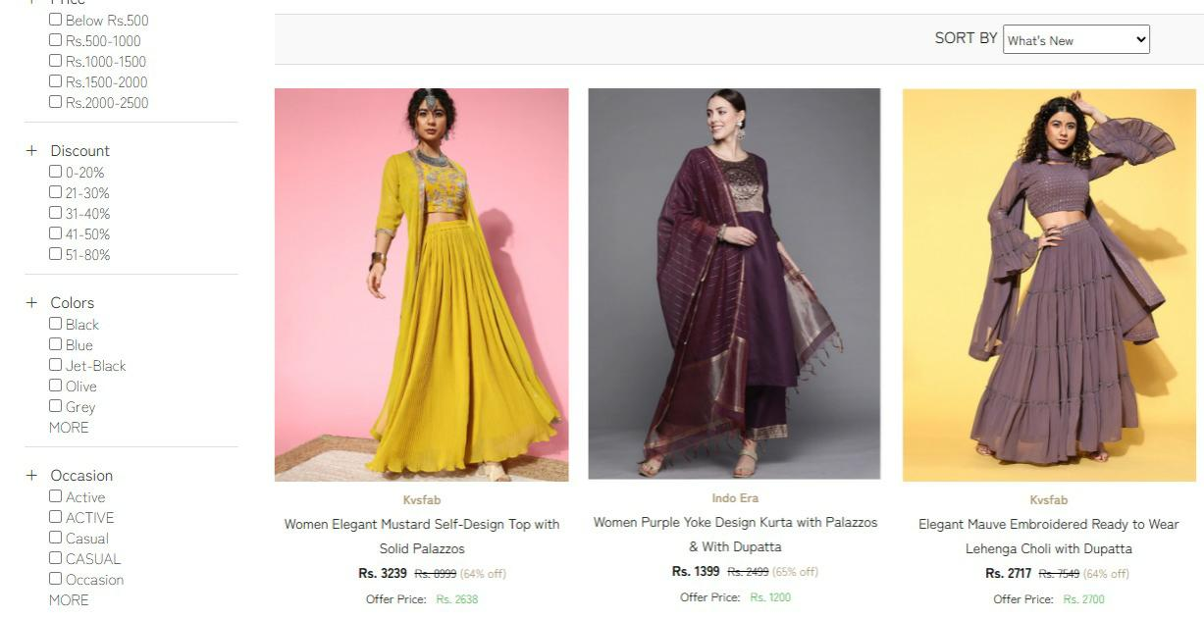
Shopping Website
Welcome to the Shopping Website
project! This website is designed to
provide a seamless and user-friendly
online shopping experience,
offering a wide range of products
with features such as
secure payments fast delivery,
and customer reviews.

Slide 3
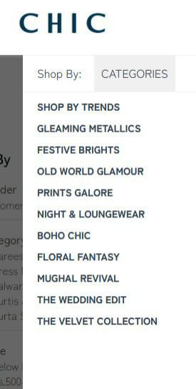
Introduction
"Why Online Shopping?"
Fast-growing industry.
Convenience and accessibility.
Broader product choices.

Slide 4
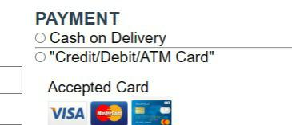

Features of Our Website
User-friendly interface.
Browse and search products by categories.
Secure payment gateway integration.

Slide 5
Technology used
"Built with Cutting-edge Technology"
● Frontend: HTML, CSS, JavaScript
● Payment Gateway: Stripe/PayPal

Slide 6
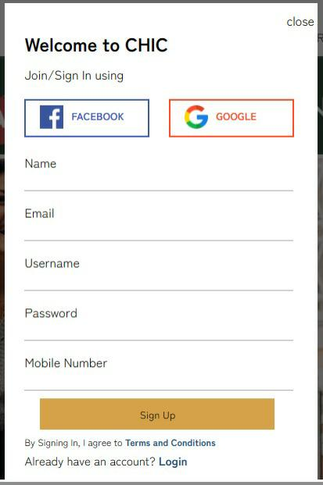
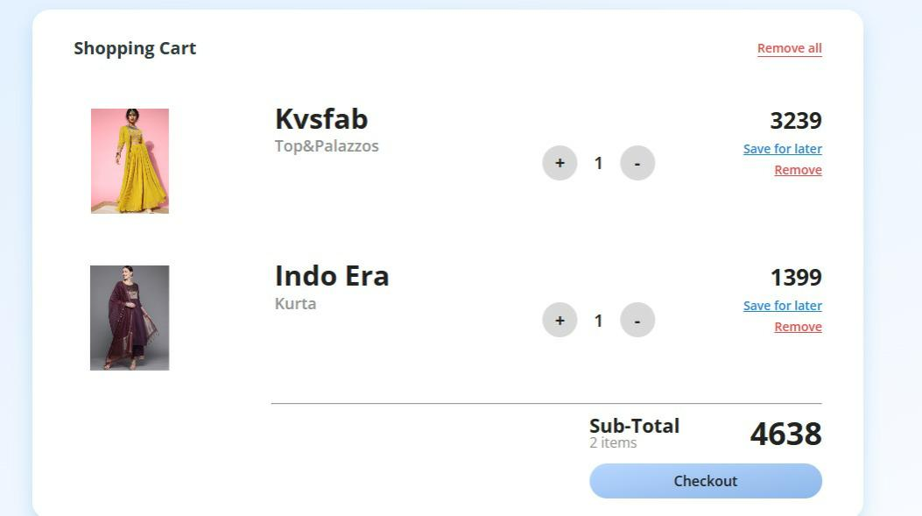
usage
Register or log in Add products to your cart and to explore the website proceed to checkout.

Slide 7
Call to Action
Contact details:
Email:CHIC@gmail.com
Telephone: 044-45614700

