Slide 1
AZ-300T01 Module 01: Managing Azure Subscriptions and Resources
Subtitle or speaker name

Slide 2
Module Overview
Exploring Monitoring Capabilities in Azure
Azure Alerts
Azure Activity Logs and Log Analytics
Network Watcher
Subscriptions and Accounts
Azure Monitor Workbooks
Lab and Review Questions
Notes:
Module overview

Slide 3
Lesson 01: Exploring Monitoring Capabilities in Azure

Slide 4
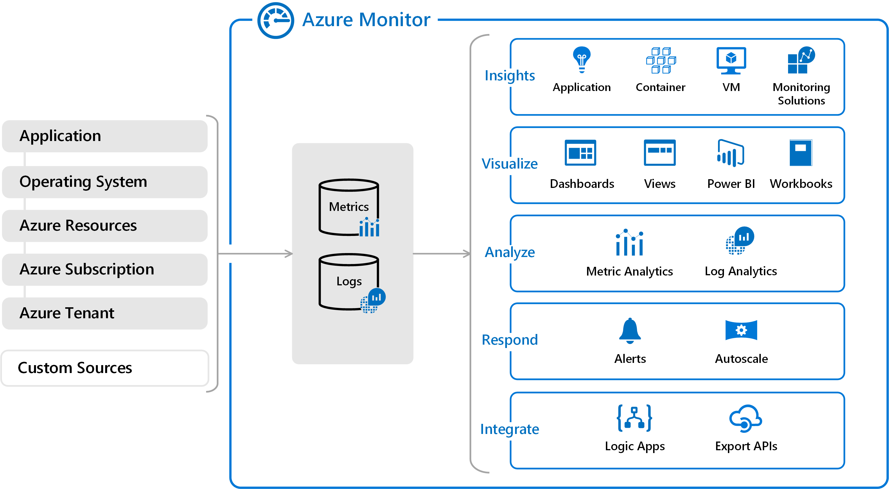
Introducing Azure Monitor Services
Notes:
✔ In this course we will cover the services that will help you with materials in the other courses. Specifically, the highlighted items in the diagram are covered in this course.
For more information, you can see:
Azure Monitor Documentation- https://docs.microsoft.com/en-us/azure/azure-monitor/
Video - Azure Monitor Overview - https://youtu.be/_hGff5bVtkM

Slide 5
Overview of Azure Monitor logs
Monitoring Data Platform
Data sources:
Application monitoring data
Guest OS monitoring data
Azure resource monitoring data
Azure subscription monitoring data
Azure tenant monitoring data
Custom sources
Application Insights
Notes:
Lesson overview

Slide 6
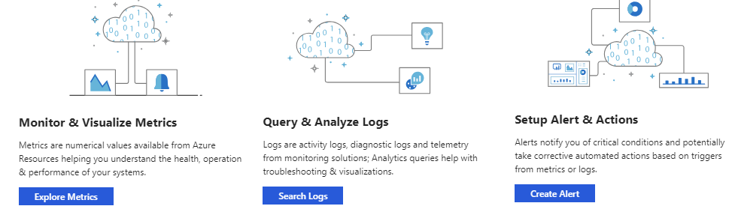
Azure Monitor: Key Capabilities
Core monitoring for Azure services
Collects metrics, activity logs, and diagnostic logs
Use for time critical alerts and notifications

Slide 7
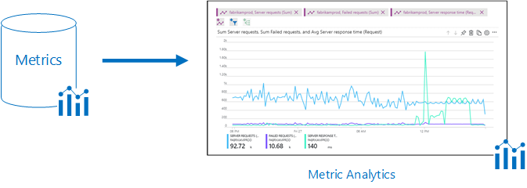
Monitoring Data Platform
Metrics are numerical values that describe some aspect of a system at a point in time. They are lightweight and capable of supporting near real-time scenarios.
Logs contain different kinds of data organized into records with different sets of properties for each type. Telemetry such as events and traces are stored as logs in addition to performance data so that it can all be combined for analysis.

Slide 8
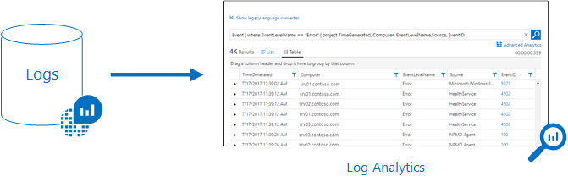
Log Data
Log data is stored in Log Analytics which includes a rich query language to quickly retrieve, consolidate, and analyze collected data
The Data Explorer query language that is suitable for simple log queries but also includes advanced functionality such as aggregations, joins, and smart analytics

Slide 9
Data Types
Application monitoring data - Performance and functionality of the code you have written, regardless of its platform
Guest OS monitoring - Azure, another cloud, or on-premises
Azure resource monitoring
Azure subscription monitoring - Operation and management of an Azure subscription, as well as data about the health and operation of Azure itself
Azure tenant monitoring – Operation of tenant-level Azure services, such as Azure Active Directory
Notes:
For more information, you can see:
Azure Fridays, Azure Monitor - [https://channel9.msdn.com/Shows/Azure-Friday/Azure-Monitor/player](https://channel9.msdn.com/Shows/Azure-Friday/Azure-Monitor/player)

Slide 10
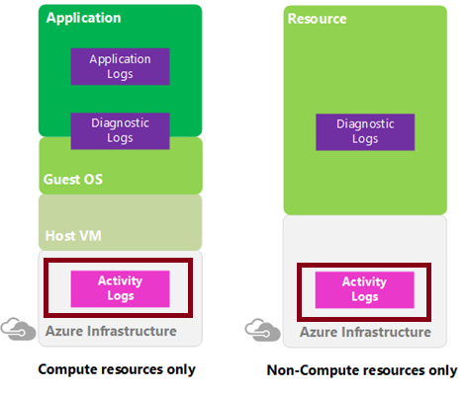
Activity Log
Determine:
what, who, and when
for all write operations (PUT, POST, DELETE)
Send data to Log Analytics for advanced search and alerts
Query or manage events in the Portal, PowerShell, CLI, and REST API
Stream information to Event Hub
Archive data to a storage account
Analyze data with Power BI
Notes:
✔ Activity Logs provide data about the operations on a resource from the outside (the "control plane"). Diagnostics Logs are emitted by a resource and provide information about the operation of that resource (the "data plane"). Activity logs are kept for 90 days. You can query for any range of dates, as long as the starting date isn't more than 90 days in the past.

Slide 11
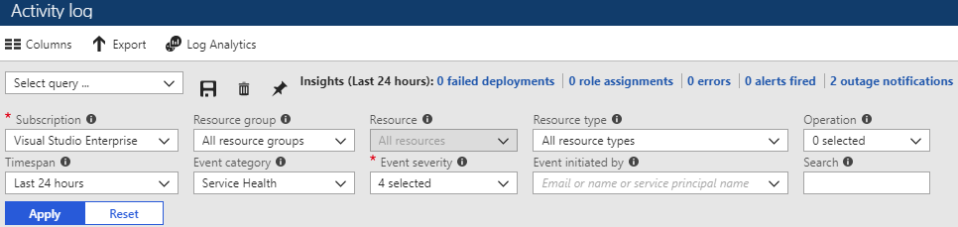
Query the Activity Log
Filter by: Subscription, Resource group, Resource (name), Resource type, Operation name, Timespan, Category, Severity, and Event initiated by
Notes:
✔ Once you have defined a set of filters, you can save it as a query that is persisted across sessions if you ever need to perform the same query with those filters applied again in the future. You can also pin a query to your Azure dashboard to always keep an eye on specific events.
For more information, you can see:
Query the Activity Log in the Azure portal - https://docs.microsoft.com/en-us/azure/monitoring-and-diagnostics/monitoring-overview-activity-logs#query-the-activity-log-in-the-azure-portal

Slide 12
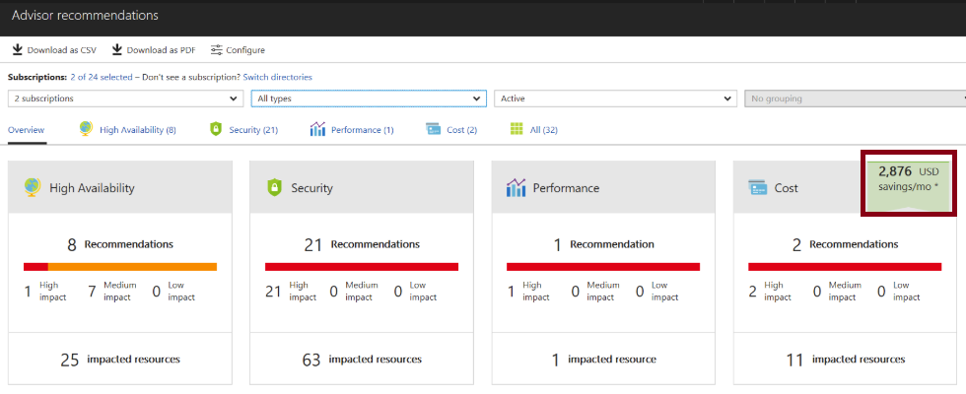
Azure Advisor
Personalized cloud consultant
Analyzes your configuration and recommends solutions
Four areas: High Availability, Security, Performance, and Cost
Notes:
✔ Advisor provides recommendations for virtual machines, availability sets, application gateways, App Services, SQL servers, and Redis Cache.

Slide 13
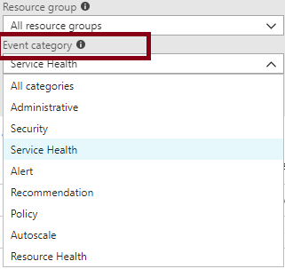
Event Categories
Administrative events
Service health events with status
Alert events
Autoscale events
Usage recommendations
Security events
Policy and Resource Health (reserved)

Slide 14
Lesson 02: Azure Alerts

Slide 15
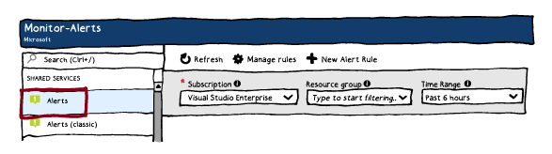
Azure Monitor Alerts
Better notification system
Unified authoring experience
Log Analytics alerts display in Azure portal
Separation of Fired Alerts and Alert Rules
Improved workflow
Notes:
For more information, you can see:
The new alerts experience in Azure Monitor - https://docs.microsoft.com/en-us/azure/monitoring-and-diagnostics/monitoring-overview-unified-alerts

Slide 16
Creating Alert Rules
Define alert conditions: Target selection, Alert criteria, and Alert logic
Define alert details: Alert rule name, description, and severity (0 to 4)
Define action group: notify your team via email and text messages or automate actions using webhooks and runbooks.

Slide 17
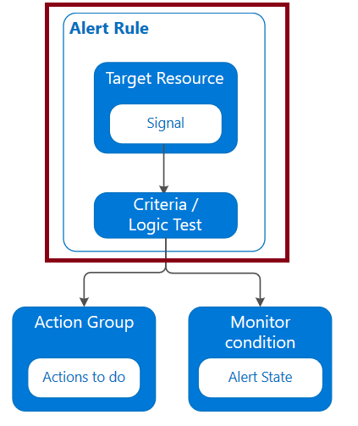
Alert Rules
Key attributes:
Target resource (e.g. an Azure VM)
Signal
Metric
Activity log
Application Insights
Log
Criteria (signal and logic on a target resource):
e.g. Percentage CPU > 70% or Server Response Time > 4 ms
Alert name
Alert description
Severity (0-4)
Action (leverages Action Groups)

Slide 18
Action Groups
Notifies a group of users that an alert has been triggered
Is a collection of notification preferences
Email/SMS/Voice
Azure Function
Logic App
Webhook
IT Service Management
Automation Runbook

Slide 19
Managing Alerts
State | Description
New | The issue has just been detected and has not yet been reviewed.
Acknowledged | An administrator has reviewed the alert and started working on it.
Closed | The issue has been resolved. After an alert has been closed, you can reopen it by changing it to another state.
You can alert on metrics and logs as such as: Metric values, log search queries, activity log events, health of the underlying Azure platform, and tests for web site availability
Notes:
✔️ Alert state is different and independent of the monitor condition. Alert state is set by the user. Monitor condition is set by the system. When an alert fires, the alert's monitor condition is set to fired. When the underlying condition that caused the alert to fire clears, the monitor condition is set to resolved. The alert state isn't changed until the user changes it.

Slide 20
Alerts Experience
Subscription – Select up to five Azure subscriptions
Resource Group – View one resource group at a time
Time range - Past hour, the past 24 hours, the past 7 days, the past 30 days, or custom.

Slide 21
Alert Detail Page
Essentials
History
Smart group
More details

Slide 22
Create an Alert
Resource
Condition
Action Group
Alert rule name
Description
Enable rule upon creation
Notes:
Alert rule name, description, and enable rule upon completion are not shown in the graphic.

Slide 23
Demonstration - Alerts
Create an alert rule
Explore alert targets
Explore alert conditions
Explore alert details
Notes:
✔ Always consider having students walk-through the demonstrations themselves. Also, consider the overlap with the formal labs and your best use of time.

Slide 24
Lesson 03: Azure Activity Logs and Log Analytics

Slide 25
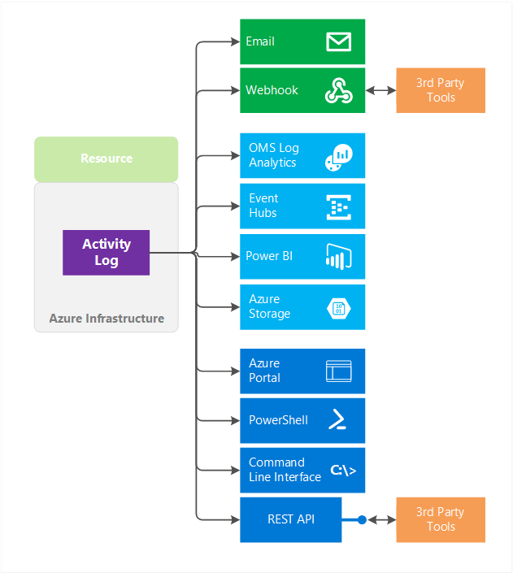
Overview of Activity Log
Subscription-level events
Control plane:
What, who, when
All write operations
Notes:
Lesson overview

Slide 26
Query the Activity Log in Azure
Available in the Azure portal via:
Activity Log
Azure Monitor
Blades of individual Azure resources
Output can be filtered based on a wide range of criteria:
Timespan
Category
Subscription, resource group, resource name, and resource type
Operation name
Severity
Caller initiating the event
Queries can be saved
Resulting output can be pinned to Azure portal dashboards

Slide 27
Log Analytics Scenarios
Example 1 - Assessing updates
IT Administrators assess systems update requirements
Must be able to accurately schedule updates
OMS/Log Analytics collects data from all customers performing updates
Uses "Crowd-sourced" data to provide an average time to help meet strict SLAs
Example 2 - Change tracking
Troubleshooting operational incidents is a complex process
OMS/Log Analytics let you perform analysis from multiple angles, using a variety of sources
Everything correlated through a single interface
Track issues such as unexpected system reboots or shutdowns
Notes:
For more information, you can see:
‎What is Log Analytics? https://docs.microsoft.com/en-us/azure/log-analytics/log-analytics-overview
What’s new in Microsoft Operations Management Suite: Log Analytics - https://blog.tyang.org/wp-content/uploads/2016/04/Whats-New-in-OMS.pdf
Log Analytics FAQ - https://azure.microsoft.com/en-us/services/log-analytics/faq/
Unified Alerts in Log Analytics - https://docs.microsoft.com/en-us/azure/log-analytics/log-analytics-alerts

Slide 28
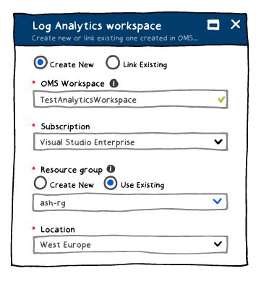
Create a Workspace
A workspace is an Azure resource and is a container where data is collected, aggregated, analyzed, and presented
You can have multiple workspaces per Azure subscription, and you can have access to more than one workspace
A workspace provides a geographic location, data isolation, and scope

Slide 29
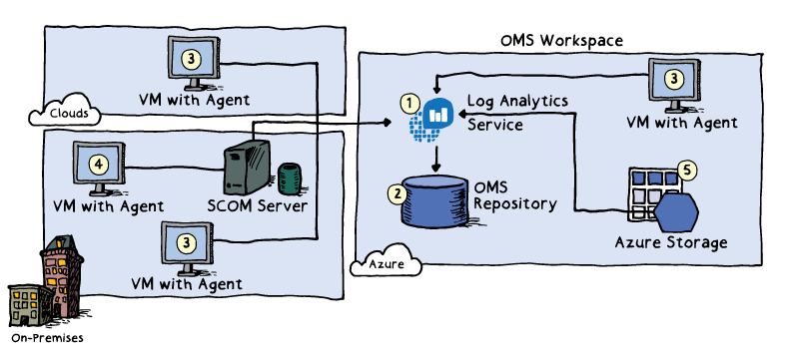
Connected Sources
Connected Sources generate data
Data can be collected from Windows, Linux, SCOM and Azure Storage

Slide 30
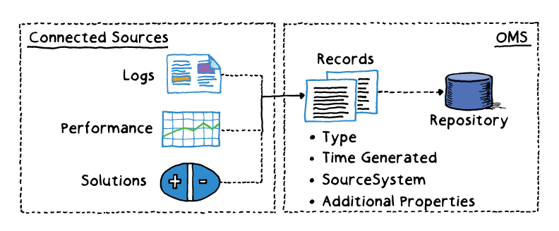
Data Sources
Data sources include: Windows Event Logs, Windows Performance Counters, Linux Performance Counters, IIS Logs, Custom Fields, Custom Logs, and Syslog.
Each data source has additional configuration options.

Slide 31
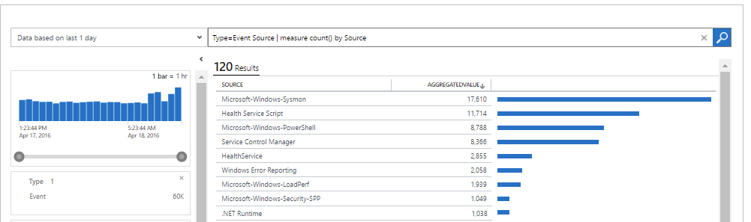
Log Analytics Querying
Log Analytics provides a query syntax
Quickly retrieve and consolidate data in the repository
Save or have log searches run automatically to create an alert
Export the data to Power BI or Excel

Slide 32
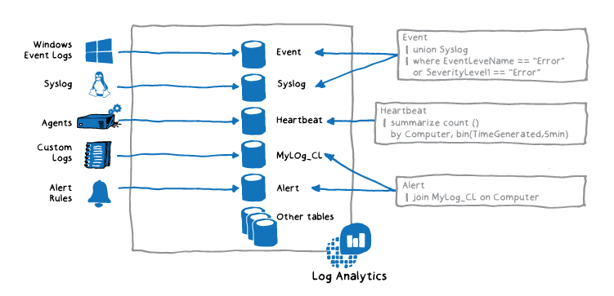
Query Language Syntax
Event
| where (EventLevelName == "Error")
| where (TimeGenerated > ago(1days))
| summarize ErrorCount = count() by Computer
| top 10 by ErrorCount desc
Notes:
For more information, you can see:
Azure Monitor log queries - https://docs.microsoft.com/en-us/azure/azure-monitor/log-query/query-language

Slide 33
Demonstration – Log Analytics
Access the demonstration environment
Use the Query Explorer
Notes:
✔ Always consider having students walk-through the demonstrations themselves. Also, consider the overlap with the formal labs and your best use of time.

Slide 34
Practice: Visualize Data
Create a shared dashboard in the Azure portal.
Visualize a performance log search.
Add a log search to a shared dashboard.
Customize a tile in a shared dashboard.

Slide 35
Practice: Alert on Data
Create an alert rule.
Configure an Action Group to send an e-mail notification.

Slide 36
Practice: Collect and Analyze Data
Part 1:
Create a workspace.
Enable Log Analytics on virtual machines.
Collect event and performance data.
View the data collected.
Part 2:
Perform a simple search of event data and use features to modify and filter the results.
Learn how to work with performance data.

Slide 37
Practice: Log Analytics Queries
See the volume of data collected in the last 24 hours in intervals of 30 minutes.
Chart the distribution of billable data by type, over the last 24 hours.
Find out which computers were alive in the past 2 days but haven't sent any data in the last 6 hours.

Slide 38
Lesson 04: Network Watcher

Slide 39
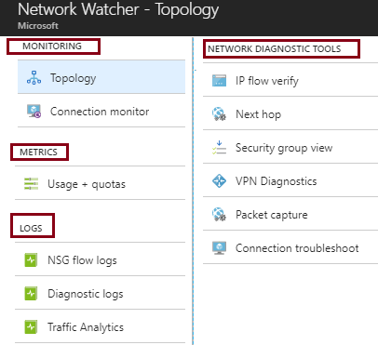
Network Watcher
Is a regional service
Provides tools to monitor, diagnose, view metrics, and enable or disable logs
Provides scenario level monitoring so you can diagnose problems at an end to end network level view
Notes:
✔ The Network Watcher instance is automatically created in a resource group named NetworkWatcherRG.
For more information, you can see:
Network Watcher - https://azure.microsoft.com/en-us/services/network-watcher/

Slide 40
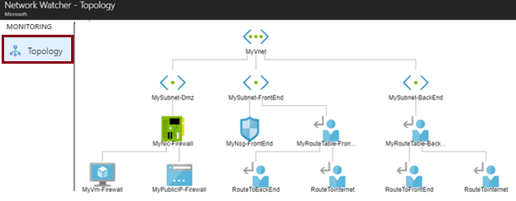
Monitoring and Visualization
Provides a visual representation of your networking elements
View all the resources in a virtual network, resource to resource associations, and relationships between the resources
Notes:
✔ To use Network Watcher capabilities, the account you log into Azure with, must be assigned to the Owner, Contributor, or Network contributor built-in roles, or assigned to a custom role. A custom role can be given permissions to read, write, and delete the Network Watcher.

Slide 41
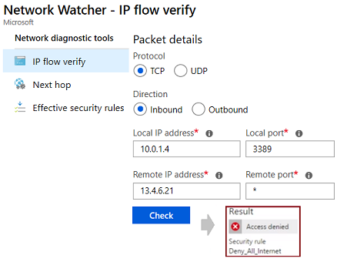
Diagnostics - IP Flow Verify
Diagnose connectivity issues from or to the internet and from or to the on-premises environment. Ideal for ensuring security rules are being correctly applied.
Notes:
✔ IP flow verify is ideal for making sure security rules are being correctly applied. When used for troubleshooting, if IP flow verify doesn’t show a problem, you will need to explore other areas such as firewall restrictions.

Slide 42
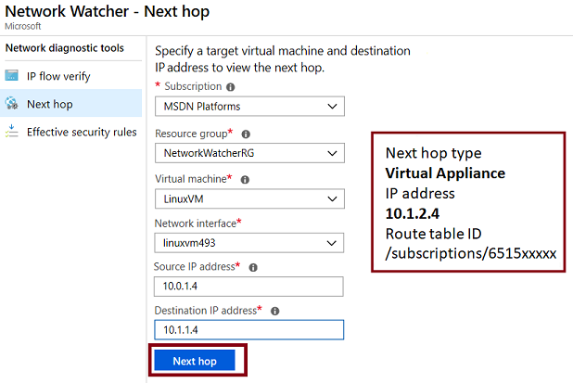
Diagnostics - Next Hop
Helps with determining whether traffic is being directed to the intended destination by showing the next hop

Slide 43
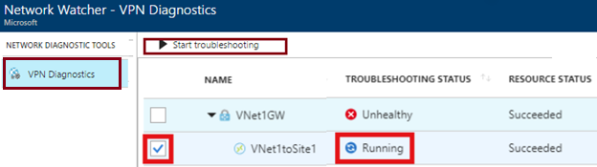
Diagnostics - VPN Diagnostics
Helps you troubleshoot gateways and connections
Provides summary information and detailed information
Can troubleshoot multiple gateways or connections simultaneously
Notes:
✔ You can select multiple gateways or connections to troubleshoot simultaneously or you can focus on an individual component.

Slide 44
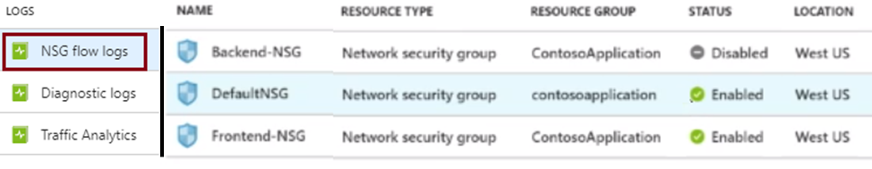
NSG Flow Logs
View information about ingress and egress IP traffic through an NSG
Flow logs are written in JSON format and show outbound and inbound flows on a per rule basis
The JSON format can be visually displayed in Power BI or third-party tools like Kibana
Notes:
✔ These capabilities can be used in security compliance and auditing. You can define a prescriptive set of security rules as a model for security governance in your organization. A periodic compliance audit can be implemented in a programmatic way by comparing the prescriptive rules with the effective rules for each of the VMs in your network.

Slide 45
Connection Troubleshoot
Check connectivity between source VM and destination
Identify configuration issues that are impacting reachability
Provide all possible hop by hop paths from the source to destination
Review hop by hop latency - min, max, and average between source and destination
View a graphical topology from your source to destination
Notes:
For more information, see:
Troubleshoot connections with Azure Network Watcher using the Azure portal - https://docs.microsoft.com/en-us/azure/network-watcher/network-watcher-connectivity-portal

Slide 46
Lesson 05: Subscriptions and Accounts

Slide 47
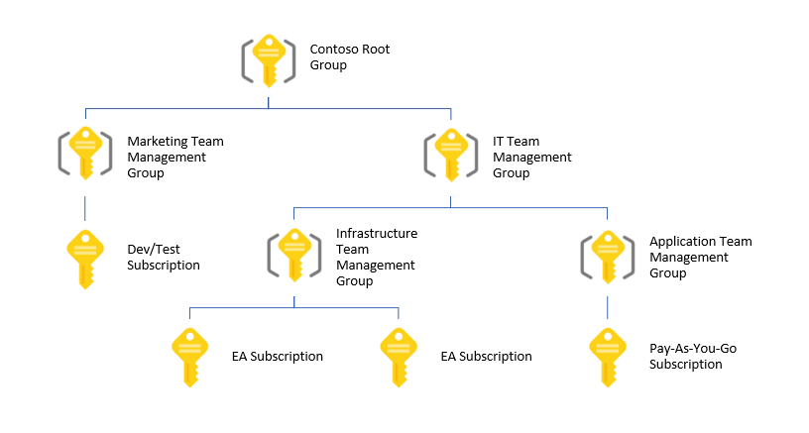
Management Groups
Provides a level of scope above subscriptions
Organizational alignment for your Azure subscriptions through custom hierarchies and grouping
Targeting of policies and spend budgets across subscriptions and inheritance down the hierarchies
Compliance and cost reporting by organization (business/teams)

Slide 48
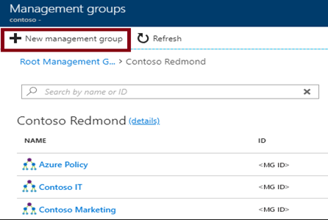
Creating Management Groups
The Management Group ID is the directory unique identifier that is used to submit commands on this management group
The Display Name field is the name that is displayed within the Azure portal

Slide 49
Azure Subscriptions
A subscription is a logical unit of Azure services that is linked to an Azure account
Subscriptions help you organize access to cloud service resources
Subscriptions have accounts
An Azure account is simply an identity in Azure Active Directory (Azure AD) or in a directory that is trusted by Azure AD, such as a work or school organization
Users,
groups, and service principles
Azure Active Directory
Authentication
& Authorization
Azure resources in resource groups
Azure Subscription(s)
Notes:
✔️ Do you know how many subscriptions your organization has? Do you know how resources are organized into resource groups?

Slide 50
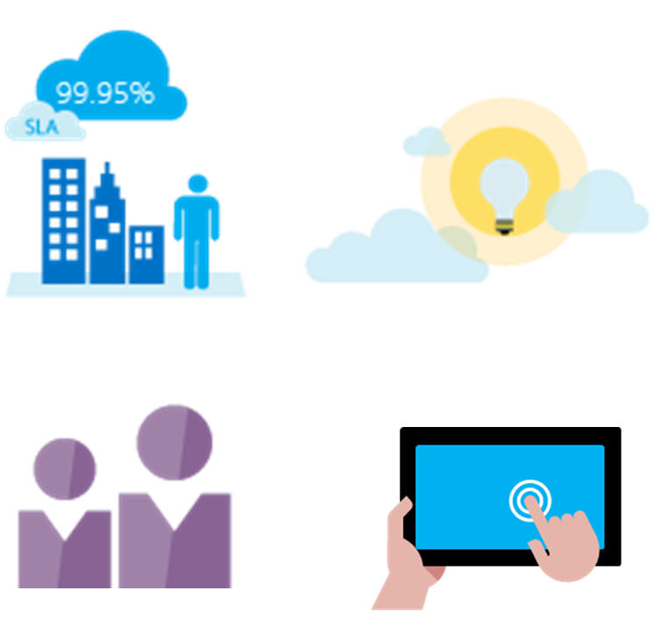
Getting a Subscription
Enterprise Agreement customers make an upfront monetary commitment and consume services throughout the year
Resellers provide a simple, flexible way to purchase cloud services
Partners can design and implement your Azure cloud solution
Personal free account -start right away
Notes:
✔️ Which subscription model are you most interested in?
For more information, you can see:
Solution providers - https://www.microsoft.com/en-us/solution-providers/home

Slide 51
Subscription Usage
Subscription | Usage
Free | Includes a $200 credit for the first 30 days, free limited access for 12 months
Pay-As-You-Go | Charges you monthly
Enterprise | One agreement, with discounts for new licenses and Software Assurance - targeted at enterprise-scale organizations.
Student | Includes $100 for 12 months – must verify student access
Notes:
Note: Credit card information is used for identity verification only. You won’t be charged for any services until you upgrade.

Slide 52
Subscription User Types
Administrative Role | Limit | Summary
Account Administrator | 1 per Azure account | Authorized to access the Account Center
Service Administrator | 1 per Azure subscription | Authorized to access the Azure Management Portal for all subscriptions in the account
Co-administrator | 200 per subscription | Same as the Service Administrator but can’t change the association of subscriptions to Azure directories
Notes:
✔️ Account Administrators using a Microsoft account must log in every 2 years (or more frequently) to keep the account active. Inactive accounts are cancelled, and the related subscriptions removed. There are no login requirements if using a work or school account.

Slide 53
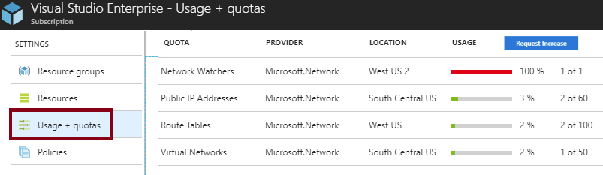
Check Resource Limits
All resources have a maximum limit listed in Azure limits
Helpful to track current usage, and plan for future use
You can request an increase

Slide 54
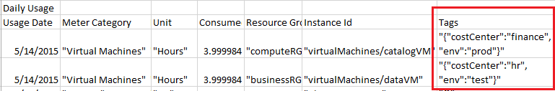
Resource Tags
Tags logically organize your resources
Tags consist of a name and value
Useful especially in billing
Notes:
✔️ If you must create a lot of tags you will want to do that programmatically. You can use PowerShell or the CLI.

Slide 55
Billing
Pricing Calculator – estimate expenditures in all areas of Azure
Billing Alert Service - monitor and manage billing activity
Create and Manage a Budget - plan for and drive organizational accountability
Azure Reservations - helps you save money by pre-paying for services

Slide 56
Lesson 06: Azure Monitor Workbooks

Slide 57
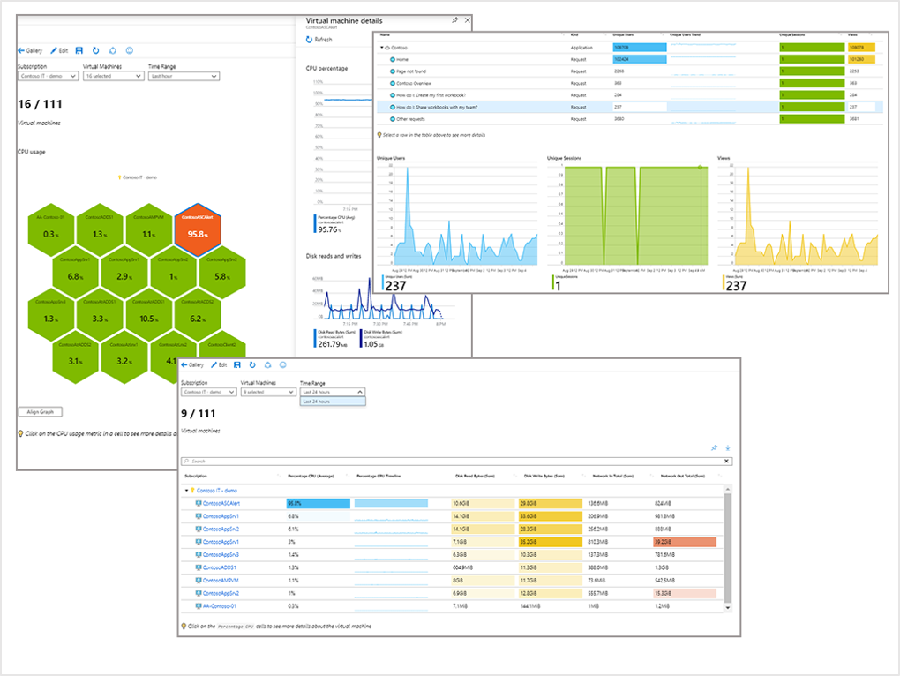
Azure Monitor workbook visualizations
Workbooks provide capabilities for visualizing data.
Visualization types:
Text
Charts
Grids
Tiles
Trees
Graphs
Notes:
✔️ Which subscription model are you most interested in?
For more information, you can see:
Solution providers - https://www.microsoft.com/en-us/solution-providers/home

Slide 58
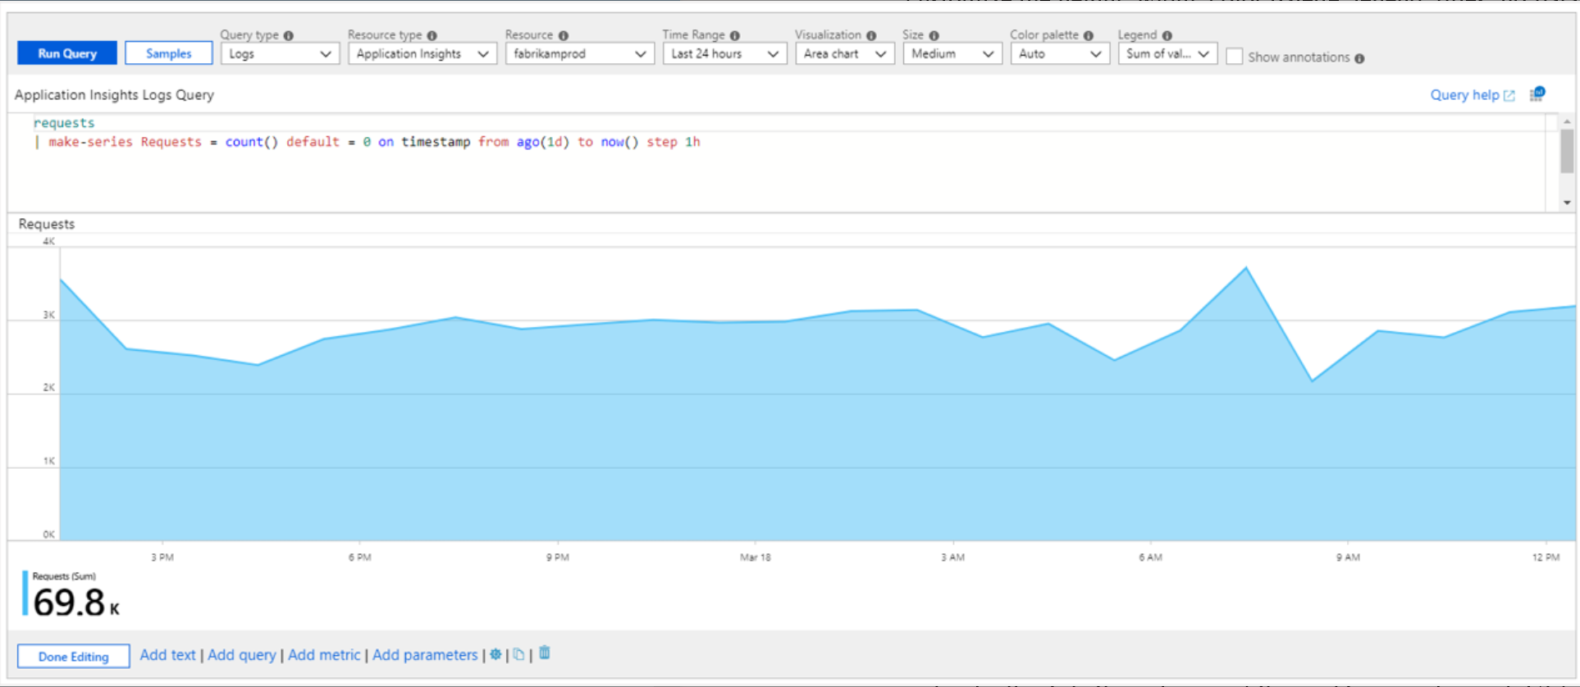
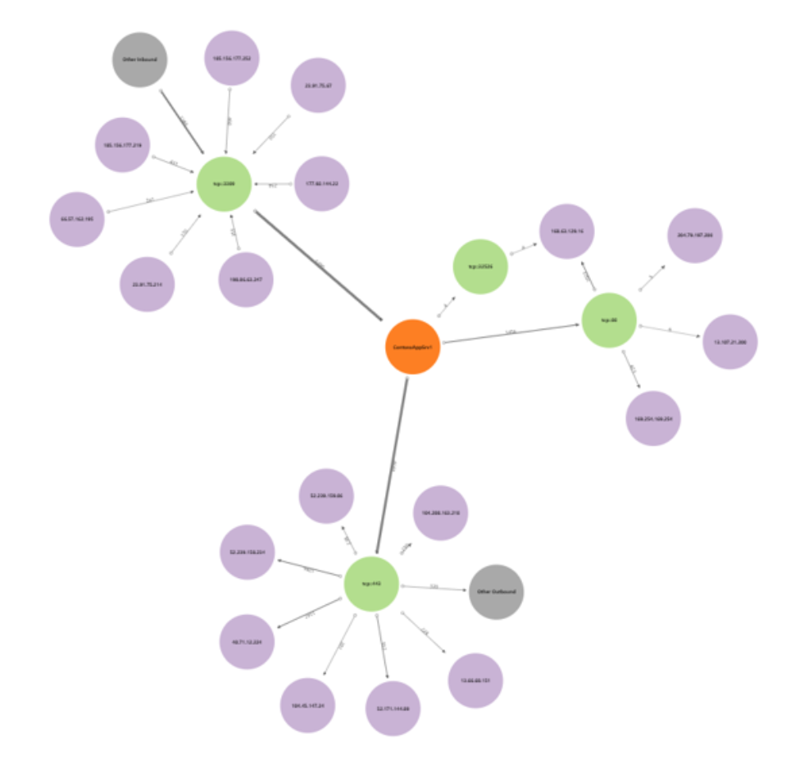
Azure Monitor Workbooks
Text: Includes human analysis of telemetry, information to help users interpret your data, section headings, etc.
Charts: Includes line, bar, bar categorical, area, scatter plots, pie and time. Workbooks support logs and metric data sources.
Grids: Individually style the columns of the grid for rich UI for reports.
Tiles: Displays summary data in workbooks.
Workbook tiles: Displays title, subtitle, large text, icons, metric based gradients, spark line/bars, footer, etc.
Trees: Hierarchical views using tree-grids allowing rows to be expandable into the next level for a drill-down.
Graphs: Visualize arbitrary graphs with data from logs showing relationships between monitoring entities.
Notes:
✔️ Which subscription model are you most interested in?
For more information, you can see:
Solution providers - https://www.microsoft.com/en-us/solution-providers/home

Slide 59
Online Lab: Exploring Monitoring Capabilities in Azure

Slide 60
Module Review Questions
Notes:
As you have time go through the Module Review questions in the student materials.

