Slide 1
AZ-300T02 Module 02: Implementing and Managing Storage
Subtitle or speaker name

Slide 2
Module 02: Implementing and Managing Storage Lesson 01: Azure Storage Accounts

Slide 3
Azure Storage
A service that you can use to store files, messages, tables, and other types of information
Durable, secure, scalable, managed, accessible
Manage data with multiple storage accounts
Three categories of Azure storage:
Storage for virtual machines – Disks and File Shares
Unstructured data – Blobs and Data Lake Store
Structured data - Tables, Cosmos DB, and Azure SQL DB
Notes:
For more information, you can see:
Azure Storage - https://azure.microsoft.com/en-us/services/storage/

Slide 4
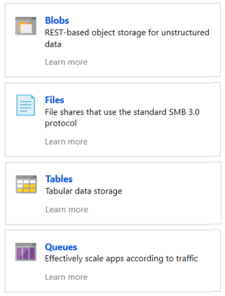
Azure Storage Services
Azure Blobs: A massively scalable object store for text and binary data
Azure Files: Managed file shares for cloud or on-premises deployments
Azure Tables: A NoSQL store for schema less storage of structured data
Azure Queues: A messaging store for reliable messaging between application components
Notes:
Blobs and Files each have a lesson. This is the only time Tables and Queues are discussed.

Slide 5
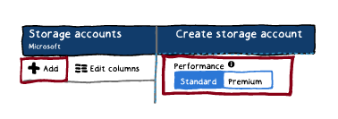
Standard and Premium Storage Accounts
Standard:
Backed by magnetic drives (HDD)
Lowest cost per GB
Premium:
Backed by solid state drives (SSD)
Can only be used with Azure VM disks
Notes:
This topic was touched on in the Virtual Machines lesson.
✔️ It is not possible to convert a Standard storage account to Premium storage account or vice versa. You must create a new storage account with the desired type and copy data, if applicable, to a new storage account.

Slide 6
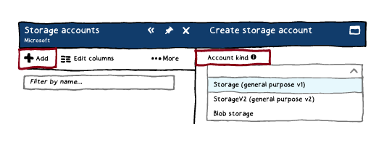
Storage Types
Storage V2 – latest version, lowest price, supports all services, recommended
Storage V1 – legacy account
Blob Storage - specialized for storing unstructured object data
FileStorage accounts: Files-only storage accounts with premium performance characteristics. Recommended for enterprise or high-performance scale applications.
BlobStorage accounts: Legacy Blob-only storage accounts.
✔️ You can easily upgrade a general-purpose v1 or Blob storage account to a general-purpose v2 account with no downtime and without the need to copy data

Slide 7
Storage Account Endpoints
Every object has a unique URL address
The storage account name forms the subdomain of that address
The subdomain and domain name forms an endpoint
Blob service: http://mystorageaccount.blob.core.windows.net
Table service: http://mystorageaccount.table.core.windows.net
Queue service: http://mystorageaccount.queue.core.windows.net
File service: http://mystorageaccount.file.core.windows.net
If you prefer you can configure a custom domain name
CNAME record | Target
blobs.contoso.com | contosoblobs.blob.core.windows.net
Notes:
Endpoints are covered in more detail in the Virtual Networking lesson.
✔️A Blob storage account only exposes the Blob service endpoint. And, you can also configure a custom domain name to use with your storage account.

Slide 8
Configuring Custom Domain Names
Direct CNAME mapping:
Create a CNAME record that points to the Azure storage account [storage account].blob.core.windows.net.
This method can result in a brief downtime during registration of the custom domain with Azure.
Intermediary mapping with asverify:
Step 1. Prepend asverify to your own CNAME record. This allows Azure to recognize your custom domain.
Step 2. Modify the DNS record for the domain.
This methods eliminates downtime.

Slide 9
Pricing and Billing
Storage costs depend on:
The amount of data
Performance level
Access tier (per-gigabyte cost decreases as the tier gets cooler)
Storage costs include:
Data access costs: increase as the tier gets cooler.
Transaction costs: increases as the tier gets cooler.
Geo-Replication data transfer costs (per GB): for GRS and RA-GRS storage accounts.
Outbound data transfer costs (per GB): transferred out of an Azure region
Changing the storage tier:
Changing the account storage tier from cool to hot incurs a charge equal to reading all the data existing in the storage account.
changing the account storage tier from hot to cool incurs a charge equal to writing all the data into the cool tier (GPv2 accounts only).

Slide 10
Creating Storage Accounts
General purpose v2 storage account:
Resource group
Name
Location (Azure region)
Deployment model
Performance
Account kind
Replication
Access tier
Field | Value
Deployment model | Resource Manager
Performance | Standard
Account kind | StorageV2 (general-purpose v2)
Replication | Locally redundant storage (LRS)
Access tier | Hot
Notes:
✔ Always consider having students walk-through the demonstrations themselves. Also, consider the overlap with the formal labs and your best use of time.

Slide 11
Demonstration – Creating Storage Accounts
Create a storage account in the portal
Create a storage account using PowerShell
Create a storage account using CLI
Notes:
✔ Always consider having students walk-through the demonstrations themselves. Also, consider the overlap with the formal labs and your best use of time.

Slide 12
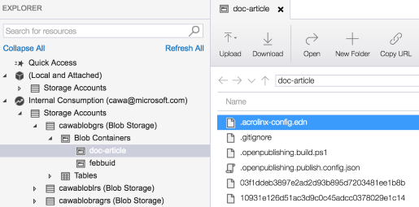
Azure Storage Explorer
Access multiple accounts and subscriptions
Create, delete, view, edit storage resources
View and edit Blob, Queue, Table, File, Cosmos DB storage and Data Lake Storage
Obtain shared access signature (SAS) keys
Available for Windows, Mac, and Linux

Slide 13
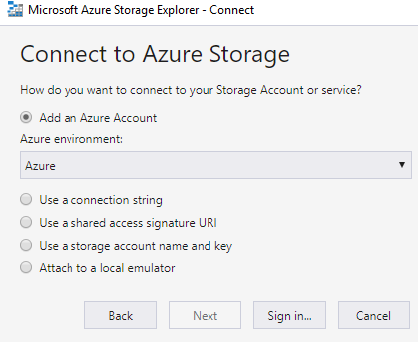
Storage Explorer Connection Options
Connect to an Azure subscription
Work with local development storage (emulator)
Attach to external storage
Attach a storage account or storage service by using a shared access signature
Connect to an Azure Cosmos DB account by using a connection string

Slide 14
Demonstration – Storage Explorer
Download and install Storage Explorer
Connect to an Azure subscription
Attach an Azure storage account
Notes:
✔ Always consider having students walk-through the demonstrations themselves. Also, consider the overlap with the formal labs and your best use of time.

Slide 15
Module 02: Implementing and Managing Storage Lesson 02: Data Replication

Slide 16
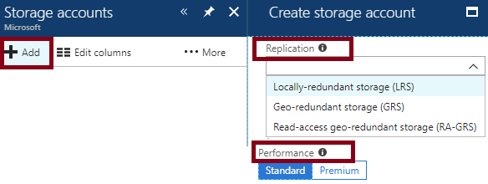
Replication Options
Locally-redundant storage (LRS):
The only replication option when using Premium performance tier
Zone-redundant storage (LRS):
Geo-redundant storage (GRS)
Read-access geo-redundant storage (RA-RGS)

Slide 17
Locally-redundant Storage
Replication | Copies | Strategy
Locally redundant storage (LRS) | Maintains three copies of your data. | Data is replicated three time within a single facility in a single region.
Maintains three copies of your data at a single facility
All copies of the data exist within the same region
Use if data can be easily reconstructed
Use if there are regional governance requirements
Low-cost option

Slide 18
Zone-redundant Storage
Replication | Copies | Strategy
Zone-redundant storage (ZRS) | Maintains three copies of your data. | Data is replicated three times across two to three facilities, either within a single region or across two regions.
Replicates your data across three storage clusters in a single region
Each storage cluster is physically separated from the others and resides in its own availability zone
Each availability zone, and the ZRS cluster within it, is autonomous, with separate utilities and networking capabilities
Not available in all regions
Notes:
✔️Consider ZRS for scenarios that require strong consistency, strong durability, and high availability even if an outage or natural disaster renders a zonal data center unavailable.

Slide 19
Geo-redundant Storage
Replication | Copies | Strategy
Geo-redundant storage (GRS) | Maintains six copies of your data. | Data is replicated three times within the primary region and is also replicated three times in a secondary region hundreds of miles away from the primary region.
Read access geo-redundant storage (RA-GRS) | Maintains six copies of your data. | Data is replicated to a secondary geographic location and provides read access to your data in the secondary location.
GRS replicates your data to another data center in a secondary region, but that data is available to be read only during a failure
RA-GRS is based on GRS and replicates data to another data center in another region. Provides read access from the secondary region, even without a failure
Consider RTO and RPO
Notes:
✔️ If you enable RA-GRS and your primary endpoint for the Blob service is myaccount.blob.core.windows.net, then your secondary endpoint is myaccount-secondary.blob.core.windows.net. The access keys for your storage account are the same for both the primary and secondary endpoints.

Slide 20
Replication Option Comparison
Replication Option | LRS | ZRS | GRS | RA-GRS
Node unavailability within a data center | Yes | Yes | Yes | Yes
An entire data center (zonal or non-zonal) becomes unavailable | No | Yes | Yes | Yes
A region-wide outage | No | No | Yes | Yes
Read access to your data (in a remote, geo-replicated region) for region-wide unavailability | No | No | No | Yes
Available in storage account types | GPv1, GPv2, Blob | Standard, GPv2 | GPv1, GPv2, Blob | GPv1, GPv2, Blob

Slide 21
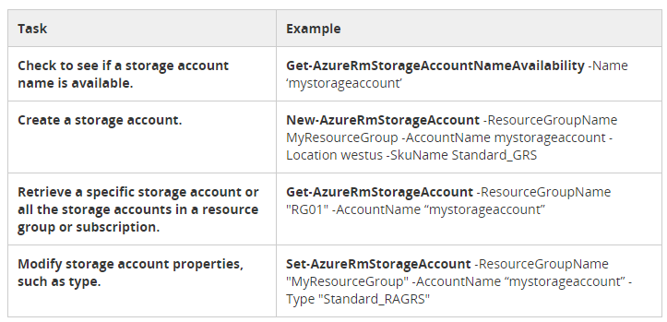
Storage Account PowerShell Tasks

Slide 22
Module 02: Implementing and Managing Storage Lesson 03: Storing and Accessing Data

Slide 23
Import and Export Service
Transfers very large amounts of data between on-premises and Azure:
Import. Securely transfers data to Azure Blob storage (block and page blobs) and Azure Files. You ship hard drives containing your data to an Azure data center.
Export. Securely transfers data from Azure Blob storage (block, page, and append blobs) to your location. You ship empty hard drives to an Azure data center.
Scenarios:
Migrating data to the cloud
Content distribution
Backup and data recovery

Slide 24
Components and Requirements
Import and Export service components:
Import/Export service
WAImportExport tool
Disk Drives
Import and Export service requirements:
Operating systems
Supported storage accounts
Supported storage types
Supported disks

Slide 25
Import and Export Tool
Drive preparation and repair tool:
Before creating an import job: copy data to the hard drives
After an import job has completed: repair any blobs that were corrupted
After receiving the drives: repair any files that were corrupted
WAImportExport.exe PrepImport /j:<JournalFile> /id:<SessionId> /DataSet:<dataset.csv>

Slide 26
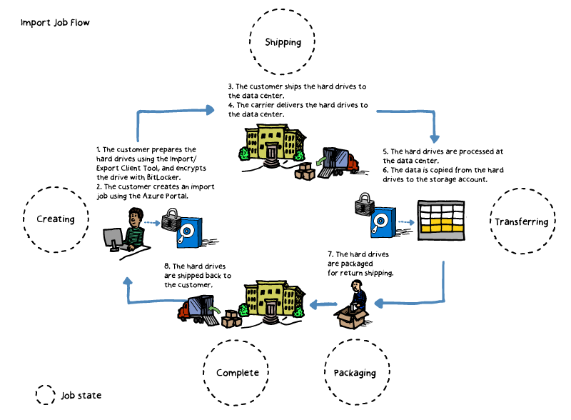
Import Jobs
Identify:
data to be imported
the number of drives
destination blob or file
Run WAImportExport Tool:
To copy data to hard disk drives
To encrypt data with BitLocker
Create an import job:
Via Azure portal (upload drive journal)
Via Import/Export REST API
Provide shipping info
Ship the hard disk drives
Update tracking number
Microsoft handles:
Job processing
Shipment of drives back to you

Slide 27
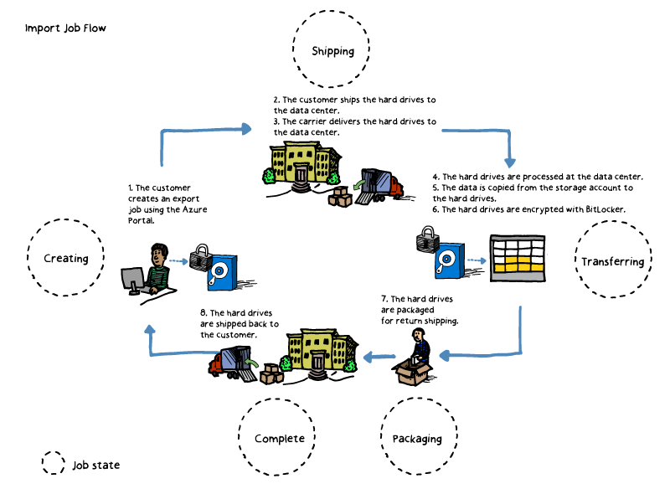
Export Jobs
Identify:
data to be exported
the number of drives
the source blobs
Create an export job:
via the Azure portal
via Import/Export REST API
Provide shipping info
Ship empty hard drives
Update delivery tracking info
Microsoft handles:
job processing
shipment of drives back to you

Slide 28
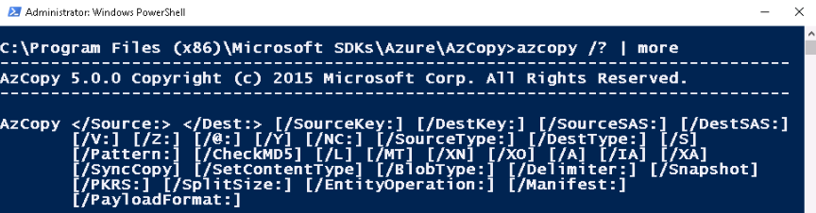
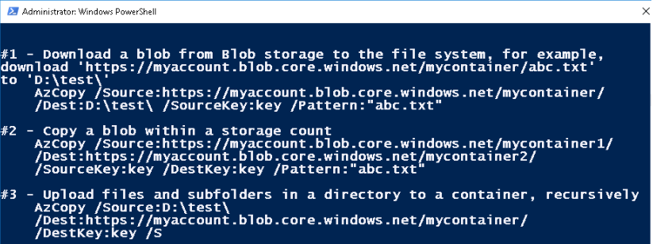
AzCopy
a command-line utility for automating Azure Storage tasks:
Copy to/from Microsoft Azure Blob, File, and Table storage
Copy between a file system and a storage account, or between storage accounts

Slide 29
Demonstration – AzCopy
Install the AzCopy tool
Explore the help
Download a blob from Blob storage to the file system
Upload files to Azure blob storage
Notes:
✔ Always consider having students walk-through the demonstrations themselves. Also, consider the overlap with the formal labs and your best use of time.

Slide 30
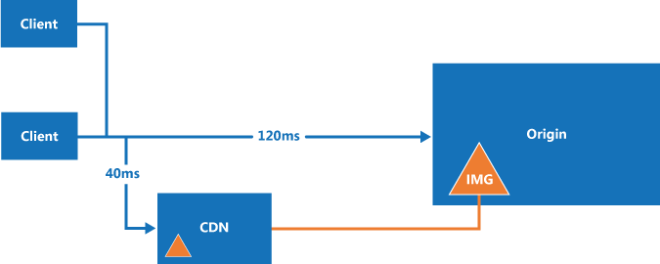
Content Delivery Network (CDN)
A distributed network of caching servers:
Provides lower latency and faster delivery of content to users
Helps reduce load on target servers or applications

Slide 31
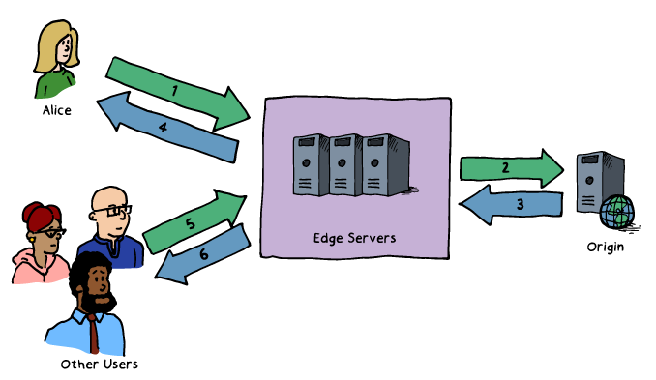
How CDN Works
Azure content caching service:
Designed to expedite delivery of audio, video, images, etc. hosted by Azure services
Utilizes the following data flow:
1. Alice requests a file using a URL pointing to a CDN location. DNS routes the request to the optimal POP
2. If edge servers do not have the file cached,
they requests it from the origin.
3. The origin returns the file, including its TTL.
4. The server caches the file and returns it to Alice.
The file remains cached until the TTL expires.
5. Subsequent requests are served from the cache.

Slide 32
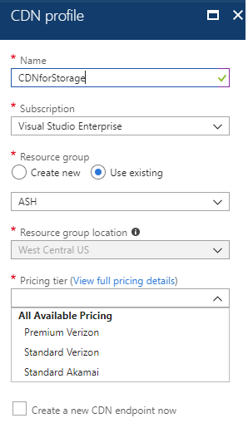
CDN Profiles
A collection of CDN endpoints with the same:
Pricing tier and provider:
Premium Verizon
Standard Verizon
Standard Akamai
Pricing based on:
GBs of outbound data transfers
Zone:
Zone 1—North America, Europe, Middle East and Africa
Zone 2—Asia Pacific (including Japan)
Zone 3—South America
Zone 4—Australia
Zone 5—India

Slide 33
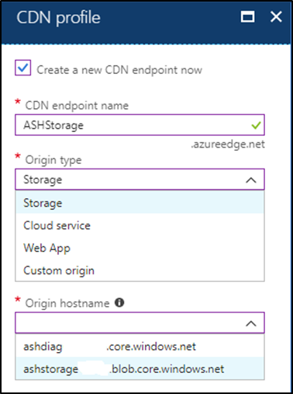
CDN Endpoints
Represent configuration of content origin:
CDN endpoint name
Origin type:
Storage
Cloud Service
Web App
Custom origin
Origin hostname
CDN features that affect content delivery, such as:
Compression
Query string
Geo filtering
Custom domains

Slide 34
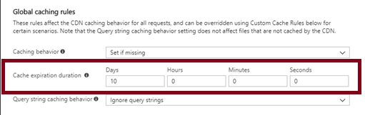
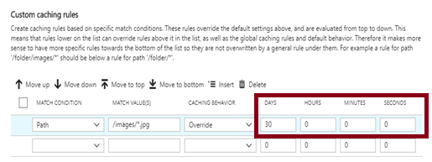
CDN Time-to-Live
CDN TTL can be:
Included in cache-directive headers in the HTTP response from the content origin
Determined by Cache Expiration Duration, configurable by using:
Global caching rules: affect all requests to the endpoint
Custom caching rules: match paths and file extensions
Custom caching rules override global ones

Slide 35
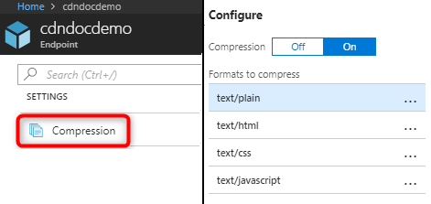
CDN Compression
Improves file transfer speed and increases page-load performance:
Supports:
Enabling compression on the origin. In this case, the CDN passes along the compressed files and delivers them to clients that request them.
Enabling compression directly on the CDN edge servers. In this case, the CDN compresses the files and serves them to end users.
Enabling compression based on the MIME types list, allowing selection of the content formats to compress.

Slide 36
Practice: Optimize Your Content Delivery with Azure CDN
Access the Azure CDN caching rules page
Set global caching rules
Set custom caching rules

Slide 37
Module 02: Implementing and Managing Storage Lesson 04: Monitoring Storage

Slide 38
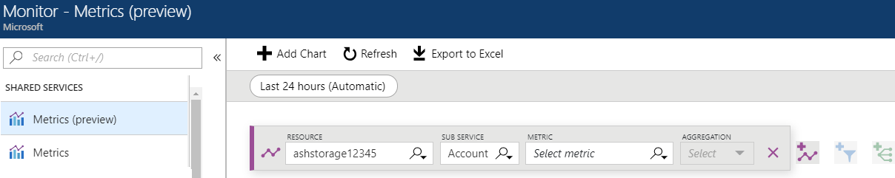
Monitor Metrics
Azure Monitor provides unified interface for monitoring Azure services
Includes Azure Storage monitoring
Offers access via the Azure portal and Monitor API (REST and .NET)
Integrates with Log Analytics and Event Hubs
Stores metrics for 30 days and allows long term retention in Azure Storage
Supports consistent metrics filtering (resource, subservice) and aggregation criteria.

Slide 39
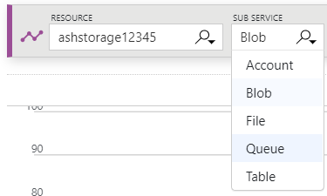
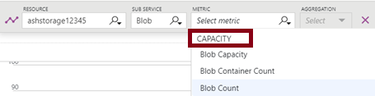
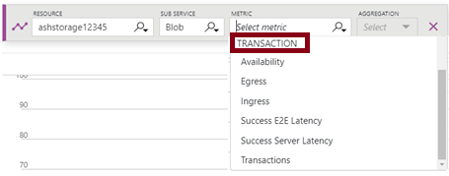
Capacity and Transaction Metrics
Available from the Azure portal:
Select a Storage Account resource
Select a sub-service: Account, Blob, File, Queue, or Table
The sub-service selection determines Capacity metrics:
For example, for Blob sub-service, Capacity metrics include:
Blob Capacity
Blob Container Count
Blob Count
Transaction metrics are available at:
account level
service level:
Blob storage
Table storage
Queue storage
Azure Files

Slide 40
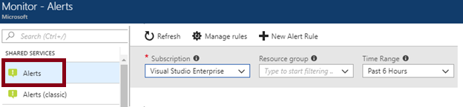
Azure Monitor Alerts
New experience – comparing with Alerts (Classic):
Better notification system
A unified authoring experience
Access to Log Analytics alerts from the Azure portal
Separation of Fired Alerts and Alert Rules
Better workflow

Slide 41
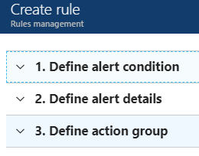
Alert Rules
Part of the new experience:
alerts authoring is consistent regardless of the monitoring service or signal type
all alerts fired and related details are available on a single page
Authoring is a three-step process:
1. Define alert condition, including:
Target selection. For example, a storage account.
Alert criteria. For example, Used Capacity.
Alert logic. For example, over a six-hour period
whenever the Used Capacity is over 1000000 bytes.
2. Define alert details, including:
Alert rule name, description, and severity. There are five severity levels, Severity 0 to Severity 4.
3. Define an action group to notify your team via email and text messages or automate actions using webhooks and runbooks.

Slide 42
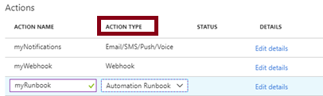
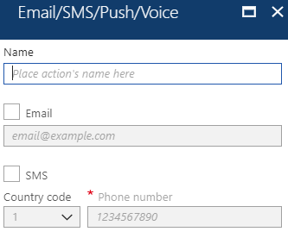
Action Groups
Action groups facilitate configuring actions in response to an alert:
Email/SMS/Push/Voice
Logic App
Webhook
Automation Runbook
IT Service Management

Slide 43
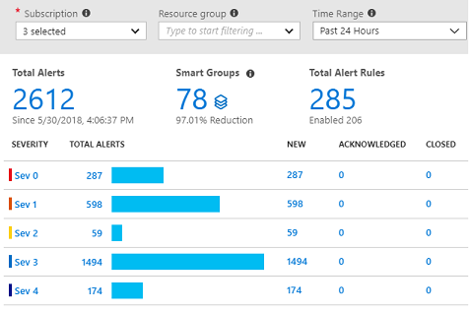
Alert Experience
Filtering based on:
Subscription
Resource group
Time range

Slide 44
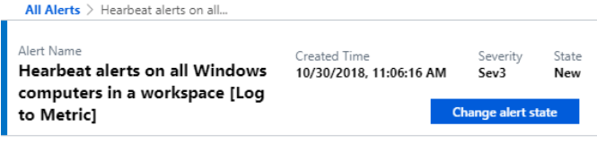
Alert Detail Page
Sections:
Essentials
History
Smart group
More details

Slide 45
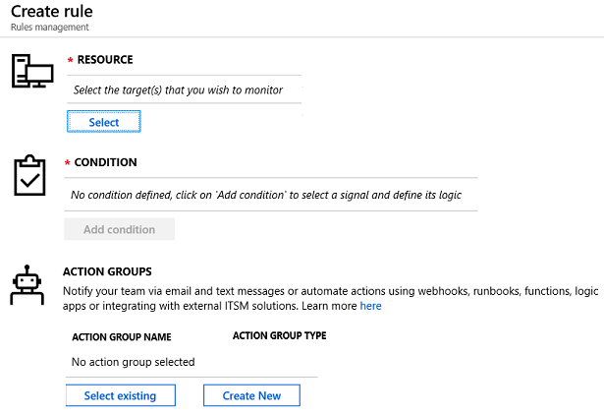
Create an Alert
Settings:
Resource
Condition
Action Group
Alert rule name
Description
Enable rule upon creation

Slide 46
Demonstration – Alerts
Create an alert rule
Explore alert targets
Explore alert conditions
Explore alert details
Notes:
✔ Always consider having students walk-through the demonstrations themselves. Also, consider the overlap with the formal labs and your best use of time.

Slide 47
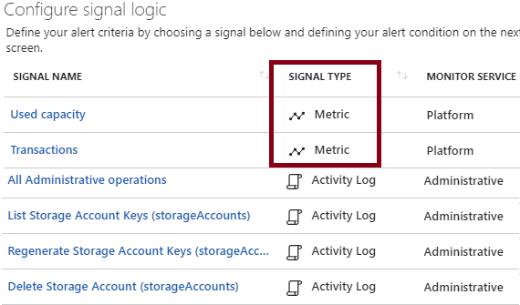
Signal Types and Metrics
Signals are emitted by target resources and include:
Metrics
Activity log
Application Insights
Logs
The latest metrics alerts offer:
Improved latency
Support for multi-dimensional metrics
More control over metrics conditions
Combined monitoring of multiple metrics
Metrics from Logs (limited public preview)

Slide 48
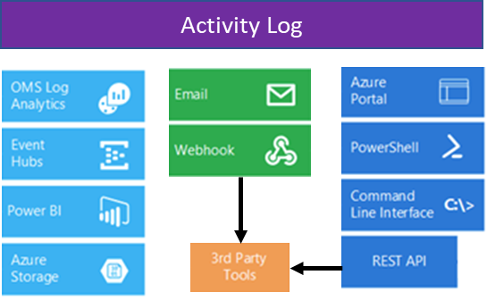
Activity Log
A subscription-level log that captures:
Azure Resource Manager operational data (control plane)
Service Health events
Includes audit trail of all write/change operations:
Helps determine “what, who, and when”
Provides the status of each operation
Its content can be:
Streamed to Event Hub.
Analyzed with Power BI.
Viewed in the Azure portal.
Forwarded to Log Analytics.
Archived in an Azure Storage account.
Processed with PowerShell, CLI, and REST API.

Slide 49
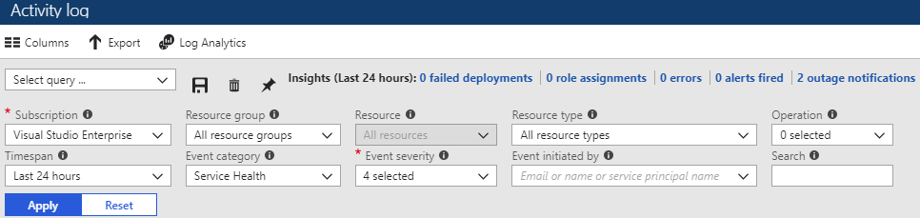
Query the Activity Log
Available directly from the Azure portal, with filtering based on:
Subscription
Resource group
Resource (name)
Resource type
Operation (type)
Timespan
Event category
Event severity
Event initiated by
Filter selection can be saved
Queries can be pinned to the Azure portal dashboard

Slide 50
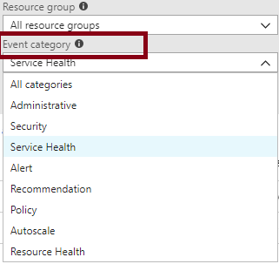
Event Categories
Administrative
Security
Service Health
Alert
Recommendation
Policy
Autoscale
Resource Health

Slide 51
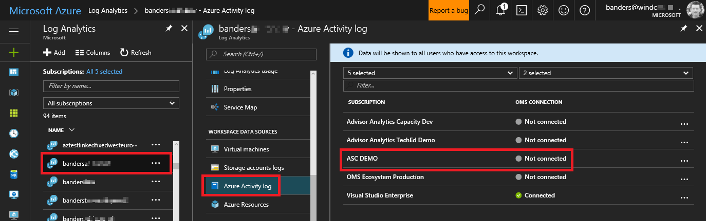
Activity Log and Log Analytics
Activity log can be added to Azure Log Analytics workspace:
Can be in the same or a different subscription (if it has the same Azure AD tenant)
Provides the ability to:
Correlate user activities, auto-scale operations, authorization changes, and service health to other logs or metrics from your environment.
Correlate activity logs with other Azure services and application data.
Analyze and search activity logs from multiple Azure subscriptions.
Keep activity logs for longer than the default of 90 days.
View operational activities aggregated by status.
Analyze activity logs with pre-defined views.
Identify outage or service health issues.
Report on authorization changes.
View trends of activities.

Slide 52
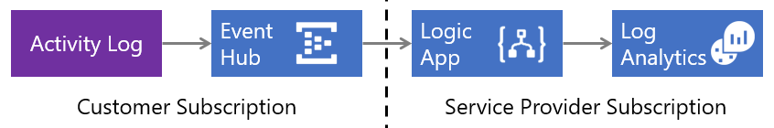
Collect Across Subscriptions
You can collect Azure Activity Logs into a Log Analytics workspace using the Azure Log Analytics Data Collector connector for Logic Apps
This facilitates using a workspace in a subscription that has a different Azure AD tenant
It offers a number of advantages, including:
Low latency, since the Azure Activity Log is streamed into the Event Hub
Serverless services, with no infrastructure components to deploy
Minimal custom code

