Slide 1
AZ-300T03 Module 03: Deploying and Managing Virtual Machines (VMs)
Subtitle or speaker name

Slide 2
Module 03: Deploying and Managing Virtual Machines (VMs) Lesson 01: Creating Virtual Machines

Slide 3

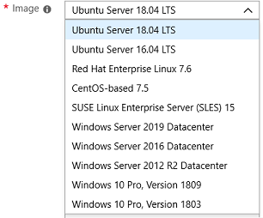
Creating Virtual Machines (Portal)
Basic (required) - Project details, Administrator account, Inbound port rules
Disks - OS disk type, data disks
Networking - Virtual networks, load balancing
Management - Monitoring, Auto-shutdown, Backup
Guest config - Add additional configuration, agents, scripts or applications

Slide 4
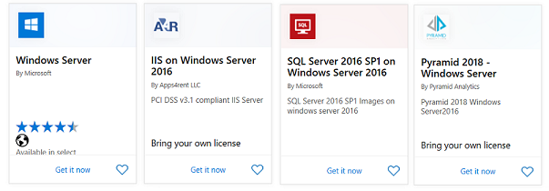
Windows Virtual Machines
Unique hybrid capabilities
Advanced multi-layer security
Faster innovation for applications
Unprecedented hyper-converged infrastructure
Notes:
Windows Virtual Machines Documentation - https://docs.microsoft.com/en-us/azure/virtual-machines/windows/

Slide 5
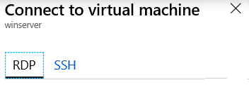
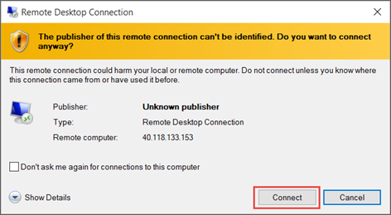
Windows VM Connections
Remote Desktop Protocol (RDP) creates a GUI session and accepts inbound traffic on TCP port 3389
WinRM creates a command-line session so can run scripts

Slide 6
Demonstration – Create a VM in the Portal
Create the virtual machine
Connect to the virtual machine
Install the Web Server role
View the IIS welcome page
Notes:
✔ Always consider having students walk-through the demonstrations themselves. Also, consider the overlap with the formal labs and your best use of time.

Slide 7
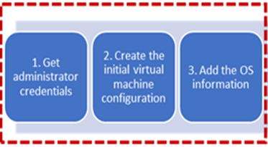
PowerShell - Example (Part 1)
# 1. Set the admin username and pwd
$cred = Get-Credential
# 2. Create the initial configuration
$vm = New-AzVMConfig -VMName myVM
-VMSize Standard_D1
# 3. Add the OS information
$vm = Set-AzVMOperatingSystem `
-VM $vm `
-Windows `
-ComputerName myVM `
-Credential $cred `
-ProvisionVMAgent `
-EnableAutoUpdate
Notes:
Steps continue on the next page.

Slide 8
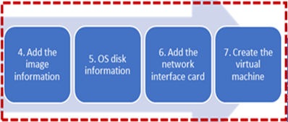
PowerShell - Example (Part 2)
# 4. Add the image information
$vm = Set-AzVMSourceImage -VM $vm -PublisherName MicrosoftWindowsServer -Offer WindowsServer -Skus 2016-Datacenter
# 5. Add the OS settings
$vm = Set-AzVMOSDisk -VM $vm -Name myOsDisk -DiskSizeInGB 128 -CreateOption FromImage -Caching ReadWrite
# 6. Add the NIC
$vm = Add-AzVMNetworkInterface -VM $vm –Id $nic.Id
# 7. Create the VM
New-AzVM -ResourceGroupName myResourceGroupVM -Location EastUS -VM $vm

Slide 9
Demonstration – Creating a VM with PowerShell
Create the virtual machine with PowerShell
Verify the machine creation in the portal
Connect to the virtual machine
Notes:
✔ Always consider having students walk-through the demonstrations themselves. Also, consider the overlap with the formal labs and your best use of time.

Slide 10
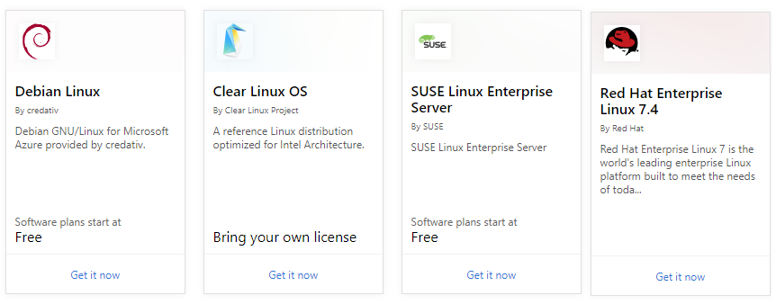
Linux Virtual Machines
Azure supports many Linux distributions including:
CentOS by OpenLogic
Core OS
Debian
Oracle Linux
Red Hat Enterprise Linux
Ubuntu.
Azure Marketplace hosts hundreds of community-built images
Created with Bitnami
Certified for Azure
Linux VMs support the same deployment options as Windows VMs
Linux VMs support open-source DevOps tools, e.g. Puppet and Chef

Slide 11
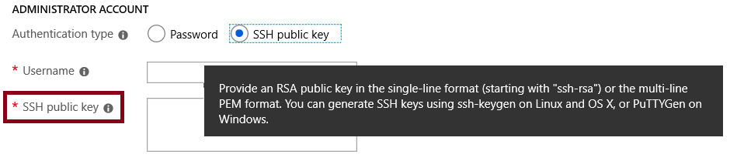
Linux VM Connections
When you create a Linux VM, you can decide to authenticate with an SSH public key or Password.
What is SSH?
SSH is an encrypted connection protocol that allows secure sign-ins over unsecured connections.
The preferred method of connecting to a VM using SSH is by using a public-private key pair:
The public key is placed on your Linux VM, or any other service that you wish to use with public-key cryptography.
The private key remains on your local system. Protect this private key. Do not share it.

Slide 12
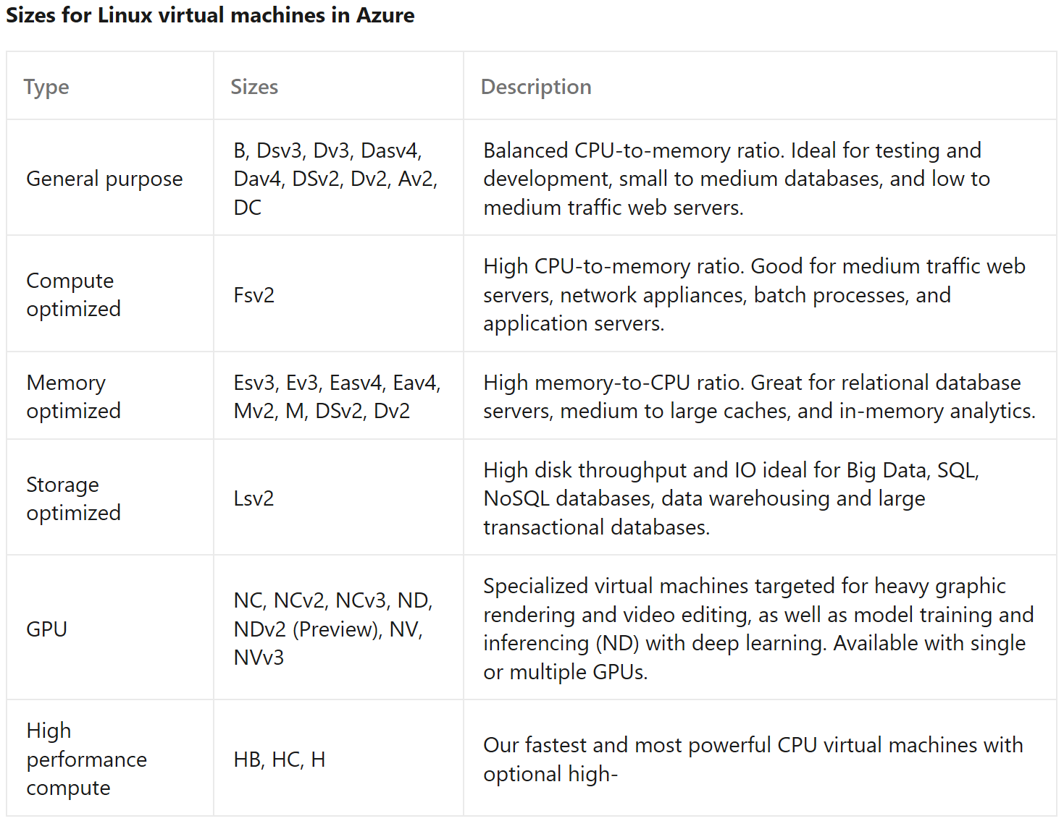
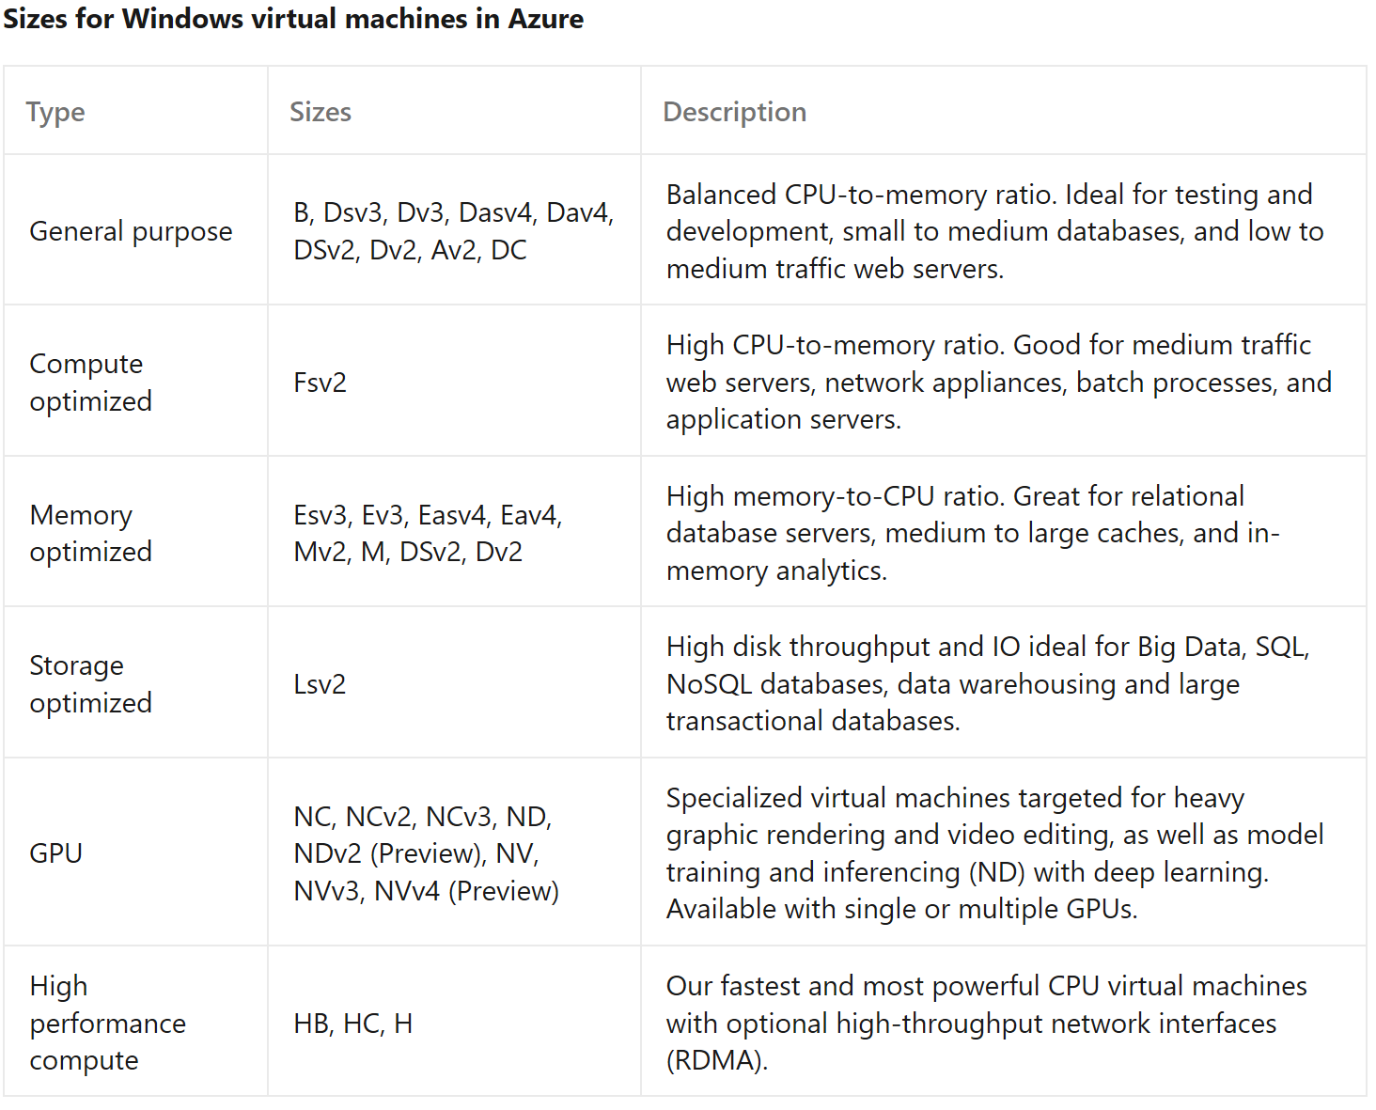
Virtual Machine Sizes (Linux and Windows)

Slide 13
Azure Dedicated Host
Physical servers able to host one or more virtual machines - dedicated to one Azure subscription.
Same physical servers used in our data centers, provided as a resource.
Provision dedicated hosts within a region, availability zone, and fault domain.
Can place VMs directly into your provisioned hosts.
Limitations
Virtual machine scale sets are not currently supported on dedicated hosts.
The following VM series are supported: DSv3 and ESv3.
Benefits
Hardware isolation at the physical server level. No other VMs will be placed on your hosts.
Control over maintenance events initiated by the Azure platform.
Azure hybrid benefit… bring your own licenses for Windows and SQL to Azure.

Slide 14
Demonstration – Connect to Linux Virtual Machines
Create the SSH keys
Create the Linux machine and assign the public SSH key
Access the server using SSH
Notes:
✔ Always consider having students walk-through the demonstrations themselves. Also, consider the overlap with the formal labs and your best use of time.

Slide 15
Module 03: Deploying and Managing Virtual Machines (VMs) Lesson 02: Backup and Restore

Slide 16
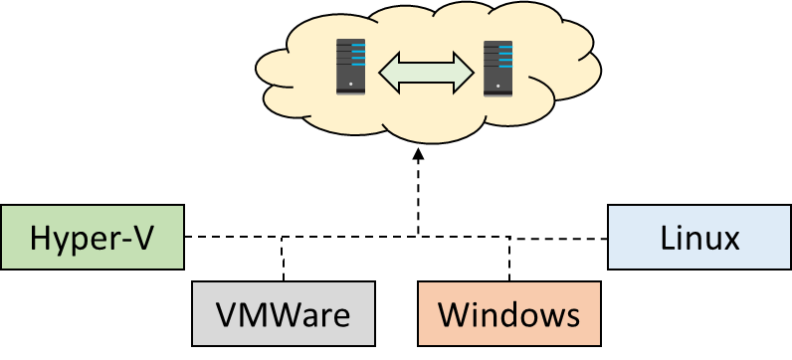
Azure Site Recovery
Replicate Azure VMs from one Azure region to another
Replicate on-premises VMware VMs, Hyper-V VMs, physical servers (Windows and Linux), Azure Stack VMs to Azure
Replicate on-premises VMware VMs, Hyper-V VMs managed by System Center VMM, and physical servers to a secondary site
Notes:
We will concentrate on replication within Azure and not migration scenarios from on-premises.

Slide 17
Virtual Machine Data Protection
Managed snapshots provide a quick and simple option for backing up VMs that use Managed Disks
Azure Backup supports application-consistent backups for both Windows and Linux VMs
Azure Site Recovery protects your VMs from a major disaster scenario when a whole region experiences an outage
Notes:
✔️ Have you tried any of these backup methods? Do you have a backup plan?

Slide 18
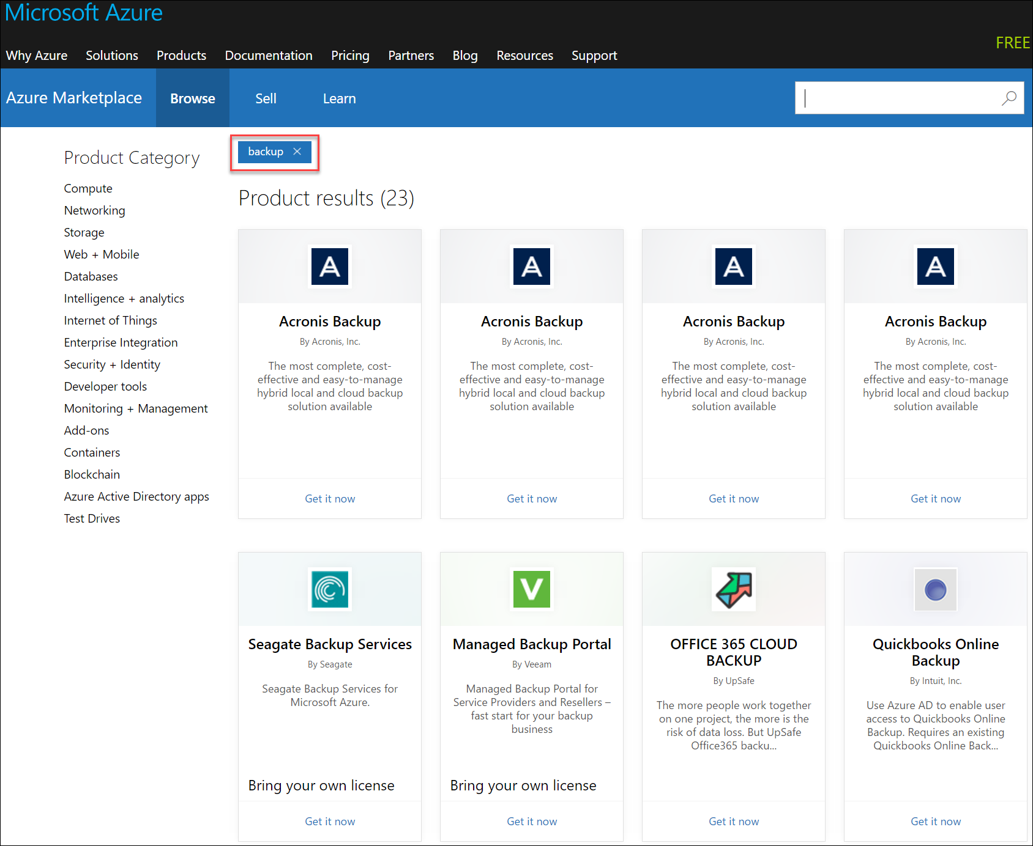
Workload Protection Needs
Many backup options are available
How the workload is being protected today?
How often is the workload is backed up?
What types of backups are being done?
Is disaster recovery protection in place?

Slide 19
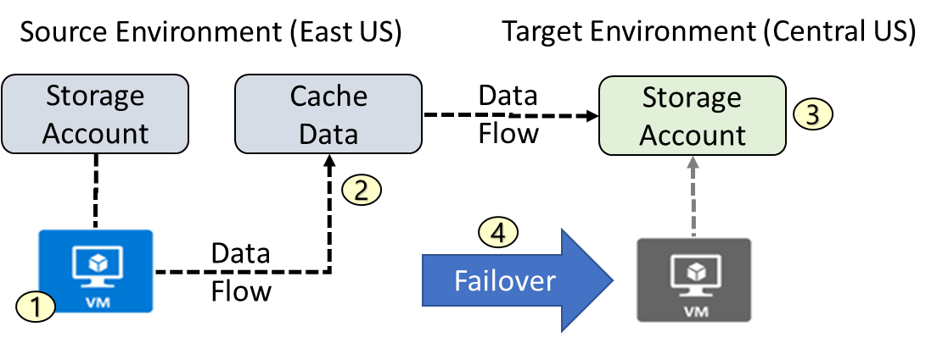
Azure to Azure Architecture
VM is registered with Azure Site Recovery
Data is continuously replicated to cache
Cache is replicated to the target storage account
During failover the virtual machine is added to the target environment

Slide 20
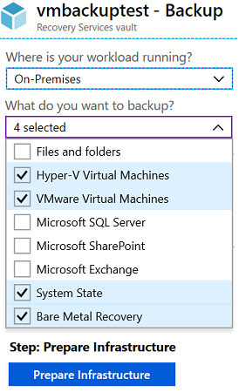
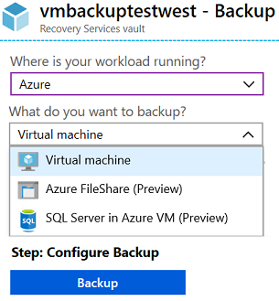
Recovery Services Vault VM Backup Options
Azure Workloads
On-Premises Workloads
✔️ Multiple servers can be protected using the same Recovery Services vault
Notes:
Focus on the choices when you select Azure or On-Premises and want to backup virtual machines.

Slide 21
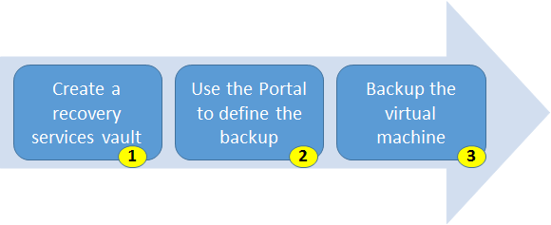
Implementing VM Backups
Use a Recovery Services vault in the region where you want to store the data To backup your files and folders. Also determine how you want your storage replicated.
Take snapshots (recovery points) of your data at defined intervals. These snapshots are stored in recovery services vaults.
For the Backup extension to work, the Azure VM Agent must be installed on the Azure virtual machine.
Notes:
For more information, you can see:
Plan your VM backup infrastructure in Azure - https://docs.microsoft.com/en-us/azure/backup/backup-azure-vms-introduction

Slide 22
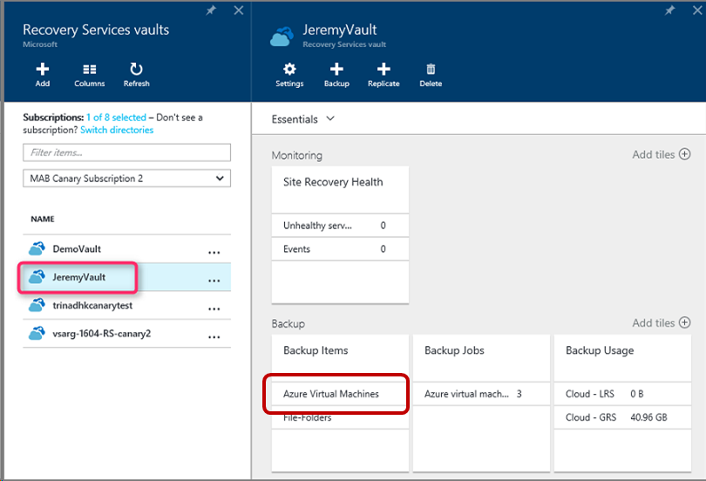
Implementing VM Restore
Once you trigger the restore operation, the Backup service creates a job for tracking the restore operation
The Backup service also creates and temporarily displays notifications, so you monitor how the backup is proceeding

Slide 23

Azure Backup Server
Specialized Workloads
Virtual Machines
Files/Folders/Volumes
Azure
System Center DPM
Or Azure Backup Server
App-aware backups, file/folder/volume backups, and machine state backups (bare-metal, system state)
Each machine runs the DPM/MABS protection agent, and the MARS agent runs on the MABS/DPM
Flexibility and granular scheduling options
Manage backups for multiple machines in a protection group

Slide 24
Backup Component Comparison
Component | Benefits | Limits | Protects | Backup Storage
Azure Backup (MARS) agent | Backup files and folders on physical or virtual Windows OS No separate backup server required. | Backup 3x per day Not application aware File, folder, and volume-level restore only No support for Linux | Files Folders | Recovery services vault
Azure Backup Server | App aware snapshots Full flex for when to backups Recovery granularity Linux support on Hyper-V and VMware VMs Backup and restore VMware VMs Doesn't require a System Center license | Cannot backup Oracle workloads Always requires live Azure subscription No support for tape backup | Files Folders, Volumes VMs Applications Workloads | Recovery services vault Locally attached disk

Slide 25
Module 03: Deploying and Managing Virtual Machines (VMs) Lesson 03: Virtual Machine Extensions

Slide 26
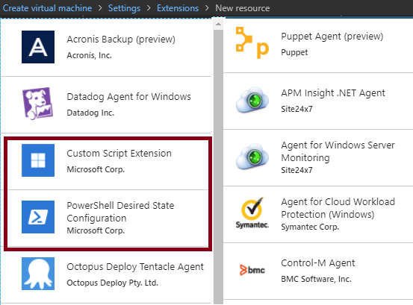
Virtual Machine Extensions
Extensions are small applications that provide post-deployment VM configuration and automation tasks
Managed with Azure CLI, PowerShell, Azure Resource Manager templates, and the Azure portal
Bundled with a new VM deployment or run against any existing system
Different for Windows and Linux machines.
Notes:
✔️ In this lesson we will focus on two extensions: Custom Script Extensions and Desired State Configuration. Both tools are based on PowerShell.
For more information, you can see:
Virtual machine extensions and features for Windows - https://docs.microsoft.com/en-us/azure/virtual-machines/extensions/features-windows?toc=%2Fazure%2Fvirtual-machines%2Fwindows%2Ftoc.json
Virtual machine extensions and features for Linux - https://docs.microsoft.com/en-us/azure/virtual-machines/extensions/features-linux

Slide 27
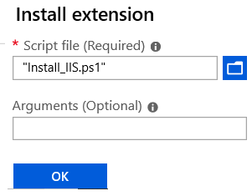
Custom Script Extensions
Extension scripts can be simple or complex
Extensions have 90 minutes to run
Double check dependencies to ensure availability
Account for any errors that might occur
Protect/encrypt sensitive information
✔️ For PowerShell use the Set-AzVmCustomScriptExtension command
Notes:
✔ Can you think of any custom script extensions that you might want to create?

Slide 28
Desired State Configuration
Configuration block(s) have a name
Node blocks define the computers or VMs that you are configuring
Resource block(s) configure the resource and it’s properties
There are many built-in configuration resources
configuration IISInstall
{
Node “localhost”
{
WindowsFeature IIS
{
Ensure = “Present”
Name = “Web-Server”
}
}
}
Notes:
✔️ The Windows PowerShell DSC comes with a set of built-in configuration resources. For example, File Resource, Log Resource, and User Resource. Use the reference link to view the resources that are available to you. Are there any resources that you might be interested in? Take a few minutes to discuss the resources and configuration parameters.

Slide 29
Demonstration – Custom Script Extension
Run a PowerShell script to install the Web Server role on a virtual machine
Notes:
✔ Always consider having students walk-through the demonstrations themselves. This is not covered in the lab.

Slide 30
Module 03: Deploying and Managing Virtual Machines (VMs) Lesson 04: Monitoring Virtual Machines

Slide 31
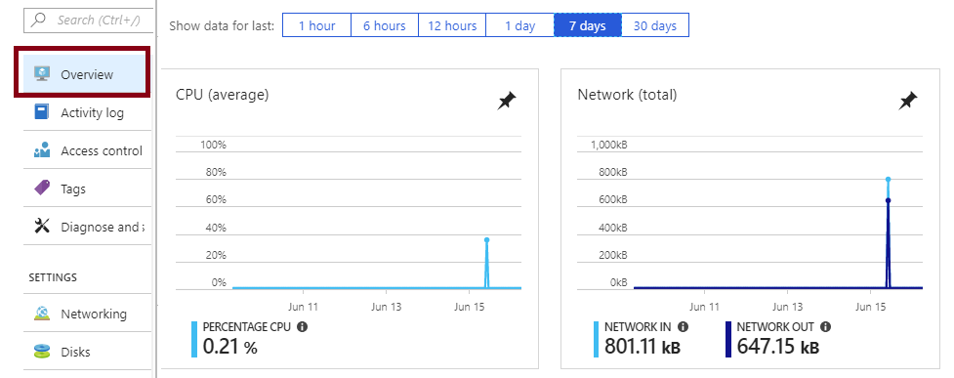
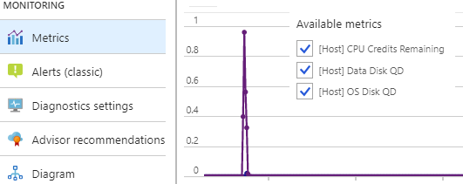
Monitoring
The Azure VM Overview blade in the Azure portal shows:
CPU
Network
Disk bytes
Disk operations
The Azure VM Monitoring section in the Azure portal shows:
Metrics
Diagnostic settings
Advisor recommendations
Diagram.

Slide 32


Diagnostic Settings
On Windows VMs, diagnostics settings include:
Performance counters
Logs
Crash dumps
Agent
Sinks (deliver diagnostics to other services, such as Application Insights)
On Linux VMs, diagnostics settings include:
Metrics
Syslog
Agent

Slide 33
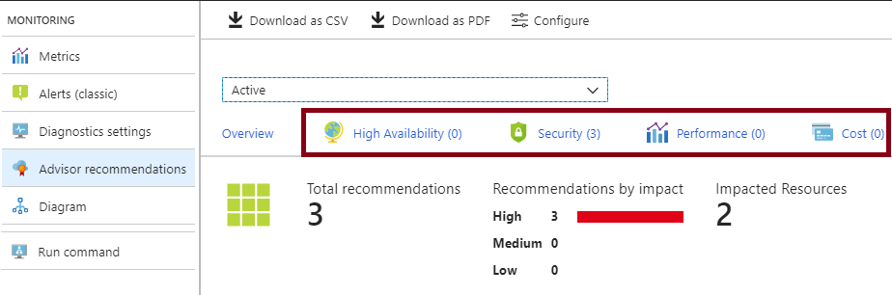
Advisor Recommendations
Personalized cloud service for optimizing Azure deployments:
Analyzes resource configuration and usage telemetry
Offers recommendations grouped in four categories:
High availability: To ensure and improve the continuity of your business-critical applications.
Security: To detect threats and vulnerabilities that might lead to security breaches.
Performance: To improve the speed of your applications.
Cost: To optimize and reduce your overall Azure spending.

Slide 34
Online Lab: Implementing Custom Azure VM Images

