Slide 1
AZ-300T01 Module 04: Configuring and Managing Virtual Networks
Subtitle or speaker name

Slide 2
Module 04: Configuring and Managing Virtual Networks Lesson 01: Azure Virtual Networks

Slide 3
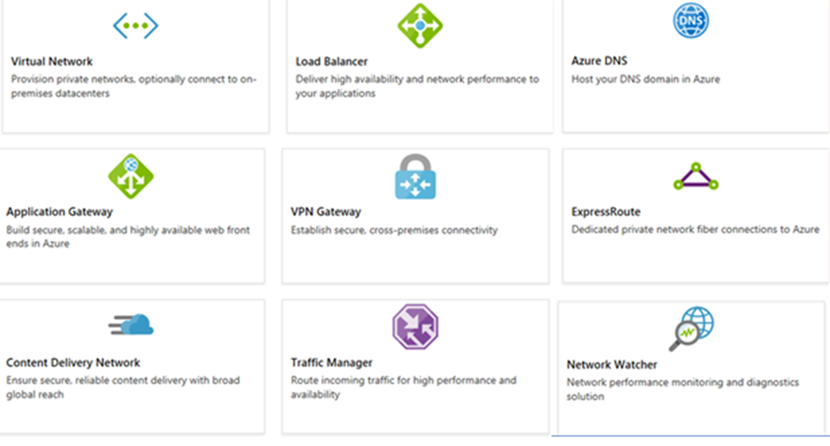
Azure Networking Components
Adopting cloud solutions can save time and simplify operations
Azure requires the same types of networking functionality as on-premises infrastructure
Azure networking offers a wide range of services and products
Notes:
For more information, you can see:
Azure Virtual Networks - https://azure.microsoft.com/en-us/services/virtual-network/

Slide 4
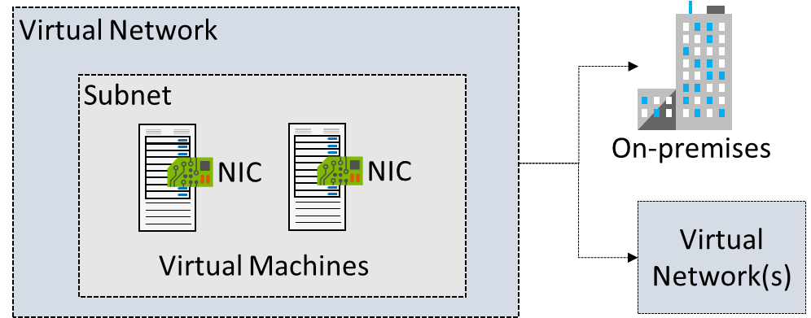
Virtual Networks
Logical representation of your own network
Create a dedicated private cloud-only VNet
Securely extend your datacenter With VNets
Enable hybrid cloud scenarios

Slide 5
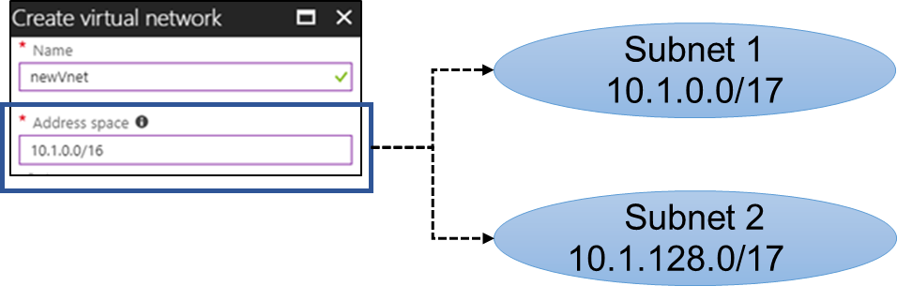
Subnets
A virtual network can be segmented into one or more subnets
Subnets provide logical divisions within your network
Subnets can help improve security, increase performance, and make it easier to manage the network
Each subnet must have a unique address range - cannot overlap with other subnets in the virtual network in the subscription
Notes:
✔️ Azure reserves the first three IP addresses and the last IP address in each subnet address range.

Slide 6
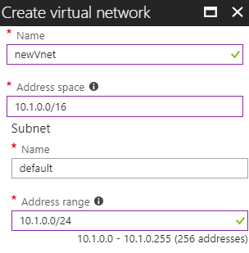
Implementing Virtual Networks
Create new virtual networks at any time
Add virtual networks when you create a virtual machine
Need to define the address space, and at least one subnet
Be careful with overlapping address spaces
Notes:
✔️ Always plan to use an address space that is not already in use in your organization, either on-premises or in other VNets. Even if you plan for a VNet to be cloud-only, you may want to make a VPN connection to it later. If there is any overlap in address spaces at that point, you will have to reconfigure or recreate the VNet. The next lesson will focus on IP addressing.

Slide 7
Demonstration – Creating Virtual Networks
Create a virtual network in the portal
Create a virtual network with PowerShell

Slide 8
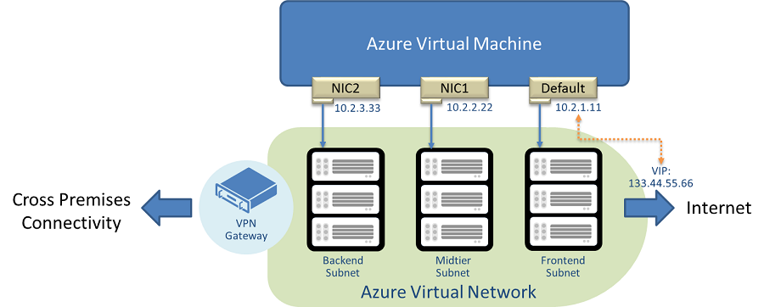
Multiple NICs in Virtual Machines
You can create virtual machines with multiple NICs
Useful for virtual appliances, network traffic management, and isolation of traffic
The VM size determines the number of NICs that can be supported

Slide 9
Demonstration – Create VMs with Multiple NICs
Create a VNet, subnet, and NSG
Create and configure multiple NICs
Create a VM and attach the NICs
Notes:
✔ Always consider having students walk-through the demonstrations themselves. Also, consider the overlap with the formal labs and your best use of time.

Slide 10
Module 04: Configuring and Managing Virtual Networks Lesson 02: Review of IP Addressing

Slide 11
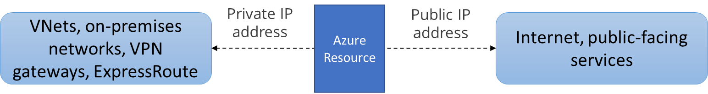
Overview of IP Addressing
Private IP addresses are used within an Azure virtual network (VNet), and your on-premises network, when you use a VPN gateway or ExpressRoute circuit to extend your network to Azure
Public IP addresses is used for communication with the Internet, including Azure public-facing services
Notes:
✔️ As a best practice you may decide to separate dynamically and statically assigned IP resources into different subnets. And, IP Addresses are never managed from within a virtual machine.

Slide 12
Public IP Addresses
Public IP addresses | IP address association | Dynamic | Static
Virtual Machine | NIC | Yes | Yes
Load Balancer | Front-end configuration | Yes | Yes
VPN Gateway | Gateway IP configuration | Yes | No
Application Gateway | Front-end configuration | Yes | No
A public IP address resource can be associated with virtual machine network interfaces, internet-facing load balancers, VPN gateways, and application gateways.

Slide 13
Private IP Addresses
Private IP Addresses | IP address association | Dynamic | Static
Virtual Machine | NIC | Yes | Yes
Internal Load Balancer | Front-end configuration | Yes | Yes
Application Gateway | Front-end configuration | Yes | Yes
Dynamic (default). Azure assigns the next available unassigned or unreserved IP address in the subnet's address range
Static. You select and assign any unassigned or unreserved IP address in the subnet's address range

Slide 14
Demonstration - Manage IP Addresses
Retrieve static private IP address information
Remove a static private IP address
Notes:
✔ Always consider having students walk-through the demonstrations themselves. Also, consider the overlap with the formal labs and your best use of time.

Slide 15
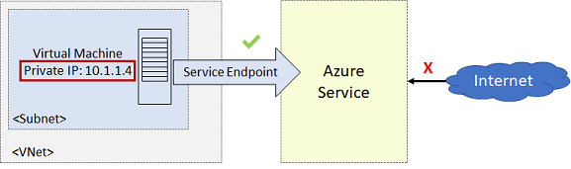
Service Endpoints
Endpoints limit network access to specific subnets and IP addresses
Improved security for your Azure service resources
Optimal routing for Azure service traffic from your virtual network
Endpoints use the Microsoft Azure backbone network
Simple to set up with less management overhead
Notes:
✔️ Can you see a use for service endpoints in your organization?
For more information, you can see:
Virtual network service endpoints - https://docs.microsoft.com/en-us/azure/virtual-network/virtual-network-service-endpoints-overview

Slide 16
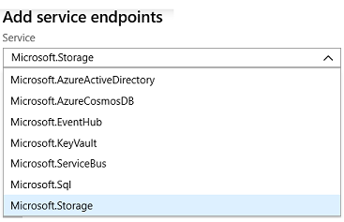
Service Endpoint Services
✔️ Adding service endpoints can take up to 15 minutes to complete

Slide 17
Module 04: Configuring and Managing Virtual Networks Lesson 03: Network Routing

Slide 18
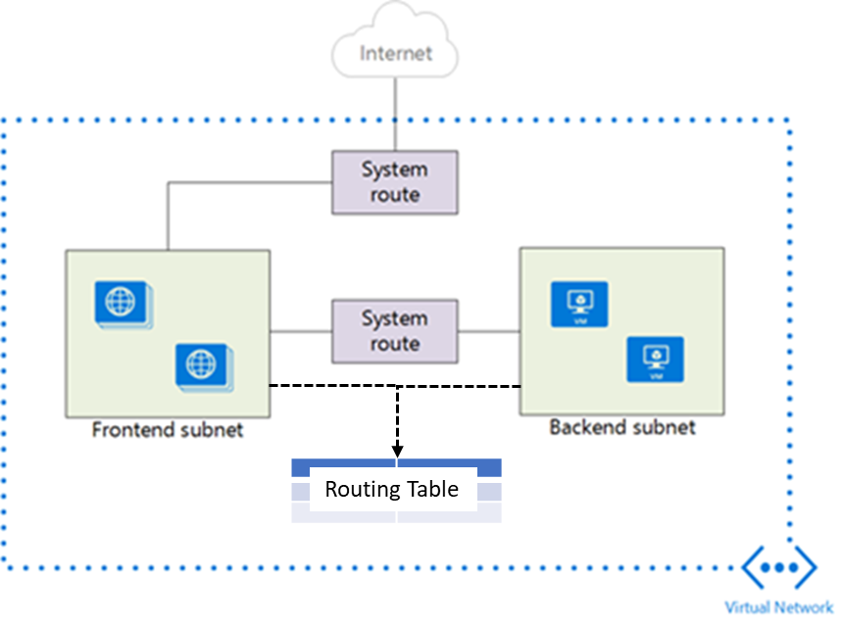
System Routes
System routes direct network traffic between virtual machines, on-premises networks, and the Internet
Traffic between VMs in the same subnet
Between VMs in different subnets in the same virtual network
Data flow from VMs to the Internet
Communication between VMs using a VNet-to-VNet VPN
Site-to-Site and ExpressRoute communication through the VPN gateway
Notes:
For more information, you can see:
System routes - https://docs.microsoft.com/en-us/azure/virtual-network/virtual-networks-udr-overview#system-routes

Slide 19
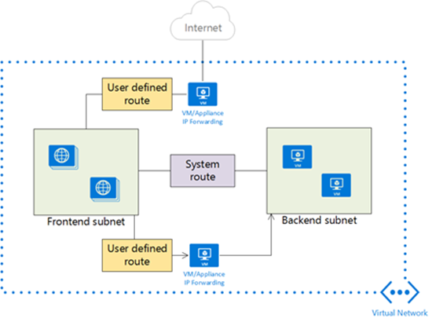
User Defined Routes
A route table contains a set of rules, called routes, that specifies how packets should be routed in a virtual network
User-defined routes are custom routes that control network traffic by defining routes that specify the next hop of the traffic flow
The next hop can be a virtual network gateway, virtual network, internet, or virtual appliance
Notes:
✔ Each route table can be associated to multiple subnets, but a subnet can only be associated to a single route table. There are no additional charges for creating route tables in Microsoft Azure. Do you think you will need to create custom routes?

Slide 20
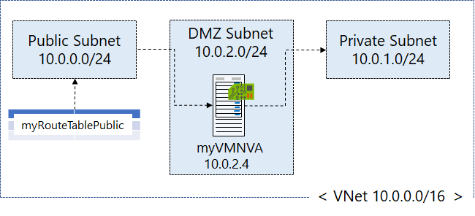
Routing Example
Create a routing table
Create a custom route
Associate the route to the subnet
Notes:
The next three topics will cover this information.

Slide 21
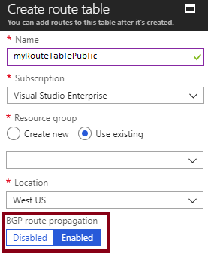
Create Route Table
Border Gateway Protocol (GBP) is a standard routing protocol used to exchange routing and reachability information between two or more networks
Routes are automatically added to the route table of all subnets with BGP propagation enabled
In most situations you will want to enable BGP route propagation

Slide 22
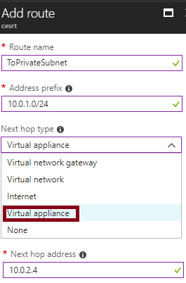
Create and Associate the Route (part 1)
When you create a route there are several Next hop types
In this example, any private subnet IP addresses will be sent to the virtual appliance
Other choices are Virtual network gateway, Virtual network, Internet, and None

Slide 23
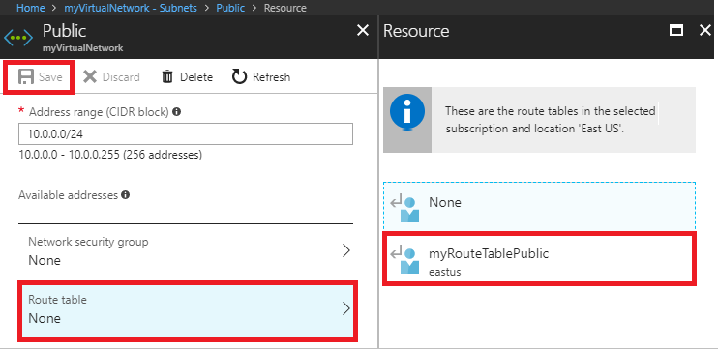
Create and Associate the Route (part 2)
Each subnet can have zero or one route table associated to it
In our example, the Public subnet will be associated with the routing table
Notes:
✔️ In this case the virtual appliance should not have a public IP address and IP forwarding should be enabled.

Slide 24
Demonstration – Custom Routing Tables
Create a route table
Add a route
Associate a route table to a subnet
Use PowerShell to view your routing information

Slide 25
Module 04: Configuring and Managing Virtual Networks Lesson 04: Intersite Connectivity

Slide 26
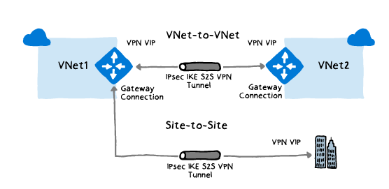
VNet-to-VNet Connections
Rely on VPN connectivity:
Require VPN gateways for each VNet
Equivalent to Site-to-Site VPN in hybrid scenarios
Support connecting:
VNets in the same or different regions.
VNets in the same or different subscriptions.
VNets and on-premises networks.
ARM VNets and classic VNets.

Slide 27
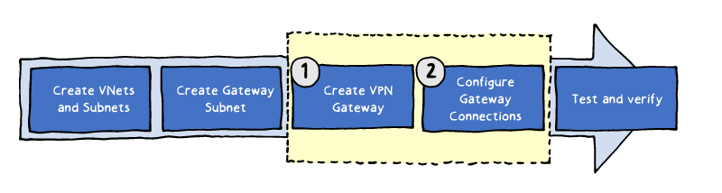
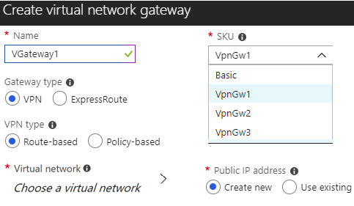
Implementing VNet-to-VNet Connections
The procedure for implementing VNet-to-VNet connections are the same as for VNet peering with the addition of configuring the VPN Gateway.
Create VPN Gateway (1)
Name and Gateway Type. Name your gateway and use the VPN Gateway type.
VPN Type. Most VPN types are Route-based.
SKU. Use the drop-down to select a gateway SKU . Your choice will affect the number of tunnels you can have and the aggregate throughput benchmark.
Virtual Networks. Associate a virtual network with the gateway. Before you do this, you must configure the gateway subnet. Each virtual network will need its own VPN gateway.
IP Address. The gateway needs a public IP address to its IP configuration to enable it to communicate with the remote network.

Slide 28
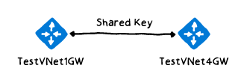
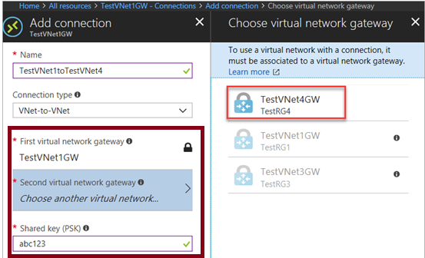
Configuring Gateway Connections
The next step after provisioning of VPN gateways is completed
Initial authentication is based on a shared key
Implementation via:
Azure PowerShell:
For VNets in the same or different subscriptions
The Azure portal:
For VNets in the same subscription

Slide 29
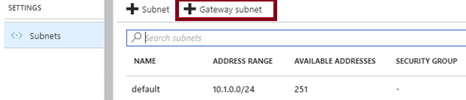
Create the Gateway Subnet
The gateway subnet contains the IP addresses; if possible, use a CIDR block of /28 or /27.
When you create your gateway subnet, gateway VMs are deployed to the gateway subnet and configured with the required VPN gateway settings.
Never deploy other resources (for example, additional VMs) to the gateway subnet.
Avoid associating a NSG with the gateway subnet.

Slide 30
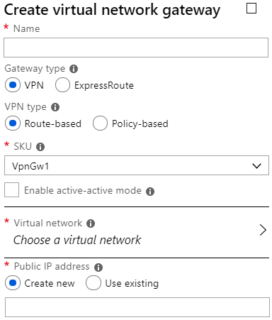
Create the VPN Gateway
Use the VPN Gateway type
Most VPN types are Route-based
Your choice of gateway SKU affects the number of tunnels you can have and the aggregate throughput benchmark
Associate a virtual network that includes the gateway subnet
The gateway needs a public IP address
✔️ It can take up to 45 minutes to provision the VPN gateway
Notes:
Gateway types and VPN types are covered in the next two topics.

Slide 31

VPN Types
Policy-based VPNs encrypt and direct packets through IPsec tunnels based on the IPsec policies
Can only be used on the Basic gateway SKU
You can have only 1 tunnel
You can only use Policy-based VPNs for S2S connections
Route-based VPNs use routes in the IP forwarding or routing table to direct packets
Most VPN Gateway configurations require a Route-based VPN

Slide 32
Gateway SKUs
SKU | S2S/VNet-to-VNet Tunnels | P2S SSTP Connections | P2S IKEv2 Connections | Aggregate Throughput Benchmark
Basic | Max. 10 | Max. 128 | Not Supported | 100 Mbps
VpnGw1 | Max. 30 | Max. 128 | Max. 250 | 650 Mbps
VpnGw2 | Max. 30 | Max. 128 | Max. 500 | 1 Gbps
VpnGw3 | Max. 30 | Max. 128 | Max. 1000 | 1.25 Gbps
✔️ The Basic SKU is considered a legacy SKU

Slide 33
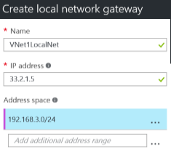
Create the Local Network Gateway
Refers to the on-premises location
Give the site a name by which Azure can refer to it
The local gateway needs a public IP address
Specify the IP address prefixes that will be routed through the gateway to the VPN device

Slide 34
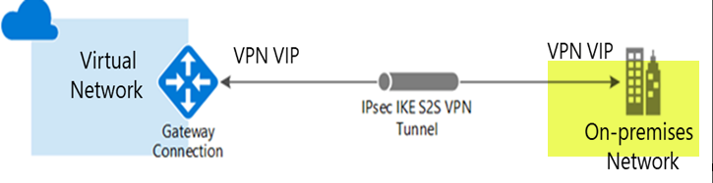
Configure the On-Premises VPN Device
Consult the list of supported VPN devices (Cisco, Juniper, Ubiquiti, Barracuda Networks)
A VPN device configuration script may be available
Remember the shared key for the Azure connection (next step)
Specify the public IP address (previous step)
Notes:
For more information, you can see:
Validated VPN devices list - https://docs.microsoft.com/en-us/azure/vpn-gateway/vpn-gateway-about-vpn-devices#devicetable

Slide 35
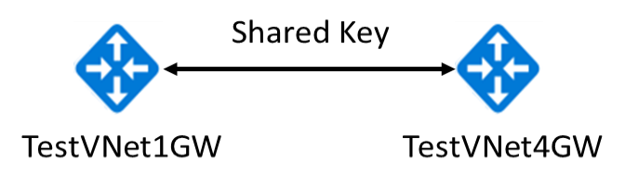

Create the VPN Connection
Once your VPN gateways are created, you can create the connection between them.
If your VNets are in the same subscription, you can use the portal.
The shared key provides the connection
Must create the connection for each virtual network
Notes:
✔️ If your VNets are in different subscriptions, you must use PowerShell to make the connection. You can use the New-AzVirtualNetworkGatewayConnection command. This command can also be used for Site-to-Site connections.

Slide 36
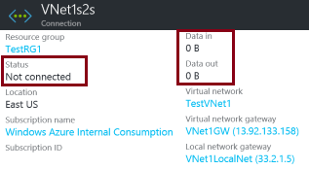
Verify the VPN Connection
Azure Portal - Status should be Succeeded or Connected. Data should be flowing in the Data in and Data out information section.
PowerShell
# Verify the connection
Get-AzVirtualNetworkGatewayConnection -Name MyGWConnection -ResourceGroupName MyRG
# Review the status
"connectionStatus": "Connected",
"ingressBytesTransferred": 33509044,
"egressBytesTransferred": 4142431
Notes:
For more information, you can see:
Verify the VPN connection - https://docs.microsoft.com/en-us/azure/vpn-gateway/vpn-gateway-howto-site-to-site-resource-manager-portal#VerifyConnection

Slide 37
Demonstration – VNet-to-VNet Connections
Explore the Gateway subnet blade
Explore the Connections blade
Explore adding a virtual network gateway
Explore adding a connection between the virtual networks

Slide 38
Module 04: Configuring and Managing Virtual Networks Lesson 05: Virtual Network Peering

Slide 39
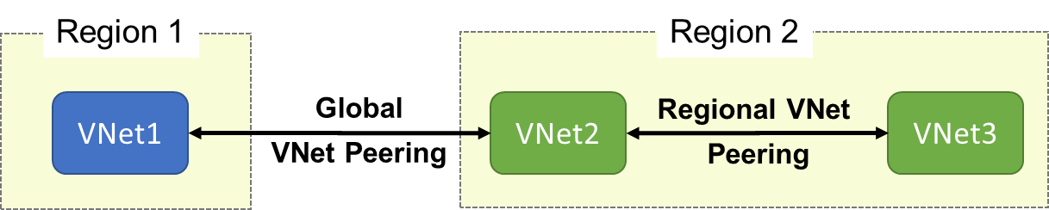
VNet Peering
VNet peering connects two Azure virtual networks (not transient)
Two types of peering: Regional and Global
Peered networks use the Azure backbone for privacy and isolation
Easy to setup, seamless data transfer, and great performance
Notes:
✔️ The default VNet peering configuration provides full connectivity. Can you see how network security groups could be applied to block or deny access to specific subnets or virtual machines?
For more information, you can see:
Virtual network peering - https://docs.microsoft.com/en-us/azure/virtual-network/virtual-network-peering-overview

Slide 40
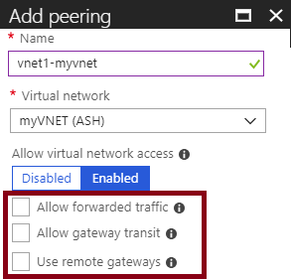
Configure VNet Peering
Allow forwarded traffic - from within the peer virtual network into your virtual network
Allow gateway transit - Allows the peer virtual network to use your virtual network gateway. (upcoming topic)
Use remote gateways -only one virtual network can have this enabled
Notes:
✔️ Remember If virtual network address spaces overlap, the virtual networks cannot be peered.

Slide 41
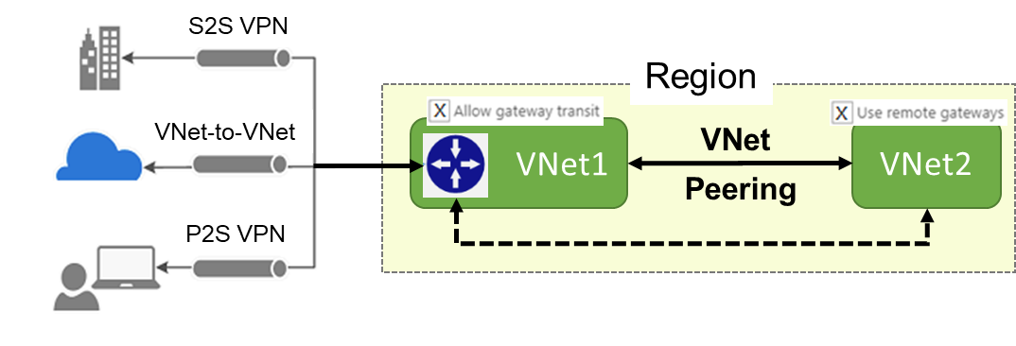
Gateway Transit
Gateway transit allows peered virtual networks to share the gateway and get access to resources
This means you do not need to deploy a VPN gateway in the peer virtual network
Notes:
✔️ When working with gateway subnets, avoid associating a network security group (NSG) to the gateway subnet. Associating a network security group to this subnet may cause your VPN gateway to stop functioning as expected.

Slide 42
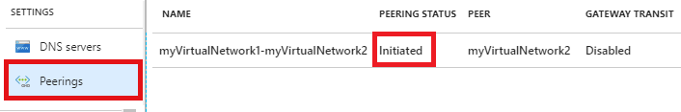
Global VNet Peering
Global VNet peering connects virtual networks across regions
Status will be Initiated or Connected
Special requirements: public clouds only, virtual network resource limitations, no gateway transit, no transitivity, and limitations on high performance virtual machines.

Slide 43
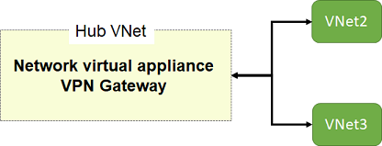
Service Chaining
Leverage user-defined routes and service chaining to implement custom routing
Implement a VNet hub with a network virtual appliance or a VPN gateway
Service chaining enables you to direct traffic from one virtual network to a virtual appliance, or virtual network gateway, in a peered virtual network, through user-defined routes

Slide 44
Module 04: Configuring and Managing Virtual Networks Lesson 06: Network Security Groups (NSG)

Slide 45
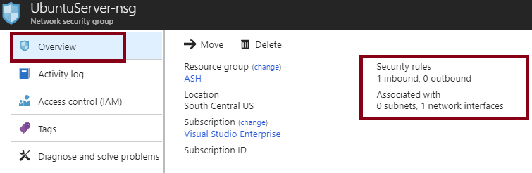
Network Security Groups (NSG)
You can limit network traffic to resources in a virtual network using a NSG
A NSG contains a list of security rules that allow or deny inbound or outbound network traffic
An NSG can be associated to a subnet or a network interface
Notes:
✔️ To simplify management of security rules, it's recommended that you associate a network security group to individual subnets, rather than individual network interfaces within the subnet.
For more information, you can see:
Network Security Groups - https://docs.microsoft.com/en-us/azure/virtual-network/security-overview#network-security-groups

Slide 46
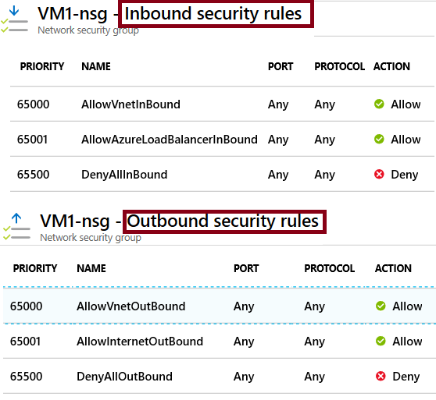
NSG Rules
Security rules in NSGs enable you to filter network traffic that can flow in and out of virtual network subnets and network interfaces.
There are default security rules. You cannot delete the default rules, but you can add other rules with a higher priority.

Slide 47
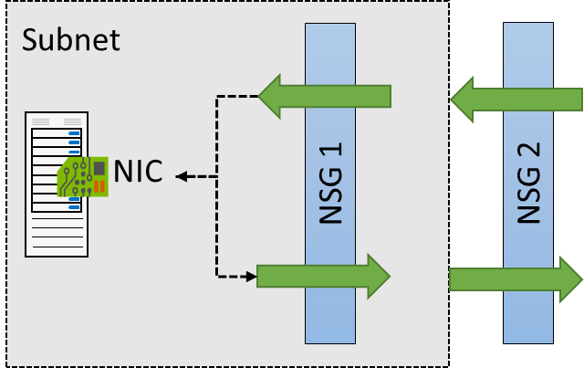

NSG Effective Rules
NSGs are evaluated independently for the subnet and NIC
An “allow” rule must exist at both levels for traffic to be admitted
Use the Effective Rules link if you are not sure which security rules are being applied

Slide 48
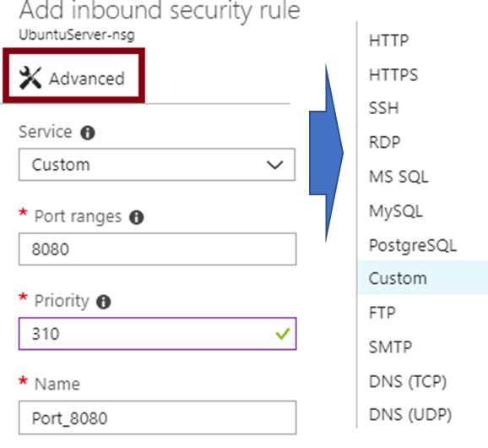
Creating NSG Rules
Select from a large variety of services
Service - The destination protocol and port range for this rule
Port ranges – Single port or multiple ports
Priority - The lower the number, the higher the priority

Slide 49
Demonstration – Network Security Rules
Access the NSGs blade
Add a new NSGs
Explore inbound and outbound rules
Notes:
✔ Always consider having students walk-through the demonstrations themselves. Also, consider the overlap with the formal labs and your best use of time.

