Slide 1
AZ-300T05 Module 05: Managing Identities
Subtitle or speaker name

Slide 2
Module 05: Managing Identities Lesson 01: Managing Azure Active Directory (AAD)

Slide 3
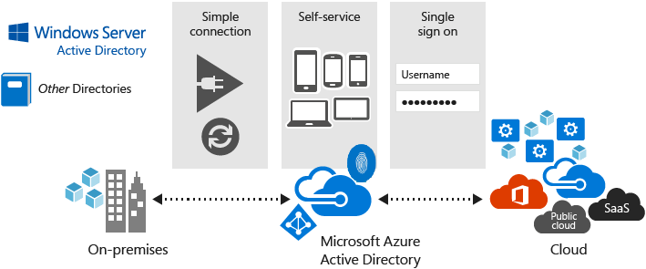
Azure Active Directory
Multi-tenant cloud-based directory and identity management:
Provides single sign-on access to cloud applications and resources
Facilitates developing apps with a global scope
Offers a full suite of identity management capabilities:
Self-service password and group management
Privileged account management
Role-based access control
App usage monitoring
Security monitoring
Device Registration
Alerting
MFA

Slide 4
Azure Active Directory Benefits
Single sign-on to any cloud or on-premises web app
Compatible with iOS, Mac OS X, Android, and Windows devices
Protect on-premises web applications with secure remote access
Extend AD to the cloud
Help protect sensitive data and applications
Notes:
✔️ What reasons do you have for considering Azure Active Directory?

Slide 5
Active Directory Domain Services (AD DS)
Windows Server-based identity management and directory service:
Traditional on-premises deployments
Cloud deployments of IaaS workloads that do not directly support Azure AD
Azure AD differs from AD DS in a number of aspects:
Management: Azure AD is a managed service with no infrastructure requirements.
Communication Protocols: Azure AD uses protocols such as SAML, WS-Federation, and OpenID Connect for authentication and OAuth for authorization.
Directory lookups: Azure AD Azure AD relies on REST API over HTTP and HTTPS.
Federation: Azure AD includes built-in federation support.
Object hierarchy: Azure AD objects exists within a flat namespace. There is no support for custom container-based hierarchy.

Slide 6
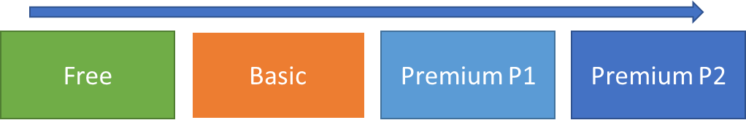
Azure Active Directory Editions
Free offers:
user/group management, single sign-on, self-service password change, basic reporting
Basic offers (in addition to the Free edition features):
group-based access management, self-service password reset, Azure Active Directory Application Proxy, 99.9% availability SLA
Premium P1 offers (in addition to the Basic edition features):
access to hybrid application access, self-service identity and access management, security in the cloud
Premium P2 offers (in addition to the Premium P1 features):
advanced identity protection and privileged identity management

Slide 7
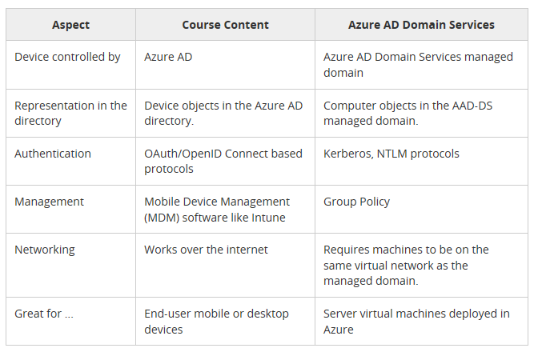
Choosing Between Azure AD and Azure AD DS
Azure AD DS is a managed AD DS deployment in an Azure VNet:
Integrates with Azure AD
Delivers core AD DS features:
Domain join
Kerberos and NTLM
LDAP
Group Policy
Intended for:
Azure VMs that rely on AD DS
Cloud-based environments

Slide 8
Choosing between Azure AD and Azure AD DS
Azure AD is primarily an identity solution, and designed for HTTP and HTTPS communications
Queried using the REST API over HTTP and HTTPS. Instead of LDAP.
Uses HTTP and HTTPS protocols such as SAML, WS-Federation, and OpenID Connect for authentication (and OAuth for authorization). Instead of Kerberos
Includes federation services, and many third-party services (such as Facebook)
Azure AD users and groups are created in a flat structure, and there are no Organizational Units (OUs) or Group Policy Objects (GPOs)
Notes:
✔️ Azure AD is a managed service. You only manage the users, groups, and policies. Deploying AD DS with virtual machines using Azure means that you manage the deployment, configuration, virtual machines, patching, and other backend tasks. Do you see the difference? How are they similar?

Slide 9
Azure AD Directories (Tenants)
A tenant is a dedicated instance of an Azure AD directory
You can have multiple tenants for:
Resource independence
Administrative independence
Synchronization independence

Slide 10
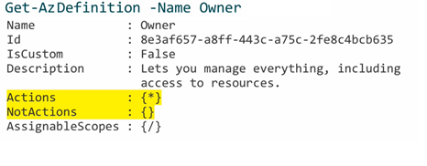
Built-in Roles
A role represents a set of permissions to carry out specific actions
Azure AD provides many built-in roles:
Built-in, not resource specific, including:
Owner: full access to all resources including the right to delegate access to others.
Contributor: creating and managing all resources but without the ability to delegate access to others.
Reader: viewing all resources (except for secrets).
Built-in, resource specific (e.g. Virtual Machine Contributor)
A role is described by a JSON-formatted role definition:
Name, Id, Actions, Not Actions, AssignableScopes
Can be retrieved by Get-AzRoleDefinition

Slide 11
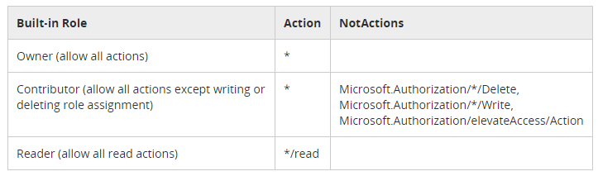
Role Definitions
Actions and NotActions:
Include or exclude actions associated with the role
AssignableScopes:
/subscriptions/[subscription id]
/subscriptions/[subscription id]/resourceGroups/[resource group name]
/subscriptions/[subscription id]/resourceGroups/[resource group name]/[resource]

Slide 12
Azure PowerShell and CLI
To automate role management, you can use:
Azure PowerShell:
New-AzRoleDefinition -InputFile .\sysops.json
New-AzRoleAssignment -RoleDefinitionName $roleName `
-SignInName $assigneeName `
-ResourceGroupName $resourceGroupName
Azure CLI:
az role definition create --role-definition “./sysops.json”
az role assignment create --role $roleName \ --assignee $assigneeName \ --resource-group $resourceGroupName

Slide 13
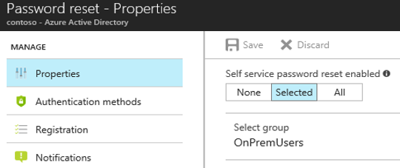
Configuring Self-Service Password Reset
Available directly from the Azure portal
Requires designating users in scope:
None
Selected (limited to specific Azure AD users or groups)
All

Slide 14
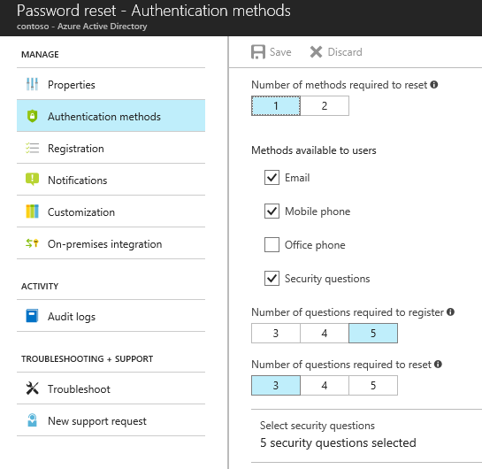
Authentication Methods for Password Reset
Include (at least one is required):
Email notification
Text or code sent to the user’s mobile device
Office phone
A set of security questions

Slide 15
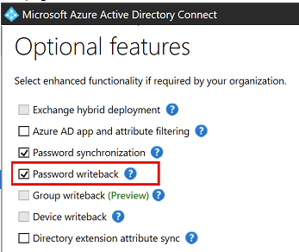
Password Writeback
Writes Azure AD users’ password changes/resets to AD DS
Eliminates the need for on-premises SSPR solutions
Requires Azure AD Premium P1 or P2 edition
Is enabled by using Azure AD Connect:
Start Azure AD Connect Configuration Wizard
Select Customize synchronization options
Enable the checkbox on the Optional features page

Slide 16
Module 05: Managing Identities Lesson 02: Implementing and Managing Hybrid Identities

Slide 17
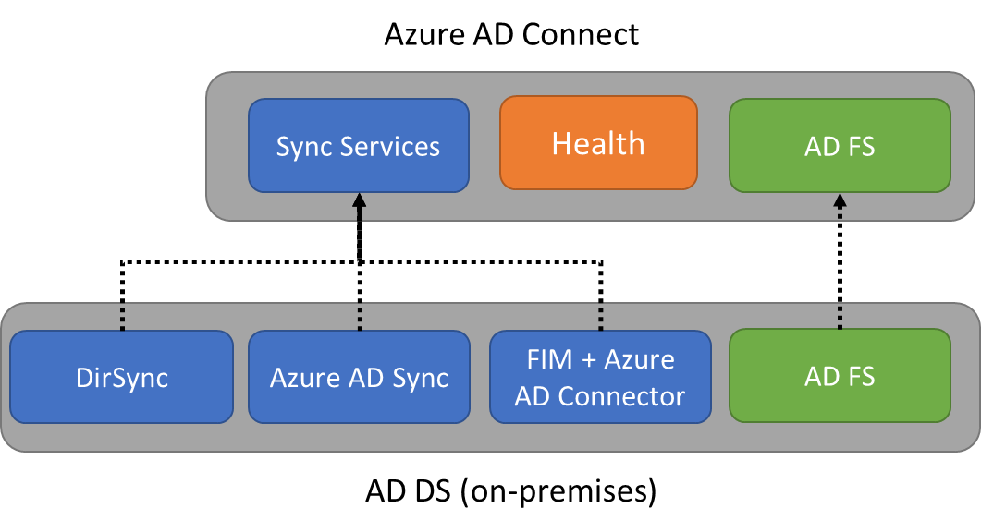
Azure AD Connect
Integrates AD DS with Azure AD:
Implements a common identity for your users across Azure, Office 365, and SaaS apps
Provides support for:
Sync Services: synchronize AD DS objects, such as users and groups.
Health Monitoring: offers centralized monitoring available from the Azure portal.
Federation: simplifies configuration of AD FS, including:
enforcement of AD sign-in policies
smart card or 3rd party MFA

Slide 18
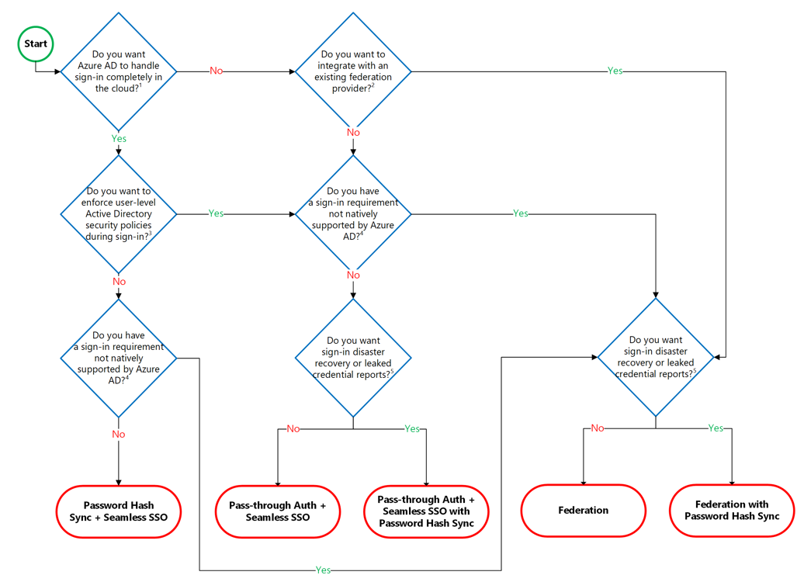
Authentication Options

Slide 19
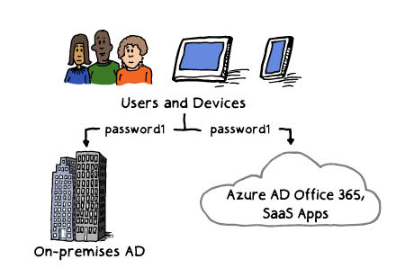
Password Synchronization
Supported by Azure AD Connect:
Synchronizes user passwords from AD DS to Azure AD
Allows users to use their AD credentials in order to access:
Azure resources
Office 365
Microsoft Intune
Dynamics 365
Azure AD DS
Improves user productivity
Reduces helpdesk costs

Slide 20
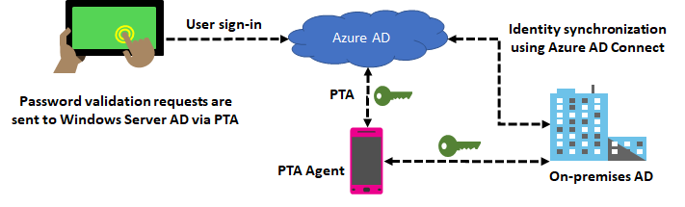
Pass-through Authentication
Eliminates the need for password hash synchronization
Always validates credentials against Active Directory

Slide 21
Password Writeback
Propagates password changes in Azure AD to Active Directory
Offers a number of benefits:
Enforcement of AD password policies
Zero-delay feedback
Support for password changes
Support for password resets
No inbound firewall requirements

Slide 22
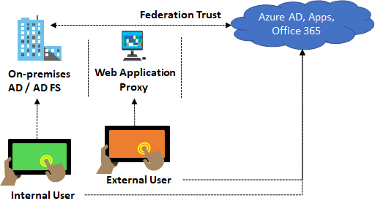
Federation with Azure AD
Represents a trust between Azure AD and AD
Ensures that all authentication is handled by AD
Eliminates the need for password hash synchronization
Password hash synchronization is optional as a backup (in case of AD FS issues)

Slide 23
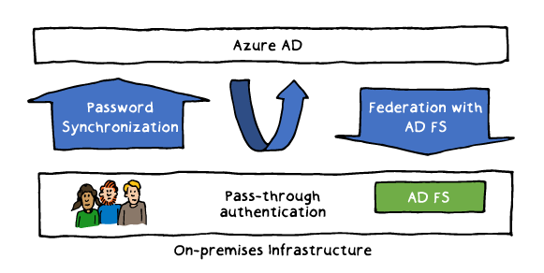
Sign-On Methods
Available when using Azure AD Connect:
Password Synchronization: synchronizes AD DS user password hashes
Federation with AD FS: uses federation to redirect authentication requests to AD DS
Pass-through authentication: redirects authentication requests to AD DS without dependency on a federation service

Slide 24
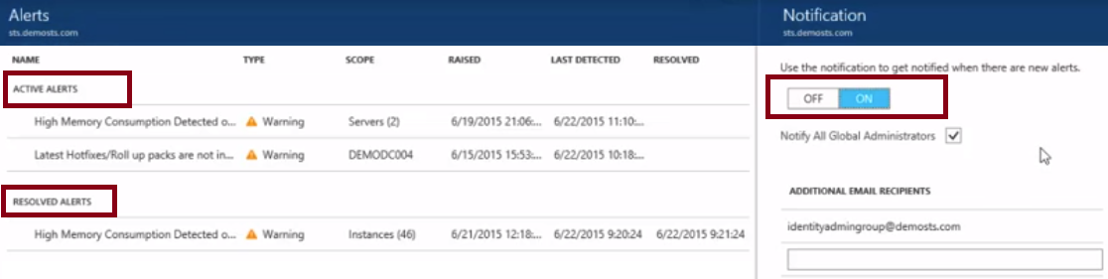
Azure AD Connect Health
Provides monitoring of AD DS and Azure AD integration:
Azure AD Connect and its synchronization engine
AD DS domain controllers
AD FS servers

Slide 25
Device Management
Azure AD supports device integration by using:
Registering a device in Azure AD:
Provides the device with an Azure AD identity (a device object) that facilitates device authentication.
Introduces device object-specific attributes in Azure AD. This facilitates using Azure AD and mobile device management (MDM) solution such as Microsoft Intune to create conditional access rules that allow or block access from devices based on their security and compliance status.
It supports disabling or enabling the Azure AD identity representing the device.
Joining a device to Azure AD:
Constitutes an extension to registering a device
Provides the benefits of registering a device and, in addition, changes the local state of a device.
Allows Azure AD users to sign-in to devices using work or school accounts instead of personal accounts.

Slide 26
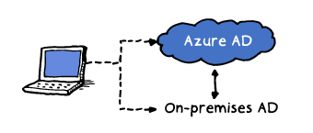
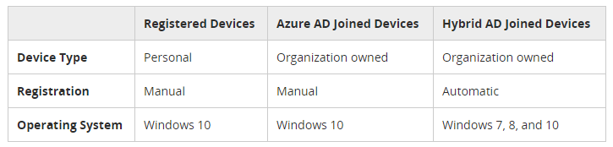
Azure Joined Devices
Hybrid Azure AD joined devices are joined to:
AD
Azure AD
Hybrid Azure AD join facilitates:
Centralized management of all work-owned devices
Support for user sign-ins with Active Directory accounts

Slide 27
Online Lab: Implementing user-assigned managed identities for Azure resources

