Slide 1
Lesson 05: Introduction to Cloud Computing

Slide 2
Lesson 05: Cloud Computing Models

Slide 3
Lesson 05: What is Microsoft Azure

Slide 4
Lesson 05: Microsoft Azure Services

Slide 5
There are more than 200+ services available in different categories
https://azure.microsoft.com/en-in/services
Some of the categories are:
Compute
Networking
Storage Accounts
Active Directory

Slide 6
Lesson 05: Microsoft Azure Architecture

Slide 7
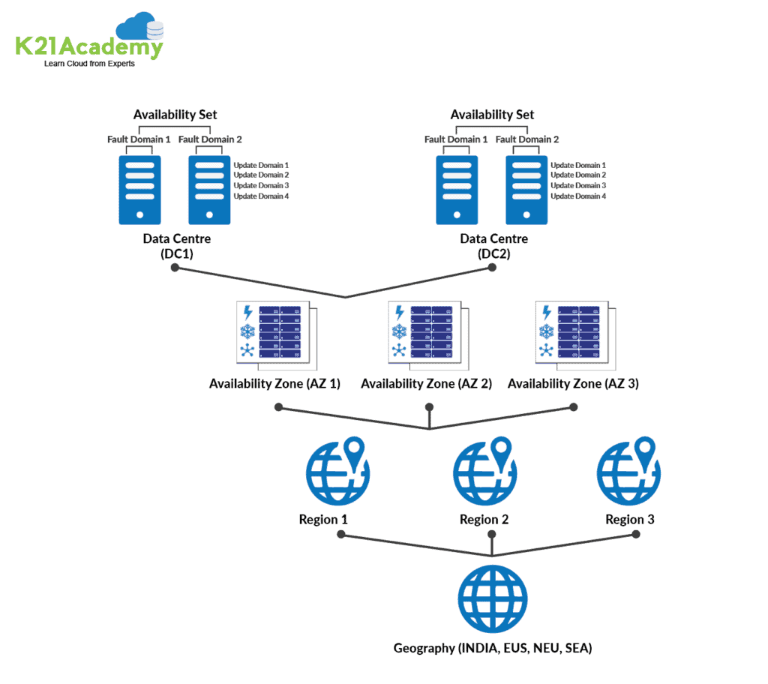

Slide 8
Region
a set of data centers deployed within a latency-defined perimeter and connected through a dedicated regional low-latency network.
With more global regions than any other cloud provider, Azure gives customers the flexibility to deploy applications where they need to. Azure is generally available in 52 regions around the world, with plans announced for 6 additional regions.

Slide 9
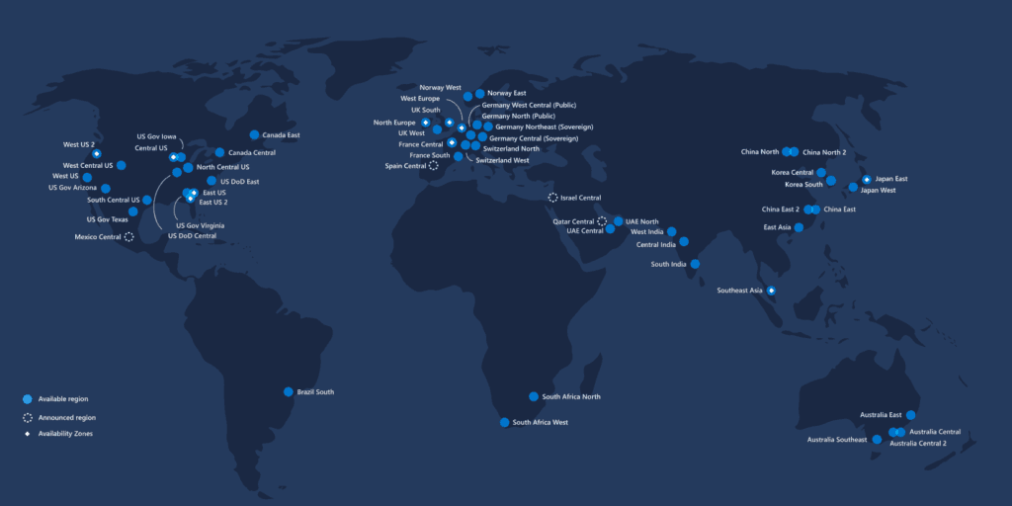

Slide 10
Region Pairs
Each Azure region is paired with another region within the same geography, together making a regional pair.
Azure serializes platform updates so only one region is updated at a time.
Azure Regions in a Pair have direct connections that bring additional benefits to use them together.
Each Azure Region in a pair is always located greater than 300 miles apart when possible.
Examples of region pairs are West US paired with East US, South-East Asia paired with East Asia.

Slide 11
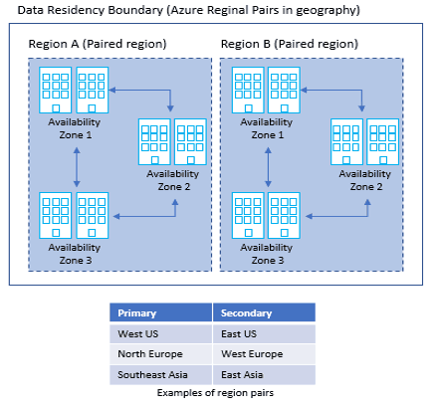

Slide 12
Geographies
Geography is a discrete market, typically containing two or more regions, that preserves data residency and compliance boundaries.
It allows customers with specific data-residency and compliance needs to keep their data and applications close.
To know more about the Geography locations refer here

Slide 13
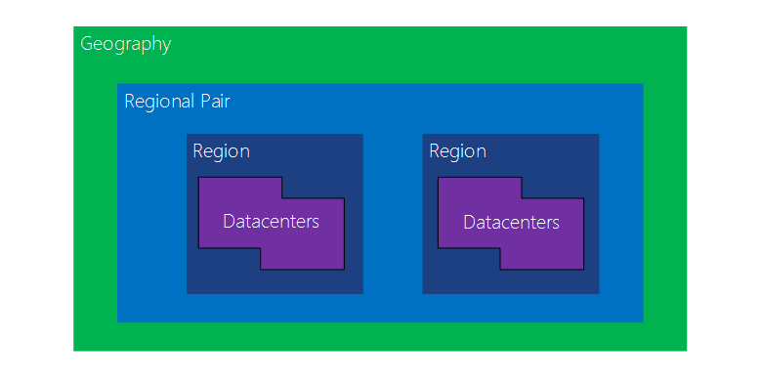

Slide 14
Availability Zone
Availability Zones is a high-availability offering that protects your applications and data from datacenter failures.
These are unique physical locations within an Azure region. Each zone is made up of one or more data centers equipped with independent power, cooling, and networking.
The physical separation of Availability Zones within a region protects applications and data from datacenter failures.

Slide 15
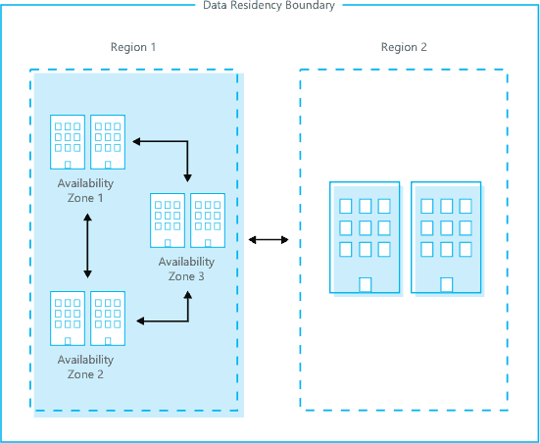

Slide 16
Availability Set
An Availability Set is a logical grouping capability for isolating VM resources from each other when they’re deployed.
By deploying your VMs across multiple hardware nodes Azure ensures that if hardware or software failure happens within Azure, only a sub-set of your virtual machines is impacted and your overall solution is safe and in working condition.
It provides redundancy for your virtual machines.

Slide 17
An Update Domain and Fault Domain is assigned to each VM in Availability Set by Azure platform.

Slide 18
Fault Domain
Fault domains define the group of virtual machines that share a common power source and network switch.
Each and every fault domain contains some racks and each rack contains a virtual machine.
Each of these Fault domain shares a power supply and a network switch.
All the resources in the fault domain become unavailable when there is a failure in the fault domain.
You should place your VMs in such a way that each fault domain gets one web server, one database server, and like that.

Slide 19
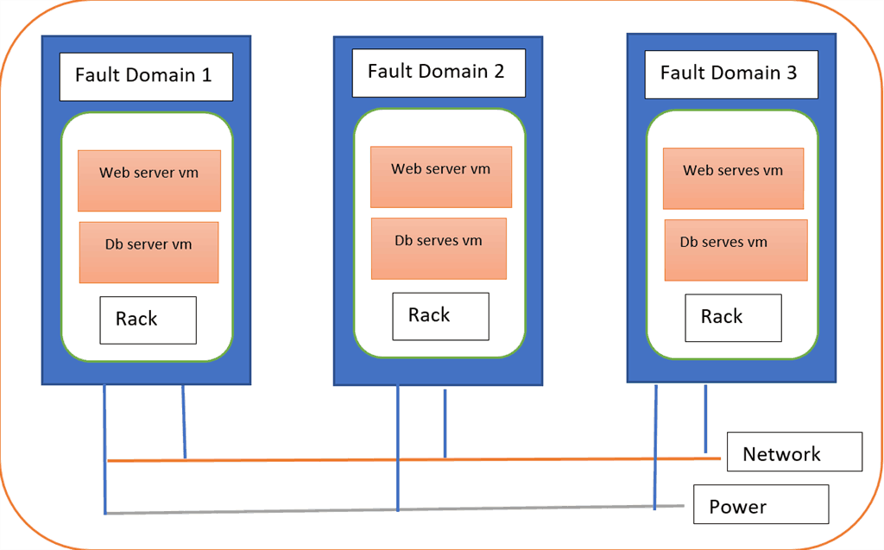

Slide 20
Update Domain
Virtual machines get update domains automatically once they are put inside the availability set.
All virtual machines within that update domain will reboot together.
They are used for patching of the virtual machines.
Only one update domain can be updated at the time.

Slide 21
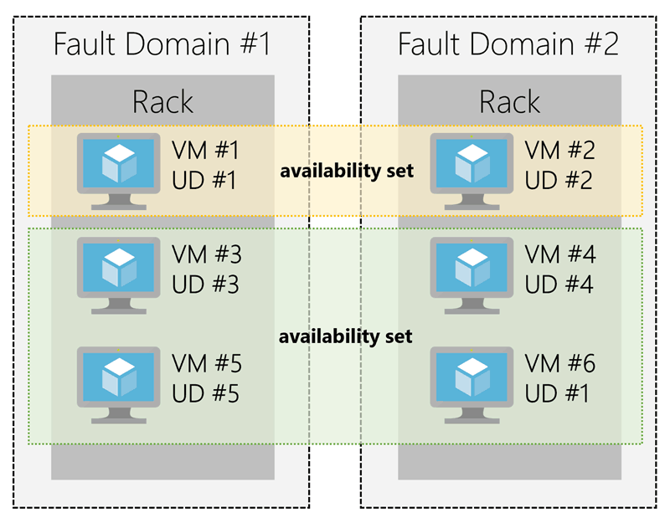

Slide 22
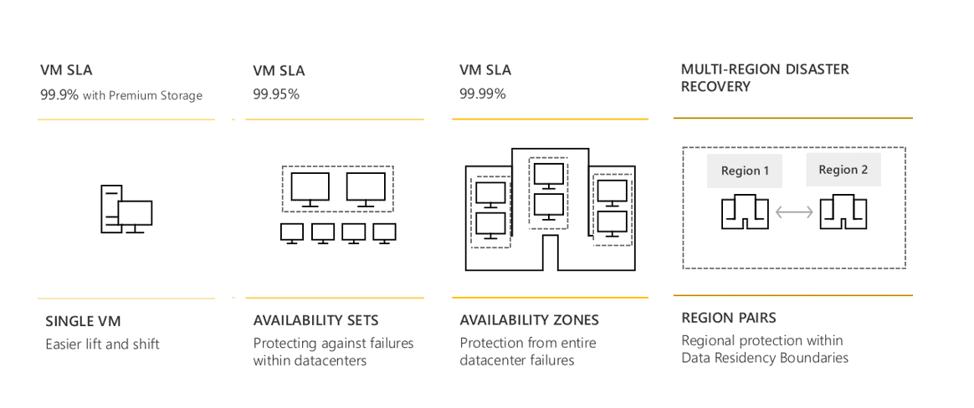
SLA(Service Level Agreement) for VM:

Slide 23
Lesson 05: Creating an Account in Microsoft Azure

Slide 24
Create FREE Microsoft Azure Trial Account
Click here to follow steps

Slide 25
Lesson 05: Different ways of accessing Microsoft

Slide 26
Portal
Powershell
CLI

Slide 27
Azure Cloud Shell is a browser-accessible, interactive shell for managing the Azure resources. It gives you the flexibility to access the shell based on the area you are working. Bash experience for linux and Powershell experience for the Windows users.
You can access the Cloud shell on your browser or through the Azure portal.
To access through the browser you can access the below link.

Slide 28
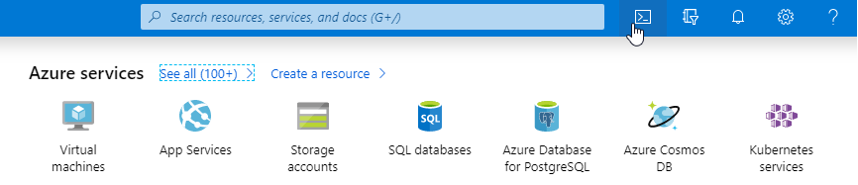
https://shell.azure.com/
or Try from Azure portal using the cloud shell icon .

Slide 29
If you are the first time user, when you access the Cloud shell it will ask you to choose the Bash or Powershell type of experience you need. But next time when you access the cloud shell it will automatically choose the most recently used environment. In our case, lets go ahead and choose the Powershell.
Note: You can change shells any time via the environment selector in the cloudshell toolbar.

Slide 30
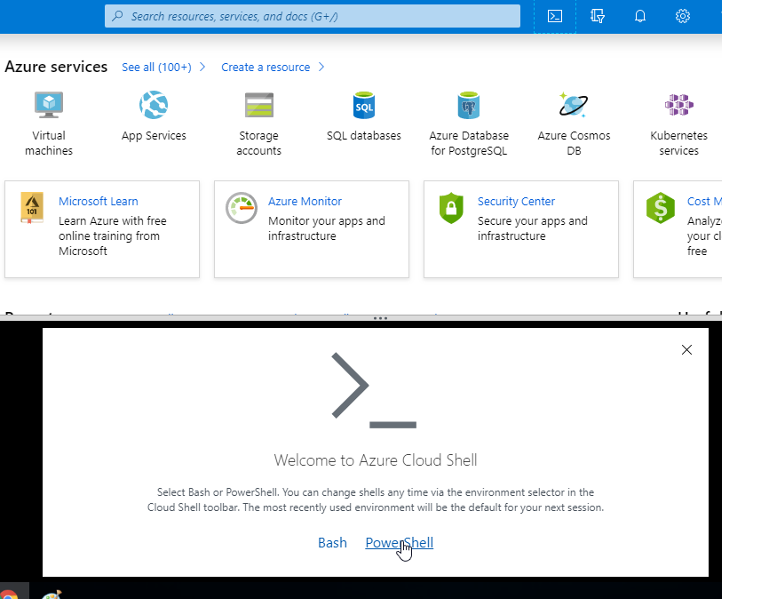

Slide 31
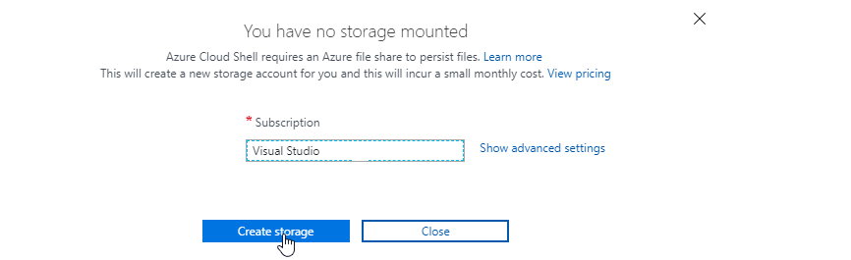
Next important thing to notice is that, at first time when you access the cloud shell it will ask you to create the storage to be mounted with the current subscription.

Slide 32
Once you click on "Create Storage" it will automatically create a storage inside the azure environment. The beauty of the Cloud shell environment is having the integrated cloud shell editor. Meaning, you can run both CLI and Powershell command files through this Cloud shell itself.

Slide 33
Lesson 05: Azure Resources

Slide 34
Lesson 05: Subscriptions and Accounts

Slide 35
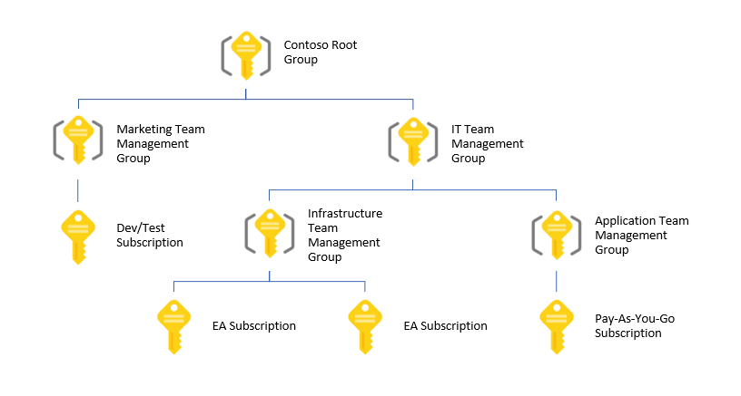
Management Groups
Provides a level of scope above subscriptions
Organizational alignment for your Azure subscriptions through custom hierarchies and grouping
Targeting of policies and spend budgets across subscriptions and inheritance down the hierarchies
Compliance and cost reporting by organization (business/teams)

Slide 36
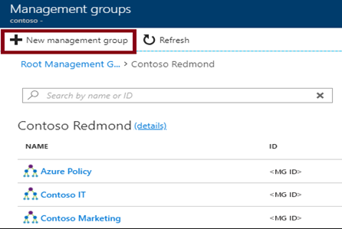
Creating Management Groups
The Management Group ID is the directory unique identifier that is used to submit commands on this management group
The Display Name field is the name that is displayed within the Azure portal

Slide 37
Azure Subscriptions
A subscription is a logical unit of Azure services that is linked to an Azure account
Subscriptions help you organize access to cloud service resources
Subscriptions have accounts
An Azure account is simply an identity in Azure Active Directory (Azure AD) or in a directory that is trusted by Azure AD, such as a work or school organization
Users,
groups, and service principles
Azure Active Directory
Authentication
& Authorization
Azure resources in resource groups
Azure Subscription(s)
Notes:
✔️ Do you know how many subscriptions your organization has? Do you know how resources are organized into resource groups?

Slide 38
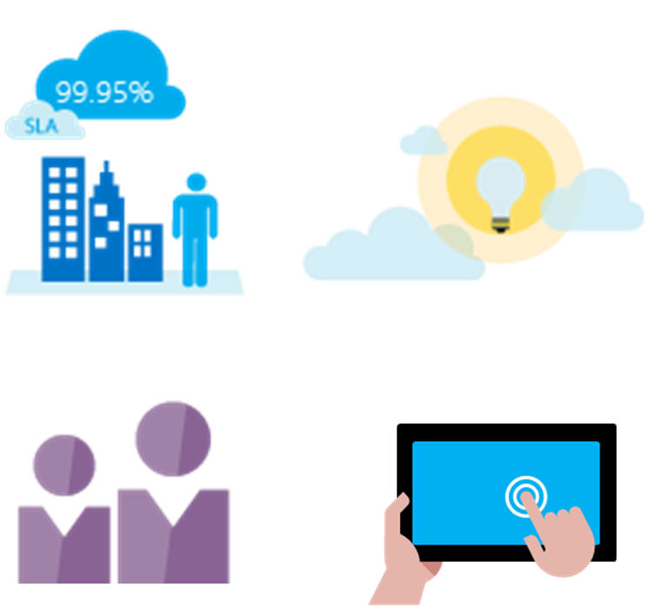
Getting a Subscription
Enterprise Agreement customers make an upfront monetary commitment and consume services throughout the year
Resellers provide a simple, flexible way to purchase cloud services
Partners can design and implement your Azure cloud solution
Personal free account -start right away
Notes:
✔️ Which subscription model are you most interested in?
For more information, you can see:
Solution providers - https://www.microsoft.com/en-us/solution-providers/home

Slide 39
Subscription Usage
Subscription | Usage
Free | Includes a $200 credit for the first 30 days, free limited access for 12 months
Pay-As-You-Go | Charges you monthly
Enterprise | One agreement, with discounts for new licenses and Software Assurance - targeted at enterprise-scale organizations.
Student | Includes $100 for 12 months – must verify student access
Notes:
Note: Credit card information is used for identity verification only. You won’t be charged for any services until you upgrade.

Slide 40
Subscription User Types
Administrative Role | Limit | Summary
Account Administrator | 1 per Azure account | Authorized to access the Account Center
Service Administrator | 1 per Azure subscription | Authorized to access the Azure Management Portal for all subscriptions in the account
Co-administrator | 200 per subscription | Same as the Service Administrator but can’t change the association of subscriptions to Azure directories
Notes:
✔️ Account Administrators using a Microsoft account must log in every 2 years (or more frequently) to keep the account active. Inactive accounts are cancelled, and the related subscriptions removed. There are no login requirements if using a work or school account.

Slide 41
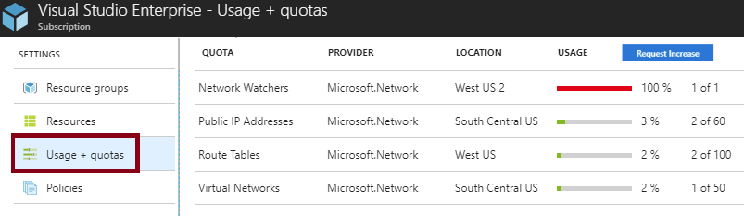
Check Resource Limits
All resources have a maximum limit listed in Azure limits
Helpful to track current usage, and plan for future use
You can request an increase

Slide 42
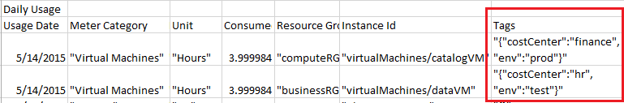
Resource Tags
Tags logically organize your resources
Tags consist of a name and value
Useful especially in billing
Notes:
✔️ If you must create a lot of tags you will want to do that programmatically. You can use PowerShell or the CLI.

Slide 44
Lesson 05: Understanding ARM

