Slide 1


Entity Framework

Slide 2
Agenda
Need of ADO.Net or Entity Framework
Limitations in ADO.Net
What is Entity Framework
Why we need Entity Framework
ORM (Object Relational Mapper)
Different Approaches in Entity Framework
CRUD Operations
Practical Implementation

Slide 3
Why do we need ADO.NET / Entity Framework?
ADO.NET is a data access technology from the Microsoft .NETFramework that provides communication between relational and non-relational systems through a common set of components.ADO.NET is a set of computer software components that programmers can use to access data and data services from a database.
Entity Framework is object-relational mapper used in .Net to access database without caring about the most of the data access code the developer needs to write. So it eases data access for developers. MVC is an architectural pattern which people used to design application.

Slide 4
Limitations of ADO.Net
You cannot utilize the ADO.NET architecture from anything but managed code.
There is no COM interoperability allowed for ADO.NET.
Only Three Managed Data Providers (so far).
Queries are checked at run-time, not at compile-time
There is no intellisense.

Slide 5
Why Entity Framework ?
Entity Framework can generate the necessary database commands for reading or writing data in the database and execute them for you.
If you're querying, you can express your queries against your domain objects using LINQ to entities.
Entity Framework will execute the relevant query in the database and then materialize results into instances of your domain objects for you to work within your app.
Entity Framework is Microsoft's recommended data access technology for new applications.
ADO.NET seems to refer directly to the technology for data sets and data tables.
Entity Framework is where all of the forward moving investment is being made, which has been the case for a number of years already.
Microsoft recommends that you use Entity Framework over ADO.NET or LINQ to SQL for all new development.

Slide 6
What is Entity framework?
Entity framework is an Object Relational Mapping (ORM) framework that offers an automated mechanism to developers for storing and accessing the data in the database.
Entity Framework was first released in 2008
means of interacting between .NET applications and relational databases.
Entity Framework (EF) is an open source ORM framework for ADO.NET which is a part of .NET Framework.
An ORM takes care of creating database connections and executing commands, as well as taking query results and automatically materializing those results as your application objects.
An ORM also helps to keep track of changes to those objects, and when instructed, it will also persist those changes back to the database for you.

Slide 7
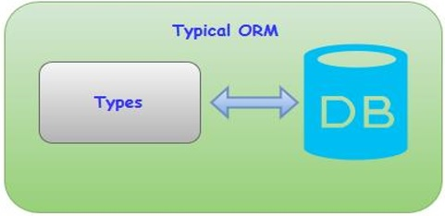
Other ORM’s ?
Nhibernate
LLBLGen Pro.
These typically map domain types directly to the database schema.

Slide 8
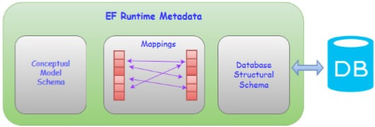
Other ORM’s ?
Entity Framework has a more granular mapping layer so you can customize mappings
for example, by mapping the single entity to multiple database tables or even multiple entities to a single table.

Slide 9
Data Model
Following are the three core parts of EDM.
The Storage Schema Model
The Conceptual Model
The Mapping Model

Slide 10
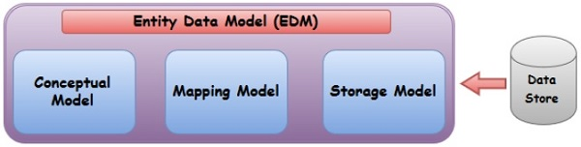
The Storage Schema Model
he Storage Model also called as Storage Schema Definition Layer (SSDL) represents the schematic representation of the backend data store.

Slide 11
The Conceptual Model
The Conceptual Model also called as Conceptual Schema Definition Layer (CSDL) is the real entity model, against which we write our queries.

Slide 12
The Mapping Model
The Mapping Model
Mapping Layer is just a mapping between the Conceptual model and the Storage model.
The logical schema and its mapping with the physical schema is represented as an EDM.
Visual Studio also provides Entity Designer, for visual creation of the EDM and the mapping specification.
The output of the tool is the XML file (*.edmx) specifying the schema and the mapping.
Edmx file contains Entity Framework metadata artifacts.

Slide 13
Schema Definition Language
ADO.NET Entity Framework uses an XML based Data Definition Language called Schema Definition Language (SDL) to define the EDM Schema.
The SDL defines the Simple Types similar to other primitive types, including String, Int32, Double, Decimal, and DateTime, among others.
An Enumeration, which defines a map of primitive values and names, is also considered a simple type.
Enumerations are supported from framework version 5.0 onwards only.
Complex Types are created from an aggregation of other types. A collection of properties of these types define an Entity Type.

Slide 14
DbContext
The Entity Framework enables you to query, insert, update, and delete data, using Common Language Runtime (CLR) objects which is known as entities. The Entity Framework maps the entities and relationships that are defined in your model to a database
It also provides facilities to −
Materialize data returned from the database as entity objects
Track changes that were made to the objects
Handle concurrency
Propagate object changes back to the database
Bind objects to controls
The primary class that is responsible for interacting with data as objects is System.Data.Entity.DbContext.

Slide 15
Lifecycle of DbContext
The lifetime of a context begins when the instance is created and ends when the instance is either disposed or garbage-collected.
Context lifetime is a very crucial decision to make when we use ORMs.
The context is performing like an entity cache, so it means it holds references to all the loaded entities which may grow very fast in memory consumption and it can also cause memory leaks.

Slide 16
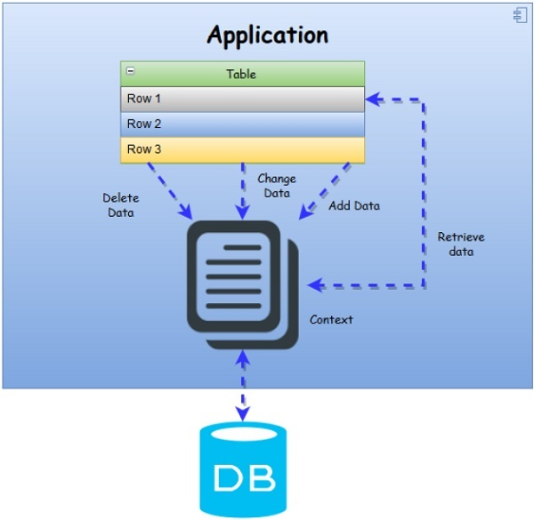
Lifecycle
In the below diagram, you can see the upper level of data workflow from application to database via Context and vice versa

Slide 17
Entity Lifecycle
The Entity Lifecycle describes the process in which an Entity is created, added, modified, deleted, etc. Entities have many states during its lifetime. Before looking at how to retrieve entity state, let’s take a look at what is entity state. The state is an enum of type System.Data.EntityState that declares the following values −
Added: The entity is marked as added.
Deleted: The entity is marked as deleted.
Modified: The entity has been modified.
Unchanged: The entity hasn’t been modified.
Detached: The entity isn’t tracked.

Slide 18
Approaches
There are three different approaches you can use while developing your application using Entity Framework:
Database-First
Code-First
Model-First

Slide 19
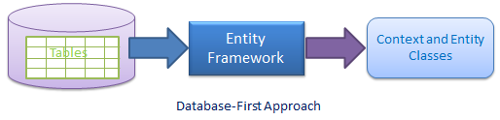
Database Approach
In The Database First Approach, we start from database and get the corresponding classes in our application.
It provides an alternative to the Code First and Model First approaches to the Entity Data Model.
It creates model codes (classes, properties, DbContext etc.) from the database in the project and those classes become the link between the database and controller.
In the database-first development approach, you generate the context and entities for the existing database using EDM wizard integrated in Visual Studio or executing EF commands.

Slide 20
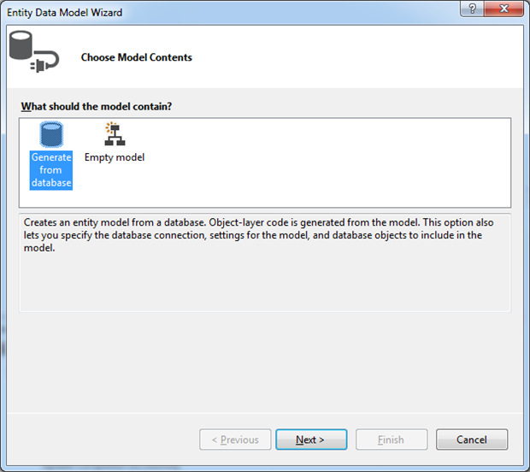
Walk through – Creation of Database First
Create the ADO.Net Entity Data model using the ‘Generate from Database’ option.

Slide 21
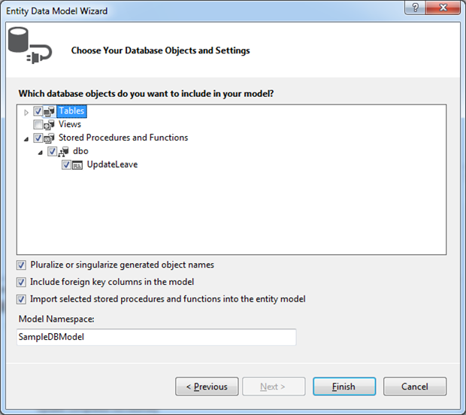
Walk through – Creation of Database First
Select an existing connection or new connection from the ‘choose data connection‘ window. We are using the sampleDB that we created as part of our Model First sample. Now, select the database objects suitable for your project such as Tables, Views and Stored procedures, functions from the ‘Choose your Database Objects‘ window.

Slide 22
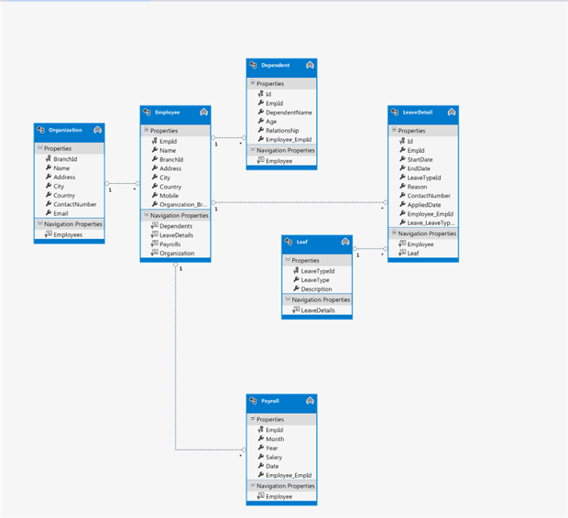
Walk through – Creation of Database First
This will generate the designer with selected entities and associations as shown below.

Slide 23
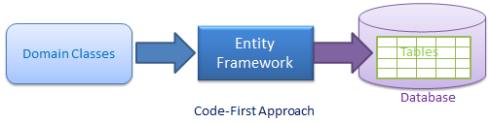
Code First Approach
Use this approach when you do not have an existing database for your application. In the code-first approach, you start writing your entities (domain classes) and context class first and then create the database from these classes using migration commands.
In Code-First Approach, we create the classes first and then generate the database from the classes directly. In code first, we won’t use the Entity Designer (for editing .edmx files) at all.
Developers who follow the Domain-Driven Design (DDD) principles, prefer to begin with coding their domain classes first and then generate the database required to persist their data.

Slide 24
Walk through – Creation of Code First
First, create the classes which represent the database table. For this walkthrough I am using the Category and Product classes.
public class Category
{
public int CategoryId { get; set; }
public string Category { get; set; }
public string Description { get; set; }
}
public class Product
{
public int ProductId { get; set; }
public string ProductName { get; set; }
public float Price { get; set; }
public int CategoryId { get;set;}
}

Slide 25
Walk through – Creation of Code First
Now, define the custom DbContext class derived from DbContext, which defines the classes that need to be converted to database tables. Here, we have defined both category and Product classes to represent as a table.
public class SampleContext : DbContext
{
public DbSet<Category> Categories { get; set; }
public DbSet<Product> Products { get; set; }
}
Add the connection string to the web.config for accessing the database at run time.
<add id="SampleContext""
connectionString="datasource=.\sqlexpress;IntegratedSecurity=SSPI;database=SampleDB"
providerName="System.Data.SqlClient"/>
For performing the CRUD operations, define the data access class with proper methods.

Slide 26
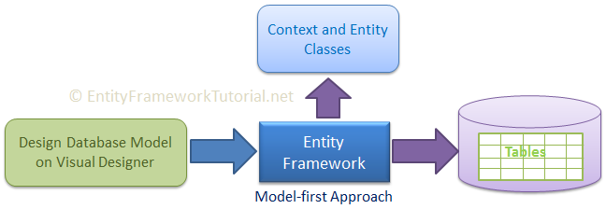
Model First Approach
In the Model-First approach, you create the entities, relationships, and inheritance hierarchies directly on the design surface of EDMX and then generate the database from your model.
In the Model First approach, the database model is created first using the ORM designer in Visual Studio. Once the model consisting of entities and relationships has been designed, the physical database will be generated from the model.
In the model-first approach, you create entities, relationships, and inheritance hierarchies directly on the visual designer integrated in Visual Studio and then generate entities, the context class, and the database script from your visual model.

Slide 27
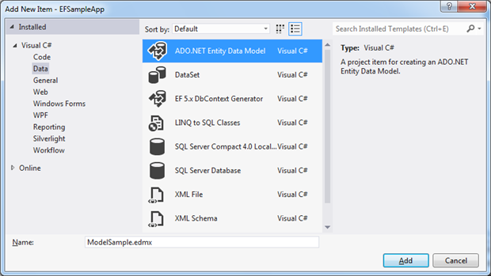
Walk through – Creation of Model First
In the Model-First approach, you create the entities, relationships, and inheritance hierarchies directly on the design surface of EDMX and then generate the database from your model.
In the Model First approach, the database model is created first using the ORM designer in Visual Studio. Once the model consisting of entities and relationships has been designed, the physical database will be generated from the model.
In order to create the model, you should create an empty ASP.Net project in Visual Studio and add a new ADO.Net Entity Data Model

Slide 28
Walk through – Creation of Model First
This will open the Entity Data Model Wizard.
This loads the entity data model designer.

Slide 29
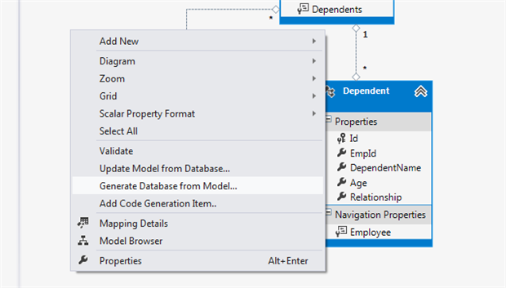
Walk through – Creation of Model First
Once the entity model design is completed, generate the database from the model using the ‘GenerateDatabase from Model‘ context menu. Right-click on the designer to invoke the Context menu, then select the ‘Generate Database from Model‘option.

Slide 30
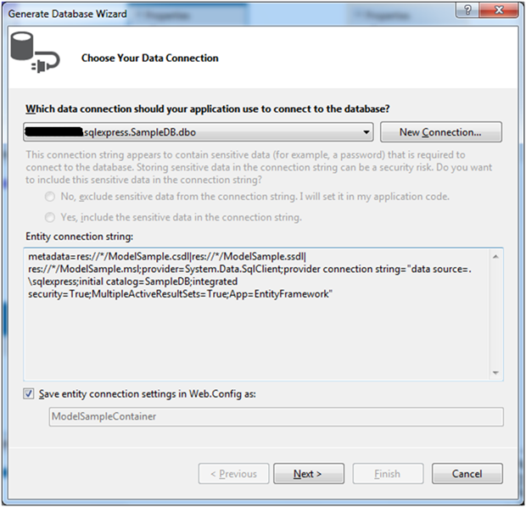
Walk through – Creation of Model First
Select an existing database connection or create a new connection to create the sample database from the Model

Slide 31
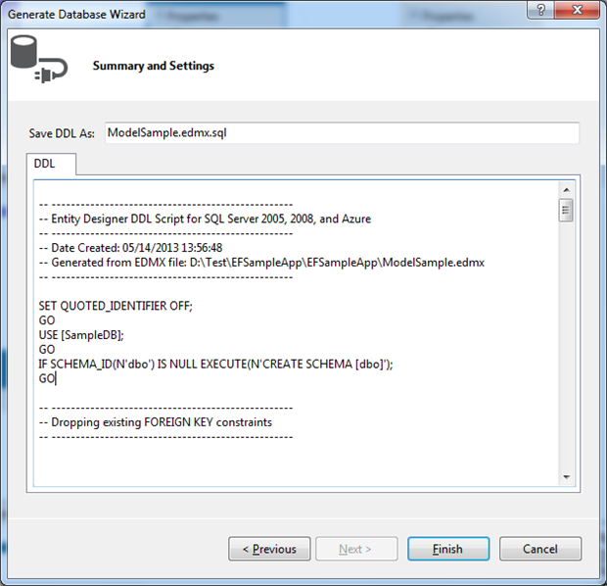
Walk through – Creation of Model First
This will generate the DDL statements, and the generated script will be added to the solution as a script file.

Slide 32
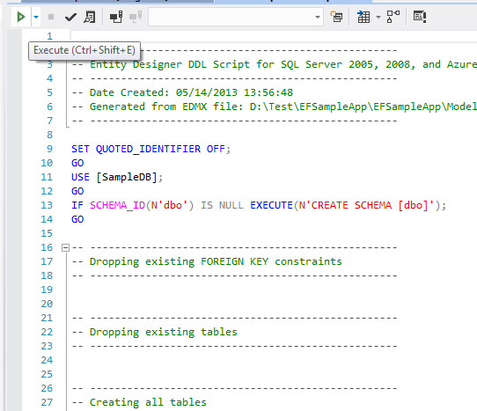
Walk through – Creation of Model First
The script file generated in the previous step will be opened in Visual Studio. Click ‘Execute‘in order to create the database using the generated script.

Slide 33
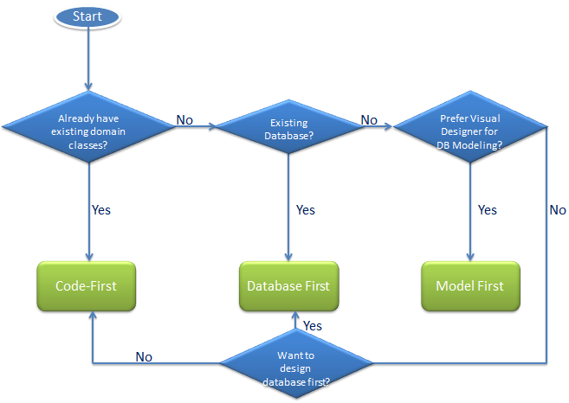
Choosing the Development Approach for Your Application
Use the following flow chart to decide which is the right approach to develop your application using Entity Framework:

Slide 34
Comparing the Model First, Database First and Code First approaches
Model First
Code First
Database First
Good support with EDMX designer
We can visually create the database model
EF generates the Code and database script
Extensible through partial classes
We can modify the model and update the generated database.
An existing database can be used
Code can be auto-generated.
Extensible using partial classes/ T4 templates
The developer can update the database manually
There is a very good designer, which sync with the underlining database
There is full control of the model from the Code; no EDMX/designer
No manual intervention to DB is required
The database is used for data only

Slide 35
Advantages of Entity Framework
It provides auto generated code
It reduce development time
It reduce development cost
It enables developers to visually design models and mapping of database
It provides capability of programming a conceptual model.
It provides unique syntax (LINQ / Yoda) for all object queries whether it is database or not
It allow multiple conceptual models to mapped to a single storage schema
It’s easy to map business objects (with drag & drop tables).

Slide 36
Disadvantages of Entity Framework
Lazy loading is the main drawbacks of EF
Its syntax is complicated
Its logical schema is not able to understand business entities and relation among each other
Logical schema of database is not capable of using certain parts of application
It is not available for every RDMS
Need to handle data in nontraditional way
It does not work if we change any schema of the database. We need to update the schema on the solution.
It is not good for huge domain model.

Slide 37


THANK YOU

