Slide 1
Web User Interface
HTML,CSS & JAVASCRIPT

Slide 2
Enabling Objectives
After completing this chapter, you will be able to explain about the basics of Web User Interface

Slide 3
Key Topics
HTML
CSS
JavaScript

Slide 4
HTML

Slide 5
HTML
Stands for Hyper Text Mark Up Language
It is a mark up language for designing web pages.
HTML pages can be viewed using any web browsers.
Cannot perform any programming logic.
HTML pages developed using mark up tags enclosed in angular
brackets(<tag>)
Can be developed using normal text editors like notepad/wordpad or
tools like dreamweaver, front page.
File extension is “.html” (or) “.htm”

Slide 6
Identify the applications and benefits of HTML
http://www.vtech-seo.com/web-design-articles/advantages-of-html.html

Slide 7
What is an HTML mark up tag ?
HTML mark up tags called as HTML elements are the building blocks of any HTML document
HTML tags occurs in pairs called the opening and closing tag
Tag Syntax:
<tag attributes>Content</tag>
Attributes : Provide additional behavior to the tags
Content : The text content to be displayed in the page

Slide 8
Basic HTML Structure
<html>
<head>
…………
…………
</head>
<body>
…………
…………
</body>
</html>
Basic Structure of a HTML file.

Slide 9
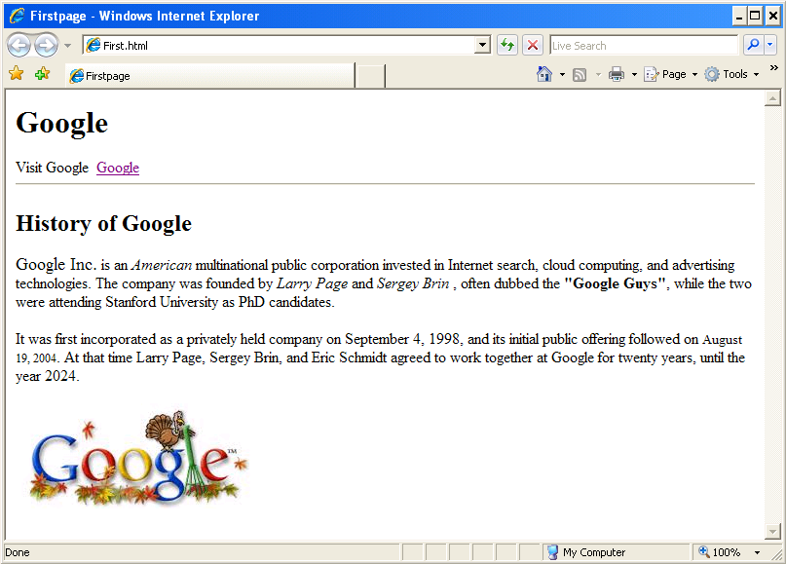
Lets work together to build this page

Slide 10
Learn How
Ready to Develop ?
We will do some initial steps before we start
Open notepad, create a new text file.
Save it as MyFirstPage.html.
Further Steps:
As we go through each HTML tags we will add that tag in our MyFirstPage.html

Slide 11
Demonstrate usage of Header, Footer and Section tags appropriately
https://www.w3schools.com/html/html5_semantic_elements.asp

Slide 12
Root, Head and Body Tags
HTML Root Tag : Encloses the entire HTML document, this is the root element.
<html>
</html>
Head Tag : Container for all head elements like title, scripts, meta information etc
<head>
………
</head>
Body Tag : This holds the other tags and the content which needs to be rendered
on the browser.
<body>
</body>

Slide 13
Heading Tag
Heading tags are used to define headings in HTML pages,
There six heading tags <h1> to <h6>
<h1> Denotes the most important heading
<h6> Denotes the least important heading.
Syntax:
<h1 id=“heading1”> This is heading 1<h1>
Where “id” is the attribute used for accessing the element.

Slide 14

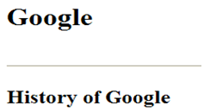
Try It out – Lets play With Headings
Add the following headings to first.html
Main Heading – Google
Sub Heading – History of Google

Slide 15
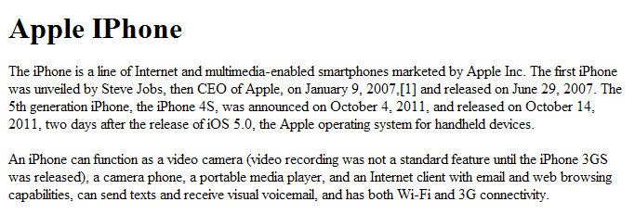
Paragraph tag
This tag is used to format texts as paragraph
Inserts a line before and after each paragraph tag
Syntax :
<p id=“ID”>Paragraph Content goes in here </p>
Paragraph 1:
One line appears between the heading and paragraph 2
Paragraph 2
15

Slide 16
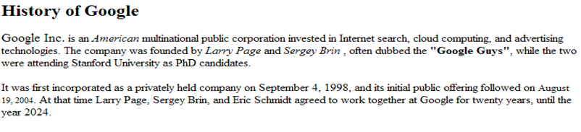
Lend a Hand: Adding Paragraph
Add two paragraphs below the sub heading “History Of Google”.
The content can be anything about Google.
16

Slide 17
Lists
Lists are used to list items in an HTML page.
Two flavors Of List,
Ordered Lists
Unordered Lists
17

Slide 18

Ordered Lists
Definition: Delineates a list, where the items are in sequential, numerical order
Syntax :
<ol>
<li>List Item1</li>
<li>List Item2</li>
<li>List Item3</li>
</ol>
Example :
<ol>
<li>Apple</li>
<li>Orange</li>
<li>Mango</li>
</ol>

Slide 19

Un Ordered Lists
Definition: delineates a list, where the items are generally of equal importance and they are listed in bullets.
Syntax :
<ul>
<li>List Item1</li>
<li>List Item2</li>
<li>List Item3</li>
</ul>
Example :
<ul>
<li>Apple</li>
<li>Orange</li>
<li>Mango</li>
</ul>

Slide 20
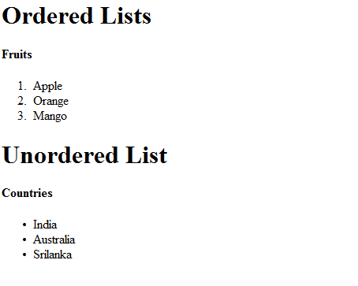
Lend a Hand - Lists
Create a set of Ordered and Unordered lists as illustrated below
20

Slide 21
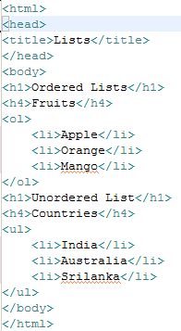
Lend a Hand - Solution

Slide 22

Anchor Tag
Anchor tag(<a>) is used for creating hyperlinks which is a word or group of words. Hyperlink when clicked opens a new web page or web site or move to a section within the same document.
Anchor tag can be used for two purposes:
To create a link to another document
To create a bookmark inside a document
Syntax :
<a href=“url” >Click me</a> url – refers to the page which needs to open when the text ”Click Me” is clicked.
Example :
<a href=“http://www.google.com”>Link to Google Site </a>

Slide 23
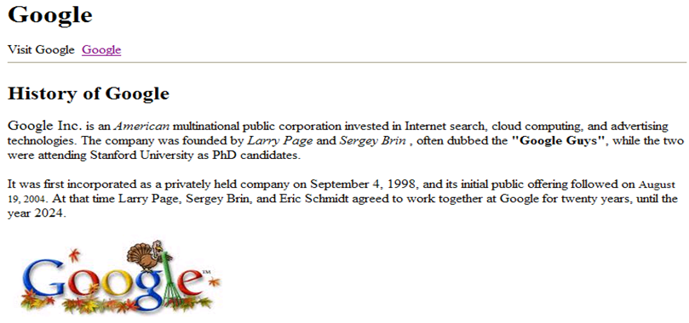
Try It Out: Lets add a Anchor and a Image tag
Add the following to the
Add a link Google below the main heading.
Add an image below the paragraph.

Slide 24
Table tag
Table tag is used to represent data in rows and columns in an HTML page.
The <table> </table> is used for creating a table.
The following are the table tag elements that are used for creating the grid.
<TR> - This is used for creating the row of he HTML table.
<TD> - This is used for creating the columns of the HTML tables.
<TH> - This is used to create the header row of the table.
The heading column is created using TH.
The data cells created using TD
All the three rows will be created using the <TR> tag.
User Name | Contact # | Column Heading 3

Slide 25
Syntax: Table tag
Syntax
<table id=“id”>
<caption>TableName</caption>
<tr>
<th>ColumnName1</th>
<th>ColumnName2</th>
<tr>
<tr>
<td>Data1</td>
<td>Data2</td>
<tr>
<tr>
<td>Data1</td>
<td>Data2</td>
<tr>
</table>
Example
<table id=“users”>
<caption>User Details</caption>
<tr>
<th>Username</th>
<th>Contact Number</th>
<tr>
<tr>
<td>Arun</td>
<td>9568748756</td>
<tr>
<tr>
<td>Rose</td>
<td>9254796541</td>
<tr>
</table>
25

Slide 26
Demonstrate usage of Blocks and Inline to align content within the document
https://www.w3schools.com/html/html_blocks.asp

Slide 27
HTML Forms

Slide 28
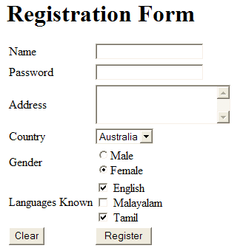
What are HTML Forms?
HTML Forms are user interface through which users inputs data and communicates with the web applications.
HTML Form
Sample

Slide 29
Need for HTML form
Why do you need a HTML Form?
Forms contain form fields (or) elements which are components used to accept inputs from the user.
Form elements example: Textbox, Label, Button etc.
A form is simply an area where form fields can be placed.
The data from the forms are sent to the server where it is read by the server using server side scripts/ CGI scripts Common Gateway interface.

Slide 30
Form Tag
Forms are created using form tags <form></form>.
Syntax:
<form method=“method” action=“action Name”>
//Form Elements
</form>
The Form elements are defined
between these tags.
You will learn more about “method” and “action” attribute in the next slides.

Slide 31
What is action attribute ?
Action Attribute specifies “where” to send the data when the user submits the form.
Specifies which component is going to handle the form at the server
This specifies the server side component which is going to process the request.
Server Side component Example : Servlets, Struts , JSF.
Example :
<form action=“LoginServlet”>
//Form Controls goes in here
</form>
Here when the user submits the form it will be handled by a Login servlet running inside a web server
31

Slide 32
Form Tag
Forms are created using form tags <form></form>.
Syntax:
<form method=“method” action=“action Name”>
//Form Elements
</form>
The Form elements are defined
between these tags.
You will learn more about “method” and “action” attribute in the next slides.
32

Slide 33
What is action attribute ?
Action Attribute specifies “where” to send the data when the user submits the form.
Specifies which component is going to handle the form at the server
This specifies the server side component which is going to process the request.
Server Side component Example : Servlets, Struts , JSF.
Example :
<form action=“LoginServlet”>
//Form Controls goes in here
</form>
Here when the user submits the form it will be handled by a Login servlet running inside a web server

Slide 34
What is method attribute ?
Method attribute are used to specify “how” to send the form data to the server.
The methods are,
Get : Form data is sent via the URL with appended to the URL.
URL data is referred to as query String.
Post : Form data is sent in the body of the HTTPrequest.
The default method value is “Get”
Example:
<form action=“LoginServlet” method=“post”>
//Form controls are implemented here.
</form>

Slide 35
GET Vs POST
GET | POST
As the data is sent through the URL, there are limitation in the size of data sent. | There is no limitation in the data size sent.
Since the data is sent in URL it is visible to the user, this cannot be used for sending secured data. | The data is sent along with the HTTP request body so this method is secured.
GET URL Example:
http://www.domain.com/forms.html?username=admin&password=admin
The form field values are sent as key/value pairs key=value.
Where the userName & password are the HTML form element attributes are sent as key and the values are depicted in brown color font.
35

Slide 36
Form Controls
Form Controls or form elements are used to accept input from the user.
They are the basic building blocks of forms in HTML pages.
The basic form controls are
Text box
Password field
Text Area
Drop Down Menu
Radio Button
Check Box
Buttons

Slide 37
Lend a Hand – Create a HTML
Lets create an user registration form with controls.
To start with lets all create a empty registration.html
NOTE: On completion of each form control we will add the control to registration.html. Use table for aligning the controls, add additional columns and rows to the table wherever required

Slide 38
Name and ID attribute for a form Control
A form control can have a name and id attribute.
<formcontrol name=“name” id=“id”><formcontrol>
- name attribute is used to refer the control at the server side using
Server side script.
- id attribute is used to refer the control at the client side using
Client side scripts and CSS

Slide 39
Label Tag
A label tag is used to label a form control.
Binds text to the form control.
Uses for attribute to bind to a particular form control, where the value is the id of the form control.
Clicking the label text activates the appropriate form control.
Usage :
<label for=“elementID”>Text</label>
<formcontrol id=“elementID” />

Slide 40

Text Box
Used to accept single line of text from the user.
Example of Text Fields: Name , Username, Phone number
40

Slide 41
How To Create a Text Box ?
To create a text box we use <input> tag
Syntax :
<input type =“text” name=“textName” id=“id” value=“defaultValue”/>
Example :
<input type =“text” name=“userName” id=“userName”
value=“Enter user Name”/>

Slide 42
Optional Attributes for Textbox
Size - Specifies the visible width, characters displayed.
Maxlength - Specifies the maximum number of characters allowed.
Tabindex - Sets the tab order for the control.
Value - Default value for the textbox.

Slide 43
Lend A Hand – Text Fields
Lets all add a user name field to the registration form,
Create a label username in registration.html
<label>Name</label>
Create a textbox in registration.html
<input type =“text” name=“userName” id=“userName” />
Set the for attribute of the label . The value should be the text box’s ID
<label for=“userName”>Name</label>
Place the form fields inside a table tag, like
<table><tr>
<td> <label for=“userName”>Name</label></td>
<td> <input type =“text” name=“userName” id=“userName” /> </td>
</tr> </table>

Slide 44
Password Field
Used to accept secure data from the user which should be displayed
on the screen.
Uses : Passwords, ATM pin number etc
44

Slide 45
How To Create a password field?
To create a text box we use <input> tag
Syntax :
<input type =“password” name=“Name” id=“id” />
Example :
<input type =“password” name=“password” id=“password”
value=“Enter user Name”/>

Slide 46
Optional Attributes for password field
Size - Specifies the visible width, characters displayed.
Maxlength - Specifies the maximum number of characters allowed.
Tabindex - Sets the tab order for the control.
Value - Default value for the textbox.

Slide 47
Lend a Hand – Password Fields
Add the Password field to the registration form,
Create a label username in registration.html
<label>Password</label>
Create a password field in registration.html
<input type =“password” name=“password” id=“password” />
Set the for attribute of the label . The value should be the password field’s ID.
<label for=“password”>Password</label>
Place the form fields inside a table tag, like
<tr>
<td> <label for=“password”>Password</label></td>
<td> <input type =“password” name=“password” id=“password” /></td>
</tr>

Slide 48
Hidden Fields
Hidden fields are similar to text field but does not show on the page. Therefore, the visitor cannot type anything into a hidden field.
When used?
Used to submit information that is not entered by the visitor.
Used as mechanism for carrying information between pages.

Slide 49
How to create a Hidden field ?
To create a hidden field we use <input> tag
Syntax :
<input type =“hidden” name=“Name” id=“id” />
Example :
<input type =“hidden” name=“userType” id=“userType”
value=“Administrator”/>
The name setting adds an internal name to the field so the program that handles the form can identify the fields.
The value setting defines what will be sent once the form is submitted.

Slide 50
Lend a Hand : Hidden Field
Add the Hidden field to the registration form,
Create a password field in registration.html
<input type =“hidden” name=“userType” id=“userType”
value=“administrator” />
View the page in the browser.
The hidden field will not be seen in the page.
NOTE: This need not be included in the table tag.

Slide 51

Text Area
Used to accept multiline text input from the user
Used for Fields: Address , Description etc
51

Slide 52
How to create a Text Area ?
To create a text area we use the <textarea> tag
Syntax:
<textarea name=“name” id=“id” cols=“columnCount”
rows=“rowCount”></textarea>
Example :
<textarea name=“address” id=“address” cols=“10” rows=“4”>
</textarea>

Slide 53
Optional Attributes for text area
Rows - Specifies the number of rows.
Cols - Specifies the number of columns.
Wrapoff - Turns off line breaking.
Tabindex - sets the tab order for the control.
Virtual - Shows line breaking, but sends text as entered.
Physical - Inserts line breaks when needed and even sends it.

Slide 54
Lend a Hand – Text Area
Add the Address field to the registration form,
Create a label username in registration.html
<label>Address</label>
Create a text area in registration.html
<textarea name=“address” id=“address” cols=“10” rows=“4”>
</textarea>
Set the for attribute of the label . The value should be the text area’s ID.
<label for=“address”>Address</label>
Place the form fields inside a table tag, like
<tr>
<td> <label for=“address”>Address</label></td>
<td> <textarea name=“address” id=“address” cols=“10” rows=“4”>
</textarea>
</td> </tr>

Slide 55

Check Box
Check boxes are used when you want to let the visitor select
one or more options from a set of alternatives.
55

Slide 56
How To Create a Check box?
To create a text box we use <input> tag
Syntax :
<input type =“checkBox” name=“Name” id=“id” value=“value” />
Example :
<input type =“checkbox” name=“language” id=“language1”
value=“English”/> English
<input type =“checkbox” name=“language” id=“language2”
value=“Tamil”/> Tamil
NOTE: All the check boxes should belong to the same group this is done by specifying the same name. Example: “Language”.

Slide 57
Optional Attributes for check box
Checked - Default check this field
Tabindex - Sets the tab order for the control.
Value - Value that is submitted if checked

Slide 58
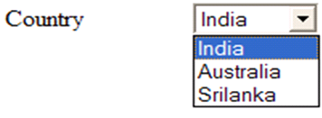
Drop Down
Drop-down menus can serve the same purpose as radio buttons (one selection only) or check boxes (multiple selections allowed).
The advantage of a drop-down menu, compared to radio buttons or check boxes, is that it takes up less space.

Slide 59
How to create a Drop Down Menu?
To create a text area we use the <select> tag. Each option is
declared inside the <option> tag.
Syntax:
<select name=“name” id=“id” >
<option value=“value”>
Option1
</option>
<option value=“value”>
Option2
<option>
</select>
Example :
<select name=“country” id=“country” >
<option value=“1” >
India
</option>
<option value=“2”>
Australia
<option>
</select>
59

Slide 60
Lend a Hand – Drop down
Add the Drop down menu to the registration form,
Create a label username in registration.html
<label>Country</label>
Create a drop down menu in registration.html
<select name=“country” id=“country” >
<option value=“1” >India</option>
<option value=“2”>Australia<option>
<option value=“3” selected=“selected” >SriLanka<option>
</select>
Place the form fields inside a table tag, like
<tr><td > <label>Country</label> </td>
<td > The drop down code snippet in point # 2 goes in here</td>
</tr>

Slide 61

Radio Button
Radio buttons are used when you want to let the visitor select one
and just one option from a set of alternatives.

Slide 62
How To Create a radio button?
To create a text box we use <input> tag
Syntax :
<input type =“radio” name=“name” id=“id” />
Example :
<input type =“radio” name=“gender” id=“male”
value=“Male”/> Male
<input type =“radio” name=“gender” id=“female”
value=“female”/> Female

Slide 63
Tips in Using Radio Button
In a radio button group, all the buttons should be given the same name to make only one button in the group getting selected. Else all the buttons can be selected which does not serve the purpose of using radio button.
The value attribute will be send to the server on page submit. It will not get printed in the html page. To display any text next to the radio button print it as normal text or using the label tag.
When a label tag is set for a radio button clicking the label enables the corresponding radio button.

Slide 64
Lend a Hand – Radio Button
Add the radio button to the registration form,
Create a label username in registration.html
<label>Gender</label>
Create a radio buttons in registration.html
<input type =“radio” name=“gender” id=“gender”
value=“Male”/> <label for=“male” >Male</label>
<input type =“radio” name=“gender” id=“gender”
value=“female”/><label for=“female”> Female</label>
3. Clicking the label text will select the corresponding radio button.
4. Place the text and radio button in TD tags similar to the check box example.

Slide 65
Buttons
Buttons are used to perform some actions in an HTML page.
There are four types of buttons in HTML,
Submit
Reset
Button
Image button

Slide 66
Submit Button
A submit button is used to submit a form to the server.
When a visitor clicks a submit button, the form data is sent to the address specified in the action setting of the <form> tag.
Syntax :
<input type=“submit” value=“value” name=“name” id=“id” />
Where, Value defines what is written on the button, Name & Id for identifying the button among other form components.
Example :
<input type=“submit” value=“Register” name=“register” id=“register” />

Slide 67
Reset Button
Used to reset the values entered in the form by the user.
A reset button resets the form control to the default values of the form components.
Syntax :
<input type=“reset” value=“value” name=“name” id=“id” />
Where, Value defines what is written on the button, Name & Id for identifying the button among other form components.
Example :
<input type=“reset” value=“Clear” name=“Clear” id=“Clear” />

Slide 68
Button
They are used for adding normal buttons.
Used to perform action with help of client side scripts.
Syntax :
<input type=“button” value=“value” name=“name” id=“id” />
Where, Value defines what is written on the button, Name & Id for identifying the button among other form components.
Example :
<input type=“button” value=“Home” name=“Clear” id=“Clear” />

Slide 69
Lend a Hand – Submit & Reset
Add a submit button with value “Register” to register.html
<input type=“submit” value=“Register” name=“register” id=“register” />
2. Add a reset button with value “Clear” to register.html
<input type=“reset” value=“Clear” name=“clear” id=“id” />
3. Fill the form and check whether clicking the reset button clears the fields to the default value.
4. Fill the form and check whether the data and click submit . Check whether the fields entered by you has been appended in the URL as query string.
5. Use table tags as mentioned below
<tr><td> Submit button code mentioned in point # 1 goes in here</td>
<td> reset button code mentioned in point # 2 goes in here</td></tr>

Slide 70

Image Button
Image button are like the submit button are used to submit a form to the server.
The difference is image button is shown as an image on the screen
whereas submit button is shown as a normal button.
Submit Image
displayed as buttons.
Submit button
70

Slide 71
How to Create image button ?
Syntax :
<input type=“image” src=“source” name=“name” />
Where “src” is the path of the image GIF.
Example :
<input type=“submit” src=“submit.gif” name=“search” />

Slide 72
Hands On Exercise
Perform the following tasks,
Create a form as shown in the next slide alignment should be done proper using table tags.
Title should be “Apply for Credit Card”.
The labels should be properly bind to the controls.
The “First/Last name” text fields should display max of 12 characters and should not allow more than 10 characters.
Only one radio button option should be selected for sex.
Should be able to select multiple options in the “Language Known” drop drown.
The default value in dropdown should be “select”
The values in drop down are “English, Hindi, Tamil, Malayalam, Telugu”.
The address field should have 4 rows and 10 columns
The check box group should have four hobbies Singing, Dancing, Sports and Others.
There should one submit button named “Apply Card” and one reset button named “Clear Fields”

Slide 73
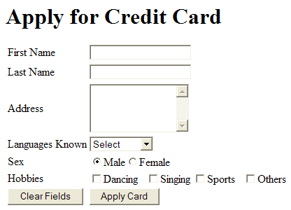
Required Screen

Slide 74
List the options available in HTML5 form fields
https://www.w3schools.com/html/html_form_input_types.asp https://www.w3schools.com/html/html5_new_elements.asp

Slide 75
CSS

Slide 76
What is CSS?
CSS Stands for Cascading Style Sheets.
It is used for applying styles to HTML elements
Example: Font bold, Italics, Page back ground color.
It also isolates the page content from the style, thus helps the developers
Advantages:
To easily maintain the HTML pages.
To reuse the same style in multiple pages thus reduces the development effort.

Slide 77
Explain the need and benefits of CSS
https://www.w3schools.com/css/css_intro.asp

Slide 78
How CSS is applied ?
Syntax:
selector { property :value ; property :value; }
Where Selector can be a,
Tag : Applies the style to all the tags of the specific type.
h1{color:red;} -- makes all Level 1 headings red
Tag id : For applying to a single/unique element. Starts with ‘#’.
#m1 {color:red;} -- makes color of element with id “m1” as red.
<h1 id=“m1">Center-aligned heading</h1>
Tag class : For applying styles to more than one element. Starts with ‘.’ Element should be declared with the class attribute.
.headings{color:red;} --makes the color of elements with class name “headings” as red.
<h1 class=“headings">Center-aligned heading</h1>
<p class="headings">Center-aligned paragraph.</p>

Slide 79
Three Ways to apply CSS
Three ways to apply CSS
Inline Style
Internal Style
External Style
Inline Style: The Style is declared inline in the html tag.
Example
<h1 style=“color: red;”>Red Heading </h1>
<body style=“background-color: red;”>Red Heading </body>
Disadvantages:
This mixes the content with the style , should be avoided

Slide 80
Internal Style Sheet
The styles are written inside the head tag.
<html>
<head>
<style type="text/css">
body{
background-color:Gray;
}
#main{
color:green;
}
.subheadings{
color:brown;
}
</style>
</head>
<body>
<h1 id="main">Main Heading</h1>
<h2 class="subheadings">SubHeading 1</h2>
<h3 class=" subheadings ">SubHeading 2</h3>
</body>
</html>
Page Back ground changed to gray
Main Heading color changed to green
All sub headings color changed to brown
80

Slide 81
Lend a Hand – Internal Style Sheet
Create an HTML file named CSSDemo.html and add the following code and run it.
<html>
<head>
<style type="text/css">
body{
background-color:Gray;
}
#main{
color:green;
}
.subheadings{
color:brown;
}
</style>
</head>
<body>
<h1 id="main">Main Heading</h1>
<h2 class="subheadings">SubHeading 1</h2>
<h3 class=" subheadings ">SubHeading 2</h3>
</body>
</html>
81

Slide 82
External Style Sheet
The styles will be written in a separate .css file and included in the HTML file. This is the ideal way as the same style can be reused in multiple pages
<html>
<head>
<link rel="stylesheet" type="text/css" href=“styles.css" />
</head>
<body>
<h1 id="main">Main Heading</h1>
<h3 class="subheadings">SubHeading 1</h3>
<h3 class=" subheadings ">SubHeading 2</h3>
</body>
</html>
CSS File included in the HTML page.

Slide 83
Lend a Hand – External Style Sheet
Steps :
Step 1:Move the inline style from CSSDemo.html to styles.css
Step 2:Import styles.css into CSSDemo.html
Style.css
CSSDemo.html
body{
background-color:Gray; }
#main{ color:green;
}
.subheadings{ color:brown;
}
<html>
<head>
<link rel="stylesheet" type="text/css" href=“styles.css" />
</head>
<body>
<h1 id="main">Main Heading</h1>
<h3 class="subheadings">SubHeading 1</h3>
<h3 class=" subheadings ">SubHeading 2</h3>
</body>
</html>
83

Slide 84
What happens if multiple styles are applied?
When multiple styles are applied in a single HTML the priority in which the styles will be applied as follows.
Priority 1: Inline Style
Priority 2: Internal Style
Priority 3: External Style
Priority 4: Browser default

Slide 85
Try it Out
Refer this URL for the styles to be applied,
http://www.w3schools.com/css/css_background.asp
Create a HTML and apply the styles
Create a page “home.html” with gray back ground
Create a Main Heading “My First HTML” with Blue Color
Place an image in the page. The image size should be 200x200.
Create links home, profile, logout.
The non visited links should be in brown color.
The visited links should be green color.
When the mouse moves over the link color should be orange .
Create two paragraphs with brown color and font-style italic. The second paragraph should have the text underlined.
Use external CSS for link, image and paragraph styles.

Slide 86
Demonstrate usage of various selectors
https://www.w3schools.com/css/css_syntax.asp

Slide 87
Explain Box Model in CSS
https://www.w3schools.com/css/css_boxmodel.asp

Slide 88
Demonstrate formatting text alignment, fonts and colors
https://www.w3schools.com/css/css_text.asp

Slide 89
JAVASCRIPT

Slide 90
The need of client side scripting?
A client side script is a small program which is executed by the browsers.
Examples : Javascript , VBscript
Need of client side script?
For validating the user data before it reaches the server.
Example: Login name and password fields are mandatory in a login page. Validation can be done by java script.
Perform some dynamic functionality based on user navigations.
Example:
User hovers above a image, dynamically changes the image.
Disable the salary text field if user selects unemployed radio button.

Slide 91

How client side script works?
A user from India is trying to login a mail application residing in US.
Assume that the user forgets to enter the login name and clicks submit.
Java Script in Browser validates the data.
User submits the login page.
Server throws an error
“login name Mandatory”
Server
(UK)
User
(India)
Server validates the login page
No Client side scripting : If each transaction (arrow depicted) takes 3 seconds the total transaction takes 9 seconds.
Client side script implemented: server calls will not happen if the user data is wrong. Assuming script validation takes 1 second for the validating the login name the transaction could be completed in 1 second (reducing the response time by 90%).

Slide 92
What is Java Script?
JavaScript is a client side scripting language which can be used to perform client side operations. Java scripts are executed by the browser engine.
Example:
Validations in fields
Show tool tips
Perform some operations on mouse click.
Change a font color on mouse over.

Slide 93
Advantages of Java Script
Java Script is used for performing the basic sanity checks on the user request before it is submitted to the server, thus improving the transactions response time.
This also reduces the load on the server as some logic is executed by the client browser.
This also reduces the network traffic by ensuring that no invalid user requests are transmitted over the network.

Slide 94
Uses Of Java Script?
Client side validation
Examples: Check for mandatory fields, numeric validation in salary field.
Dynamic application of styles
Examples: Change the font color of a text dynamically.
JavaScript can react to events like onclick , onblur, onfocus etc
Examples: Perform a validation on Click. On focus of a text box clear the values.

Slide 95
Demonstrate handling events for validations
https://www.w3schools.com/jsref/event_onclick.asp

Slide 96
How to develop a java script function ?
Java Script are developed using the <Script> </Script> tag. Functions are like java methods which executes a specific logic.
A simple function to print the date:
<script type="text/javascript">
function printDate(){ document.write("<p>" + Date() + "</p>");
}
</script>

Slide 97
Use functions to handle form validations
https://www.w3schools.com/js/js_functions.asp

Slide 98
Values & Variables
Java Script variables does not have explicit data types. Example: Variables need not be declared as integer, a string or a real.
All JavaScript variables are declared using the keyword var.
Example: var x=7 // defines a variable x with value 7.
JavaScript recognizes the data type based on the value
var pi = 3.14 – pi is considered a number by the java script engine.
var flag = true – flag is considered a boolean variable.
var countryName = “India” – This will be considered as a string.

Slide 99
Values & Variables (Cont)
A JavaScript identifier or name must start with a letter or underscore ("_“) subsequent characters can also be digits (0-9)
Variables Scope:
Local variable are declared inside a function
Global variable are declared outside a function
Applying var to declare a global variable is optional but var is mandatory for local variables.

Slide 100
JavaScript DOM
JavaScript is designed on a simple object-based paradigm.
An object is a construct with properties (variables),methods or other objects.
JavaScript uses an object model known as Document Object Model (DOM) to navigate through the HTML document in an hierarchy.

Slide 101
Document Object
Each HTML document loaded into a browser window becomes a Document object.
DOM represents HTML elements in a Tree structure.
Every elements in a HTML document is represented as a node.
DOM can be used to change, add, or delete HTML elements.
Java Script access elements of the HTML document using the document object.
DOM nodes accessed through the following methods,
getElementById() : Returns the element specified by the ID
getElementsByTagName() : Returns the list of elements with the specified tag name.
For more Details on DOM visit
http://www.w3schools.com/htmldom/default.asp

Slide 102
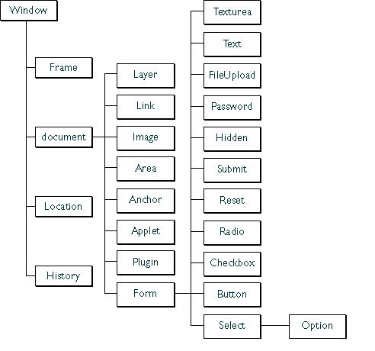
HTML DOM Structure
The nodes in the node tree are placed in a hierarchy.
The terms parent, child, and sibling are used to describe the relationships.
Parent nodes have children.
Children on the same level are called siblings, are nodes with the same parent.
In a node tree, the top node is called the root.
Every node, except the root, has exactly one parent node.
A node can have any number of children .
A leaf is a node with no children.
Elements can be accessed by moving through the tree nodes. Example: To access the text field element we use document.form.text.
102

Slide 103
Accessing Elements Using getElementsByTagName
getElementsByTagName() retrieves all the elements with a specified tag name.
Scenario: Assume that there is a HTML with many paragraph elements <P></P>.
How can one access the first paragraph tag in the document?
document.getElementsByTagName("p")[0];
Where,
document.getElementByTagName(“p”) return a list of all the paragraph tags in the page and index [0] returns the first tag in the list.
How read the contents inside the first paragraph tag in the document?
var content=document.getElementsByTagName("p")[0].innerText;
103

Slide 104
Accessing Elements Using getElementsByName
getElementsByName() method used for accessing a specific element using its name.
var choice=document.getElementsByName(“hobby”); Gets all the elements with the name “hobby”.
Individual elements can be accessed from the collection using the index.
hobby[0] returns the first element in the collection choice
Length property gives the number of elements in the collection can be used to iterate through the entire list of elements.
Value of the individual elements can be retrieved using the value property.
Scenario : Assume “hobby” is the name of a collection of check boxes with values “Singing, Dancing, Cricket” in a html page.
How to identify which hobbies are selected?
var choice=document.getElementsByName(“hobby”);
for(var i=0;i<choice.length;i++){
alert(choice[i].checked);}
This iterates through the hobbies check boxes and using the checked attribute and alerts whether it is checked or not.
104

Slide 105
How To Access Fields using getElementById() method
To access the form fields we use the method document.getElementById().
Example of Fields: Text box, Radio button, Check box , text area etc.
Syntax : document.getElementById(elementID) // This retrieves the element whose id matches the id passed as parameter. “Id” here refers to the ID attrbute of the form element.
Example: How to access a text field “user name” whose id is “username”.
document.getElementById(“username”)

Slide 106
How to access and set values of form elements
To retrieve the value of an element we use the attribute “value”.
Syntax:
// retrieves the value
var variableName=document.getElementById(elementId).value
// Sets the value
document.getElementById(elementId).value = value To Be Set.
Example:
//This retrieves the value from the text field “userName”
var userName=document.getElementById(“username”).value
//This sets the value of username as “Arun” in the text field “userName”
document.getElementById(“username”).value=“Arun” ;

Slide 107
String Object
The String Object type provides a set of methods for manipulating strings.
Example: var string1=“Hello World” and var string2=“JavaScript”
Method | Description | Example
charAt(index) | Returns the character at the specified index | string1.charAt(0) returns “H”
charCodeAt(index) | Returns the Unicode of the character at the specified index | string1.charAt(0) returns 72 which is the Unicode value for “”H
fromCharCode(unicode1,unicode2) | Converts Unicode values to characters | String.fromCharCode(72,69,76,76,79)) returns “HELLO” where the numbers 72,69,76,79 are the Unicode's of the letters H,E,L and O respectively.
indexOf(string) | Returns the position of the first found occurrence of a specified value in a string | string1.indexOf(“World”) returns 6
lastIndexOf(string) | Returns the position of the last found occurrence of a specified value in a string | string1.lastIndexOf(“o”) returns 7
107

Slide 108
String Object Methods
Method | Description | Example
match(regEx) | Searches for a match between a regular expression and a string, and returns the matches | Visit the below link for details on using regEx. http://www.w3schools.com/js/js_obj_regexp.asp
replace(stringA,StringB) | Searches for a match between a substring (or regular expression) and a string, and replaces the matched substring with a new substring | string1.replace(“World”,”John”) returns “Hello John”
search(regEx) | Searches for a match between a regular expression and a string, and returns the position of the match | Visit the below link for details on using regEx. http://www.w3schools.com/js/js_obj_regexp.asp
substr(start,length) | Extracts the characters from a string, beginning at a specified start position, and through the specified number of characters. length is optional in that case the rest of the string from the starting index is returned. | string1.substr(3,4) returns “lo w”
substring(start,stop) | Extracts the characters from a string, between two specified indices excluding the stop index. stop index is optional in that case the rest of the String starting from the start index is returned. Negative values become zero. if start > end, the arguments are swapped | String1.substring(3,5) returns “lo”
108

Slide 109
String Object Methods
Method | Description | Example
slice() | Returns a portion of the string from position start to, but not including position end. Normally Works similar to substring() method but for negative arguments it means go backwards from the tail. | String.slice(4,-2) returns “o wor” that is from 4th index to 2nd position from the tail.
toLowerCase() | Converts a string to lowercase letters | string1.toLowerCase() returns “hello world”
toUpperCase() | Converts a string to uppercase letters | String1.toUpperCase() returns “HELLO WORLD”
concat(string) | Joins two or more strings, and returns a copy of the joined strings | string1.concat(string2) returns “Hello WorldJavaScript”

Slide 110
Use methods in String object viz., length(), trim()
https://www.w3schools.com/js/js_string_methods.asp

Slide 111
Conditional Statements: If..else
Definition: Used to execute some code if the condition is true and another code if the condition is false.
Syntax
Example
if (condition){
//code to be executed if condition is true
}
else
{
//code to be executed if condition is not true
}
if (a>b){
document.write(“a is greater than b”);
}
else
{
document.write(“b is greater than a”);
}

Slide 112
Conditional Statements: If..else if ..else
Syntax
Example
if (condition){
//code to be executed if condition is true
}
else if (condition2) {
//code to be executed
}
else {
//code to be executed
}
var time=16;
if (time<11){
document.write(“Good Morning”);
}
else if (time<15) {
document.write(“Good Noon”);
}
else {
document.write(“Good Evening”);
}

Slide 113
Conditional Statements: Switch
Definition : Used to select a particular block of statements based on the user choice. Similar to if..Else..If Statement.
Syntax
Example
switch(n) {
case 1:
//execute code block 1
break ;
case 2:
//execute code block 2
break ;
default:
//code to be executed if n is different from case 1 and 2
}
Var n=2;
switch(n) {
case 1:
document.write(“one”);
break ;
case 2:
document.write(“Two”);
break ;
default:
document.write(“invalid choice”);
}

Slide 114
Conditional Statements: For Loop
Definition : Used for iterating through a block for the specified number of times.
var initval;
for(initval=startvalue;initval<=endalue;initval=initval+incrval)
{
//code to be executed in loop
}
var i;
for(i=1;i<=10;initval=initval+1)
{
document.write(i);
}

Slide 115
Conditional Statements: while and do while Loop
While Loop: The while loop iterates through a block of code till a specified condition is true.
while (initval<=endvalue)
{
//code to be executed in loop
}
var i=1;
while (i<=10)
{
document.write(i);
}
Do..While : The do...while loop is a variant of the while loop. This loop will execute the block of code atleast ONCE, and then it will repeat the loop as long as the specified condition is true.
var i=1;
do {
document.write(i);
} while (i<=10);
do {
//code to be executed in loop
} while (var<=endvalue);

Slide 116
Expressions
JavaScript expressions are similar to expressions in any other programming language.
Three types of expressions:
Arithmetic: evaluates to a number. Example : var sum = a + b;
String: evaluates to a character string. Example : var name ="Fred“;
Logical: evaluates to true or false. Example : var flag = a>b;
Conditional Expression: A conditional expression can have one of the two values based on a condition.
Syntax: var value=(condition) ? val1 : val2
If condition is true, the expression has the value of val1, Otherwise it has the value of val2.
Example: status = (age >= 18) ? "adult" : "minor”
Assigns the value "adult" to the variable status if age is eighteen or greater. Otherwise, it assigns the value "minor" to status.

Slide 117
Operators
JavaScript operators are similar to the operators in any other programming language.
JavaScript supports the following types of operators
Arithmetic – Example: +, *
Bitwise – Example: ^, &
Comparison – Example: >, < and !=
Assignment - Example: =
Logical - Example: &&, ||

Slide 118
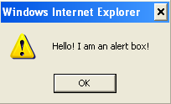
Pop up windows
Pop ups are small windows used for either getting user input (or) displaying alert messages. There are three types of popup boxes
1. Alert Box
Generally, the alert() method is used to warn the user on something.
Example of usage:
Displayed when incorrect information input in a form.
An invalid result from a calculation.
A warning that a service is not available on a given date.
Syntax:
alert(“Hello ! I am an alert box!”)
When an alert box pops up, the user will have to click "OK" to proceed.
118

Slide 119
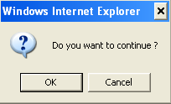
Pop Up Window – Confirm Box
A confirm box is often used if you want the user to verify or accept something.
When a confirm box pops up, the user will have to click either "OK" or "Cancel" to proceed.
If the user clicks "OK", the box returns true. If the user clicks "Cancel", the box returns false.
Syntax:
var value=confirm(“Confirm Text ?”)
Example:
var value=confirm(“Do you wish to continue ?”)
119

Slide 120
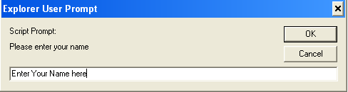
Pop Up Window- Prompt Box
A prompt box is often used if you want the user to input a value before entering a page.
When a prompt box pops up, the user will have to click either "OK" or "Cancel" to proceed after entering an input value.
If the user clicks "OK" the box returns the input value. If the user clicks "Cancel" the box returns null.
Syntax:
var variable= prompt(“Prompt Text", “Default Value") ;
Example:
var name=prompt("Please Enter your name", "Enter Your Name Here") ;
120

Slide 121
Use form object to submit the form
https://www.w3schools.com/jsref/dom_obj_form.asp

Slide 122
Recap
In this chapter, we have learnt about:
HTML
CSS
Javascript

Slide 123
You have successfully completed –
Learning on basics of Web User Interface

