Slide 1
Getting Started with ADO.Net 4.5

Slide 2
A programming language does not understand syntax and structure of other programming language but if it is required to interact from one to another programming language, there will be one mediator which will help them to interact without any problem.

Slide 3
ADO stands for active data object, which behaves as a mediator between the client side and server side. Client side can’t directly interact with the server side, so there is ADO.NET which behaves as a mediator between front end and back end as in the following figure:

Slide 4
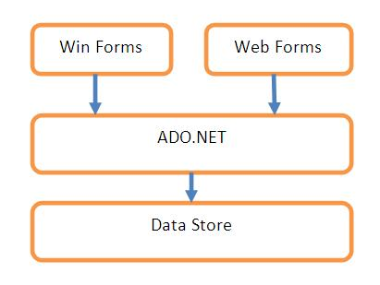

Slide 5
The diagram shows that ADO.NET can be used with any kind of application, i.e., it can be used from a Windows Forms application, an ASP.NET application, or from a WPF and/or Silverlight application.
Also, the data store underneath can be any data store, SQL Server, Access, or Oracle.
It is just a matter of using the right set of classes specific to that data store and the methodology will remain the same.

Slide 6
In a typical scenario requiring data access, we need to perform four major tasks:
Connecting to the database
Passing the request to the database, i.e., a command like select, insert, or update.
Getting back the results, i.e., rows and/or the number of rows effected.
Storing the result and displaying it to the user.

Slide 7
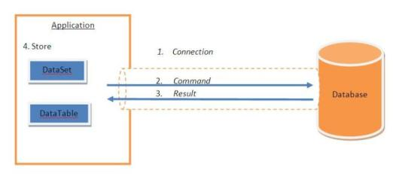

Slide 8
Classes in ADO.NET
ADO.NET is a group of class which contains.
Connection
Command
Datareader
DataAdapter
Dataset

Slide 9
Connection
Connection class used to establish the connection between front end and back end
The Connection class uses a ConnectionString to identify the database server location, authentication parameters, and other information to connect to the database.
Ex.
SqlConnection con=new SqlConnection(“Integrated security=true;initial catalog=Student;Data source=.
OR
SqlConnection Con=new SqlConnection(“User id=sa;Password=sa123;Database=Student;Server=.”);

Slide 10
Command
Once we have the connection ready, the next step would be to tell the database about what operation we need to perform on the database.
This can be done using the Command object.

Slide 11
SqlCommand cmd=new SqlCommand(“Query which has to perform”,Connection Object)

Slide 12
cmd = con.CreateCommand(); // This will specify that we are passing the stored procedures name cmd.CommandType = CommandType.StoredProcedure; cmd.CommandText = CommandName; // This will be the stored procedures name

Slide 13
If the Stored Procedure is expecting some parameters then we can pass these parameters by creating instances of SqlParameter objects as:
SqlCommand cmd = con.CreateCommand(); // This will specify that we are passing the stored procedures name cmd.CommandType = CommandType.StoredProcedure; cmd.CommandText = CommandName; // This will be the stored procedures name SqlParameter param = new SqlParameter("@id", txtSearch.Text); cmd.Parameters.Add(param);

Slide 14
Passing a SQL query from an application using a Command
If we want to pass a SQL query from our application then we can use the SqlCommand as:
SqlCommand cmd = con.CreateCommand(); cmd.CommandType = CommandType.Text; //This will specify that we are passing query from application string query = "select * from Authors"; cmd.CommandText = query;

Slide 15
Storing the Result
DataReader: DataReader used to read the data from source.
Dataset: DataSet contains the table and relation.
DataAdapter: DataAdapter behave as mediator between back end and front end. But it does not has features to contains the data .So there is dataset which contains the data of result set.

Slide 16
DataReader
A DataReader is an object that can be used to access the results sequentially from a database. The DataReader is used to get forward only sequential results as the query executes. This is used with the Command object

Slide 17
Dataset
The Dataset can be thought of as an in-memory representation of a database.
A DataSet is a disconnected data access object.
The result of the query can be stored in a Dataset.
The DataSet contains DataTables.
The DataTables contain DataRow and DataColumns.
A DataSet or a DataTable can be used with a Command and a DataAdapter object to store query results.

Slide 18
DataAdapter
A DataAdapter object is used to fill a DataSet/DataTable with query results.
This can be thought of as the adapter between the connected and disconnected data models.
A Command object will be used to execute the query and a DataAdapter will use this Command object and fill the query results coming from the database into a DataSet/DataTable

