Slide 1
Lesson 01: Introduction to Cloud Computing

Slide 2
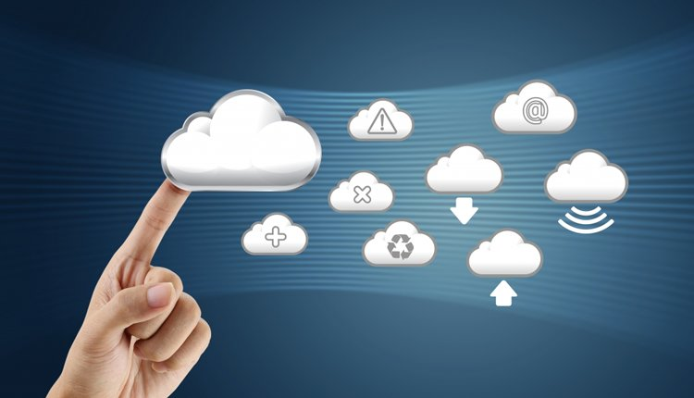
The "Cloud" is everywhere today in technology

Slide 3
What did companies use before the cloud?
Originally…(like 1970s), it was called “Service Bureaus” The service company would own and operate the computers, giving companies remote access for use. IBM was a big service bureau provider.

Slide 4
Features of Cloud computing:
You don’t have to own the hardware.
You “rent” it as needed from a cloud.
There are public clouds.
e.g. Amazon EC2, and now many others (Microsoft, IBM, Sun, and others …)
A company can create a private one with more control over security, etc.
Various providers let you create virtual servers
Set up an account, perhaps just with a credit card
You create virtual servers (“virtualization”)
Choose the OS and software each “instance” will have
It will run on a large server farm located somewhere
You can instantiate more on a few minutes’ notice
You can shut down instances in a minute or so
They send you a bill for what you use

Slide 5
Characteristics of Cloud Computing
Agility – rapidly and inexpensively re-provision technological infrastructure resources.
APIs – accessibility to software that enables machines to interact with cloud software.
Cost – reduction in cost.
Device and location independence – enable users to access systems using a web browser regardless of their location.
Multi-tenancy – enables sharing of resources and costs across a large pool of users.
Reliability – is improved.
Scalability – via dynamic (“on-demand”) provisioning of resources.
Security – could improve due to centralization of data, increased security-focused resources.
Maintenance – of cloud computing applications is easier, since they don’t have to be installed on each user’s computer.
Metering – means that cloud computing resources usage should be measurable and should be metered per client and application on a daily, weekly, monthly, and yearly basis.

Slide 6
What is Cloud Computing?
The term "cloud computing" is everywhere. In the simplest terms, cloud computing means storing and accessing data and programs over the internet instead of your computer's hard drive. ... When you store data on or run programs from the hard drive, that's called local storage and computing.
To be precise, cloud computing is the delivery of computing services like servers, storages and more over the Internet. The companies that offer these computing services are called cloud providers. They charge for cloud computing services based on usage.
Cloud computing is usually classified on the basis of location, or on the service that the cloud is offering.

Slide 7
Who owns the cloud?
The cloud is simply a collection of servers housed in massive, acre-filling complexes and owned by some of the world's largest corporations. This essentially means that our data sits on computers we don't have access to. Microsoft, Amazon and Apple have all invested huge sums in creating homes for our personal data.

Slide 8
Cloud Computing Models

Slide 9
Based on a cloud location, we can classify cloud as:
Public,
Private,
Hybrid

Slide 10
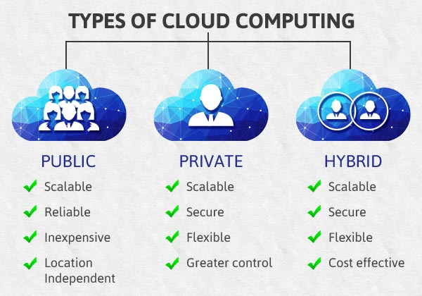

Slide 11
Public Cloud – Whole computing infrastructure is located on the premises of a cloud computing company that offers the cloud service.
Private Cloud – Hosting all your computing infrastructure yourself and is not shared. The security and control level is highest while using a private network.
Hybrid Cloud – using both private and public clouds, depending on their purpose. You host your most important applications on your own servers to keep them more secure and secondary applications elsewhere.

Slide 12
Services of Cloud
Cloud computing can be broken up into three main services:
Software-as-a-Service (SaaS),
Infrastructure-as-a-Service (IaaS) and
Platform-as-a-Service (PaaS).
These three services make up what Rackspace calls the Cloud Computing Stack, with SaaS on top, PaaS in the middle, and IaaS on the bottom.

Slide 13
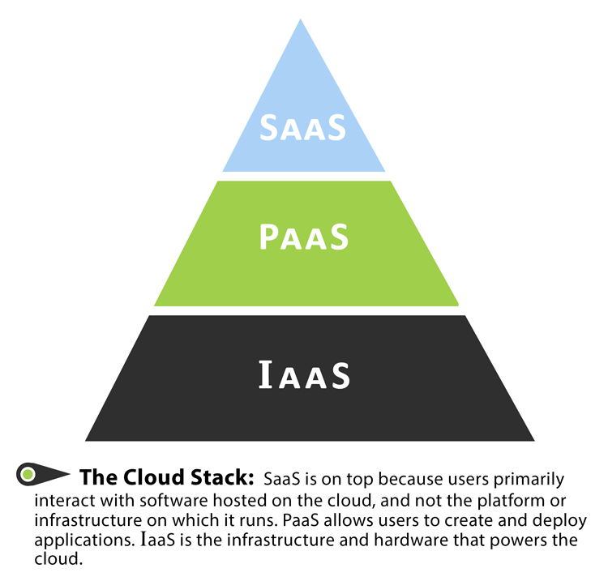

Slide 14
Uses of cloud computing
Although you do not realize you are probably using cloud computing right now, most of us use an online service to send email, edit documents, watch movies, etc.
It is likely that cloud computing is making it all possible behind the scenes.
Today a variety of organisations ranging from tiny startups to government agencies are embracing this technology for the following:
Create new apps and services as well as store, back up and recover data
Host websites and blogs
Stream audio and video
Deliver on demand software services
Analyze data for patterns
Make predictions

Slide 15
Level 1: IaaS > Virtualization, Server, Storage, Network (AWS, Rackspace …)
Level 2: PaaS > Runtime, Middleware, OS (Heroku, appfog, dotcloud …)
Level 3: SaaS > Application, Data (most startups)

Slide 16
Examples of PaaS services are App Services, Azure Search and Azure CDN. You don't have to worry about the OS or even the serve
Like IaaS, PaaS includes infrastructure—servers, storage and networking—but also middleware, development tools, business intelligence (BI) services, database management systems and more. PaaS is designed to support the complete web application lifecycle: building, testing, deploying, managing and updating.

Slide 17
Cloud service provider
A third-party company offering a cloud-based platform, infrastructure, application or storage services.
Much like a homeowner would pay for a utility such as electricity or gas, companies typically have to pay only for the amount of cloud services they use, as business demands require.

Slide 18
Some Cloud Service Providers
Microsoft Azure.
Amazon Web Services (AWS)
Google Cloud.
Alibaba Cloud.
IBM Cloud.
Oracle.
Salesforce.
SAP.

Slide 19
What is Microsoft Azure

Slide 20
Microsoft Azure, commonly referred to as Azure, is a cloud computing service created by Microsoft
Used for building, testing, deploying, and managing applications and services through Microsoft-managed data centers.

Slide 21
Microsoft Azure, formerly known as Windows Azure, is Microsoft's public cloud computing platform. ... Users can pick and choose from these services to develop and scale new applications, or run existing applications in the public cloud.

Slide 22
Microsoft Azure Services

Slide 23
There are more than 200+ services available in different categories
https://azure.microsoft.com/en-in/services
Some of the categories are:
Compute
Networking
Storage Accounts
Active Directory

Slide 24
Microsoft Azure Architecture

Slide 25
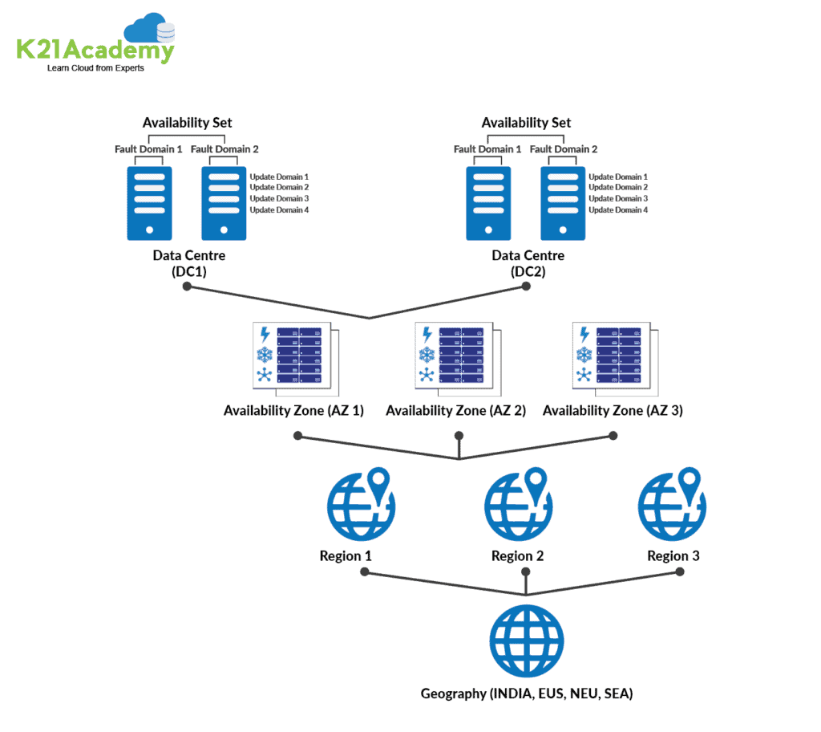

Slide 26
Region
A set of data centers deployed within a latency-defined perimeter and connected through a dedicated regional low-latency network.
With more global regions than any other cloud provider, Azure gives customers the flexibility to deploy applications where they need to. Azure is generally available in 52 regions around the world, with plans announced for 6 additional regions.

Slide 27
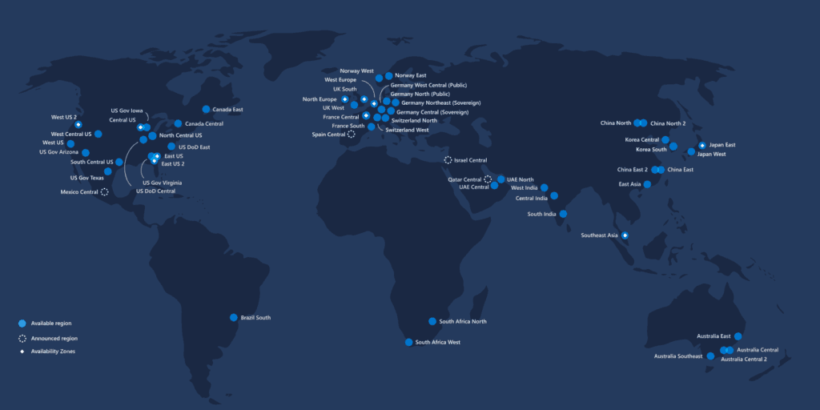

Slide 28
Region Pairs
Each Azure region is paired with another region within the same geography, together making a regional pair.
Azure serializes platform updates so only one region is updated at a time.
Azure Regions in a Pair have direct connections that bring additional benefits to use them together.
Each Azure Region in a pair is always located greater than 300 miles apart when possible.
Examples of region pairs are West US paired with East US, South-East Asia paired with East Asia.

Slide 29
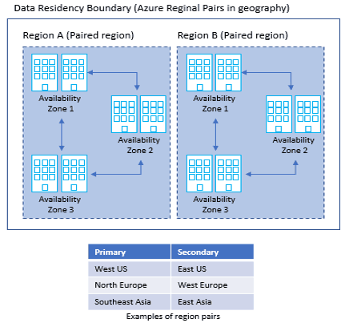

Slide 30
Geographies
Geography is a discrete market, typically containing two or more regions, that preserves data residency and compliance boundaries.
It allows customers with specific data-residency and compliance needs to keep their data and applications close.
To know more about the Geography locations refer here

Slide 31
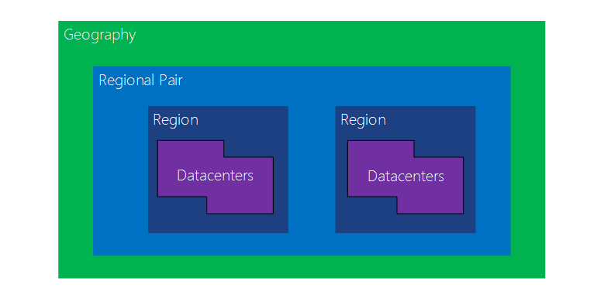

Slide 32
Availability Zone
Availability Zones is a high-availability offering that protects your applications and data from datacenter failures.
These are unique physical locations within an Azure region. Each zone is made up of one or more data centers equipped with independent power, cooling, and networking.
The physical separation of Availability Zones within a region protects applications and data from datacenter failures.

Slide 33
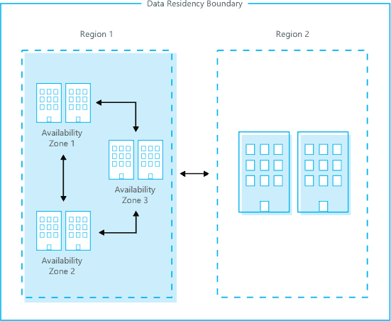

Slide 34
Availability Set
An Availability Set is a logical grouping capability for isolating VM resources from each other when they’re deployed.
By deploying your VMs across multiple hardware nodes Azure ensures that if hardware or software failure happens within Azure, only a sub-set of your virtual machines is impacted and your overall solution is safe and in working condition.
It provides redundancy for your virtual machines.

Slide 35
An Update Domain and Fault Domain is assigned to each VM in Availability Set by Azure platform.

Slide 36
Fault Domain
Fault domains define the group of virtual machines that share a common power source and network switch.
Each and every fault domain contains some racks and each rack contains a virtual machine.
Each of these Fault domain shares a power supply and a network switch.
All the resources in the fault domain become unavailable when there is a failure in the fault domain.
You should place your VMs in such a way that each fault domain gets one web server, one database server, and like that.

Slide 37
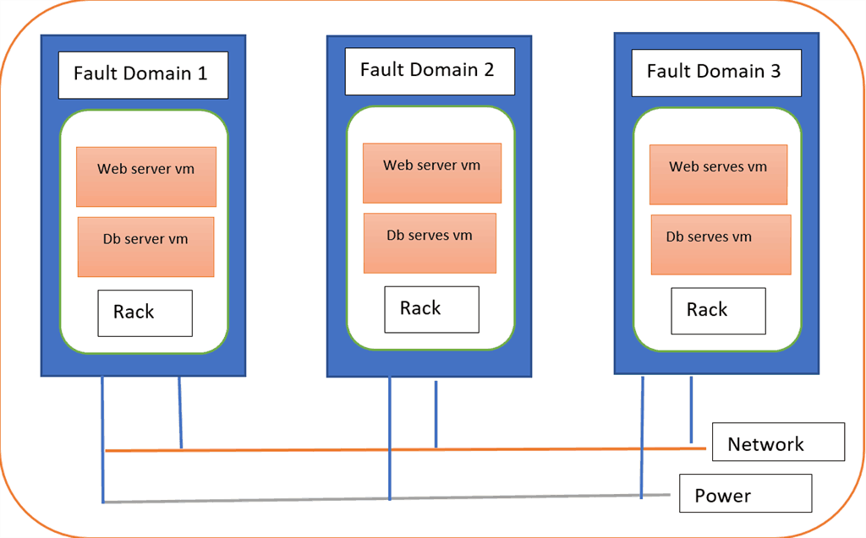

Slide 38
Update Domain
Virtual machines get update domains automatically once they are put inside the availability set.
All virtual machines within that update domain will reboot together.
They are used for patching of the virtual machines.
Only one update domain can be updated at the time.

Slide 39
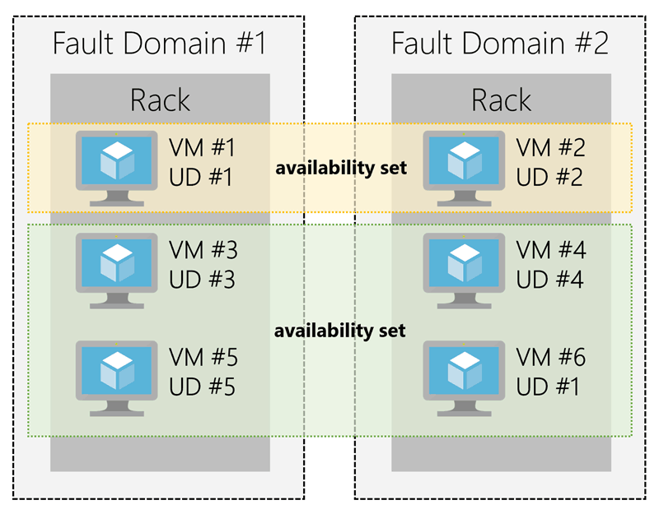

Slide 40
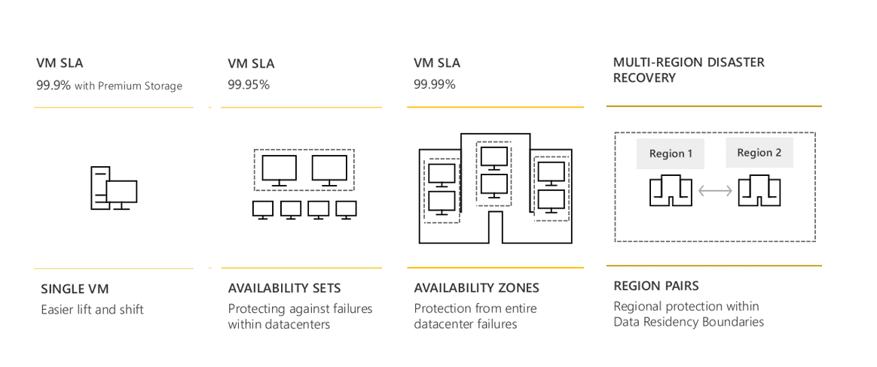
SLA(Service Level Agreement) for VM:

Slide 41
Creating an Account in Microsoft Azure

Slide 42
Create FREE Microsoft Azure Trial Account
Click here to follow steps

Slide 43
Different ways of accessing Microsoft Azure

Slide 44
Portal (Graphical Way)
Powershell (Through Commands)
CLI (Through Commands)

Slide 45
Azure Cloud Shell is a browser-accessible, interactive shell for managing the Azure resources. It gives you the flexibility to access the shell based on the area you are working. Bash experience for linux and Powershell experience for the Windows users.
You can access the Cloud shell on your browser or through the Azure portal.
To access through the browser you can access the below link.

Slide 46
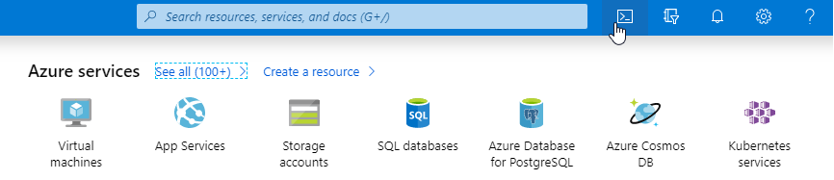
https://shell.azure.com/
or Try from Azure portal using the cloud shell icon .

Slide 47
If you are the first time user, when you access the Cloud shell it will ask you to choose the Bash or Powershell type of experience you need. But next time when you access the cloud shell it will automatically choose the most recently used environment. In our case, lets go ahead and choose the Powershell.
Note: You can change shells any time via the environment selector in the cloudshell toolbar.

Slide 48
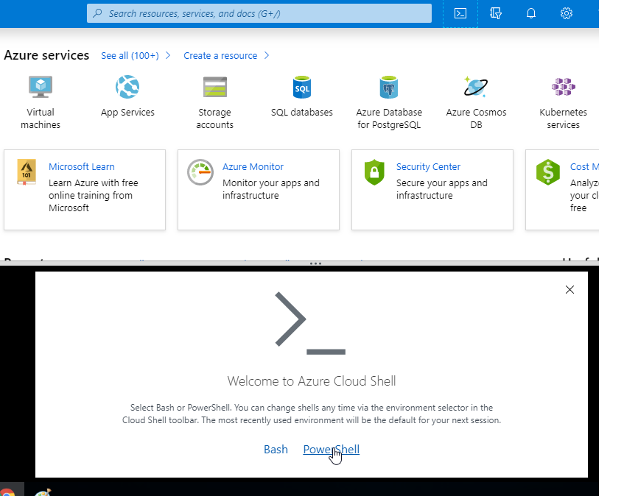

Slide 49
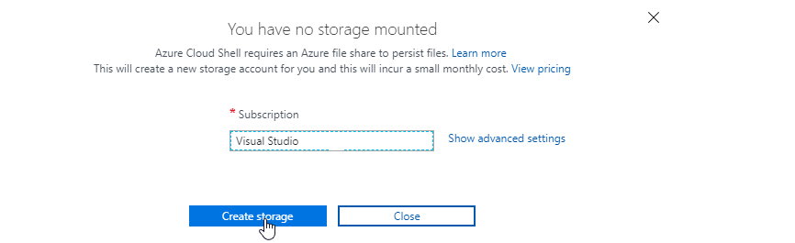
Next important thing to notice is that, at first time when you access the cloud shell it will ask you to create the storage to be mounted with the current subscription.

Slide 50
Once you click on "Create Storage" it will automatically create a storage inside the azure environment. The beauty of the Cloud shell environment is having the integrated cloud shell editor. Meaning, you can run both CLI and Powershell command files through this Cloud shell itself.

Slide 51
Subscriptions and Accounts

Slide 52
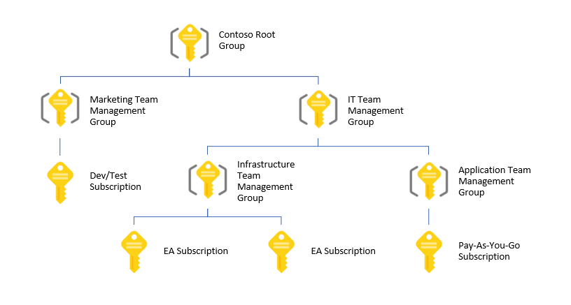
Management Groups
Provides a level of scope above subscriptions
Organizational alignment for your Azure subscriptions through custom hierarchies and grouping
Targeting of policies and spend budgets across subscriptions and inheritance down the hierarchies
Compliance and cost reporting by organization (business/teams)

Slide 53
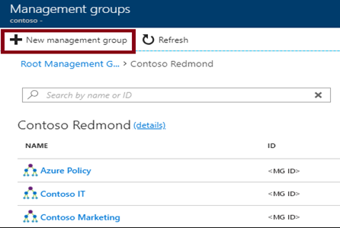
Creating Management Groups
The Management Group ID is the directory unique identifier that is used to submit commands on this management group
The Display Name field is the name that is displayed within the Azure portal

Slide 54
Azure Subscriptions
A subscription is a logical unit of Azure services that is linked to an Azure account
Subscriptions help you organize access to cloud service resources
Subscriptions have accounts
An Azure account is simply an identity in Azure Active Directory (Azure AD) or in a directory that is trusted by Azure AD, such as a work or school organization
Users,
groups, and service principles
Azure Active Directory
Authentication
& Authorization
Azure resources in resource groups
Azure Subscription(s)
Notes:
✔️ Do you know how many subscriptions your organization has? Do you know how resources are organized into resource groups?

Slide 55
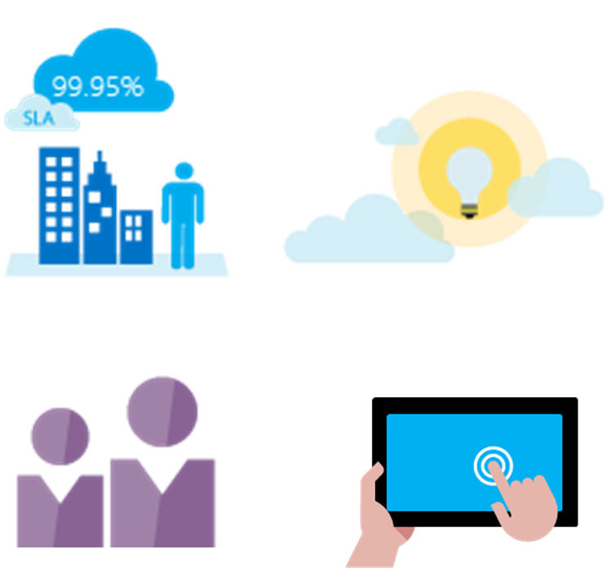
Getting a Subscription
Enterprise Agreement customers make an upfront monetary commitment and consume services throughout the year
Resellers provide a simple, flexible way to purchase cloud services
Partners can design and implement your Azure cloud solution
Personal free account -start right away
Notes:
✔️ Which subscription model are you most interested in?
For more information, you can see:
Solution providers - https://www.microsoft.com/en-us/solution-providers/home

Slide 56
Subscription Usage
Subscription | Usage
Free | Includes a $200 credit for the first 30 days, free limited access for 12 months
Pay-As-You-Go | Charges you monthly
Enterprise | One agreement, with discounts for new licenses and Software Assurance - targeted at enterprise-scale organizations.
Student | Includes $100 for 12 months – must verify student access
Notes:
Note: Credit card information is used for identity verification only. You won’t be charged for any services until you upgrade.

Slide 57
Subscription User Types
Administrative Role | Limit | Summary
Account Administrator | 1 per Azure account | Authorized to access the Account Center
Service Administrator | 1 per Azure subscription | Authorized to access the Azure Management Portal for all subscriptions in the account
Co-administrator | 200 per subscription | Same as the Service Administrator but can’t change the association of subscriptions to Azure directories
Notes:
✔️ Account Administrators using a Microsoft account must log in every 2 years (or more frequently) to keep the account active. Inactive accounts are cancelled, and the related subscriptions removed. There are no login requirements if using a work or school account.

Slide 58
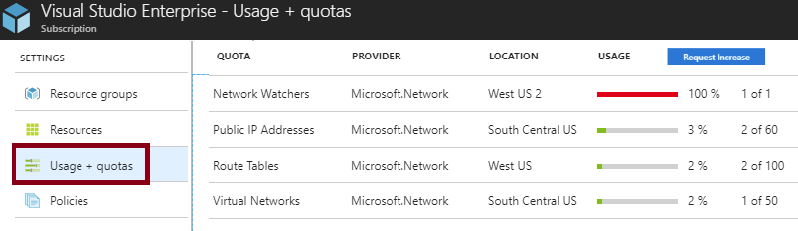
Check Resource Limits
All resources have a maximum limit listed in Azure limits
Helpful to track current usage, and plan for future use
You can request an increase

Slide 59
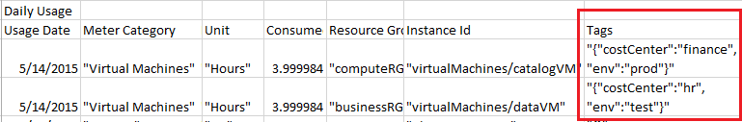
Resource Tags
Tags logically organize your resources
Tags consist of a name and value
Useful especially in billing
Notes:
✔️ If you must create a lot of tags you will want to do that programmatically. You can use PowerShell or the CLI.

Slide 60
Azure Resources

Slide 61
What Is Resource?
All the entities and services managed by Azure are called Resources. Resources may be virtual machines including Windows and Linux machines, storage, databases, active directories, or networks in Azure.

Slide 62
What Is A Resource Group?
In Azure, a Resource Group is a logical collection of all resources. The resource group stores metadata about the resources.
It is generally created on an environment basis such as development, production, or testing resource groups.
Basically, it provides a way to monitor, control access, provision, and manage to bill for collections of assets/resources that are being used by a client.

Slide 63
Create Resource Group
Follow the steps. Demo to be shown

Slide 64
Add a Resource in Resource Group
Demo to be shown

Slide 65
Practical to be done
Create a Free Account
Create Resource Group
Create Resource
Understand Regions, AZ, AS
Understand subscription
Understand Active Directory
Create Users
Assign them password
Open azure portal for that user mode
Login
Check there
Use your subscription, give this new user permission of Contributor
Open his account again, and try to create resources
Move resources from one Resource Group or subscription to other

