Slide 1

A. P. Shah Institute of Technology
International Conference on Innovations in Computer Technology and Applications (IC2TA-2019)
Eye Control System Based on Hough Transform Algorithm
‹#›
Notes:
‹#›
‹#›

Slide 2
Authors
Anindita Chowdhury
Vibha Gaikwad
Anamika Sonavane

Slide 3
OUTLINE OF PRESENTATION
Abstract
Introduction
Literature Review
Problem Statement
Proposed System
Implementation / Technologies Used
Result Discussion
Conclusion

Slide 4
ABSTRACT
This paper presents an eye control system that utilizes eye gaze tracking techniques that might be helpful for limb disabled and/or speech impaired people with healthy eyes, to interact with the digital world.
Functionalities
Motion function
Blink detection

Slide 5
INTRODUCTION
Around 15% of the world's population has some form of disability.
Census 2001 has revealed that over 21 million people in India are suffering from one or the other kind of disability. This is equivalent to 2.1% of the population.
Hence, a vast amount of people cannot enjoy the convenience and entertainment of the ever-advancing computer technology.
Notes:
More than 1 billion people in the world This corresponds to about

Slide 6
LITERATURE REVIEW
1908
1937
2006
2016
First eye-tracker designed by Edmund Huey
Non-intrusive eye trackers were built by Guy Thomas
Taiwanese engineers developed Powered Wheelchair controlled by Eye Tracking system
Comparative study of user experience in online social media branding web pages

Slide 7
PROBLEM STATEMENT
An efficient Eye Tracking system that utilizes eye gaze position and eye-state (staring or blinking) for enabling virtual mouse.
The image frames of eye pupil captured from webcam, which will be used to detect pupil center using appropriate algorithms.
Functionalities
Motion function
Blink detection

Slide 8
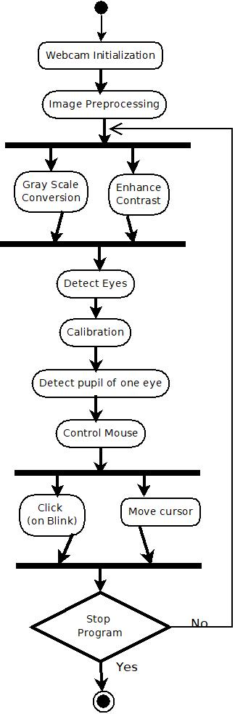
PROPOSED SYSTEM

Slide 9

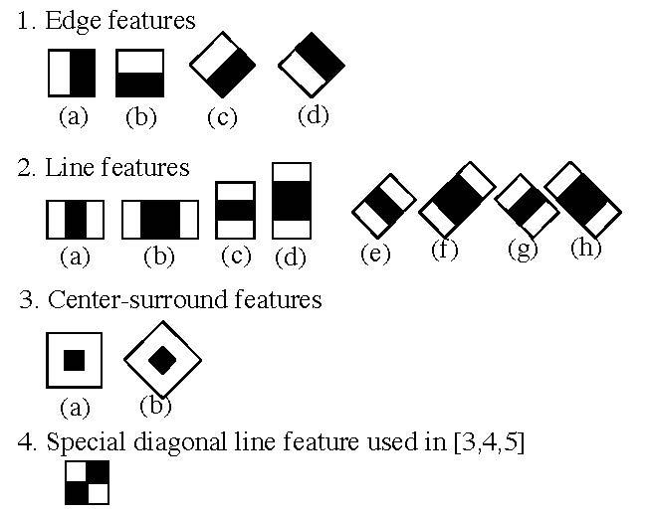
Face and Eye Detection
Viola-Jones Algorithm
Edge Feature
Line Feature
Notes:
The algorithm has four stages: Haar Feature Selection Creating an Integral Image Adaboost Training Cascading Classifiers

Slide 10
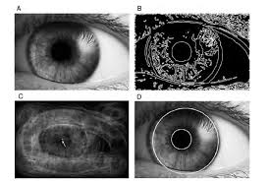
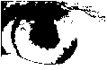
Iris and Pupil Detection
Fig. 1. Captured Eye image area
Fig. 2. Binary Image
Fig. 3. Canny-edge detected image
After Hough Transform

Slide 11
X
X
(x − a)² + (y − b)² = r²
X

Slide 12
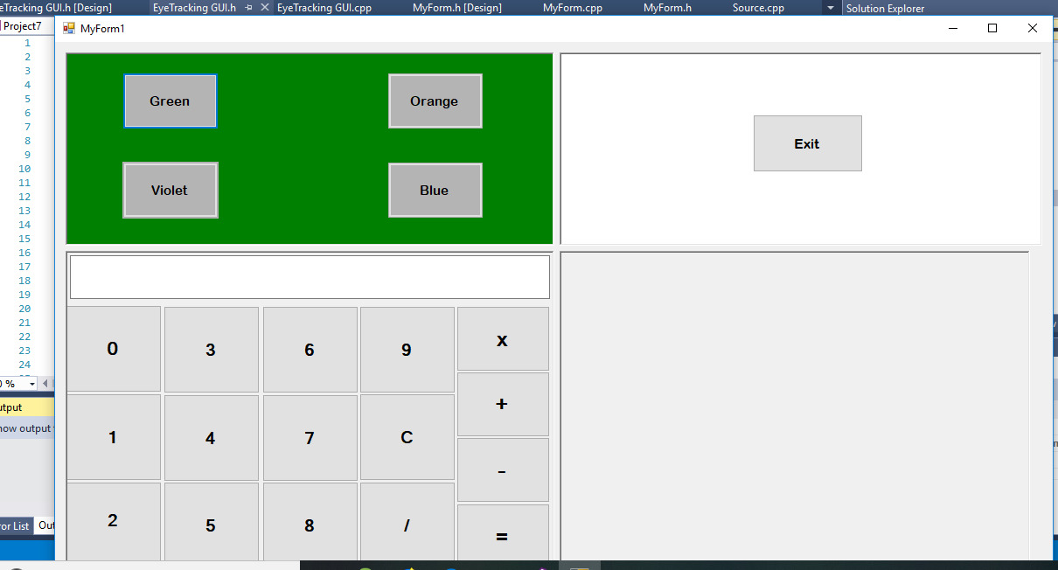
User Interface Display Screen

Slide 13
IMPLEMENTATION / TECHNOLOGIES USED
Windows Operating System, Windows 7 Professional.
Visual Studio 2015 Community version
Open CV with C++

Slide 14
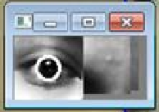
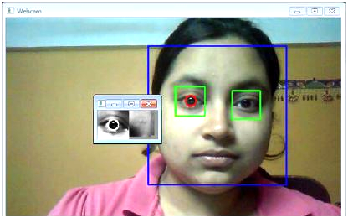
RESULT ANALYSIS
Fig. 2. Result of iris detection of the left eye
Fig. 1. After detecting the face and eyes
Notes:
Latency Less Precision

Slide 15
CONCLUSION
Input through an eye-tracking system can be achieved without using an external eye tracker
Future improvements
Improvement in the pupil localization method.
Increasing the number of buttons.
Transplanting the system from PC platform to the mobile platform with the help of a VR gear.

Slide 16
QUESTIONS?

Slide 17
THANK YOU!

