Slide 1


Introductuon to Data base
Presented by
Anamika Gupta
B.Cs DATA SCIENCE
SEM(1)
Presented to
Mr.sNeema Jha

Slide 2

CONTENT
Introduction to structure of Database
DATABASE ADMINISTRATION
DATABASE MANNAGEMENT SYSTEM STRUCTURE
STORAGE MANNAGER
DATABASE MANAGEMENT COMPONENTS COMPONENTS
STORAGE MANNAGER COMPONENTS
DISK STORAGE
The Storage Manager
Data base
File system
Data base management system
Components of data base management system
Types of data base management system
Appplication of data base
Advantages of data base management system

Slide 3
Data base
A database is information that is set up for easy access, management and updating.
Databases are used for storing, maintaining and accessing any sort of data. They collect
They collect information on people, places or things. That information is gathered in one place so that it can be observed and analyzed
. Databases can be thought of as an organized collection of information

Slide 4
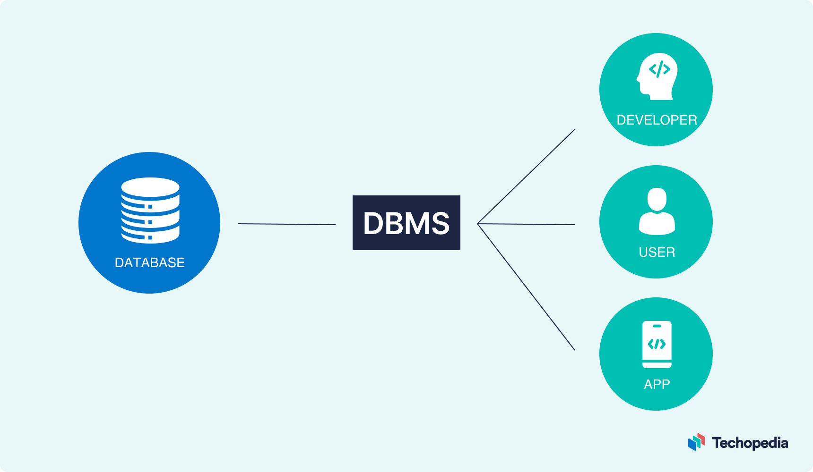
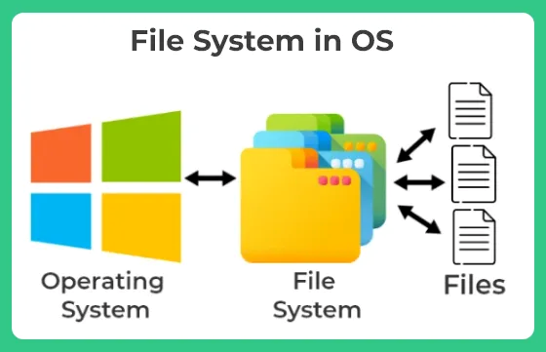
File system
Data base management system
The file system is basically a way of arranging the files in a storage medium like a hard disk.
File systems consist of different files which are grouped into directories. The directories further
contain other folders and files. The file system performs basic operations like management, file naming, giving access rules, etc.
Database management system is an application software which is used perform various operations on data .example-my sql.
DBMS provide a platform ofr users to carry out different action,updation,deletion and a lot more.
All the processes are the protected and secured even data consistency is maintained during multiple users.

Slide 5
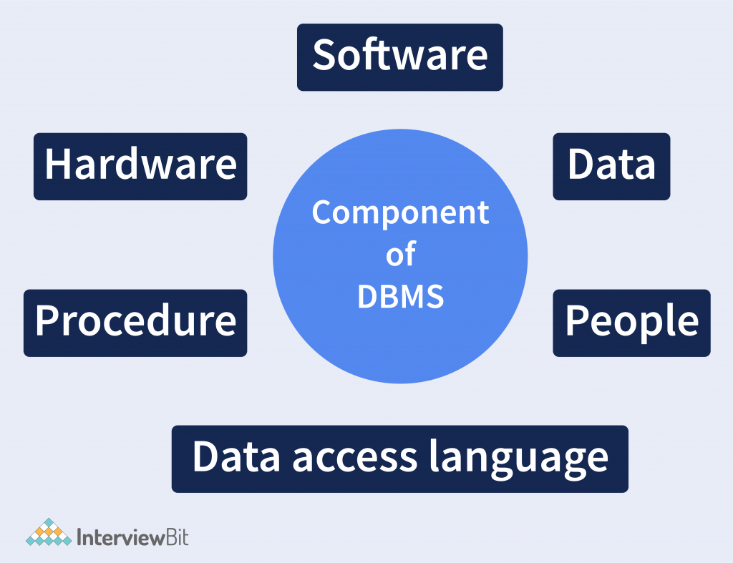
Components of data base management system
There are many components available in the DBMS. Each component has a significant task in the DBMS. A database environment is a collection of components that regulates the use of data, management, and a group of data. These components consist of people, the technique of Handel the database, data, hardware, software, etc. there are several components available for the DBMS. We are going to explain five main topics of the database below.

Slide 6
Types of data base management system
Hierarchial database
These DBMS employ parent and child relationship to store the data. Hierarchial DBMS is wide.
They store data in a tree- like structure so that it is easy to find and use. Similarly,the configuration of the DBMS is present in the node of the tree.
Network DBMS
Network DBMS supports many to many realtion which result in complex database structures.
RDM Server is a major example of the network DBMS.
Relational DBMS
Relational DBMS stores data using the database relationships in the form of tables, also known as relational or tuples .
They do not support many to many relationship and have pre- defined data tupes that they can support. They are the most popular DBMS type in the industry
Object- Oriented relational DBMS
This DBMS supports the storage of miscellaneous data types.they store data in the form of objects.
The object has attributes (i.e,name ,id ,gender,etc) and the logic for the what nedds to be done with the data example : postgreSQL

Slide 7
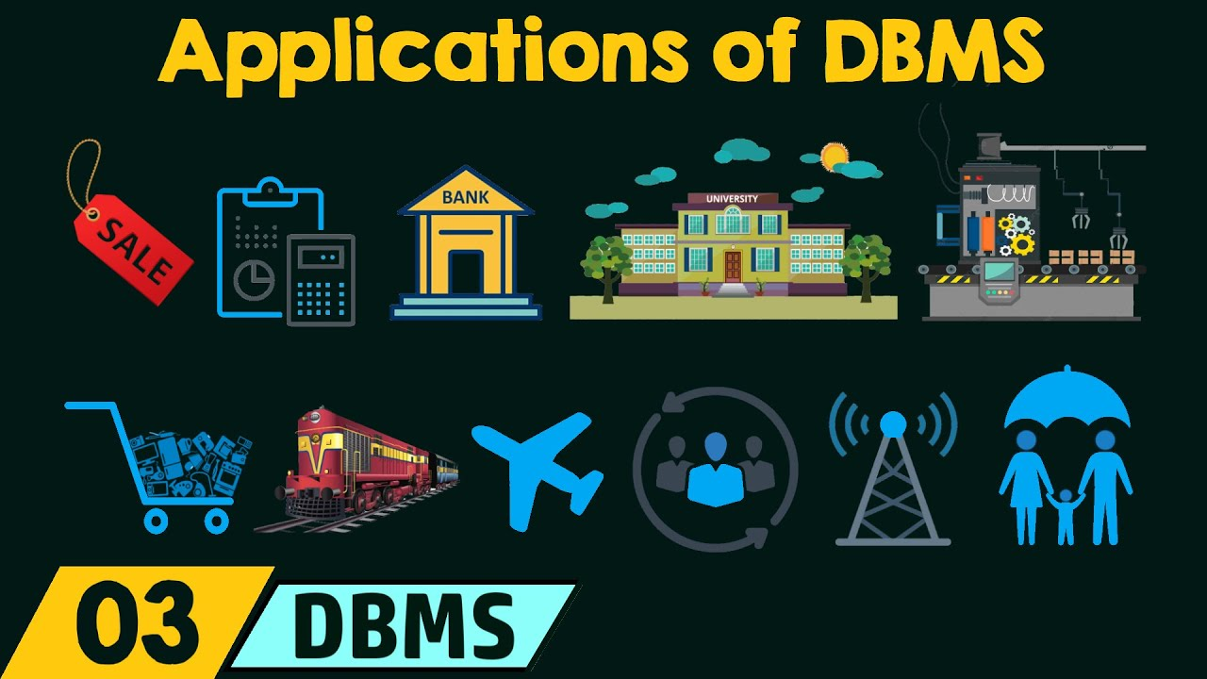
Appplication of data base
Business Applications:
E-commerce:
Healthcare:
Education:
Finance:
Telecommunications:
Government:
Research and Science:
Social Media:

Slide 8
Advantages of data base management system
• Data independence: The DBMS provides an abstract view of the data. Data representation
and storage are independent of application programs.
• Efficiency: DBMSs are very efficient at accessing, storing and modifying data.
• Data integrity: DBMSs can enforce some constraints on the data, for example, a DBMS can
enforce salary information to be of integer type. Also, DBMSs can enforce access controls to
different classes of users. For example, human resources department could be given read and
write access to the ‘employees’ table, while another group could have access to ‘products’
and ‘sales’ tables.
• Data administration: A centralized program to manage the data has advantages related to
minimize redundancy, improve security, data durability, and access speed.
• Reduced application development time: most DBMSs use SQL as lingua franca. SQL is a
standardized language used for writing and retrieving data. This facilitates quick development
of applications and more robust applications.

Slide 9
Introduction to structure of Database
Data Abstraction
Data Abstraction refers to the process of hiding irrelevant details from the user.
• Physical level – it will contains block of storages (bytes,GB,TB,etc)
• Logical level – it will contain the fields and the attributes of data.
• View level – it works with CLICommand Line Interface or GUI(Graphical User
Interface) access of database
• Physical: This is the lowest level of data abstraction. It tells us how the data is actually stored
in memory. The access methods like sequential or random access and file organization
Methods
• Logical: This level comprises the information that is actually stored in the database in the form
of tables. It also stores the relationship among the data entities in relatively simple structures.
• View: This is the highest level of abstraction. Only a part of the actual database is viewed by
the users. This level exists to ease the accessibility of the database by an individual user. Users
view data in the form of rows and columns.

Slide 10
DATABASE ADMINISTRATION
Role and Duties of Database Administrator (DBA)
• Decides hardware – They decide on economical hardware, based on cost, performance, and efficiency of
hardware, and best suits the organization. It is hardware that is an interface between end
users and the database.
• Manages data integrity and security –Data integrity needs to be checked and managed accurately as it protects and restricts data
from unauthorized use. DBA eyes on relationships within data to maintain data integrity.
• Database Accessibility –Database Administrator is solely responsible for giving permission to access data available in
the database. It also makes sure who has the right to change the content.

Slide 11
• Database design –
DBA is held responsible and accountable for logical, physical design, external model design,
and integrity and security control.
• Database implementation –
DBA implements DBMS and checks database loading at the time of its implementation
• Query processing performance –
DBA enhances query processing by improving speed, performance, and accuracy.
• Tuning Database Performance –
If the user is not able to get data speedily and accurately then it may lose organization’s
business. So, by tuning SQL commands DBA can enhance the performance of the database.

Slide 12
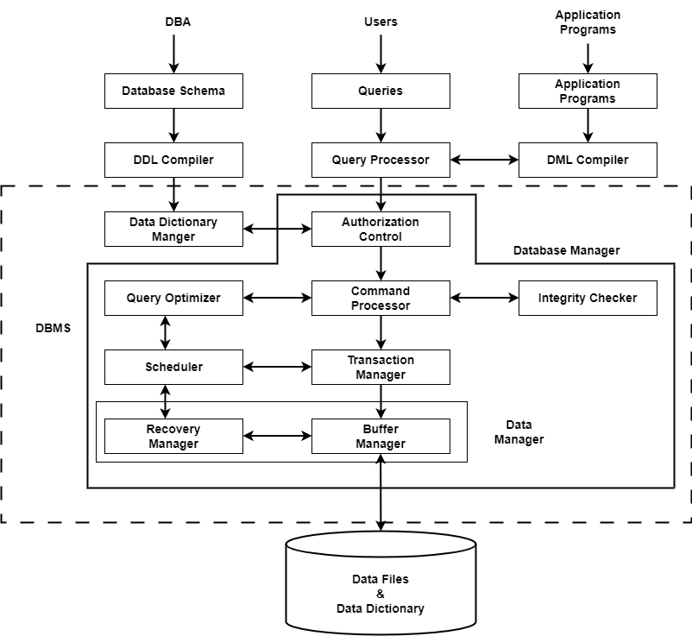
DATABASE MANNAGEMENT SYSTEM STRUCTURE

Slide 13
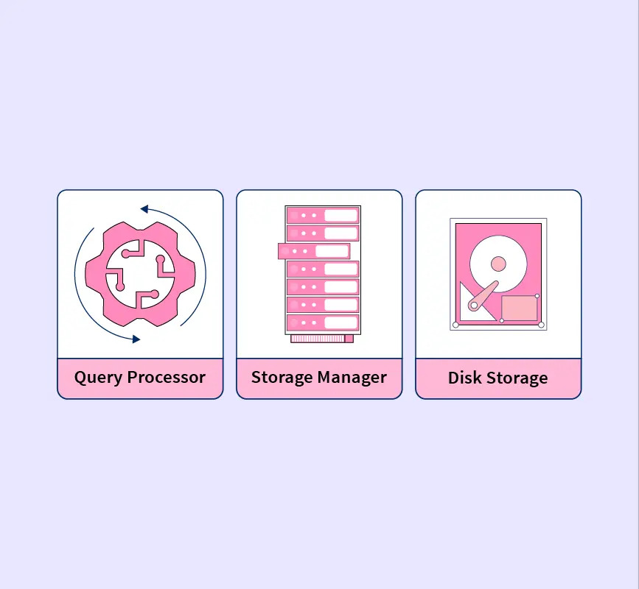
DATABASE MANAGEMENT COMPONENTS COMPONENTS
The database system is divided into three components:
Query Processor
Storage Manager,
and Disk Storage.

Slide 14
1. Query Processor: It interprets the requests (queries) received from end user via an
application program into instructions. It also executes the user request which is received
from the DML compiler.
Query Processor contains the following components –
• DML Compiler: It processes the DML statements into low level instruction (machine
language), so that they can be executed.
• DDL Interpreter: It processes the DDL statements into a set of tables containing meta data
(data about data).
• Embedded DML Pre-compiler: It processes DML statements embedded in an application
program into procedural calls.
• Query Optimizer: It executes the instruction generated by DML Compiler.

Slide 15
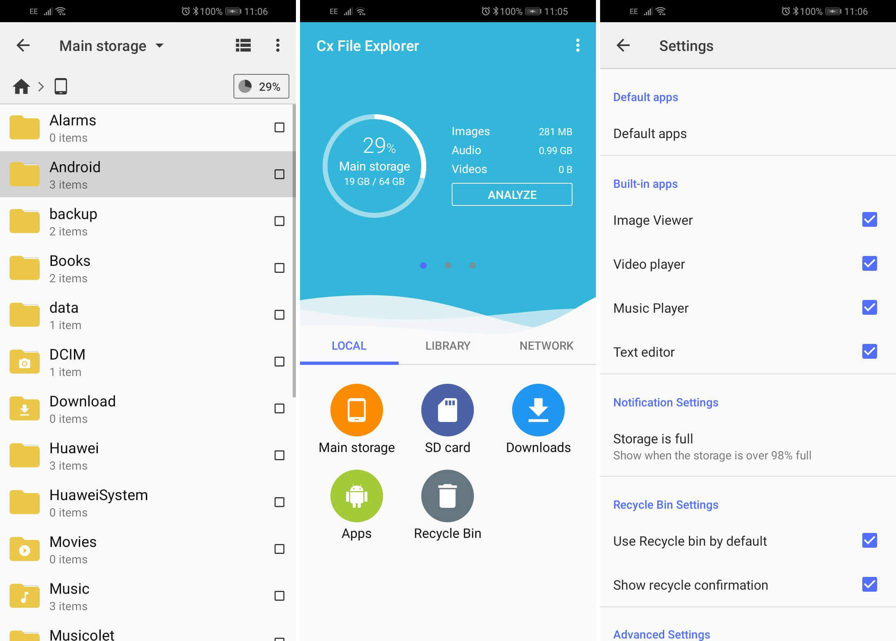
STORAGE MANNAGER
2. Storage Manager: Storage Manager is a program that provides an interface between the
data stored in the database and the queries received. It is also known as Database Control
System. It maintains the consistency and integrity of the database by applying the
constraints and executing the DCL statements. It is responsible for updating, storing,
deleting, and retrieving data in the database.

Slide 16
STORAGE MANNAGER COMPONENTS
It contains the following components –
• Authorization Manager: It ensures role-based access control, i.e,. checks whether the
particular person is privileged to perform the requested operation or not.
• Integrity Manager: It checks the integrity constraints when the database is modified.
• Transaction Manager: It controls concurrent access by performing the operations in a
scheduled way that it receives the transaction. Thus, it ensures that the database remains in
the consistent state before and after the execution of a transaction.
• File Manager: It manages the file space and the data structure used to represent
information in the database.
• Buffer Manager: It is responsible for cache memory and the transfer of data between the
secondary storage and main memory.

Slide 17
DISK STORAGE
Disk storage (also sometimes called drive storage) is a general category of storage mechanisms where data is recorded by various electronic, magnetic, optical, or mechanical changes to a surface layer of one or more rotating disks
3. Disk Storage: It contains the following components –
• Data Files: It stores the data.
• Data Dictionary: It contains the information about the structure of any database object. It is
the repository of information that governs the metadata.
• Indices: It provides faster retrieval of data item.

Slide 18
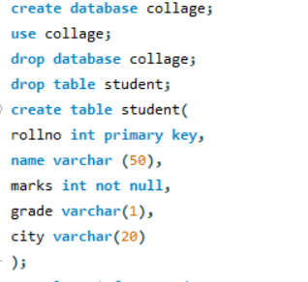
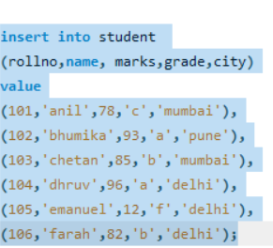
MY SQL
MY SQL create database

Slide 19
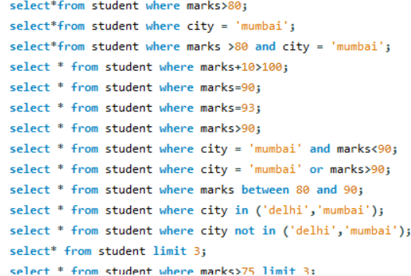

Slide 20
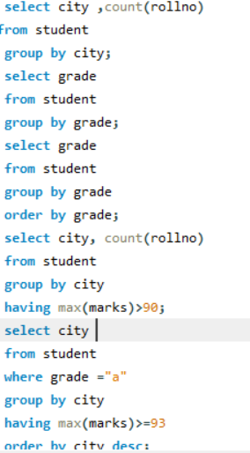

Slide 21
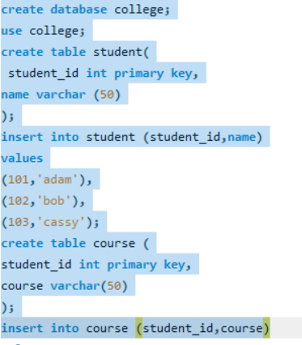
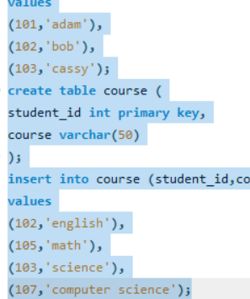

Slide 22
THANK YOU FOR ATTENTION

