Slide 1
Linear Regression
Dr. V. Chandra Sekhar

Slide 2
Linear Regression
Linear Regression is a simple and powerful model for predicting a numeric response from a set of one or more independent variables.
And although it may seem like linear regression is overlooked in modern machine learning's ever-increasing world of complex neural network architectures.
The algorithm is still widely used across a large number of domains because it is effective, easy to interpret, and easy to extend.
The key ideas in linear regression are recycled everywhere, so understanding the algorithm is a must-have for a strong foundation in machine learning.

Slide 3
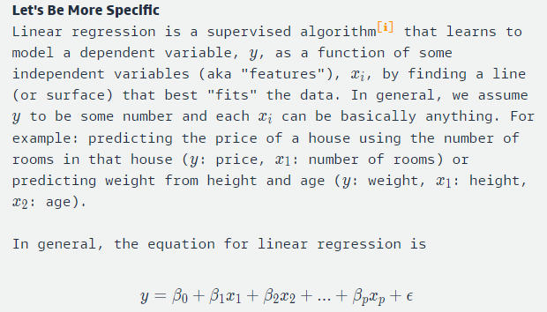
Linear Regression

Slide 4
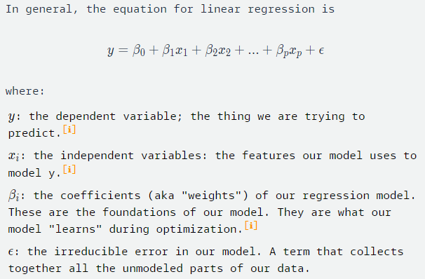
Linear Regression

Slide 5
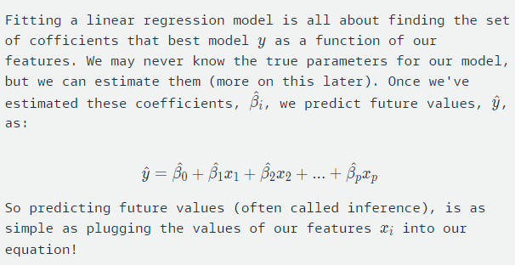
Linear Regression

Slide 6
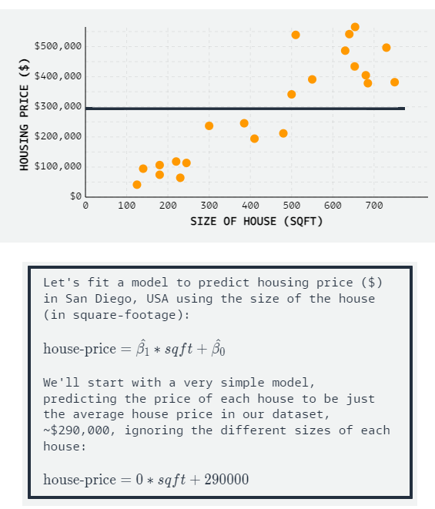
Linear Regression

Slide 7
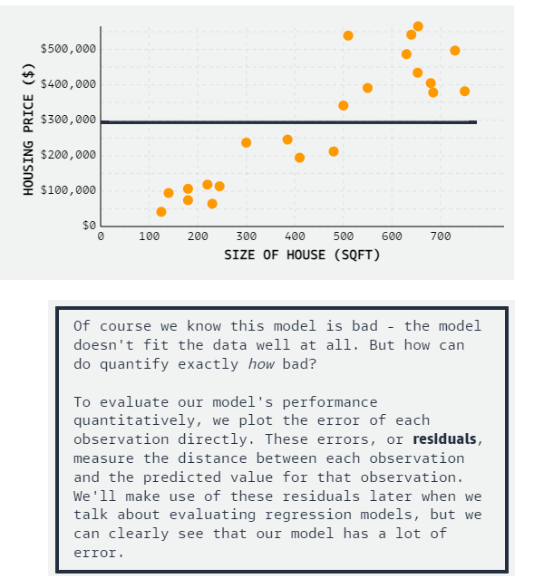
Linear Regression

Slide 8
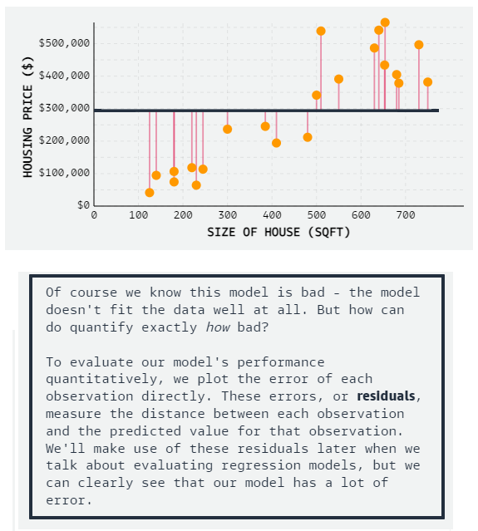
Linear Regression

Slide 9
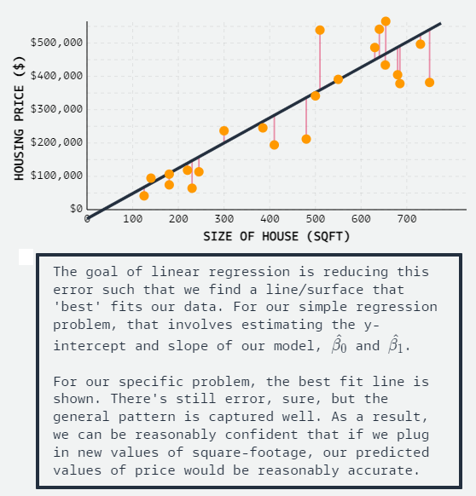
Linear Regression

Slide 10
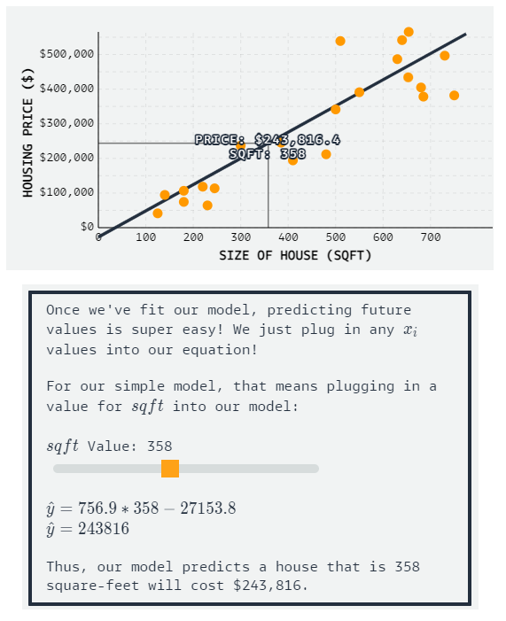
Linear Regression

Slide 11
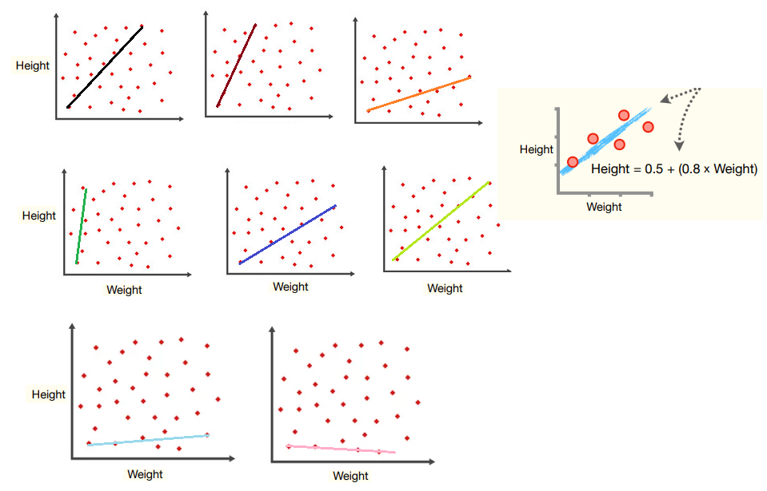

Slide 12
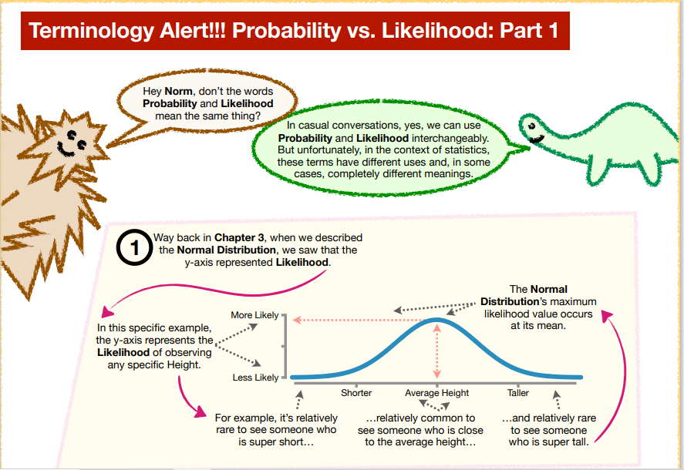

Slide 13
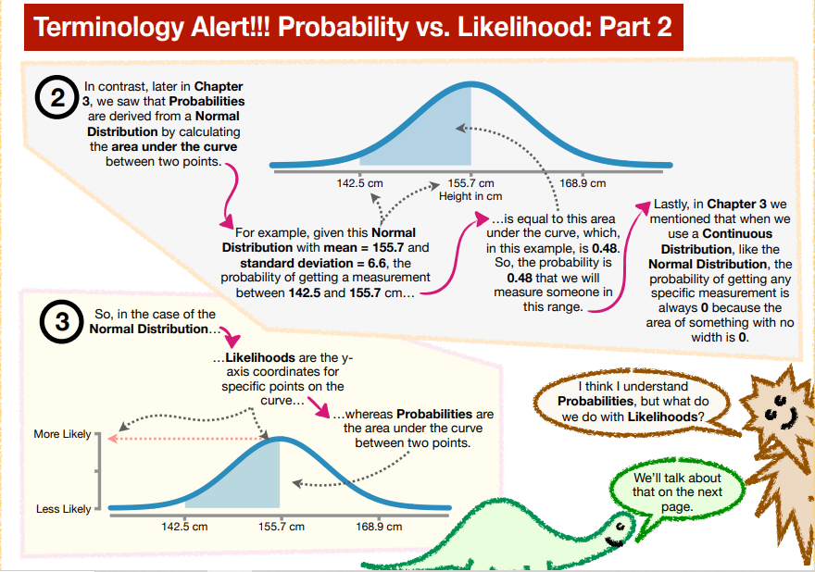

Slide 14
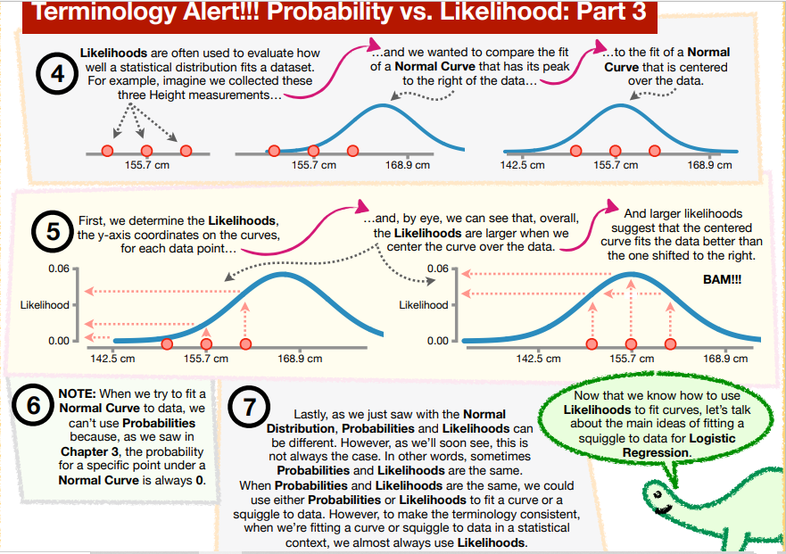

Slide 15
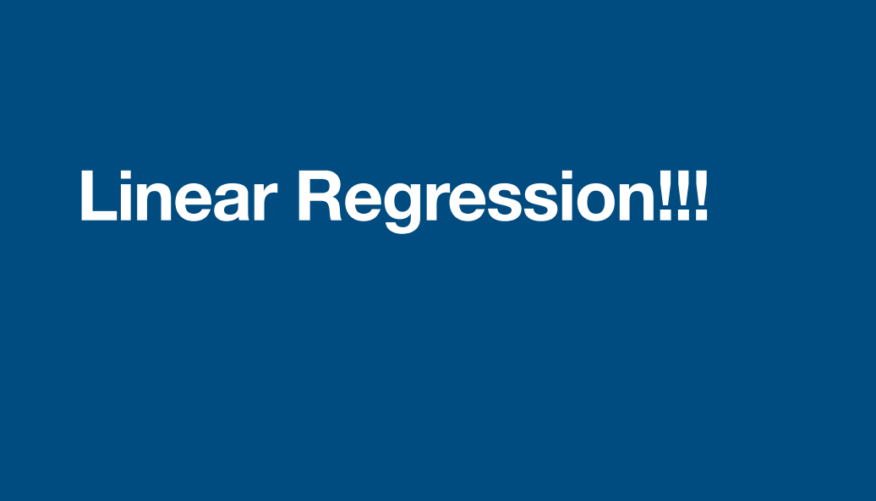

Slide 16
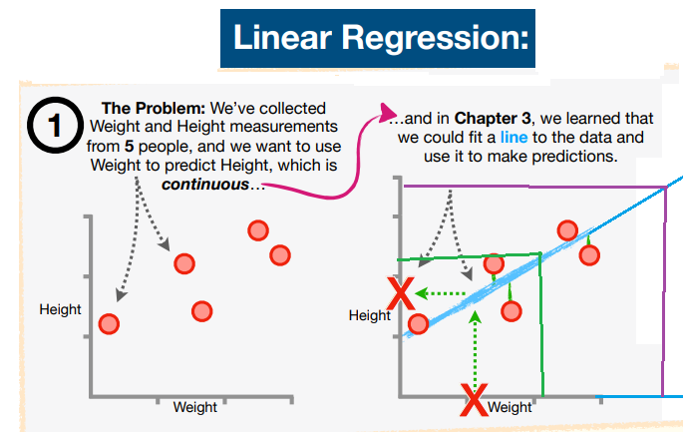

Slide 17
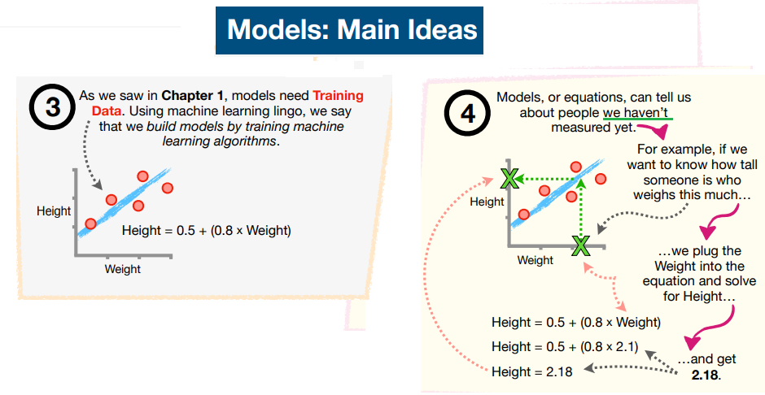

Slide 18
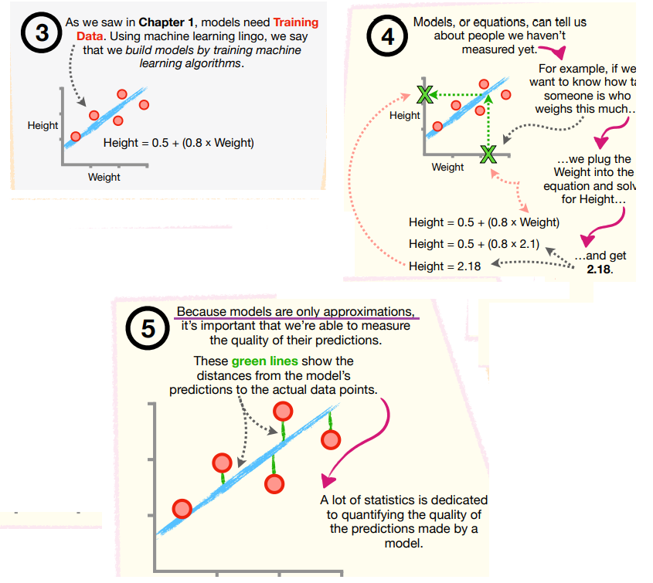

Slide 19
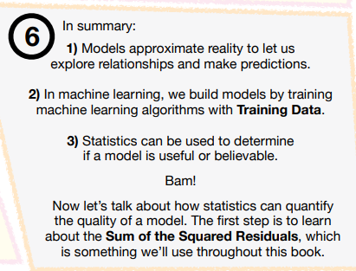

Slide 20
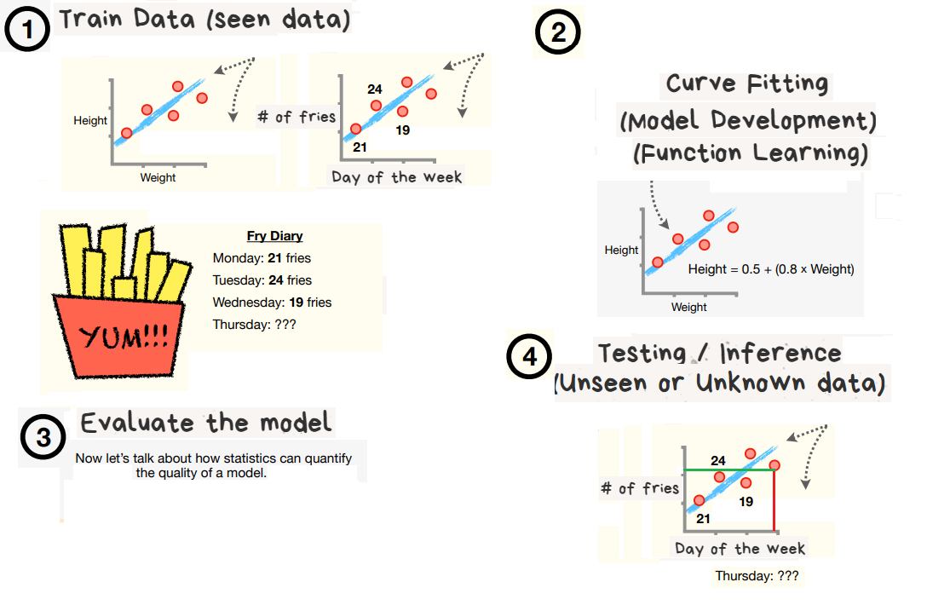

Slide 21
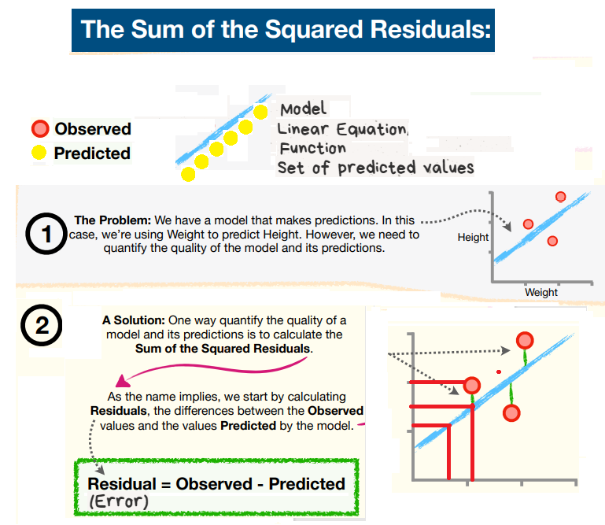

Slide 22
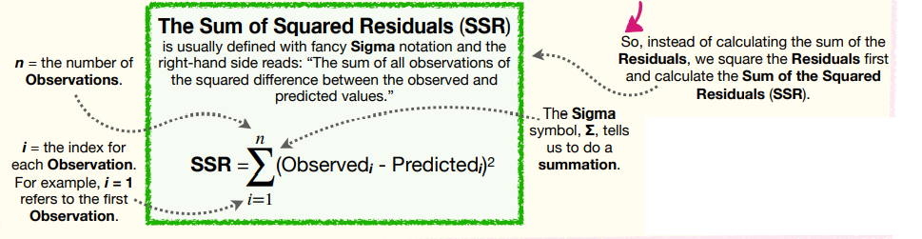

Slide 23
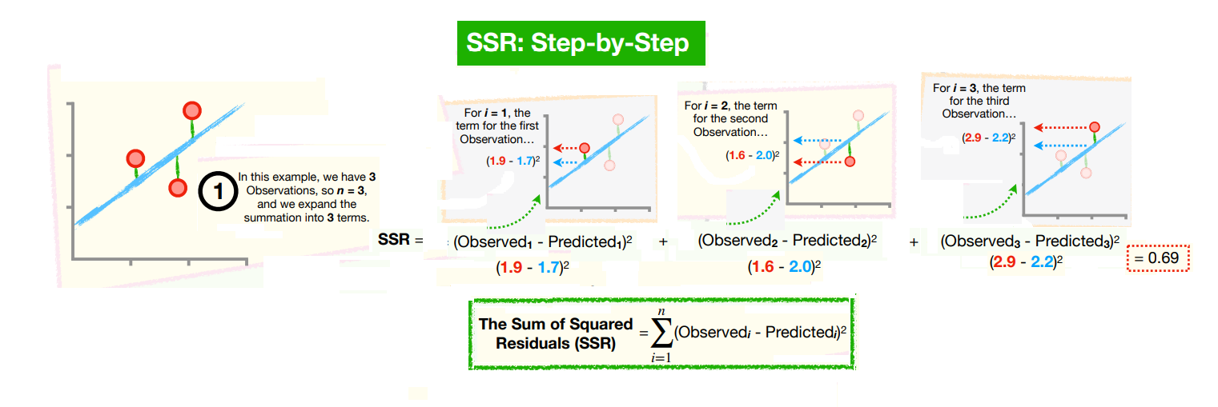

Slide 24
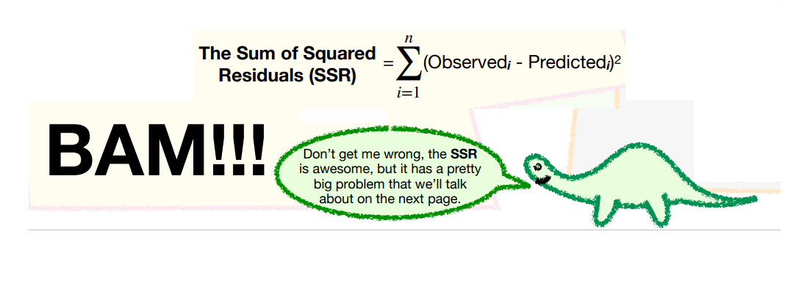

Slide 25
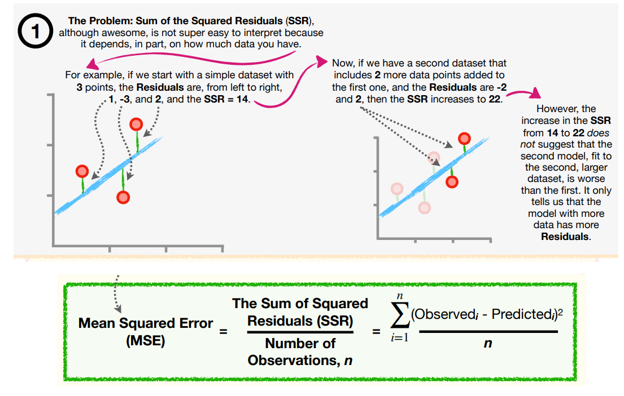

Slide 26
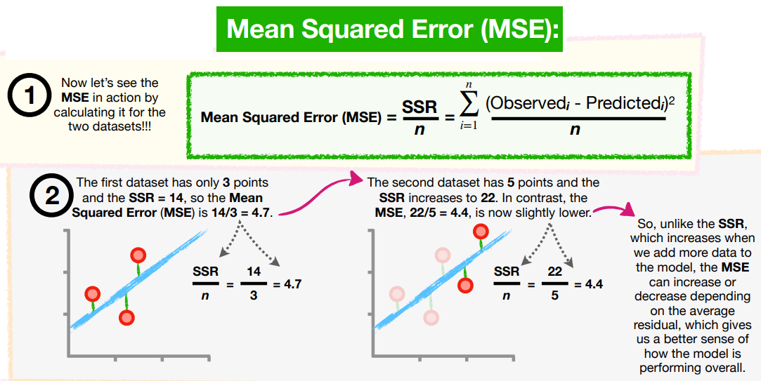

Slide 27
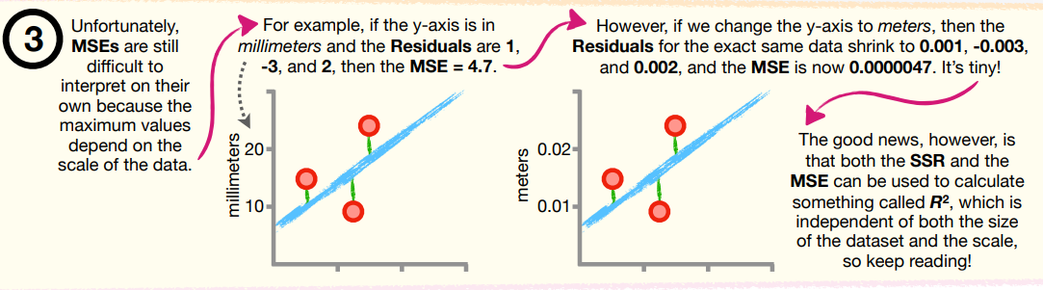

Slide 28
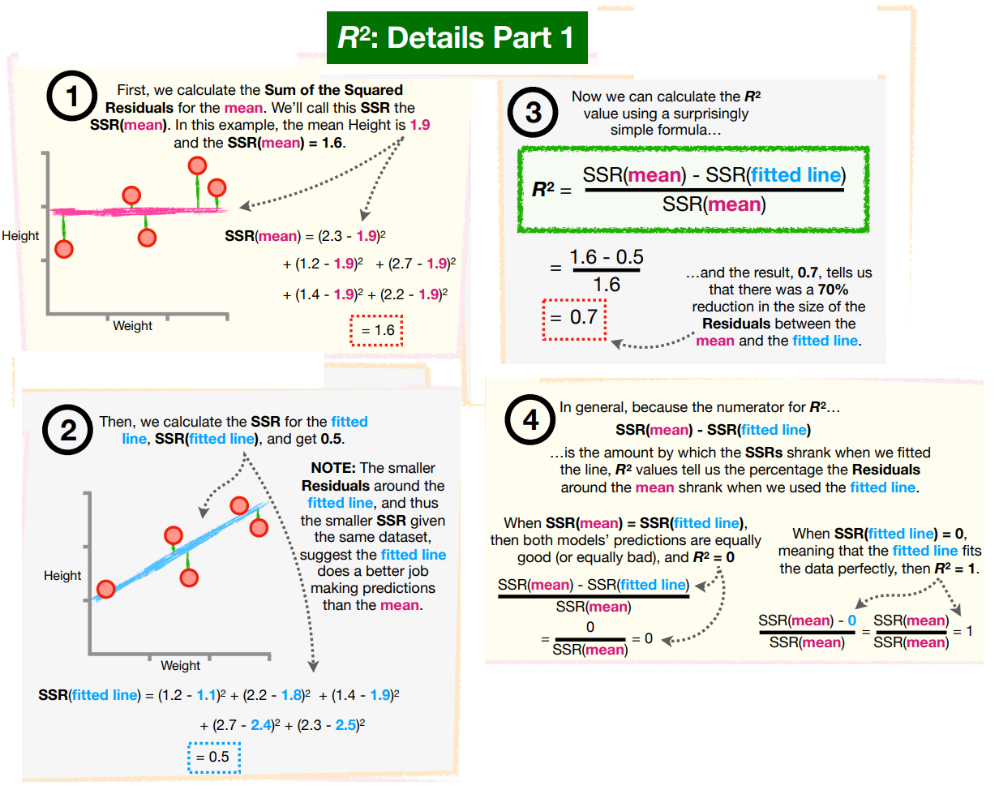

Slide 29
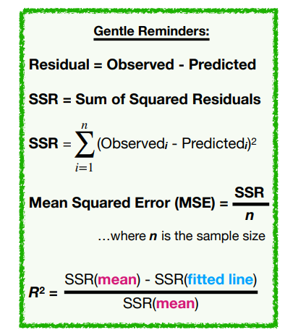

Slide 30
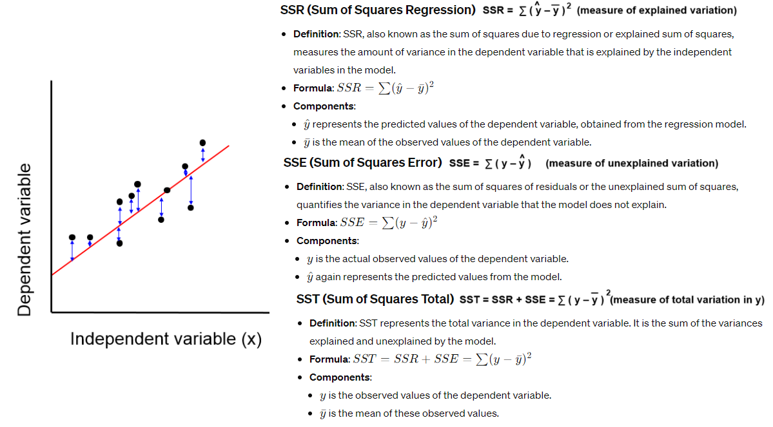
Linear Regression

Slide 31
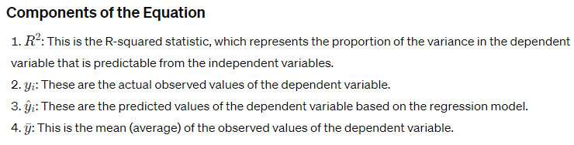
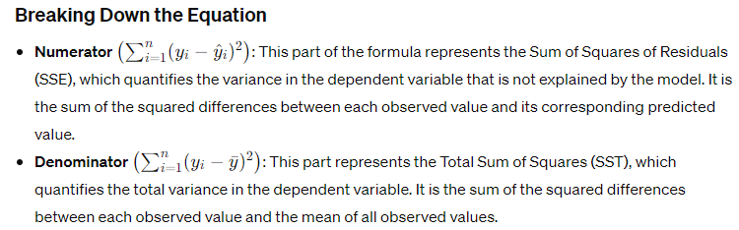
Linear Regression

Slide 32
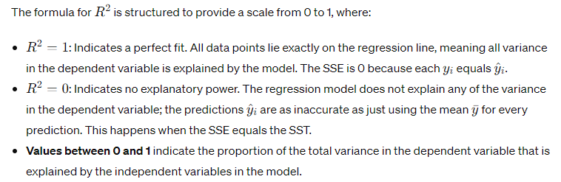
Linear Regression
Learning The Coefficients
Let's recap what we've learned so far: Linear regression is all about finding a line (or surface) that fits our data well.
And as we just saw, this involves selecting the coefficients for our model that minimize our evaluation metric.
But how can we best estimate these coefficients? In practice, they're unknown, and selecting them by hand quickly becomes infeasible for regression models with many features.

Slide 33
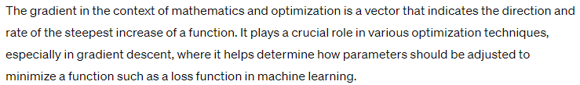
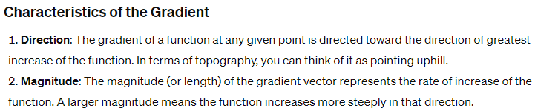
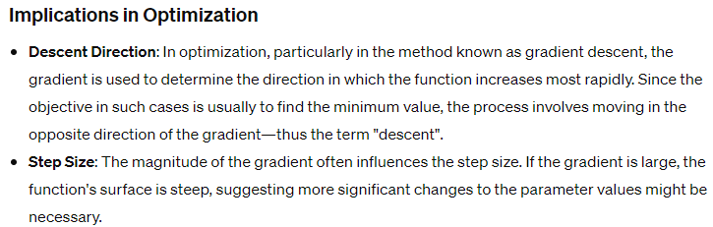
Linear Regression

Slide 34
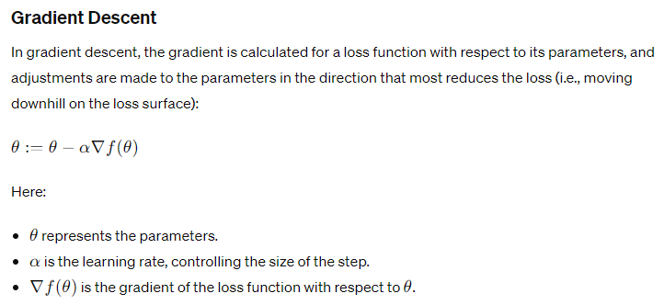
Linear Regression

Slide 35
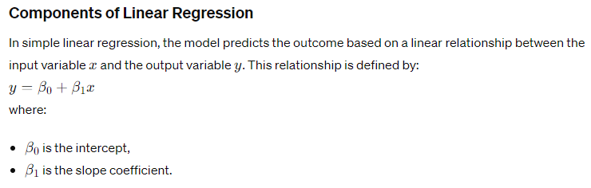
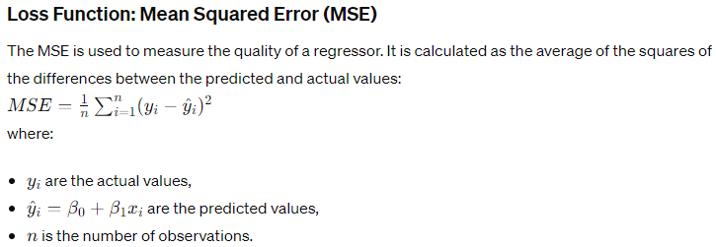
Linear Regression

Slide 36
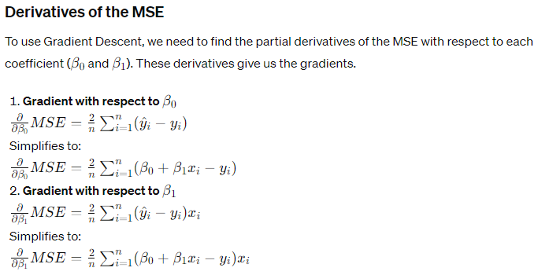
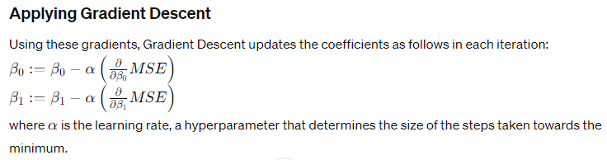
Linear Regression

Slide 37
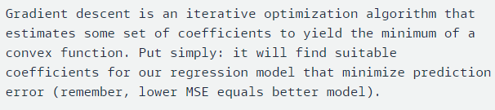
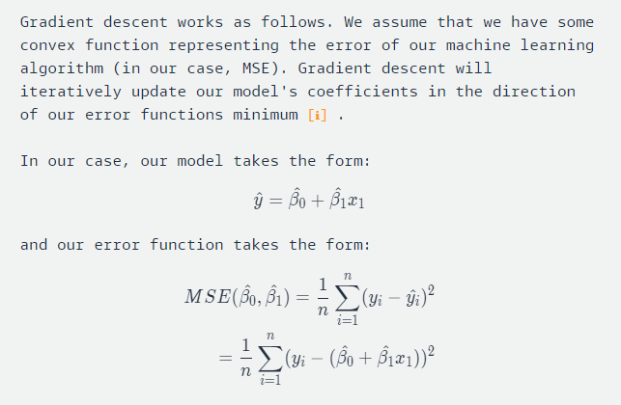
Linear Regression : Gradient Descent

Slide 38
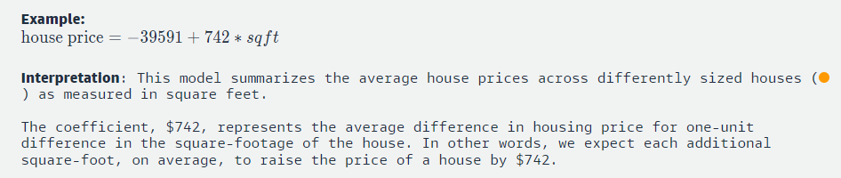
Linear Regression

Slide 39
Logistic Regression
Logistic regression is a statistical method for analyzing datasets in which there are one or more independent variables that determine an outcome.
The outcome is a binary variable, meaning it has two possible outcomes.
The model predicts the probability of a certain class or event, such as pass/fail, win/lose, alive/dead, etc

Slide 40
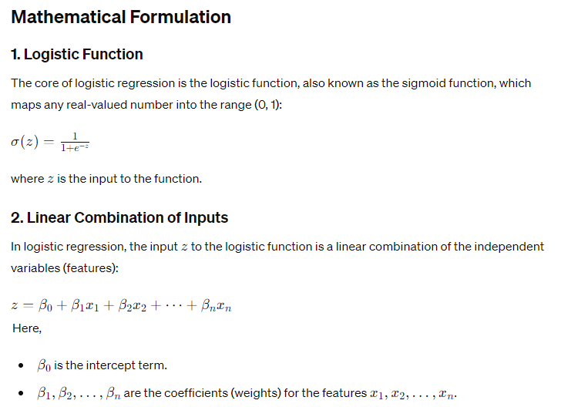
Logistic Regression

Slide 41
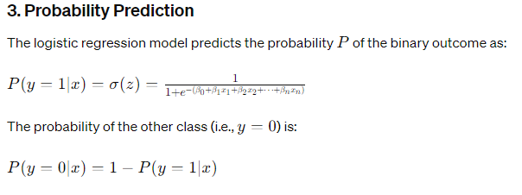
Logistic Regression

Slide 42
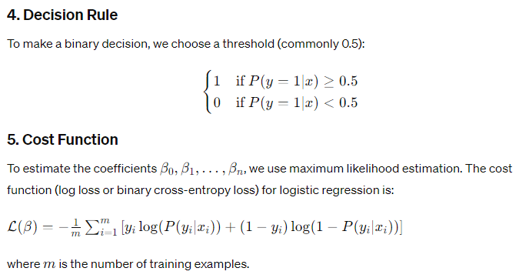
Logistic Regression

Slide 43
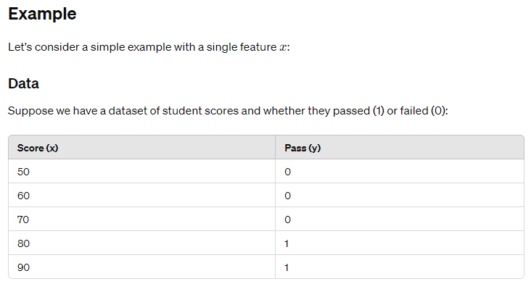
Logistic Regression

Slide 44
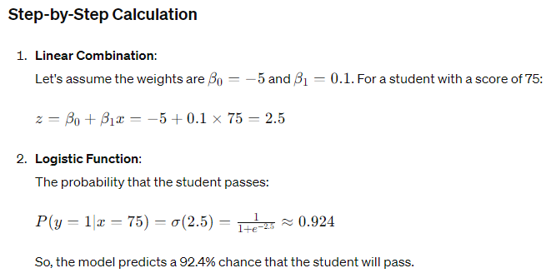

Logistic Regression

Slide 45
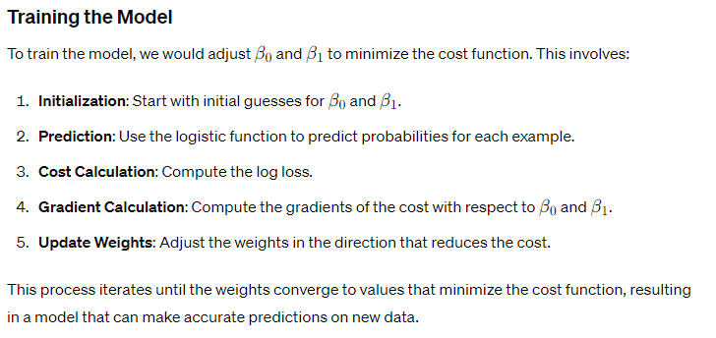
Logistic Regression

Slide 46
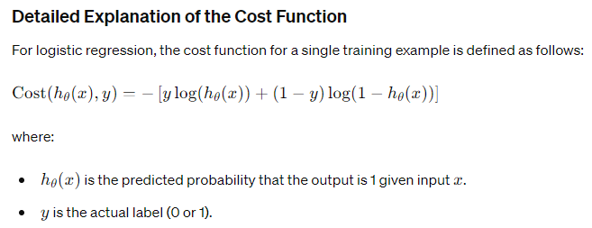
Loss function
The cost function in logistic regression, also known as the log loss or binary cross-entropy loss, measures the performance of a classification model whose output is a probability value between 0 and 1.
The cost function quantifies the error between the predicted probabilities and the actual binary labels.
Minimizing this cost function helps to fit the logistic regression model to the training data.

Slide 47
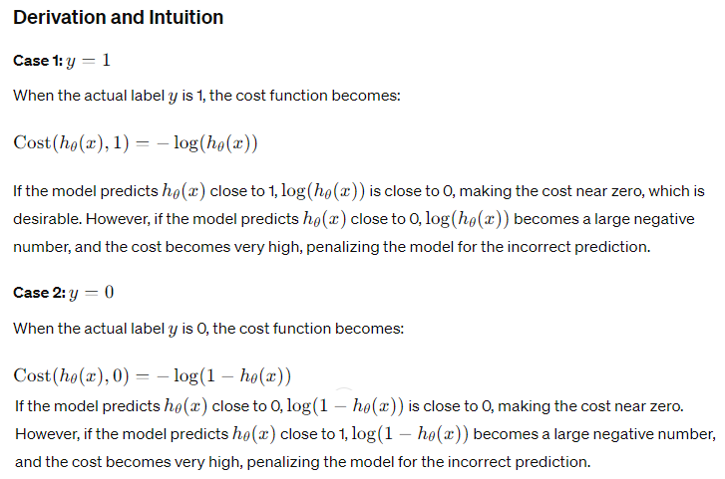
Logistic Regression

Slide 48

Logistic Regression

Slide 49
Summary
The cost function in logistic regression measures the error between the predicted probabilities and the actual binary labels.
It penalizes wrong predictions more heavily, encouraging the model to produce probabilities closer to the true labels.
By minimizing this cost function using optimization techniques like gradient descent, we can fit the logistic regression model to the training data, resulting in accurate predictions on new data.

Slide 50

Summary

Slide 51

Summary

Slide 52

Summary

Slide 53

Summary

Slide 54

Summary

Slide 55


Polynomial Regression

Slide 56

Polynomial Regression

Slide 57

Polynomial Regression

Slide 58

Polynomial Regression

Slide 59

Polynomial Regression

Slide 60

Polynomial Regression
Polynomial Regression is a form of regression analysis in which the relationship between the independent variables and dependent variables are modeled in the n^{th} degree polynomial.
Polynomial Regression models are usually fit with the method of least squares. The least square method minimizes the variance of the coefficients, under the Gauss Markov Theorem.
Polynomial Regression is a special case of Linear Regression where we fit the polynomial equation on the data with a curvilinear relationship between the dependent and independent variables.

Slide 61


Polynomial Regression

Slide 62

Polynomial Regression

Slide 63

Polynomial Regression

Slide 64

Polynomial Regression

Slide 65


Polynomial Regression

Slide 66

Lasso and Ridge Regression

Slide 67

Lasso and Ridge Regression

Slide 68

Lasso and Ridge Regression

Slide 69

Lasso and Ridge Regression

Slide 70


Lasso and Ridge Regression

Slide 71

Lasso and Ridge Regression

Slide 72

Lasso and Ridge Regression

Slide 73


Lasso and Ridge Regression

Slide 74

Lasso and Ridge Regression

Slide 75


Lasso and Ridge Regression

Slide 76

Lasso and Ridge Regression

Slide 77

Lasso and Ridge Regression

Slide 78

Lasso and Ridge Regression

Slide 79

Lasso and Ridge Regression

Slide 80
Regression Ends

