Slide 1
Linear Regression
Dr. V. Chandra Sekhar

Slide 2
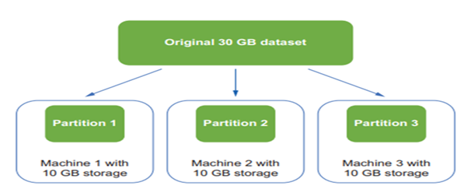
Paralellism

Slide 3
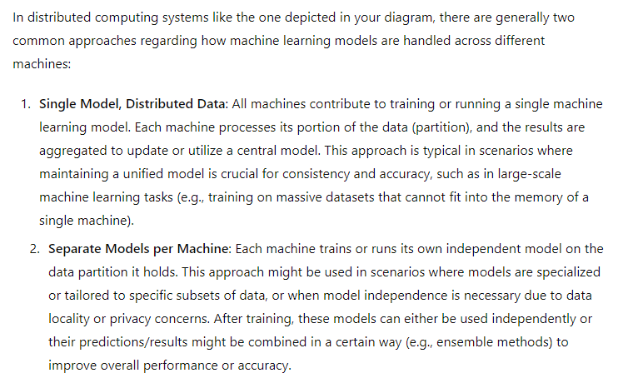
Paralellism

Slide 4
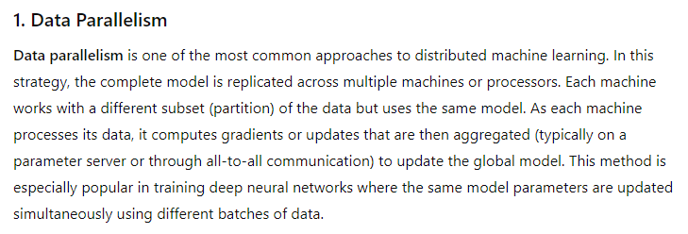
Paralellism
Partitioning a machine learning model across multiple machines, a technique often utilized in distributed computing environments, involves several strategies depending on the model's architecture and the specific computational tasks.

Slide 5
Paralellism
Partitioning a machine learning model across multiple machines, a technique often utilized in distributed computing environments, involves several strategies depending on the model's architecture and the specific computational tasks.

Slide 6
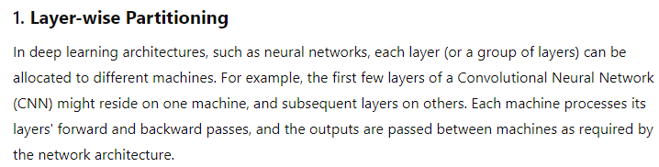
Paralellism
Model slicing, or model parallelism, involves dividing the model itself across multiple processing units or machines. This method is particularly useful when a model is too large to fit into the memory of a single machine or when different components of a model can be processed in parallel to speed up computation.

