Slide 1
Customer Churn Rate Prediction using KNIME
Project by MIS6382.503.Group 1
Members:
1. Anamika Das 2. Preksha Nagesh 3. Vishwa Rakesh Kotecha

Slide 2
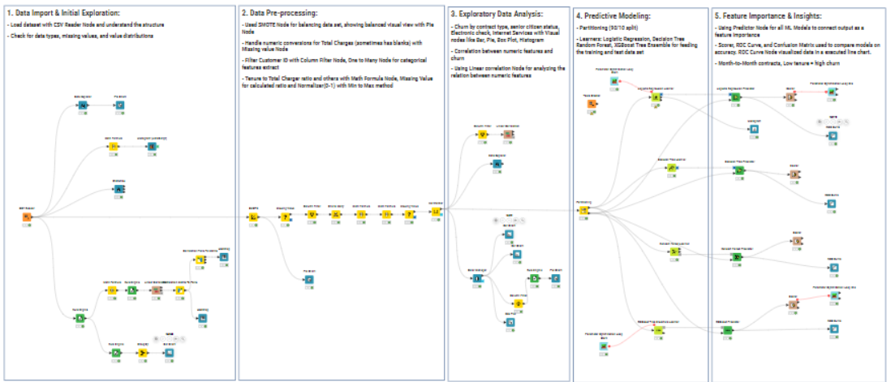
PROJECT OVERVIEW
Objective: To build a KNIME Machine Learning workflow to predict Customer Churn rate.
Dataset: The raw data contains 7043 rows (customers) and 21 columns (features).
ML Models used: Decision Tree, Logistic Regression, Random Forest and XGBoost Predictor.

Slide 3
DATA PREPROCESSING
SMOTE node: Some supervised learning algorithms (such as decision trees and neural nets) require an equal class distribution to generalize well, i.e. to get good classification performance. Since there is an imbalance between yes(1870) and no(5175) churn in the original dataset, we utilized SMOTE node to oversample ’yes’ churn rows.
Column filter node: To filter out the column “customerID” since it is not a significant feature.
One-To-Many: Convert each category of various features, including InternetService, Contract, and Payment method, into separate columns.
Normalizer: To normalize the values of columns: tenure, Monthlycharges, TotalCharges and TenureToTotalCharge Ratio.
Rule Engine node:
To convert churn data type from string to int ( yes -> 1, no -> 0)
To convert month tenure into tenure year buckets
Math Formula node:
To convert tenure months into years
To calculate the Tenure to total Charges ratio
To calculate missing values of Total charges = Monthly charges * Tenure

Slide 4
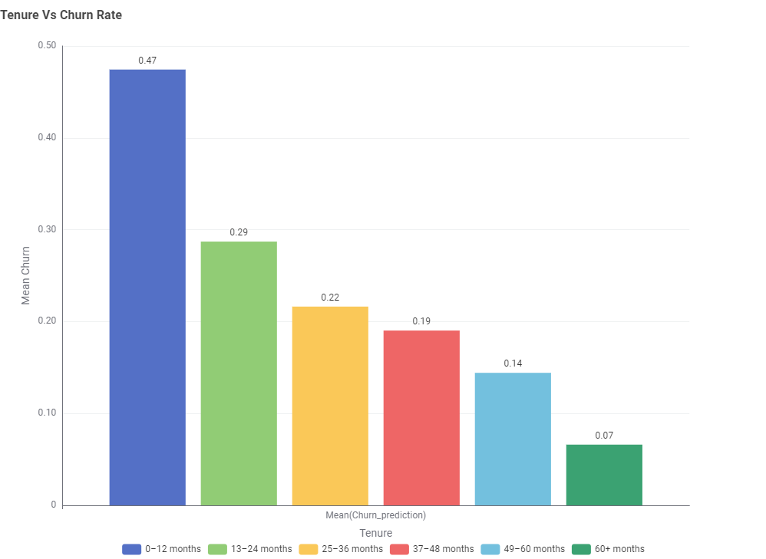
EXPLORATORY DATA ANALYSIS ON RAWDATA
We conducted data analysis on both raw data and post-oversampling of data using the SMOTE node.
Types of data visualization nodes used:
Pie Chart: to visualize the proportion of churn outcome across the dataset
Histogram: to understand the frequency of tenure in years.
Statistics: To reveal the statistics of numeric features, such as tenure, monthly charges, and total charges.
Bar chart: to visualize churn rate across all tenure years.
Linear Correlation/Heatmap: to establish visualize the correlation between tenure, Monthly charges, total charges, and churn.

Slide 5
EXPLORATORY DATA ANALYSIS POST-SAMPLING
After adding SMOTE node, the number of rows increased from 7043 to 10348. With 5174 rows with yes churn and 5174 rows with no churn, creating perfect balance for classification supervised ML models.
Types of data visualization nodes used:
Pie Chart: to visualize the proportion of churn outcome across the dataset; the proportion of churn across different internet service types.
Box plot: Financial behavior amongst churned customers.
Bar chart: to visualize churn across several categories of customers, including Senior citizens and contract type.
Linear Correlation: to establish and visualize the correlation between tenure, Monthly charges, and total charges. Note: The correlation values are almost equal before and after sampling.

Slide 6
PREDICTIVE MODELING
Partitioning
Partitioning the data in 90/10
Using 90% data for training the model
Remaining 10% goes in testing/validation the model
Modelling
The given customer churn prediction is a Yes/No classification problem.
Hence, the models selected are Logistic Regression, Decision Tree, Random Forest and XGBoost.
To optimize some models, we implemented Parameter Optimization Loop for Hyperparameter tuning.

Slide 7
Logistic Regression Learner:
We have used Hyperparameter tuning for this model using stepSize.
As we need the prediction base on Churn, set the targer column to churn and Epsilon to 1E-5
Decision Tree Learner:
We set the class column to Churn as that is our target column.
Selecting the criteria for split as Gini index for the best AUC value and pruning method as MDL.
Random Forest Learner:
Selected the target column as churn and the split criteria as Information Gain Ration for the best AUC result.
XGBoost Learner:
Used Lambda and Epsilon as Hyperparameter tuning parameters.
Set the tree construction booster to tree and depth to 10 for maximum optimized results.

Slide 8
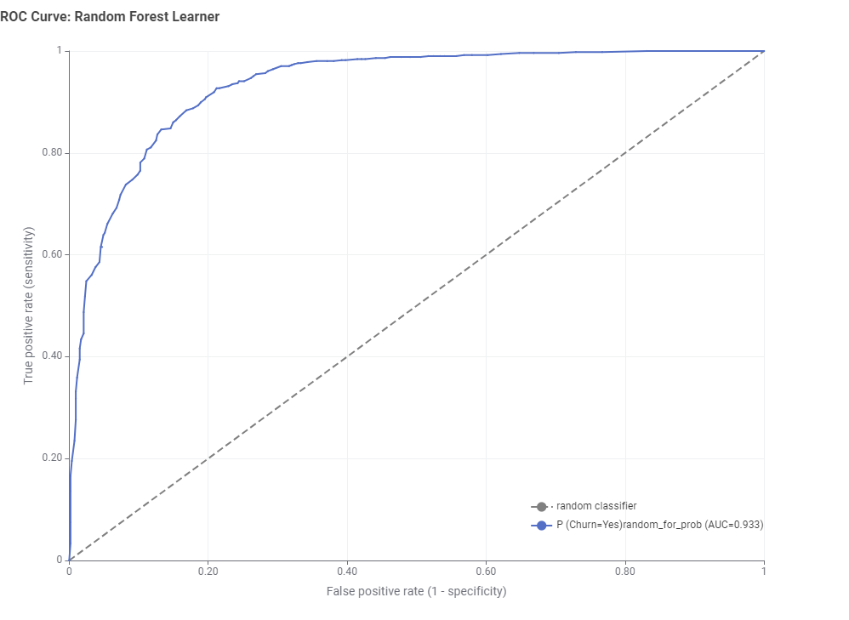
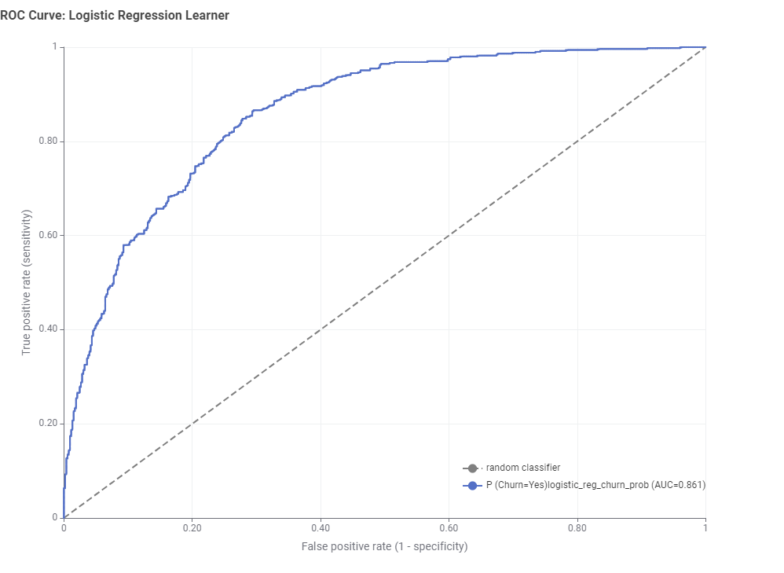
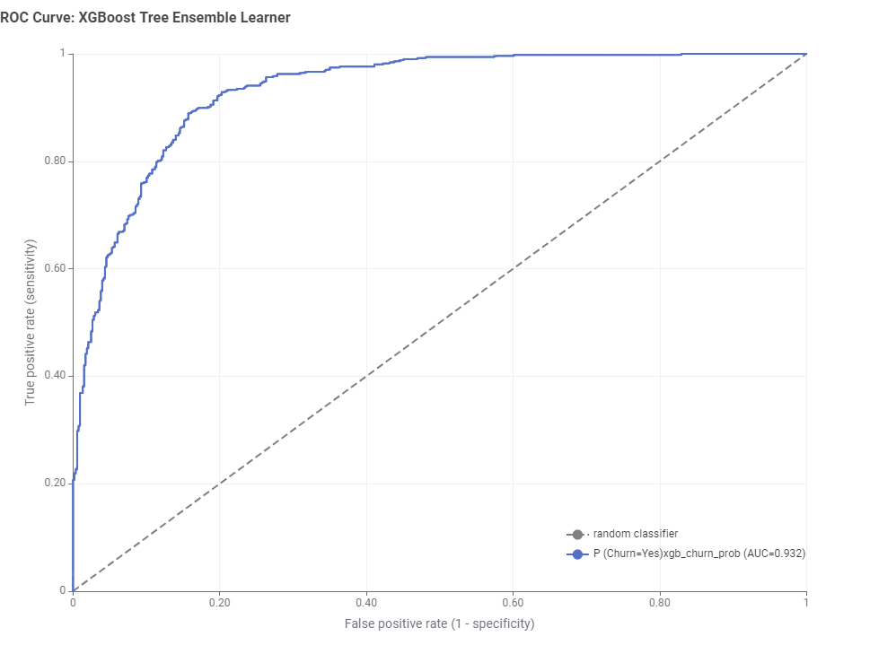
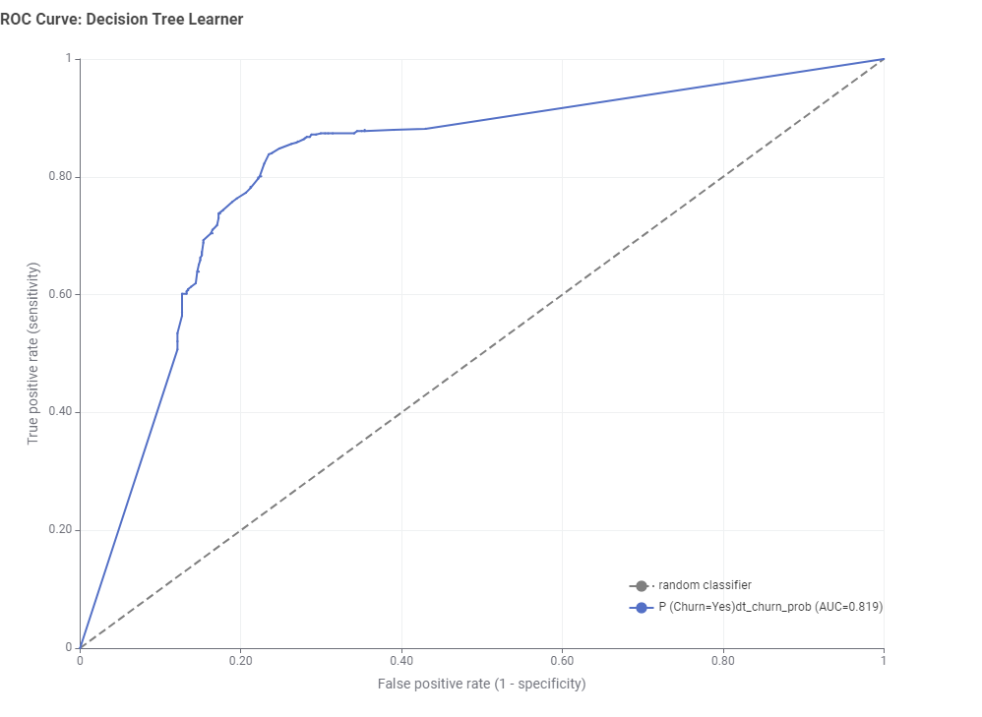
BEST MODEL CHOSEN
Random Forest Learner(Best), Based on the ROC curve accuracy(AUC 0.933)
XGBoost Tree Ensemble Learner(Second best) as ROC curve slightly difference(AUC 0.932)

Slide 9
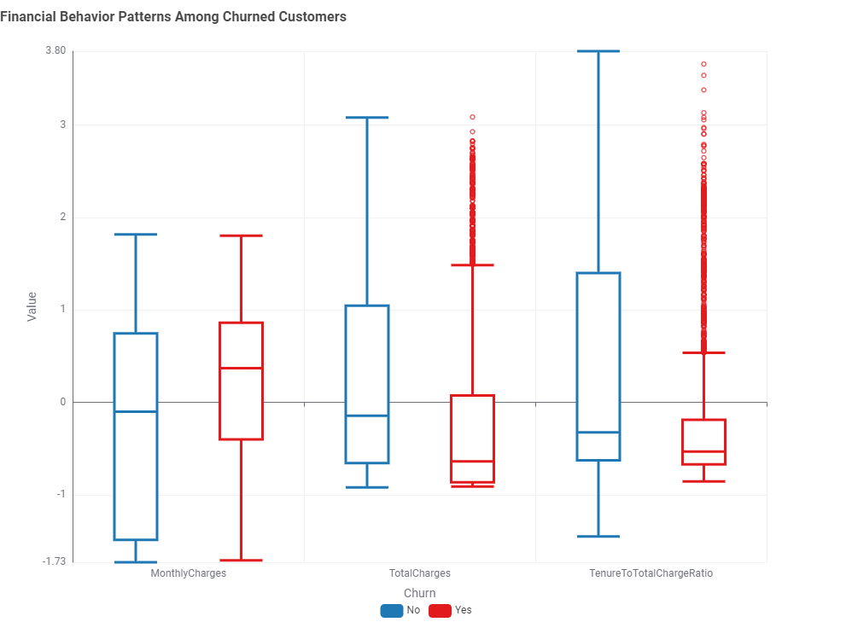
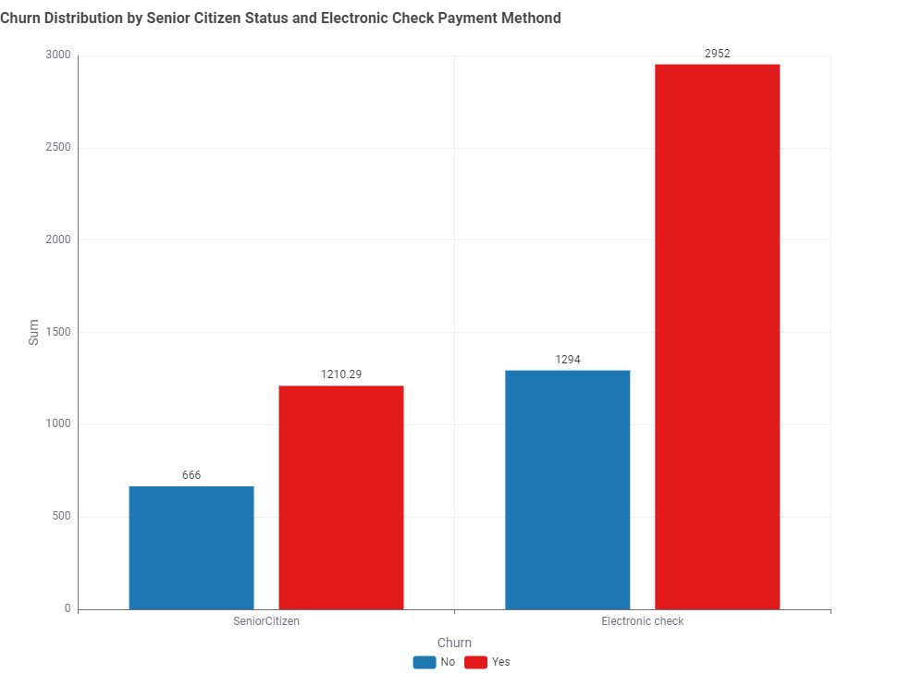
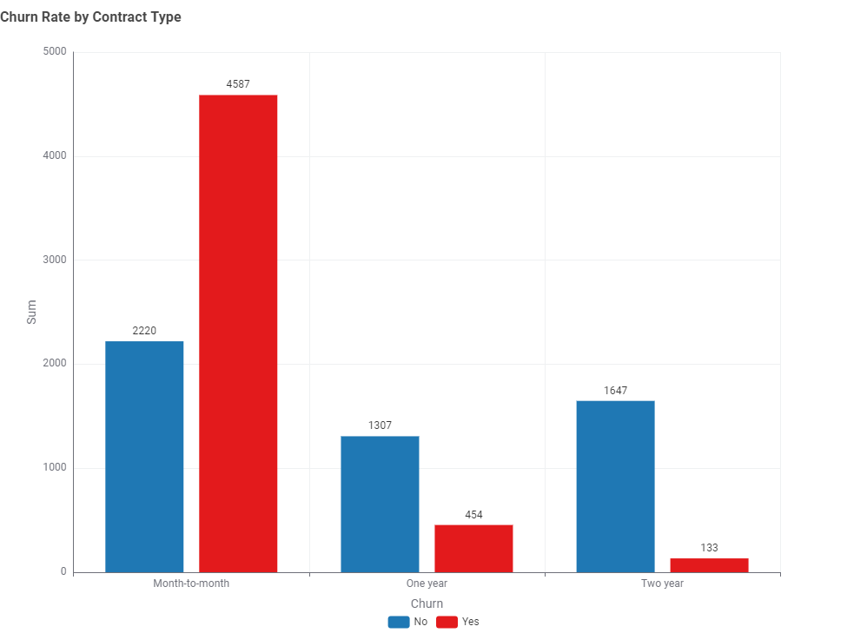
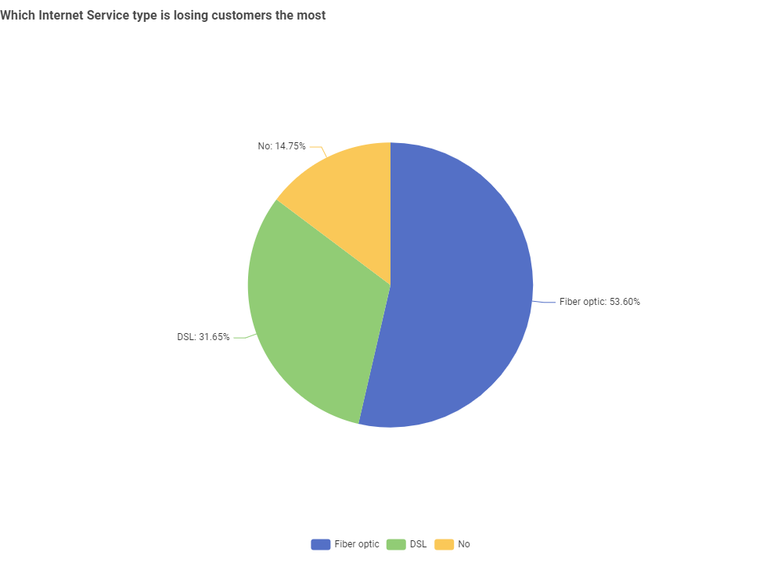
FEATURE IMPORTANCE
Month to month contract, Internet Service: Fiber Optic, Financial Behabior: Monthly Charge, Total Charge, Tenure to Total Charge ration and Senior Citizen, Electronic Check
The following figures are showing the justification according to the Churn Rate vs Features

Slide 10
RECOMMENDATIONS FOR CUSTOMER RETENTION
Encourage 1-2 year contracts
Offer loyalty discounts to high-risk churners
Discount to customers who use Electronic Check as a payment method
Improve Tech supports specially for Fiber Optic internet service holders
Discount to Senior citizen customers
Multi-service discount

