Slide 1
Group 1 Presentation
Group Members: Anamika Das, Vishwa Kotecha, Christopher Sanders, Judy Yang

Slide 2
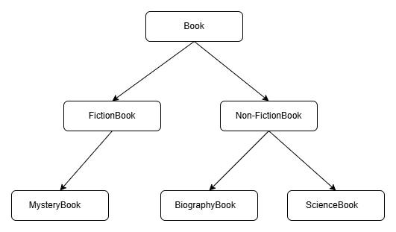
Introduction
Data about Books in a Library from their Catalog
Hierarchy Diagram of Dataset
Dataset: The data set is about book library catalog containing 12,000 individual book entries.
Catalog: Information is about books across three genres- Biography, Mystery, and Science. Each title's genre falls in a hierarchy, being classified as either a Fiction or Non-Fiction book "type".

Slide 3
Data Cleaning and Preprocessing
Key Attributes Analysis: info(), describe(), isnull().sum()
Categorical Column: These represent groups or categories. They describe qualities or labels, not numbers.
Date, title, type, genre
How it was cleaned:
Using the .fillna() and mode()
Numerical Column: These represent measurable quantities. They are actual numbers you can count or measure.
Price, rating, average_reading time
How it was cleaned:
Using the .fillna() and .mean()

Slide 4
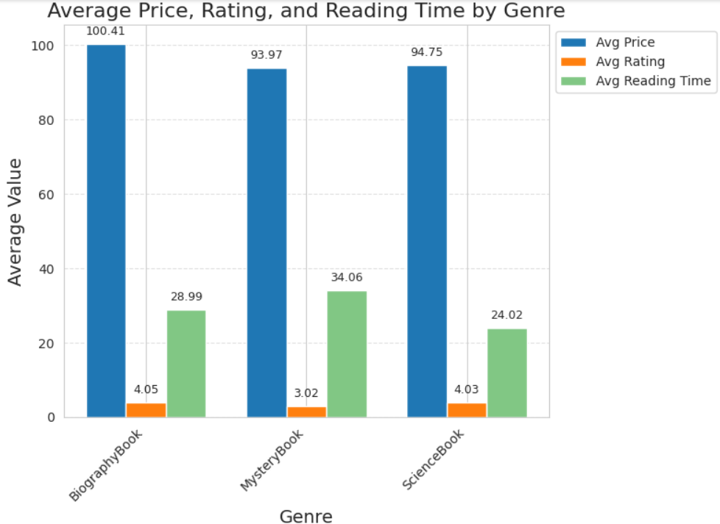
Visualization – Bar Chart
BiographyBook: premium priced, highly rated, and moderately time-consuming — ideal for deep, quality-oriented readers.
MysteryBook: long reading engagement but with a lowest rating, suggesting a potential mismatch between reader expectation and content. Indicates that although Mystery books are lengthy, they are less favored by readers.
ScienceBook: quicker reading, high satisfaction, and moderate price — a strong choice for time-conscious readers seeking quality.

Slide 5
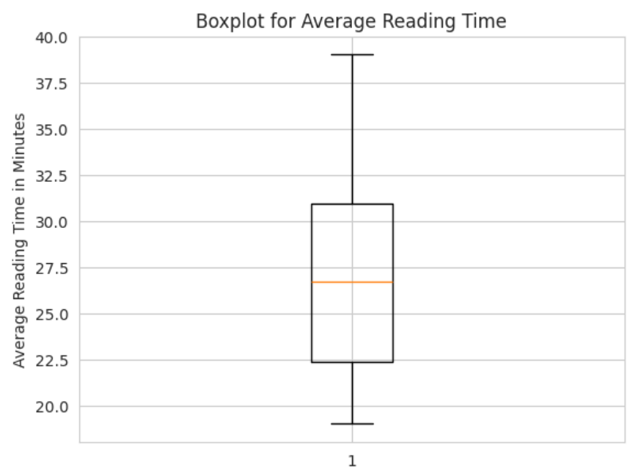
Visualization – Boxplot
50% of the average reading time is between 22.5 minutes to ~31 minutes
Median is ~27 minutes
Relative balance
Box is closer to the minimum
Slightly right-skewed
Seems symmetric around the median with a slight tendency toward longer reading times due to higher maximum values
No outliers = relatively consistent data

Slide 6
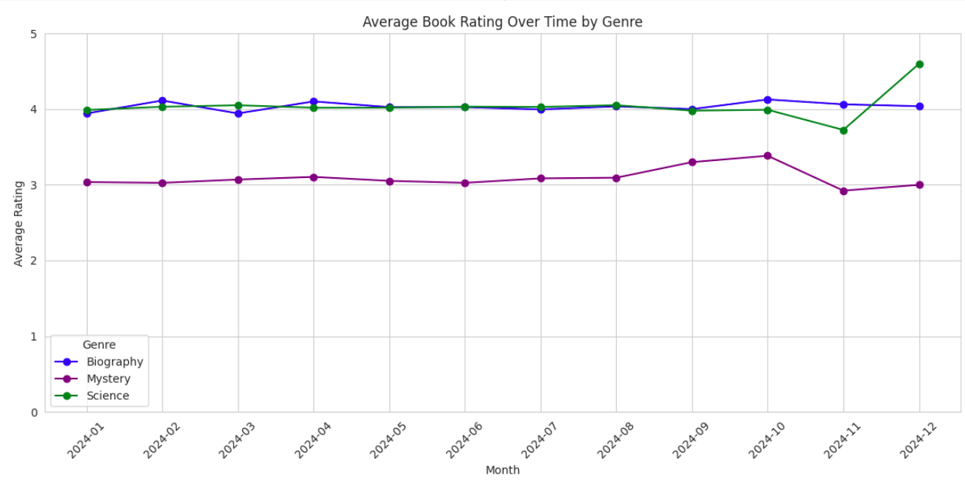
Visualization – Line Plots
Mystery rose in August, peaking in October, which correlates with Halloween.
Science dipped in November but spiked in December.
Biography was fairly static year-round.
Science was the most popular.

Slide 7
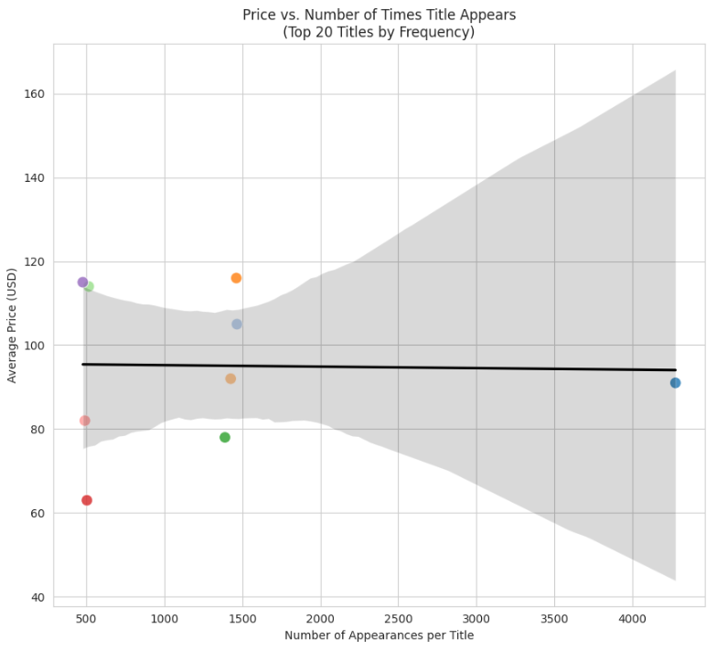
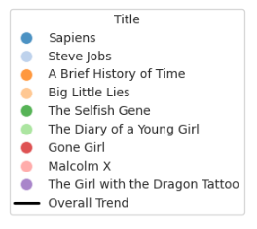
Visualization – Scatter Plots
Nature of title “Popularity” (Number of Times Title Appears) is ambiguous
Could it be demand or supply?
No correlation to Average Price

Slide 8
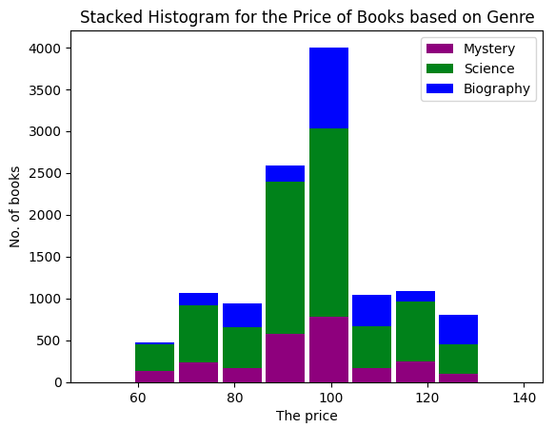
Visualization – Histogram
Majority of the books are science books
Followed by Biography, then Mystery
Suggest specialized or niche library
Central tendency cost is in the range of $95 - $105
Suggest premium quality and/or specialized content

Slide 9
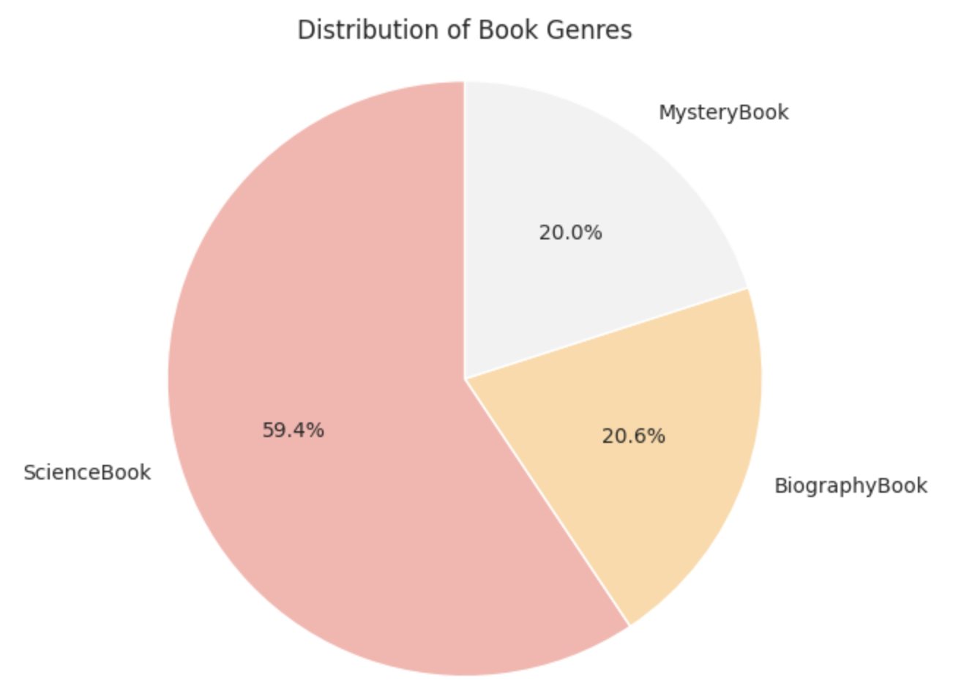
Visualization – Pie Charts
The pie chart highlights the proportional representation of book genres in the dataset.
ScienceBook dominates the collection, making up approximately 59.4% of the total. The remaining genres,
BiographyBook and MysteryBook, are almost evenly split with 20.6% and 20.0% respectively.
Dive into visualization/trend discussion

Slide 10
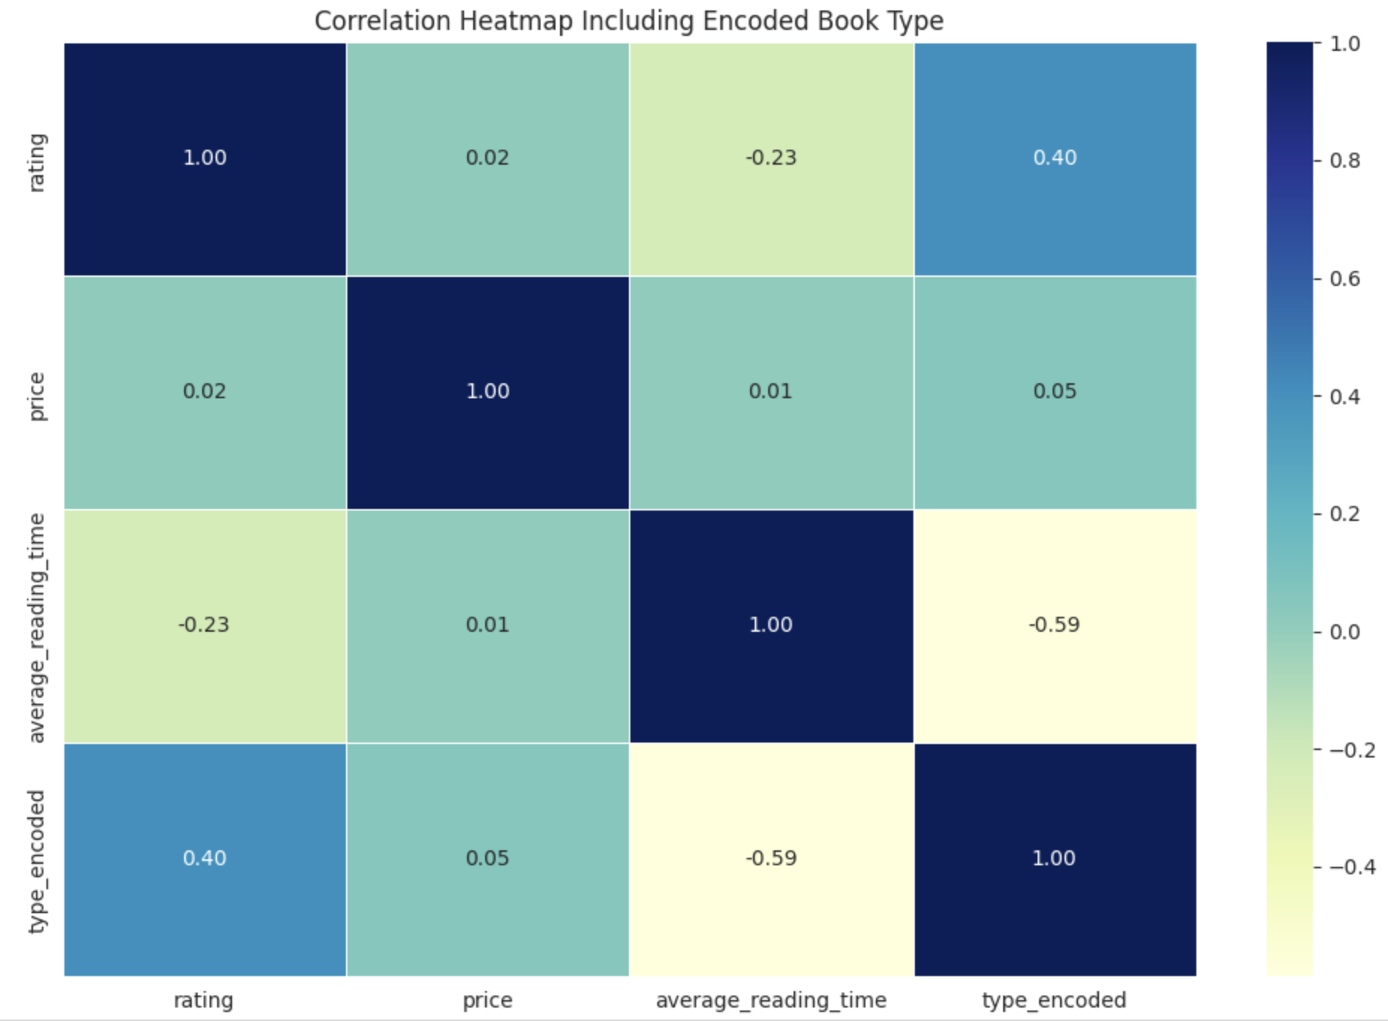
Visualization – Heat Maps
The heatmap illustrates the correlation between key numerical attributes of the books dataset: rating, price, average reading time, and the encoded book type (where Fiction = 0 and Non-Fiction = 1).
The most notable observation is the moderate negative correlation (-0.59) between average reading time and type_encoded, indicating that Non-Fiction books (type = 1) tend to have shorter reading times compared to Fiction.
Conversely, a positive correlation (0.40) between rating and type_encoded suggests that Non-Fiction books are generally rated higher.
Other relationships implying pricing is relatively independent of book type, rating, or length.

Slide 11

Conclusion
Non-Fiction books dominate the collection, with Science books contributing the highest volume.
Average price range between $95 - $105 suggest that the books are likely premium quality and biography has the highest average price amongst all genre.
Mystery books have the longest average reading time but the lowest average rating.
Mystery spikes in October and Science dips in November before spiking in December.
There is no correlation between the “popularity” of books in the library catalogue and average price.
Non-Fiction book tend to have shorter reading time as compared to Fiction.

Slide 12
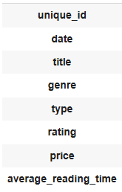
Proposed Recommendation
Current Book Attributes:
Include reader demographics (age, gender, occupation) to understand audience preferences
Record completion rate of books to assess engagement beyond just reading time
Include Borrowing Frequency: Track how often each book is borrowed to gauge popularity
Capture Publication Year: Understand trends based on book age and relevance
Have more specialized genres due to disproportion
Effort should be made to demystify the nature of title “popularity” in the catalogue.

Slide 13
Thank You :)

