Slide 1
📋 Todo List CLI Application
Built in Java • By Anamika Kumari

Slide 2
🎯 Approach & Design
Built a command-line Todo app using Java for ease and portability.
Designed with modular architecture: Model, Service, and CLI interface.
Uses JSON file for simple and lightweight task persistence.
Core features: Add, List, Remove, Complete, Filter by Category.
org.json (json.jar) used for JSON parsing and serialization.
Junit library for unit testing.

Slide 3
📁 Key Files and Folders
Auto-created during unit tests
Auto-created during unit tests
src/model/Task.java – Task model (id, description, category, status).
src/service/TaskManager.java – Handles logic and file operations.
src/Main.java – CLI interface for user interaction.
data/tasks.json – Seed data for initial task bootstrapping.
Data/test_tasks.json – empty task, auto – created during unit tests
test/TaskManagerTest.java – JUnit test cases for all core features.
lib/ – Contains external JARs: json.jar, junit-4.13.2.jar, hamcrest-core-1.3.jar.
bin/ – Contains compiled .class files.

Slide 4
▶️ Running the Application
Compile code:
javac -cp ".;lib/json.jar" -d bin src/model/Task.java src/service/TaskManager.java src/Main.java
Run app:
java -cp ".;bin;lib/json.jar" Main
CLI Commands:
• add → Create new task
• list → Display all tasks
• list-category → Filter by category
• complete → Mark task as completed
• remove → Delete task by ID
• exit → Quit application

Slide 5
🧪 Running Unit Tests
Unit tests written using JUnit 4.
Test Cases: Add Task, Remove Task, Complete Task, Filter by Category.
Ensure junit and hamcrest JARs are in lib/:
• junit-4.13.2.jar
• hamcrest-core-1.3.jar
Compile:
javac -cp ".;lib/*" -d bin src/*.java test/*.java
Run:
java -cp ".;bin;lib/*" org.junit.runner.JUnitCore TaskManagerTest

Slide 6
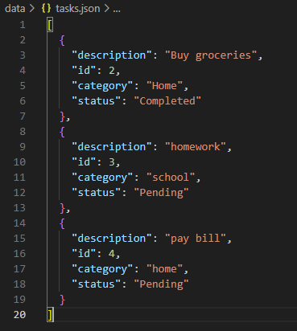
Seed Data
Test Data
Test Scenario | Sample Data Used
Add a task | "Write unit tests"
Remove a task | Task with ID 1
Handle empty task list | Starts with an empty task file test_tasks.json
Mark complete | Task with status change
Filter by category | Multiple tasks with category = "Work"

