Slide 1

ARYA COLLEGE OF ENGINEERING · KUKAS, JAIPUR
ARYA’S
DOMAIN VERSE 1.0
EXPLORE | SOLVE | INNOVATE | BEYOND LIMITS
A 6-DAY TECHNICAL PROBLEM-SOLVING PROGRAM · AGENTIC AI TRACK (PS-02)
Submission: AI College Helpdesk Agent
An autonomous, evidence-grounded RAG assistant for Students, Faculty & Staff
DATE
DURATION
TRACK
PARTICIPANT
24 – 30 Sep 2026
6 Days
Agentic AI (PS-02)
Anamika Shah
An initiative by Arya Innovators Club · Powered by Gemini

Slide 2
THE PROBLEM
Students can't find scattered college information
1
Real-world scenario
2
Why it matters
Students regularly need info on exams, departments, events, clubs and facilities — scattered across notices, PDFs, webpages and predefined data. They often don’t know where to look.
A simple, reliable way to access college information saves time for both students and staff, every single day.
3
Who the users are
4
Expected outcome
Students, faculty, and other members of the college community — each with different information needs.
A helpdesk agent that understands a request, finds the relevant information, and responds clearly — without inventing anything.
PS-02 · AI College Helpdesk Agent · Domain Verse 1.0
2

Slide 3
OBJECTIVE
Build a controlled, tool-using helpdesk agent
Build an AI-powered helpdesk that answers college-related questions using a controlled information source and appropriate tools — never free-floating generation.
PS-02 compliance
NLU • Controlled retrieval • RBAC • Evidence grounding • Agent planning • Zero-downtime fallback — all met.
1
2
3
4
Understand
Retrieve
Ground
Replan
Multi-turn natural-language queries via LangChain + Gemini
Vector search over local PDFs and structured data.json
Every answer tagged with its exact evidence source
Deterministic fallback when API limits or context shifts
PS-02 · AI College Helpdesk Agent · Domain Verse 1.0
3

Slide 4
ARCHITECTURE
How a query becomes a grounded answer
Streamlit Web UI
Student / Faculty / Staff
Router & Agent Executor
Plan → Act → Replan
Dense Vector Search (RAG)
Deterministic Rule Engine
ChromaDB + Gemini embeddings
JSON + PDF local parser (fallback)
Verified Evidence & Output
Source-tagged response
Two retrieval paths converge on one evidence-tagged answer — nothing reaches the user unsourced.
PS-02 · AI College Helpdesk Agent · Domain Verse 1.0
4

Slide 5
TECH STACK
Built entirely on free-tier, production-grade tools
Streamlit
LangChain
Google Gemini
Multi-portal web UI & session/auth routing
Agent orchestration, prompt & memory management
LLM reasoning + embeddings (free tier)
ChromaDB
Python 3.10+
Indexer
Local vector store for RAG retrieval
Core agent, indexing & fallback logic
Chunking rtu syllabus PDFs into the KB
PS-02 · AI College Helpdesk Agent · Domain Verse 1.0
5

Slide 6
ROLE-BASED ACCESS
One agent, three tailored portals
🎓
👩‍🏫
💼
Student Portal
Faculty Portal
Staff & Admin
• Timetable & room lookups
• Teaching assignments & labs
• Academic calendar oversight
• Academic calendar alerts
• Syllabus queries by semester
• Faculty allocations & venues
• Campus events & hackathons
• Department notices
• Live knowledge base uploads
PS-02 · AI College Helpdesk Agent · Domain Verse 1.0
6

Slide 7
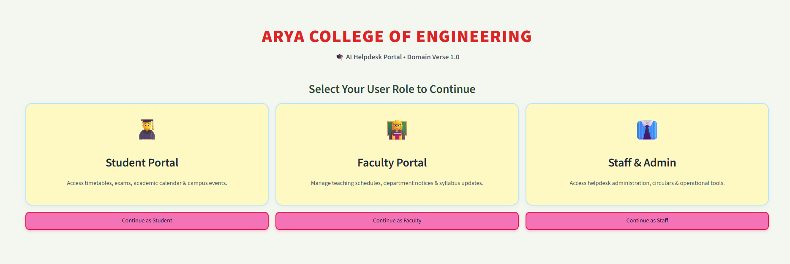
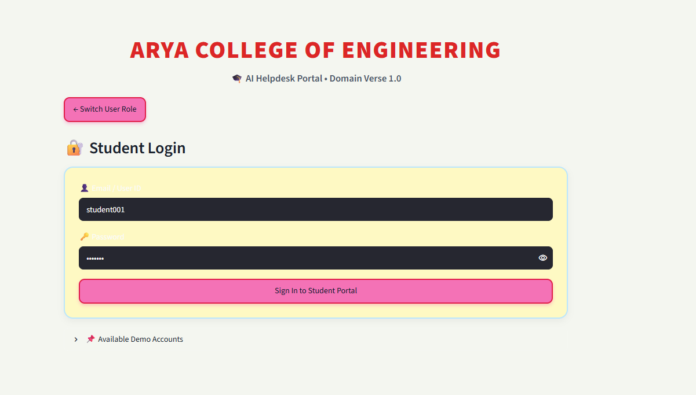
LIVE DEMO · 01
Role selection & secure sign-in
Landing screen — pick Student, Faculty, or Staff
Credentialed login per role
Access control is enforced before any query reaches the agent — each portal only exposes tools and data scoped to that role.
PS-02 · AI College Helpdesk Agent · Domain Verse 1.0
7

Slide 8
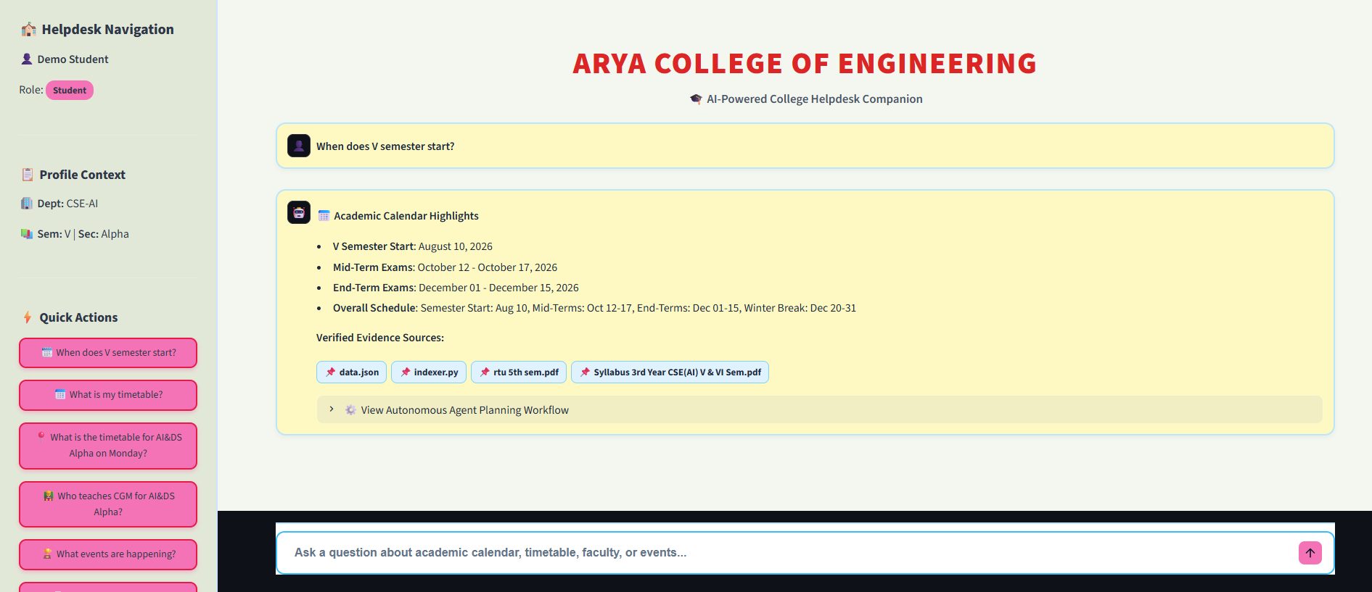
LIVE DEMO · 02
Student Portal — grounded, sourced answers
✓ Answer pulled from data.json + syllabus PDFs
✓ Every reply tags its exact evidence source
✓ “View Agent Planning Workflow” exposes reasoning
✓ Quick-action chips speed up common asks
Query: “When does V semester start?”
Query
Agent Router
RAG + Fallback
Verified Answer
PS-02 · AI College Helpdesk Agent · Domain Verse 1.0
8

Slide 9
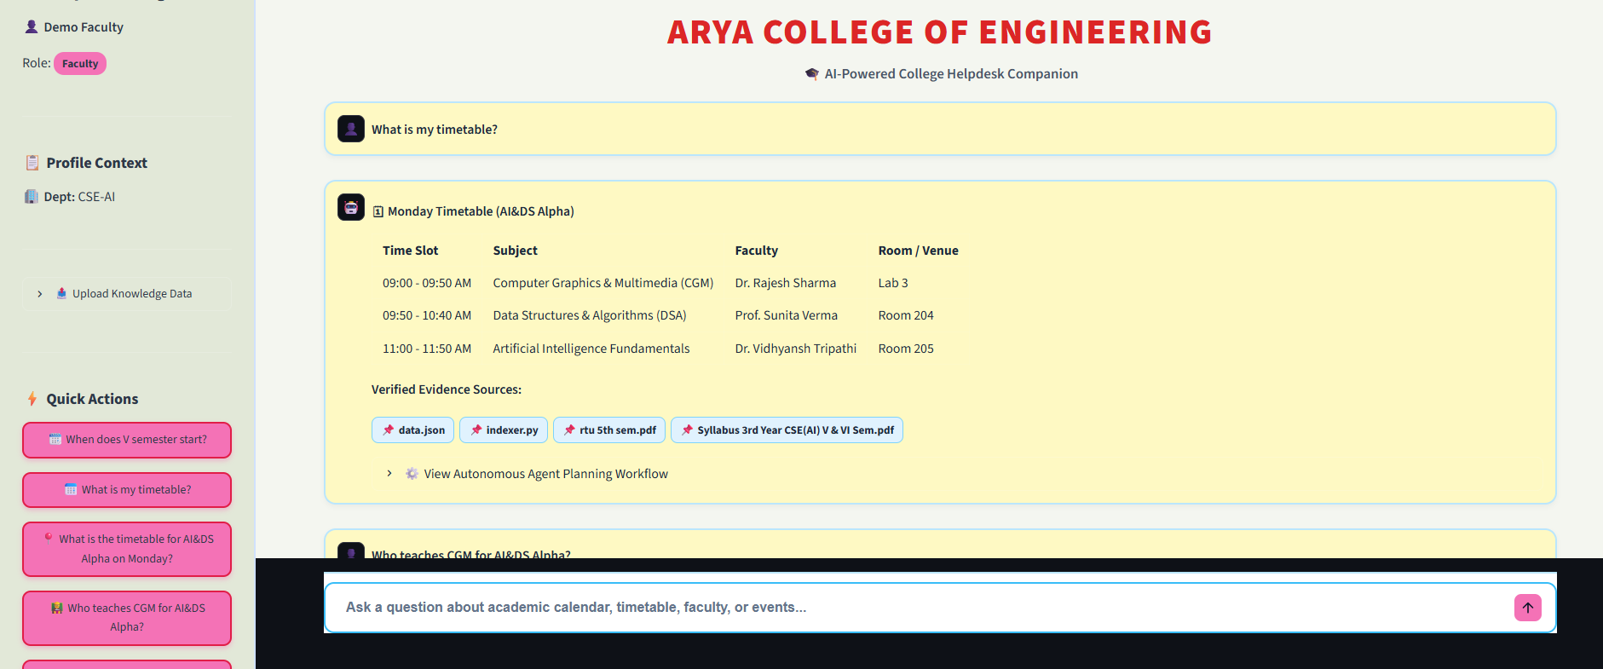
LIVE DEMO · 03
Faculty Portal — structured timetable retrieval
✓ Structured table output, not raw text
✓ Filtered to the faculty member’s own dept
✓ Same evidence-source tagging as Student view
✓ One agent core, three presentation layers
Query: “What is my timetable?”
Query
Agent Router
RAG + Fallback
Verified Answer
PS-02 · AI College Helpdesk Agent · Domain Verse 1.0
9

Slide 10
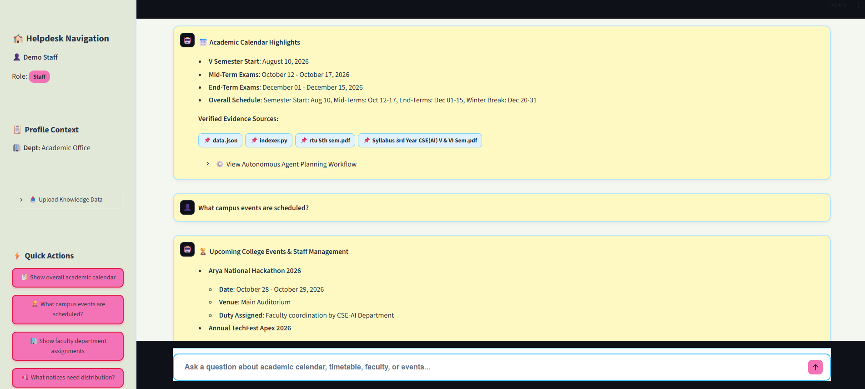
LIVE DEMO · 04
Staff & Admin — operational oversight
✓ Broadest scope: calendar, events, notices
✓ Live knowledge-base uploads re-index ChromaDB
✓ Multi-event detail (dates, venue, duty owner)
✓ Same zero-hallucination guarantee
Query: “What campus events are scheduled?”
Query
Agent Router
RAG + Fallback
Verified Answer
PS-02 · AI College Helpdesk Agent · Domain Verse 1.0
10

Slide 11
TRUST & RELIABILITY
Zero-hallucination by design
User Query
Gemini API
Available?
NO
YES
Deterministic Fallback
Gemini RAG Retrieval
Rule-based JSON + PDF parser — zero downtime
ChromaDB vector search over PDFs + data.json
Evidence-Tagged Answer
Evidence tagging
Visible planning
Scoped retrieval
Zero downtime
PS-02 · AI College Helpdesk Agent · Domain Verse 1.0
11

Slide 12
CONCLUSION
A grounded, role-aware helpdesk — built solo, live
What we delivered
What’s next
✓ Full PS-02 compliance across all 6 core requirements
→ Push notifications for exam & notice changes
✓ RAG over structured data + unstructured syllabus PDFs
→ Multi-language support for regional students
✓ 3 role-based portals on one shared agent core
→ Analytics dashboard for Staff on query trends
✓ Deterministic fallback for zero-downtime reliability
→ Voice-based query input for accessibility
✓ Transparent, inspectable agent planning workflow
→ Auto-sync with official college ERP feeds
PS-02 · AI College Helpdesk Agent · Domain Verse 1.0
12

Slide 13


