Slide 1

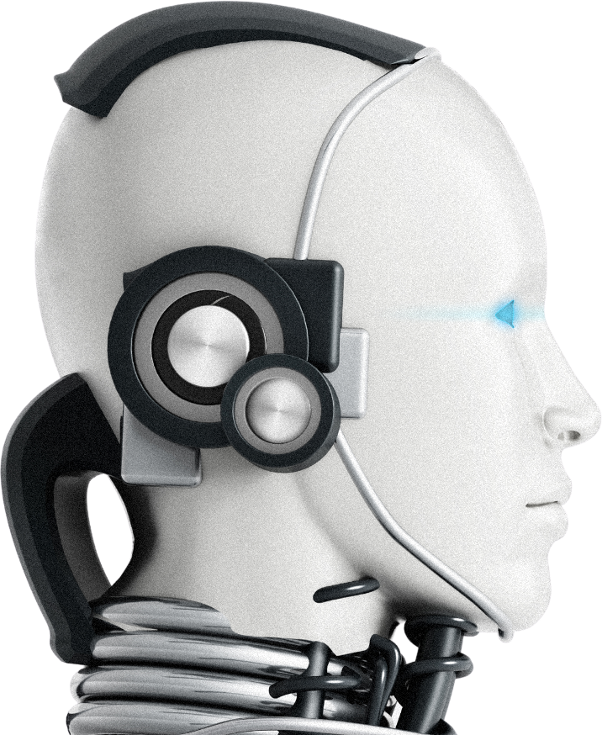
SAMADHAN 2.0
MINDSPARK
IGNITING CURIOSITY AND LEARNING
TEAM NEW HORIZON
Anamika Dwivedi
Sadhvi Pandey
Saurabh Yadav

Slide 2
PROBLEM STATEMENT
Students face difficulty identifying weak topics
Low motivation without gamification & collaboration.
Generalized test series instead of personalizes ones.
Lack of bilingual or multimedia support.

Slide 3
PROPOSED
SOLUTION
AI generates topic-wise questions to track efficiency.
Group collaboration: study rooms, chat, discussions.
Bilingual text + voice support (Hindi & English).
Gamification: badge & reward system.
Multimedia query resolution: Text, Audio, Video, PDF.

Slide 4
KEY FEATURES
Agentic AI Question Generator (tpoic-wise)
Topic Efficiency Tracker with analytics.
Adaptive Personalized Learning (learning speed).
Bilingual AI Tutor: Hindi & English (Text + Voice).
Group Collaboration Tools: Study rooms, peer chat.
Multimedia Inputs: Text, Audio, Video, PDF.
Gamified Badge System for motivation.

Slide 5
WORKFLOW /
SYSTEM ARCHITECTURE
STUDENT SELECTS TOPIC
AI GENERATES QUESTION
STUDENT ATTEMPTS & EVALUATED
01
03
02
DOUBTS RESOLVING VIA TEXT/
VOICE/VIDEO/PDF
PERSONALIZED RECOMMENDATIONS
EFFICIENCY TRACKER UPDATES
06
04
05
07
COLLABORATION IN STUDY ROOMS
08
BADGE SYSTEM TRIGGERS ON ACHIEVEMENT

Slide 6
BADGE AND REWARD SYSTEM
🥇
ACCURACY MASTER
⚡
SPEED SOLVER
🎤
INTERACTIVE LEARNER
📚
📈
CONSISTENCY KING
COLLABORATOR
Participated in group study & had a chat.
Steady and continuous improvement over time.
Attaining full marks in quiz.
Solving under given time.
Asked doubt via voice.

Slide 7
BILINGUAL AI DOUBT SUPPORT
SUPPORTS TEXT, AUDIO, VIDEO, PDF AS INPUT
ANSWERS DELIVERED IN HINDI & ENGLISH
RESPONSE FORMATS: TEXT & VOICE
AI EXPLAINS STEP-BY-STEP WITH EXAMPLES

Slide 8
GROUP COLLABORATION TOOLS
STUDY ROOMS FOR TOPIC- BASED COLLABORATION
LIVE CHAT & VOICE CHAT WITH PEERS
SHARED WHITEBOARD FOR SOLVING PROBLEMS
AI ASSISTED GROUP DISCUSSIONS FOR HINTS

Slide 9
ANALYTICS &
PERSONALIZED LEARNING
HEAT MAPS FOR TOPIC EFFICIENCY
GRAPHS FOR ACCURACY & SPEED TRACKING
AI GENERATES CUSTOM PRACTICE SETS FOR WEAK TOPICS
LEARNING SPEED ADAPTATION: FAST-TRACK OR GUIDED MODE

Slide 10
TECHNOLOGY STACK
FRONTEND: REACT / ANGULAR (DASHBOARD, STUDY ROOMS)
AI : LLM-BASED AGENTIC AI, SPEECH-TO-TEXT, TEXT-TO-SPEECH
BACKEND: NODE.JS / DJANGO + WEBSTOCKS
FILE HANDLING: PDF PARSING (LANGCHAIN, PYMUPDF)
COLLABORATION: WEBRTC FOR LIVE STUDY ROOMS
DATABASE: MONGODB

Slide 11
BENEFITS
STUDENTS: TOPIC MASTERY, AI TUTOR, GAMIFICATION, FOCUS ON WEAK POINTS
TEACHER: MONITOR STUDENT PROGRESS & ENGAGEMENT
INSTITUTES: DATA-DRIVEN INSIGHTS, SCALABLE SOLUTION

Slide 12
FUTURE SCOPE
Expansion to NEET, UPSC, GATE and similar exam preparations
AI-generated video explanations for all topics
Leaderboards & national-level competitions
AI mentors guiding career path recommendations

Slide 13
CONCLUSION
PERSONALIZED, ADAPTIVE, COLLABORATIVE LEARNING SYSTEM
COMBINES AI + GAMIGFICATION + PEER LEARNING
KEEPS STUDENTS IN CHECK WITH THEIR WEAK TOPICS
EMPOWERS STUDENTS TO PREPARE EFFECTIVELY FOR JEE

