Slide 1
MACHINE LEARNING • HEALTH ANALYTICS
CardioSense AI
Cardiovascular Risk Prediction & Analytics
A data-driven screening prototype built from routine health measurements
PROJECT TEAM
70K
73.7%
0.802
Om Punekar
RAW RECORDS
TEST ACCURACY
ROC-AUC
Roll No. 13 • Section A7-B1 • 27/10/2026
Model comparison • Feature analysis • Streamlit app
ACADEMIC PROJECT PRESENTATION

Slide 2
01 / CONTEXT
Why predict cardiovascular disease risk?
The project turns routine health measurements into an estimated risk probability—not a diagnosis.
THE PROBLEM
THE APPROACH
THE GAP
Health readings are noisy
Compare before choosing
Avoid headline-only scores
Blood pressure, age, cholesterol and body measurements can reveal risk patterns, but raw data may contain impossible values.
Clean the dataset, train multiple classifiers, select on validation ROC-AUC and evaluate once on an untouched test set.
Studies using small or different datasets report very high accuracy. Results on the same 70,000-row dataset are closer to 73%.
PROJECT OBJECTIVES
01
02
03
04
Prepare data
Benchmark models
Explain patterns
Build a tool
Remove invalid records; prevent leakage.
Compare accuracy, precision, recall, F1 and ROC-AUC.
Identify the features most important to predictions.
Make a responsive browser interface for model outputs.
Research context: Slime et al. (2024) report ~73% test accuracy on the same Kaggle dataset; Zhou et al. (2024) highlight generalisation and interpretability gaps.
CARDIOSENSE AI / CARDIOVASCULAR RISK PREDICTION & ANALYTICS
02

Slide 3
02 / DATA
Dataset profile
Public Kaggle Cardiovascular Disease dataset with a binary target (`cardio`).
70,000
68,523
≈49.5%
11 + 1
RAW PATIENT RECORDS
RECORDS AFTER CLEANING
DISEASE POSITIVE RATE
RAW INPUTS + TARGET
BMI is engineered for modeling
DEMOGRAPHICS
BODY MEASURES
VITAL SIGNS
CLINICAL
LIFESTYLE
Age
Height
Systolic BP
Cholesterol
Smoking
Gender
Weight
Diastolic BP
Glucose
Alcohol
BMI*
Activity
TARGET
cardio = 1 Disease present
cardio = 0 No cardiovascular disease
*BMI = weight (kg) / height (m)². Age is stored in days in the raw file and converted to years for modeling.
CARDIOSENSE AI / CARDIOVASCULAR RISK PREDICTION & ANALYTICS
03

Slide 4
03 / PREPARATION
Data cleaning: retain plausible records
The raw file had no missing values, but it contained impossible readings and duplicate rows.
WHAT WAS FIXED
CLEANING FUNNEL
70,000
24
Duplicate rows
Identical records removed after ignoring the ID field.
raw records
−1,477
1,329
Blood-pressure errors
2.1% removed
Kept ap_hi 70–250, ap_lo 40–200 and required ap_hi > ap_lo.
68,523
124
Body-measure errors
Applied broad height, weight and BMI plausibility ranges.
clean records retained
STRATIFIED SPLIT · RANDOM STATE 42
Feature engineering: age → years • derive BMI • drop ID and raw age
Wide rules preserve severe readings (e.g., 200/120 mmHg) rather than removing them as outliers.
CARDIOSENSE AI / CARDIOVASCULAR RISK PREDICTION & ANALYTICS
04

Slide 5
04 / METHOD
A leakage-aware training workflow
The test set is held back until the final evaluation; validation data selects the winning model.
01
02
03
04
05
06
RAW CSV
CLEAN + DERIVE
SPLIT
TRAIN MODELS
VALIDATE
TEST ONCE
70,000 rows
68,523 rows
70 / 15 / 15
7 models
Pick by ROC-AUC
Final metrics
STRATIFIED DATA SPLIT
EVALUATION METRICS
TRAIN
VALIDATION
TEST
Accuracy
Precision
Recall
F1
ROC-AUC
47,966 · 70%
10,278 · 15%
10,279 · 15%
Overall correctness
Reliability of positive flags
Diseased patients detected
Precision–recall balance
Ranking across cutoffs
Reproducibility: random_state = 42 • scaling fitted on training data only • model selected on validation ROC-AUC (0.8002)
Models cover linear, distance-based, margin-based (SVM), tree-based (entropy) and boosted approaches.
CARDIOSENSE AI / CARDIOVASCULAR RISK PREDICTION & ANALYTICS
05

Slide 6
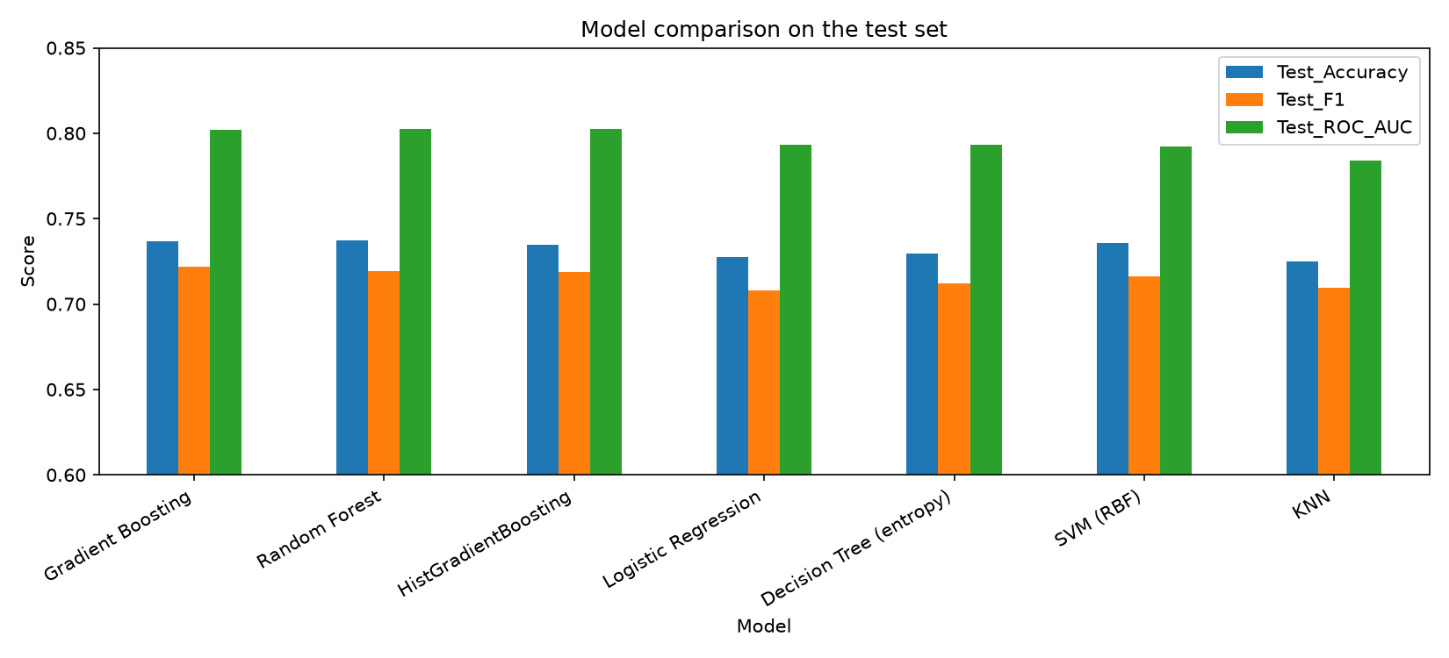
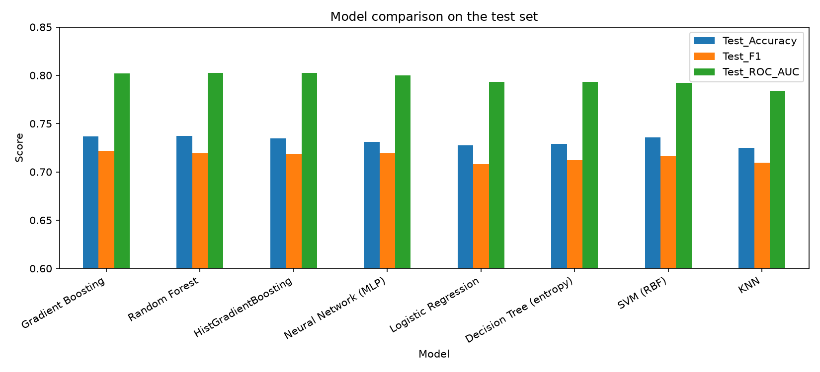
05 / BENCHMARK
Model comparison: scores are tightly clustered
Seven models were trained on the same split; the strongest three are within 0.001 ROC-AUC.
HOW TO READ THIS
73–74%
Accuracy range across the strongest models
Selected: Gradient Boosting
Validation ROC-AUC = 0.8002 — the winner was selected before checking test results.
Important distinction
Random Forest has the highest test accuracy (73.74%) and HistGradientBoosting the highest test ROC-AUC (0.8026), but test scores are for evaluation—not model selection.
Source: project outputs/model_comparison.csv (7 models, same split).
CARDIOSENSE AI / CARDIOVASCULAR RISK PREDICTION & ANALYTICS
06

Slide 7
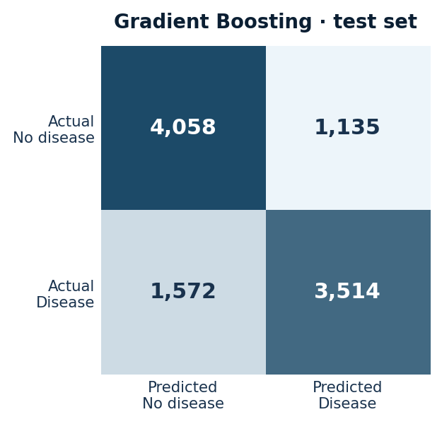
06 / TEST RESULTS
Gradient Boosting: final held-out performance
Test set: 10,279 records • Model picked using validation ROC-AUC = 0.8002.
73.66%
75.59%
69.09%
0.8022
ACCURACY
PRECISION
RECALL
ROC-AUC
Correct predictions
Positive flags that were correct
Diseased patients detected
Ranking ability
Screening trade-off: lowering the cutoff catches more cases
Cutoff
Accuracy
Recall
Missed
False alarms
0.5
73.7%
69.1%
1,572
1,135
0.4
72.7%
77.6%
1,140
1,664
0.3
68.4%
87.6%
633
2,620
At cutoff 0.4, recall rises by 8.5 points while accuracy falls by about 1 point.
A model prediction is an estimate; recall, precision and thresholds have different costs depending on the screening setting.
CARDIOSENSE AI / CARDIOVASCULAR RISK PREDICTION & ANALYTICS
07

Slide 8
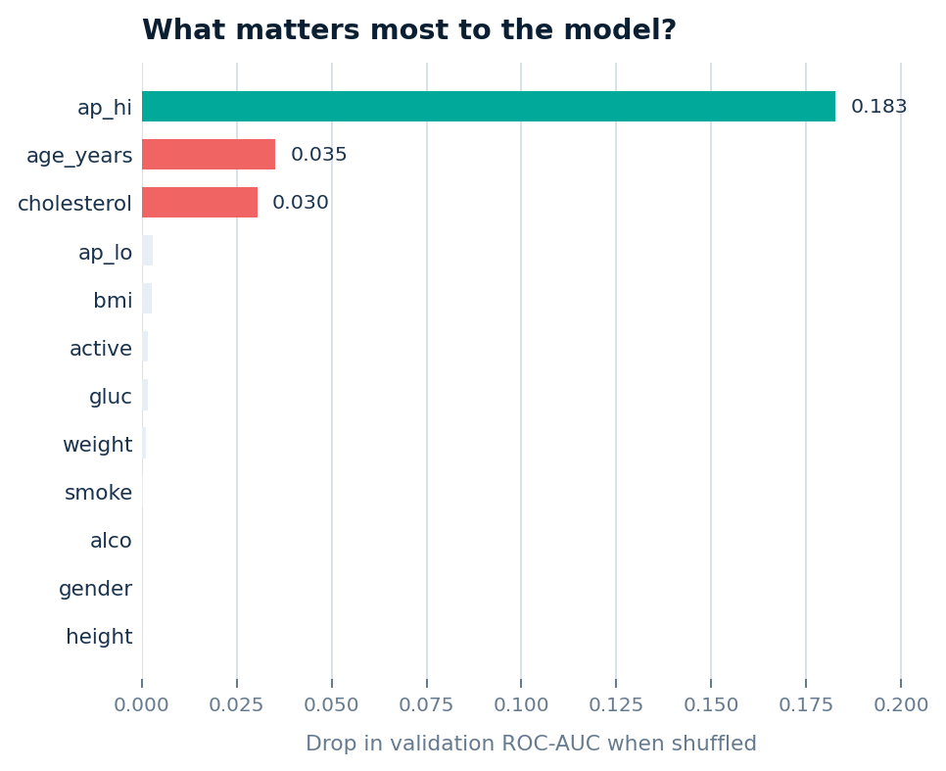
07 / INTERPRETATION
What drives the predictions?
Permutation importance measures the drop in validation ROC-AUC when one feature is shuffled.
SIGNALS IN THE CLEANED DATA
133.9 vs 119.6 mmHg
Average systolic BP: disease vs no disease
54.9 vs 51.7 years
Average age: disease vs no disease
28.4 vs 26.4
Average BMI: disease vs no disease
DISEASE SHARE BY CHOLESTEROL
Level 1
Level 2
Level 3
43.6%
59.7%
76.2%
Interpretation: predictive association, not proof of cause. Systolic BP carries around 5–6× the permutation importance of age or cholesterol.
CARDIOSENSE AI / CARDIOVASCULAR RISK PREDICTION & ANALYTICS
08

Slide 9
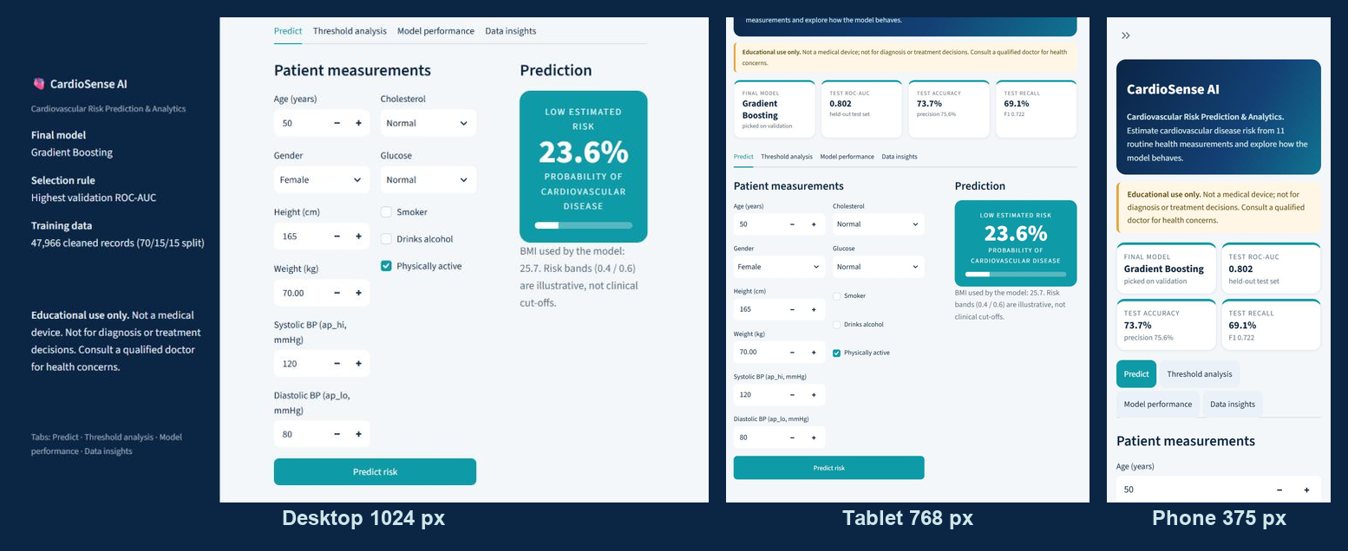
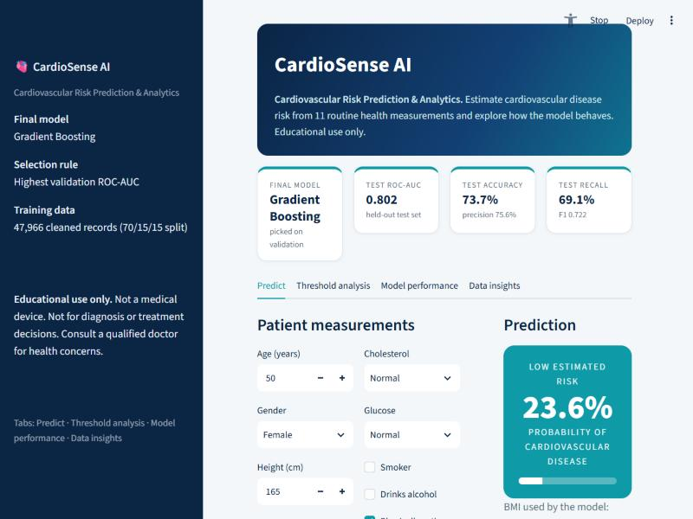
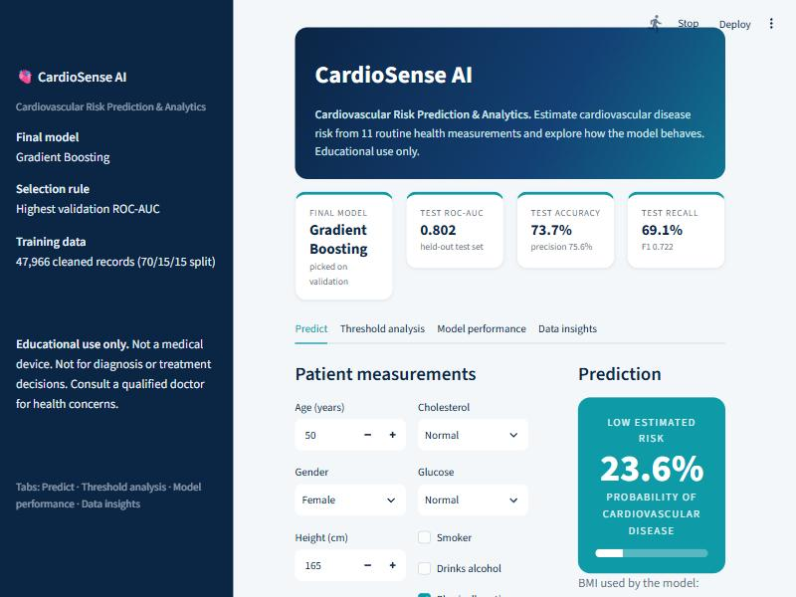
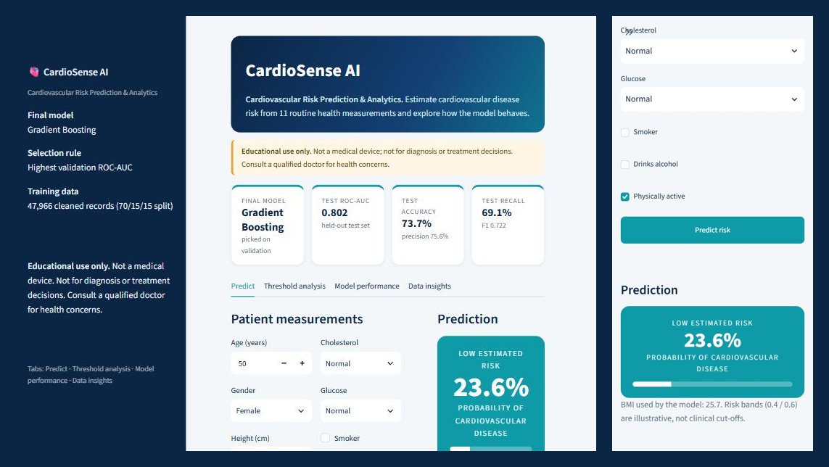
08 / APPLICATION
Browser-based risk prediction app
Streamlit interface: inputs → engineered features → saved model → estimated probability and risk band.
USER JOURNEY
1
Enter 11 routine inputs
Age, gender, height/weight, blood pressure, cholesterol, glucose and lifestyle flags.
2
Validate and transform
Reject systolic BP ≤ diastolic BP; calculate BMI and align columns.
3
Get a probability
Loaded model calls `predict_proba`; probability is shown with a progress bar.
4
Interpret the band
Below 40% = low; 40–60% = moderate; 60% or above = high.
Run locally: `python -m streamlit run app/app.py`
Phone (same Wi-Fi): add `--server.address 0.0.0.0`
Live: https://cardiosense-risk-predictor.streamlit.app/ (Streamlit Community Cloud). Layout tested in browser emulation at phone, tablet and desktop sizes, not on physical devices.
CARDIOSENSE AI / CARDIOVASCULAR RISK PREDICTION & ANALYTICS
09

Slide 10
09 / CRITICAL REVIEW
What the current prototype can—and cannot—claim
Promising as a learning project; not validated for real clinical decisions.
LIMITATIONS
NEXT STEPS
Single public dataset
01
Validate externally
Random split does not establish performance on a new hospital or population.
Test on a separate dataset and population.
Moderate recall
02
Tune and compare
At 0.5 cutoff, about 3 in 10 disease-positive cases are missed.
Use cross-validation and a documented search over hyperparameters.
BP-heavy behavior
03
Calibrate threshold
Systolic pressure dominates; some BP bands are much harder than others.
Choose a cutoff based on the cost of missed cases vs false alarms.
Untuned configurations
04
Improve explainability
Manual settings were used; systematic cross-validation remains future work.
Add SHAP-style explanations and evaluate fairness across groups.
IMPORTANT: Educational prototype only. It must not be used to diagnose or rule out cardiovascular disease. Tested in browser emulation only; deployed on Streamlit Community Cloud.
CARDIOSENSE AI / CARDIOVASCULAR RISK PREDICTION & ANALYTICS
10

Slide 11
10 / TAKEAWAYS
A reproducible baseline—not a clinical endpoint
The contribution is the end-to-end workflow: cleaned data, fair comparison, interpretation and a working UI.
01
02
03
Reliable evaluation
Measured performance
Actionable next step
68,523 cleaned records; stratified 70/15/15 split; test kept separate.
Gradient Boosting: 73.7% accuracy and ROC-AUC 0.802 on held-out data.
External validation and threshold calibration matter more than tiny score gaps.
SELECTED REFERENCES
Slime, K. et al. (2024). Toward a model to predict cardiovascular disease risk using a machine learning approach. IAENG Int. J. Computer Science.
Zhou, C. et al. (2024). A comprehensive review of deep learning-based models for heart disease prediction. Artificial Intelligence Review, 57, 263.
Deng, L. et al. (2025). An interpretable LightGBM model for predicting coronary heart disease. PLoS ONE, 20(9), e0330377.
Dataset: Ulianova, S. Cardiovascular Disease dataset (70,000 records), Kaggle. Implementation: scikit-learn, pandas, Streamlit.
Thank you
CARDIOSENSE AI / CARDIOVASCULAR RISK PREDICTION & ANALYTICS
11

