Slide 1

Logisim (not LOGISISM)
CSE 206
July 2021
Rayhan Rashed

Slide 2
What is Logisim?
Tool for designing and simulating digital logic circuits
Developed by Dr. Carl Burch
Proteus

Slide 3
Download EXE or JAR
Make sure JDK/JRE is installed
Download EXE (Requires JRE 1.5.0)
https://sourceforge.net/projects/circuit/files/2.7.x/2.7.1/
OR
Download Jar (Works for JRE >= 1.5.0)
https://sourceforge.net/projects/circuit/files/2.7.x/2.7.1/logisim-generic-2.7.1.jar/download
Double click the exe/jar to open Logisim

Slide 4
Resources
Follow demonstration
Useful Resources
http://www.cburch.com/logisim/docs/2.7/en/html/guide/index.html
https://www.youtube.com/watch?v=cMz7wyY_PxE&ab_channel=BarryBrown

Slide 5

Implement a Basic Circuit
$\left(\overline{A}∪B\right)∩(\overline{c∩A})$

Slide 6

Build the Truth Table
$\left(\overline{A}∪B\right)∩\left(\overline{c∩A}\right)$
A B C F
0 0 0 1
0 0 1 1
0 1 0 1
0 1 1 1
1 0 0 0
1 0 1 0
1 1 0 1
1 1 1 0

Slide 7
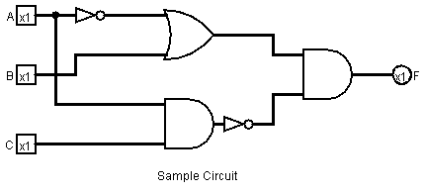

Design in Logisim and Simulate
$\left(\overline{A}∪B\right)∩(\overline{c∩A})$
Match output with the truth table

Slide 8

View Truth Table in Logisim
$\left(\overline{A}∪B\right)∩\left(\overline{c∩A}\right)$
Project -> Analyze Circuit
A B C F
0 0 0 1
0 0 1 1
0 1 0 1
0 1 1 1
1 0 0 0
1 0 1 0
1 1 0 1
1 1 1 0

Slide 9
External Library
Libraries like 7400 Series IC can be imported
http://www.cburch.com/logisim/links.html
https://en.wikipedia.org/wiki/List_of_7400-series_integrated_circuits

Slide 10
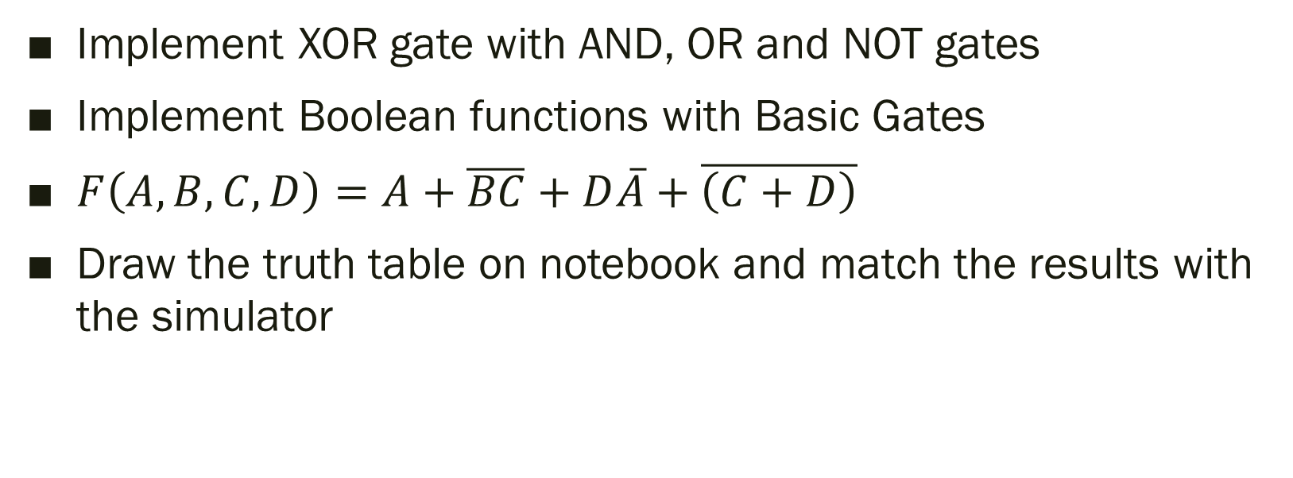
Practice
Implement XOR gate with AND, OR and NOT gates
Implement Boolean functions with Basic Gates
$F\left(A,B,C,D\right)=A+\overline{BC}+D\overline{A}+\overline{\left(C+D\right)}$
Draw the truth table on notebook and match the results with the simulator

Slide 11

Dont give me this vibe, please!

