Slide 1
Mobile Security Framework (MobSF)
Zarif Ikram (1905111)
Anamul Hoque Emtiaj (1905113)

Slide 2
About mobsf
Mobile Security Framework is an open source mobile application (Android/iOS) automated pentesting framework capable of performing end to end security testing of mobile Apps.
Key features:
Static Analysis
Malware Detection and Analysis
Security Analysis
Dynamic Analysis
Report Generation

Slide 3
Running MobSF
Install Docker
Pull the docker image
docker pull opensecurity/mobile-security-framework-mobsf:latest
Run the docker image
docker run -it --rm -p 8000:8000 opensecurity/mobile-security-framework-mobsf:latest
Access the web interface
http :// localhost :8000

Slide 4
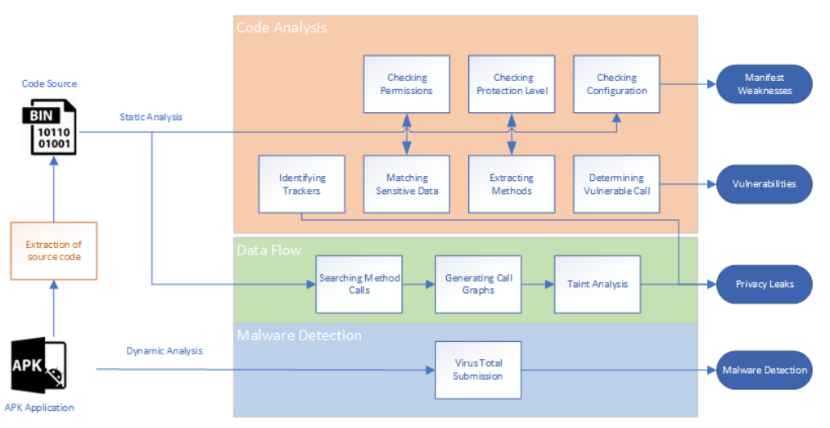
Architecture

Slide 5
Demonstration
Used DIVA (Damn insecure and vulnerable App)
https://github.com/0xArab/diva-apk-file

Slide 6

STATIC ANALYSIS
Examination of a mobile application's code and configuration files without actually executing the program.

Slide 7
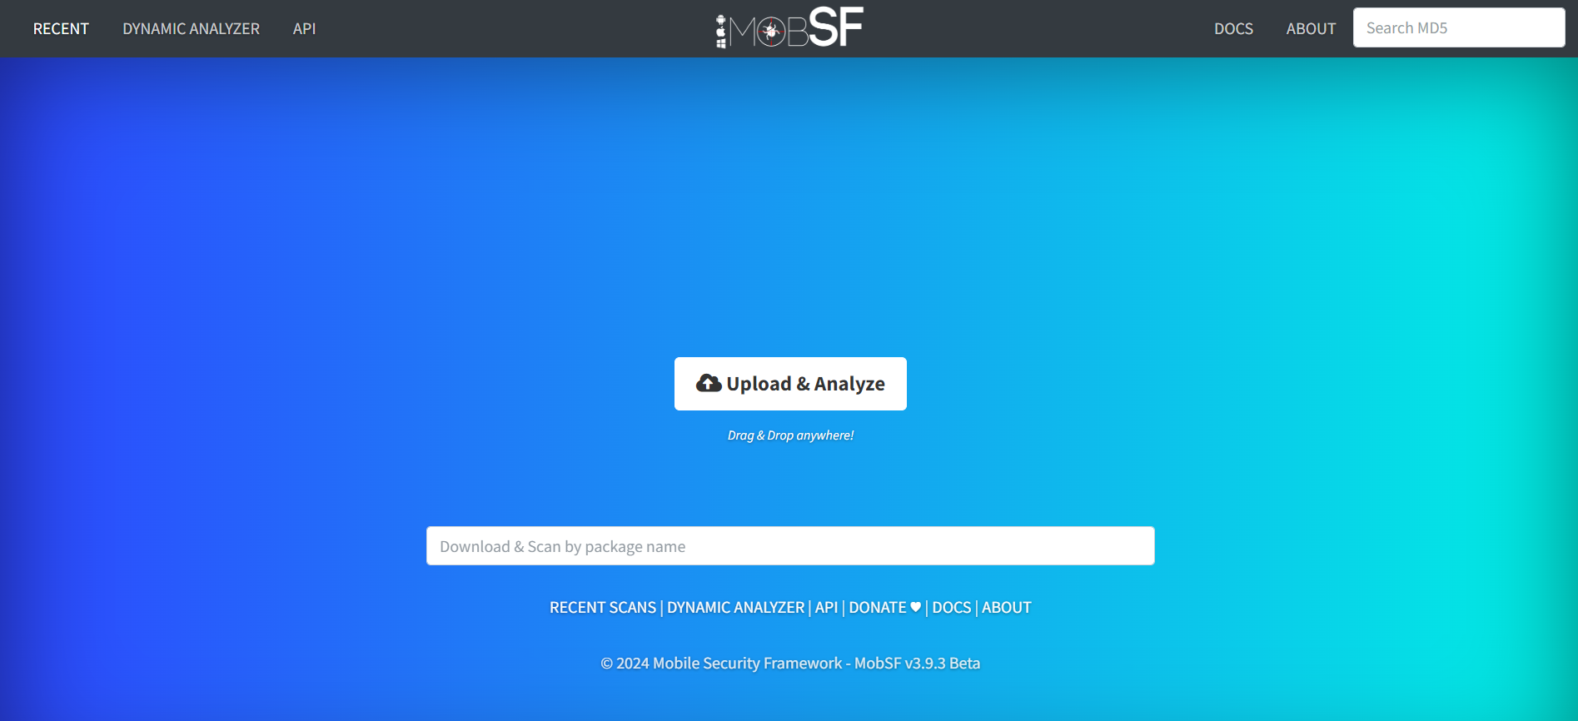
scanning

Slide 8
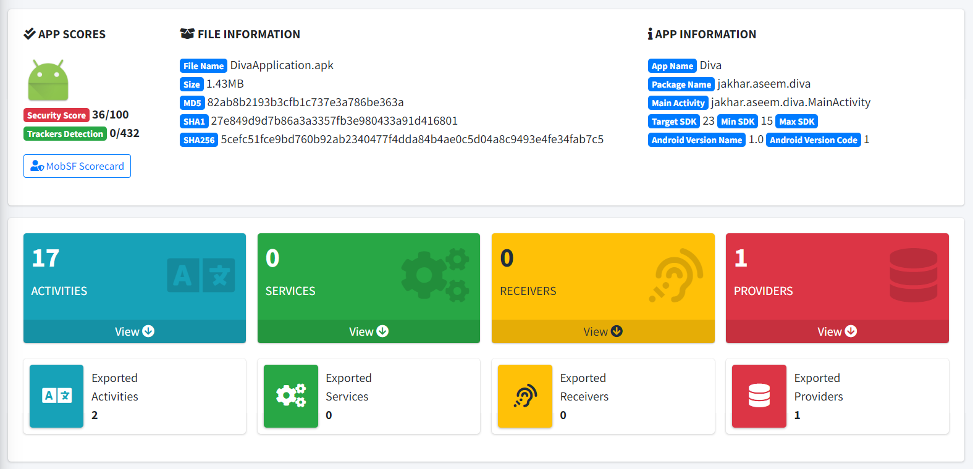
App information

Slide 9
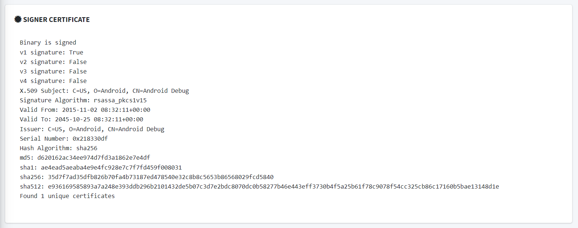
Signer Certificate

Slide 10
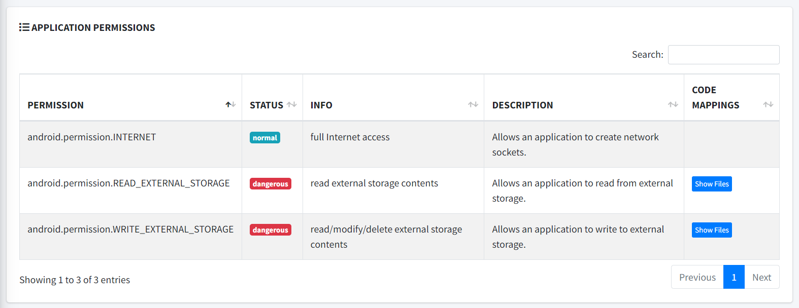
Application permissions

Slide 11
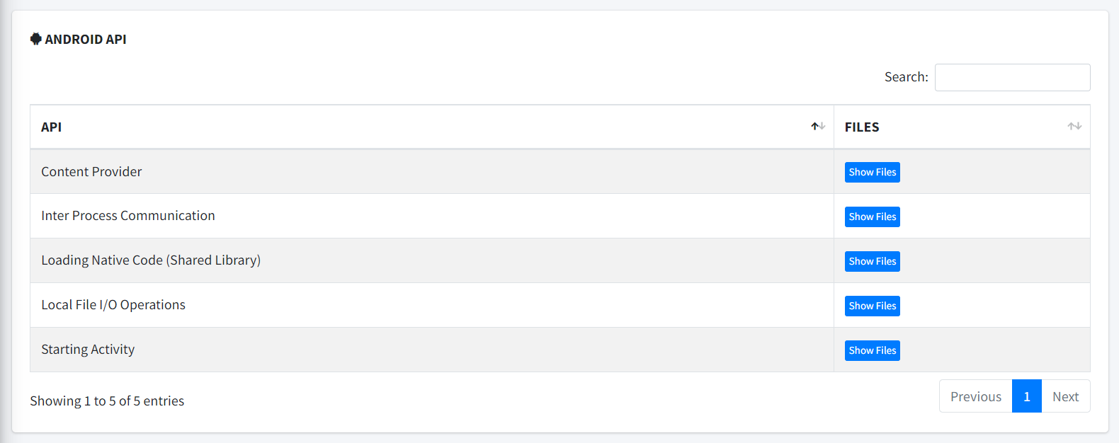
Android API

Slide 12
Security Analysis

Slide 13
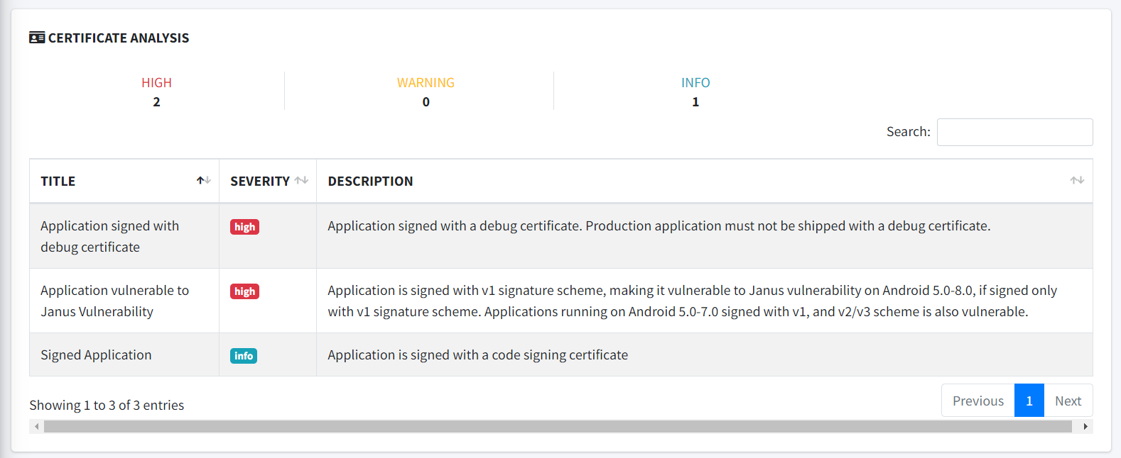
Certificate Analysis

Slide 14
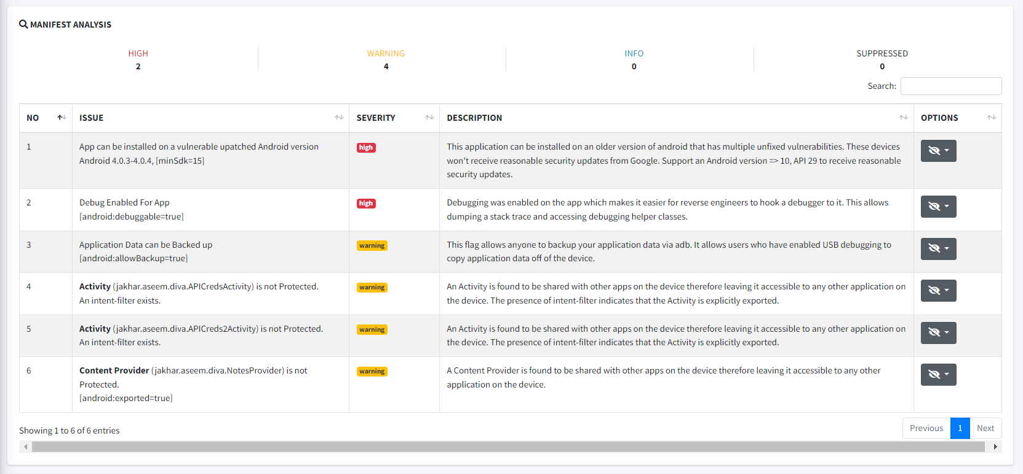
Manifest Analysis

Slide 15
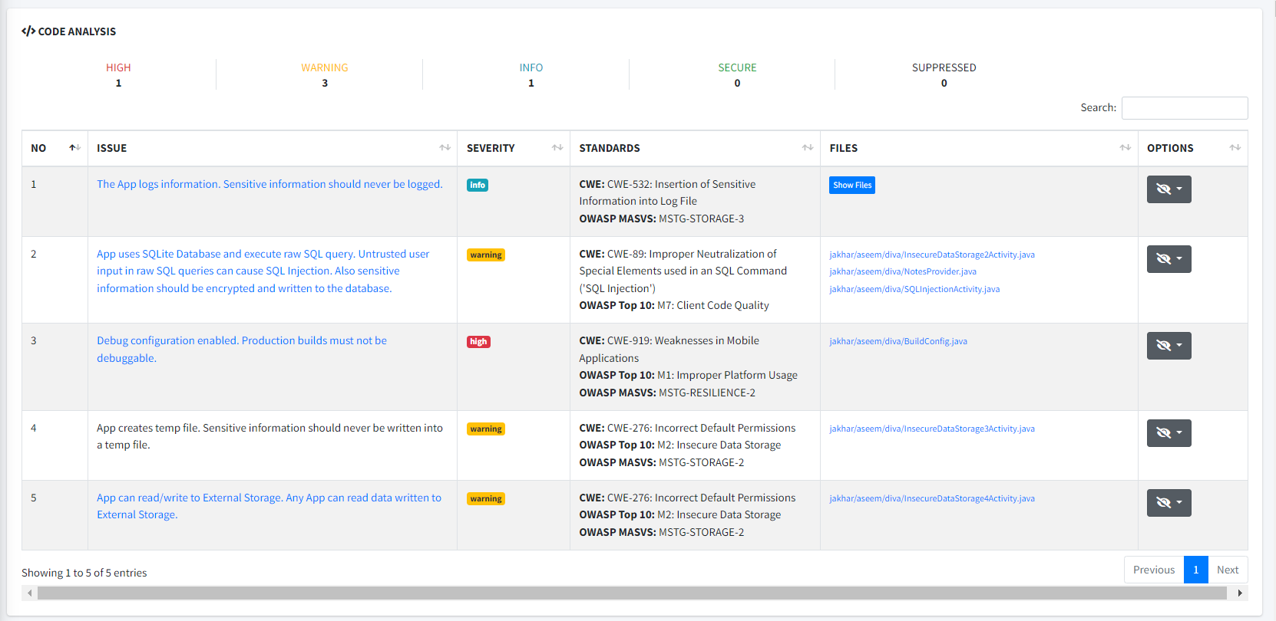
Code Analysis

Slide 16
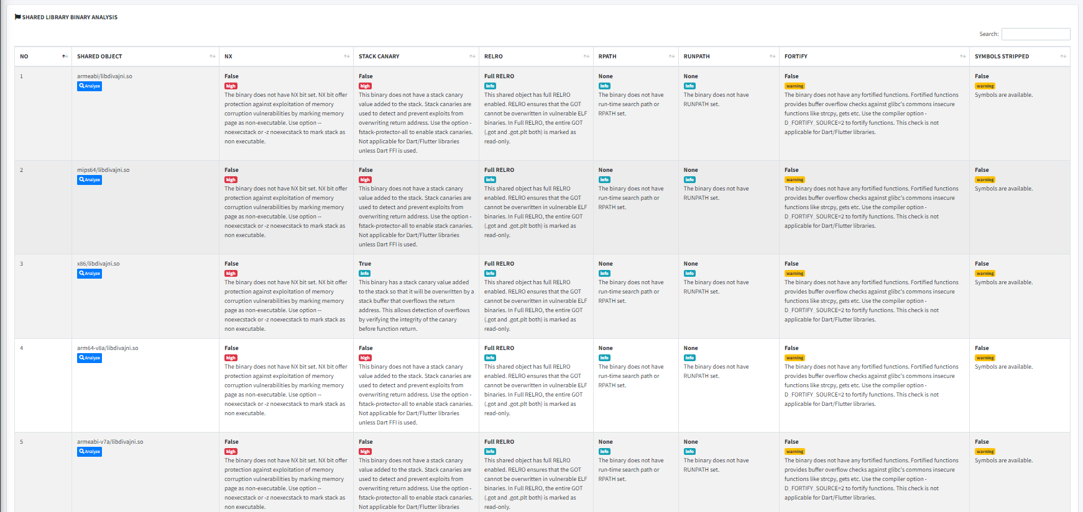
Binary Analysis

Slide 17
Malware Analysis

Slide 18
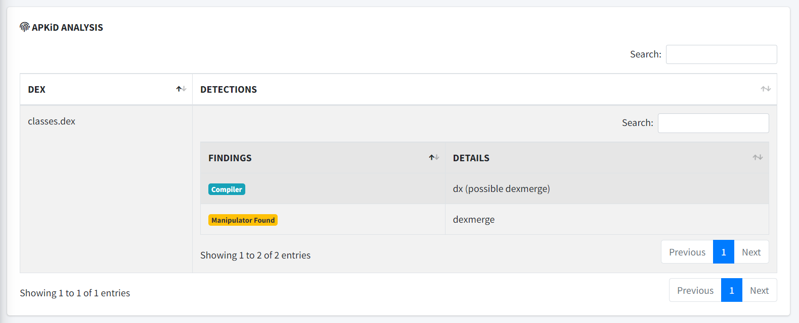
APKiD ANALYSIS

Slide 19
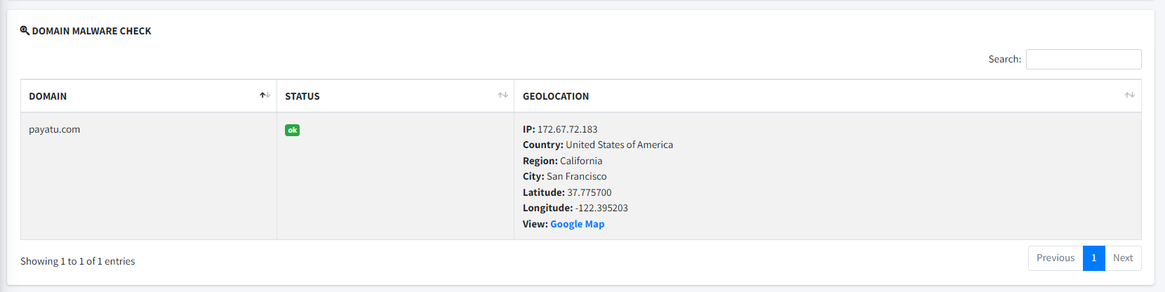
DOMAIN MALWARE CHECK

Slide 20
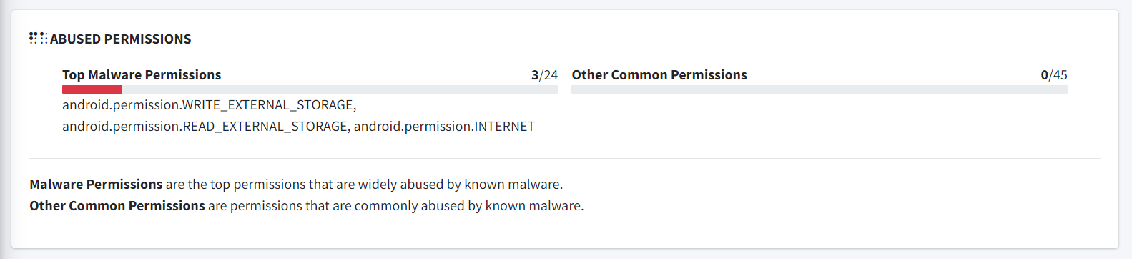
Abused Permissions

Slide 21
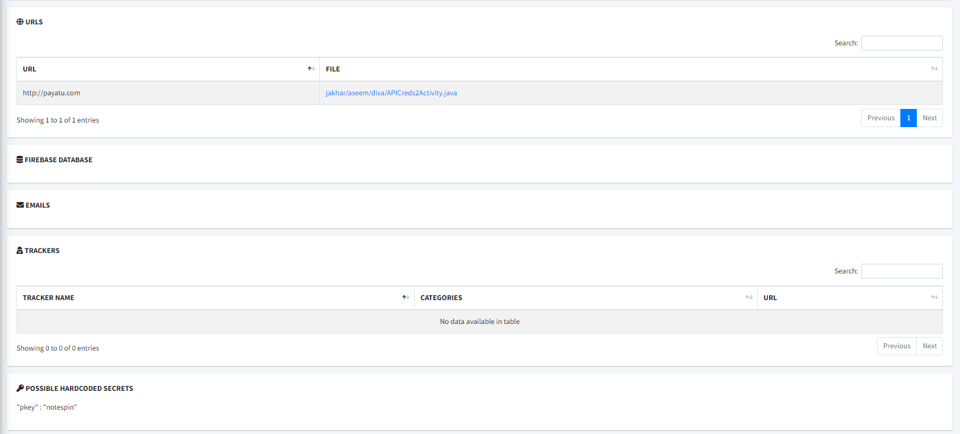
Reconnaissance

Slide 22
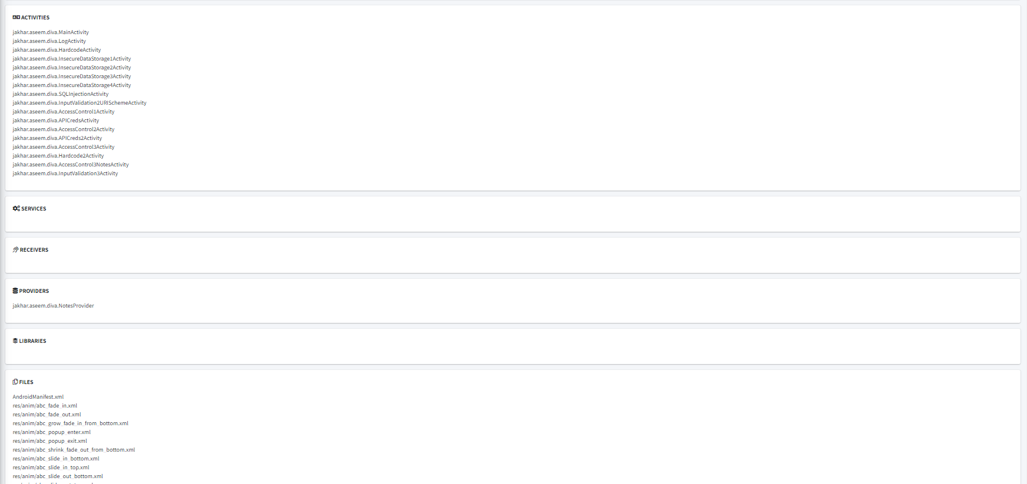
Components

Slide 23
Dynamic Analysis
Real-time application testing: Testing while the application software is running
Dynamic Analysis Testing: Conducted during application runtime
Objective: Identify security flaws in Android applications
Application: Suitable for use during development or production stages
Methodology: Involves examining the application while it's actively being used
Focus: Detection and resolution of security vulnerabilities

Slide 24
Android virtual machines (VMs)
Supported rooted Android virtual machines (VMs)/emulators by MobSF:
Genymotion
Genymotion Cloud VM
Android Studio Emulator
Corellium
Genymotion utilized in our work: Identified as the ideal dynamic analysis environment with minimal setup friction
Supported Android versions:
Android 5.0 to 11.0: Compatible with Frida, requiring no additional setup for dynamic analysis
Android 4.1 through 4.4: Requires MobSFying the runtime initially due to reliance on Xposed Framework; installation of Xposed Modules and virtual machine reboot necessary for dynamic analysis

Slide 25
Setting up Genymotion VM
Genymotion Desktop Setup:
Download Genymotion desktop from the official website (Version 3.6 used).
Installation completed.
Setup Process:
Click on the plus (+) icon.
Select the desired virtual device (e.g., Samsung Galaxy S6).
Choose Android version (e.g., Android 11.0, compatible with MobSF).
Use default settings for the remaining configurations.
Virtual Device Download:
Download the selected virtual device (Samsung Galaxy S6).
Download size: 600MB.

Slide 26
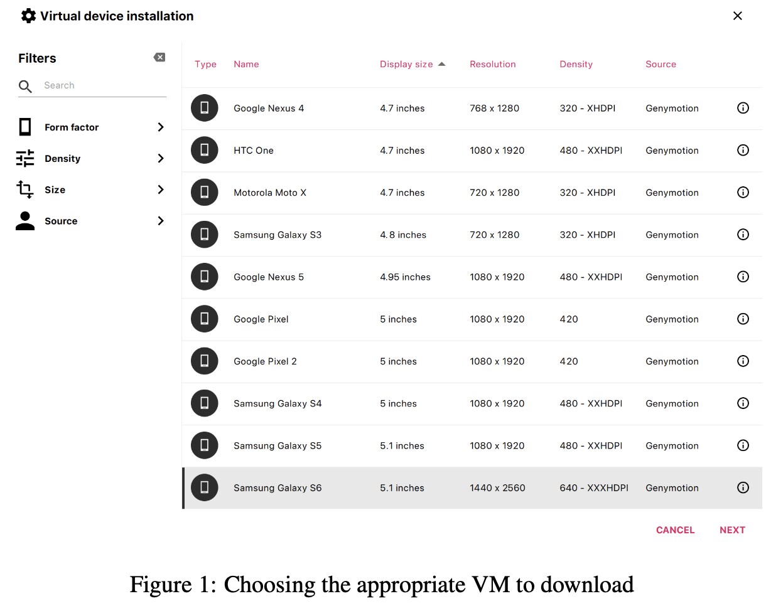
Setting up Genymotion VM

Slide 27
Connecting Genymotion VM with MobSF for Dynamic Analysis
Dynamic Analysis Setup:
Start Genymotion VM before initiating MobSF.
Steps to Follow:
Start the downloaded VM
Identify the device identifier from the title bar
Execute MobSF using the following command:
docker run -it –rm -p 8000:8000 -p 1337:1337 -e MOBSF_ANALYZER_IDENTIFIER=127.0.0.1:6555 opensecurity/mobile-security-framework-mobsf:latest
Example identifier: 127.0.0.1:6555

Slide 28
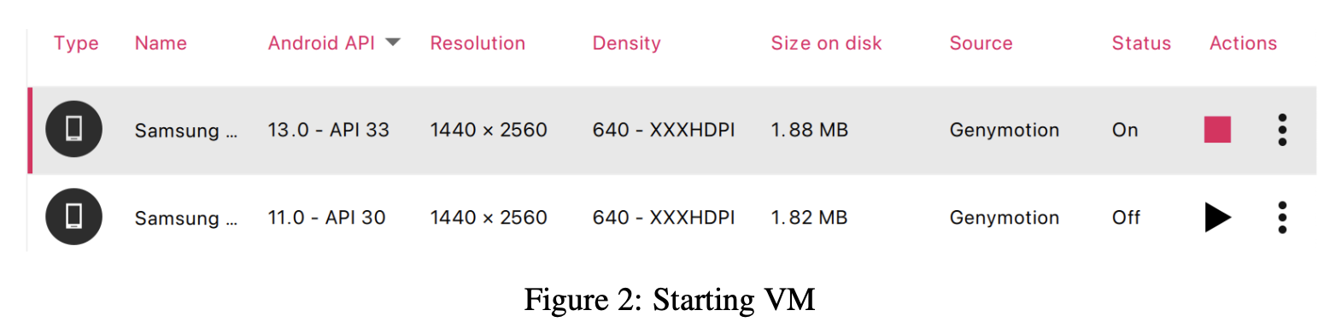
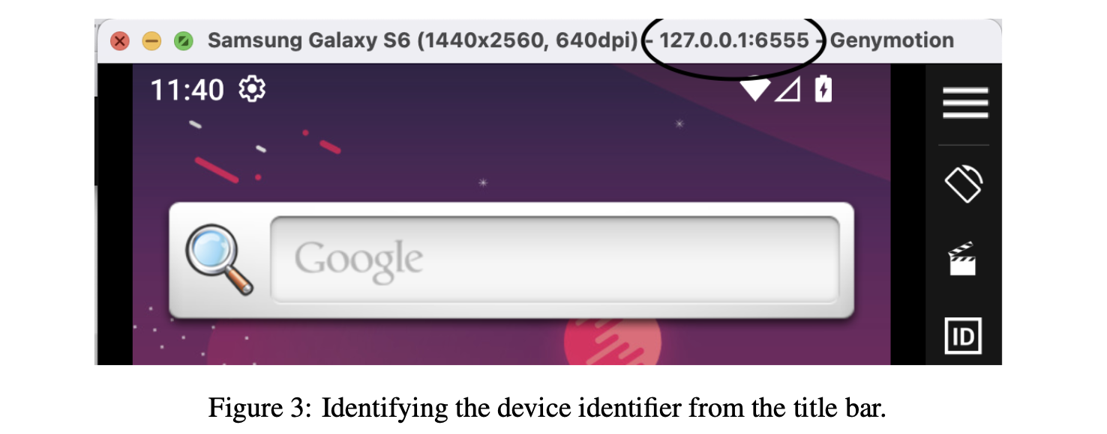
Connecting Genymotion VM with MobSF for Dynamic Analysis

Slide 29
Initiating dynamic analysis
Initiating Dynamic Analysis with MobSF:
Obtain DIVA (Damn Insecure and Vulnerable App) from https://github.com/0xArab/diva-apk-file.
Follow these steps for dynamic analysis:
Prepare the APK file for testing on the MobSF dashboard.
Access the MobSF dashboard.
Upload the DIVA application's APK file.
Start Dynamic Analysis by selecting the "Start Dynamic Analysis" option on the MobSF dashboard
MobSF will proceed to install the DIVA application on the connected Android Virtual Device (AVD).
Ensure the Android API version meets MobSF's minimum requirements if installation fails.
Upon successful installation, access the Dynamic Analyzer page, showing the application ready for dynamic analysis
Utilize the available menus on the dashboard for Dynamic Analysis testing.

Slide 30
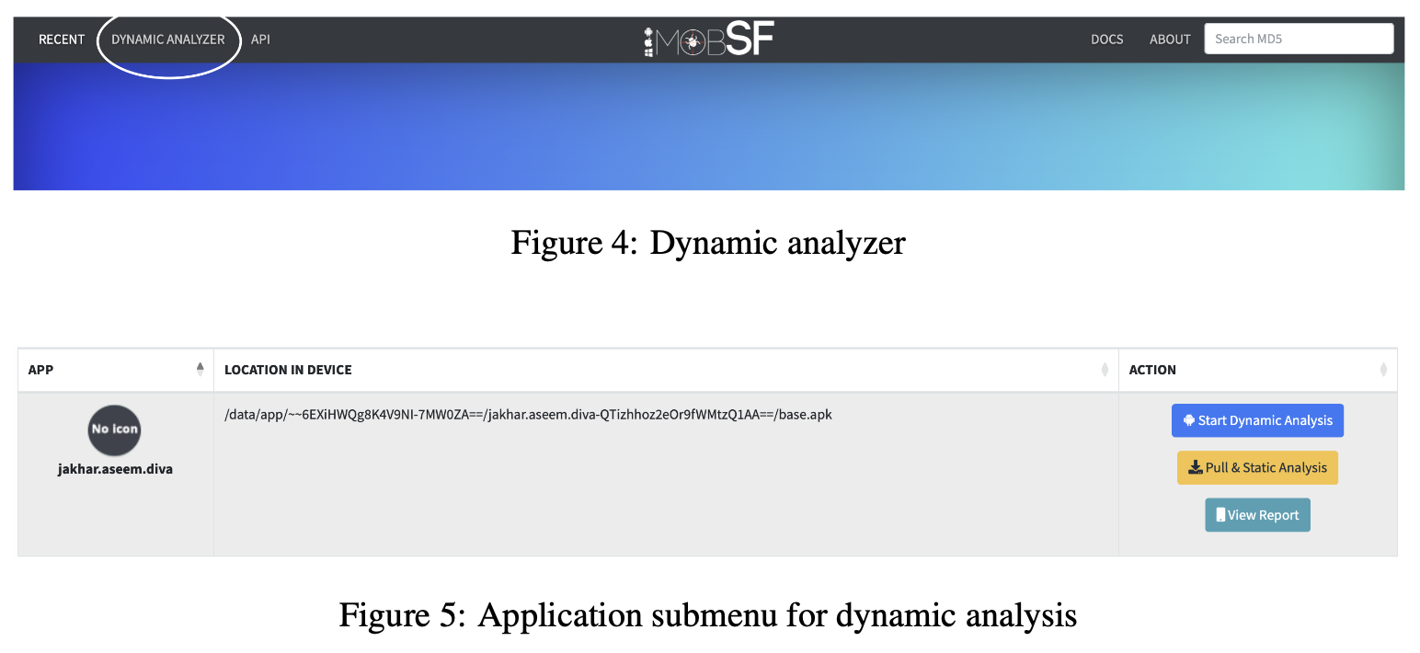
Initiating dynamic analysis

Slide 31
Performing dynamic analysis
Dynamic Analysis Process:
Open the DIVA app and execute a specific vulnerable example.
Upon completion, generate a report via MobSF to identify underlying vulnerabilities.
DIVA App Vulnerability Examples:
Insecure Data Storage:
Lack of proper encryption or protection for sensitive data, risking unauthorized access.
Input Validation Issues:
Failure to properly validate user inputs, leading to potential security vulnerabilities like injection attacks or buffer overflows.
Access Control Issues:
Inadequate management of user permissions, allowing unauthorized access to restricted functionality or data.
Hardcoding Issues:
Storing sensitive information directly in the code, accessible to anyone with access to the application’s code.

Slide 32
Example: Insecure data storage in XML
Insecure Data Storage in XML in Android App Development:
Definition: Storing sensitive or confidential information within XML files without encryption or protection mechanisms.
Vulnerability: Occurs when user credentials, API keys, or sensitive data are stored in plain text within XML files.
Risk: Susceptibility to unauthorized access by malicious actors.
Example:
If an Android app stores user passwords or authentication tokens in plain text within an XML file,
Potential Misuse: Attacker with device access could extract information for unauthorized access or identity theft.

Slide 33
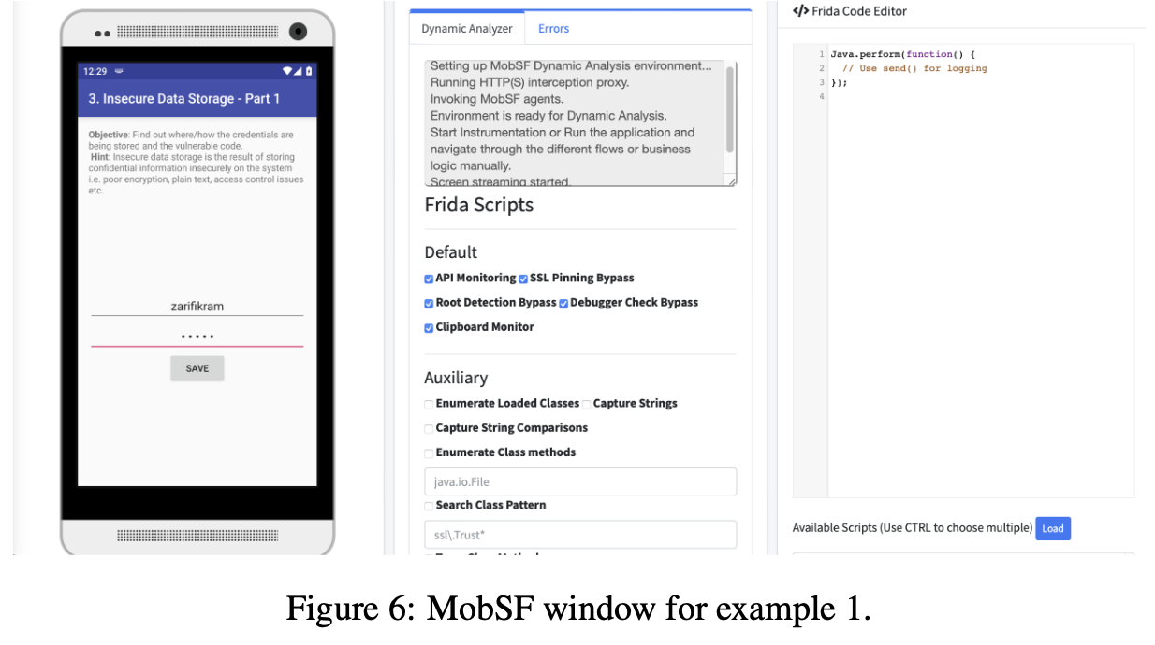
Steps To Perform
Open the application in the virtual machine (VM).
Select "INSECURE DATA STORAGE - PART 1".
Toggle "Show Screen" in MobSF to display the app screen

Slide 34
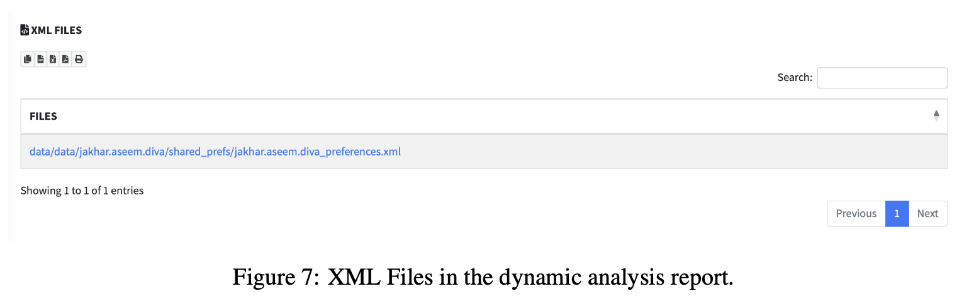
Steps To Perform
Enter input for username and password.
Click on "Generate Report" to view the dynamic analysis report.
Navigate to the submenu containing XML Files

Slide 35
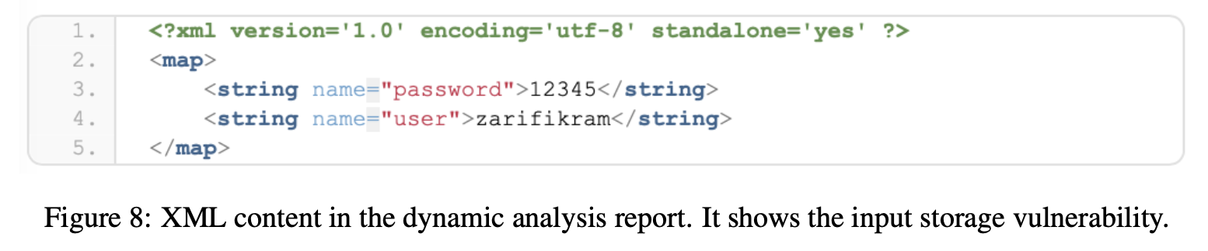
Steps To Perform
Click on the file with the .xml extension to view its contents in XML format revealing vulnerabilities associated with data storage in XML.

