Slide 1
KHABO COLLABORATION DIAGRAM
Group Members
1905095 - Md. Raihan Sobhan
1905106 - Rayan Islam
1905110 - Md. Labid Al Nahiyan
1905111 - Zarif Ikram
1905113 - Anamul Hoque Emtiaj
1905114 - Sk. Saifullah Hafiz

Slide 2
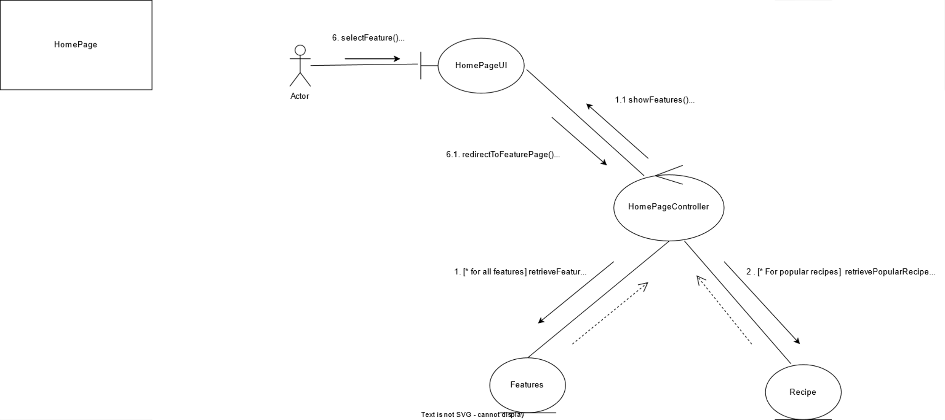

Slide 3
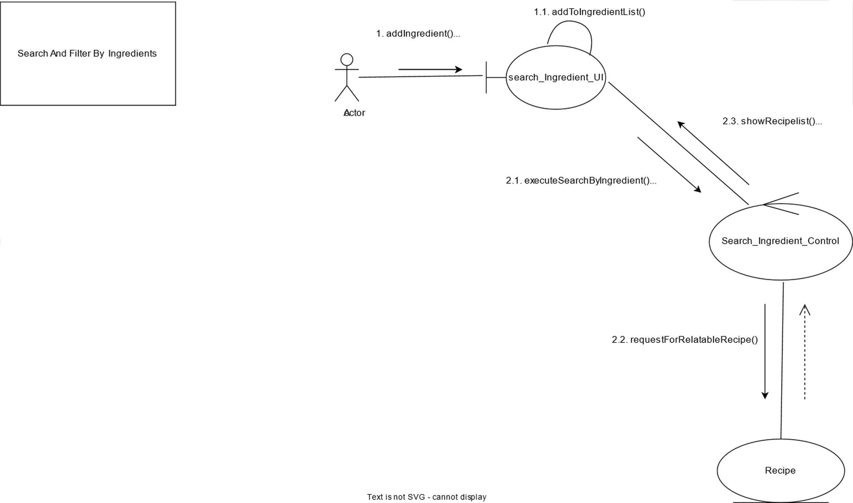

Slide 4
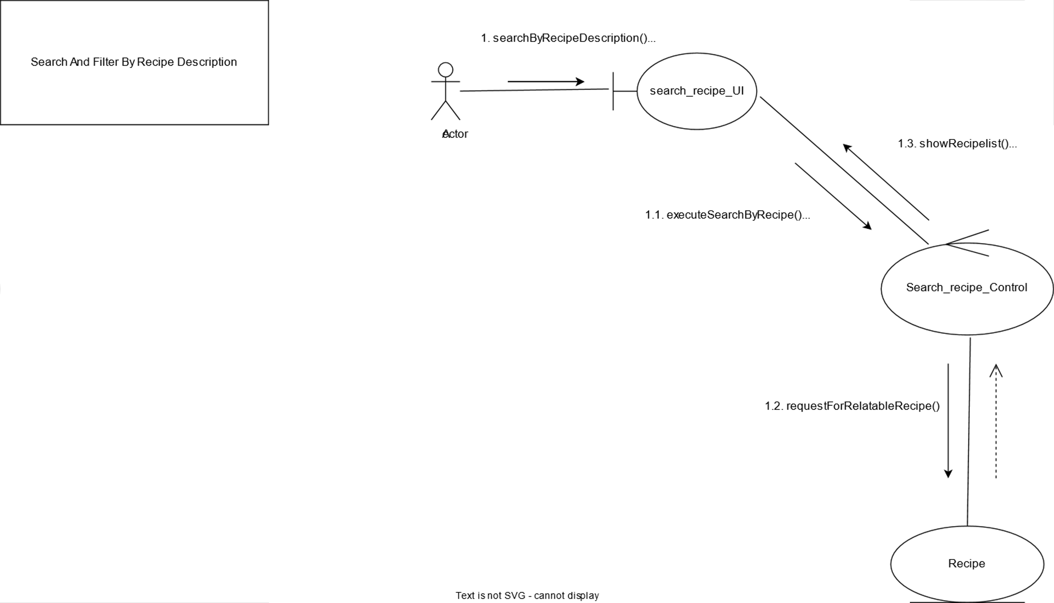

Slide 5
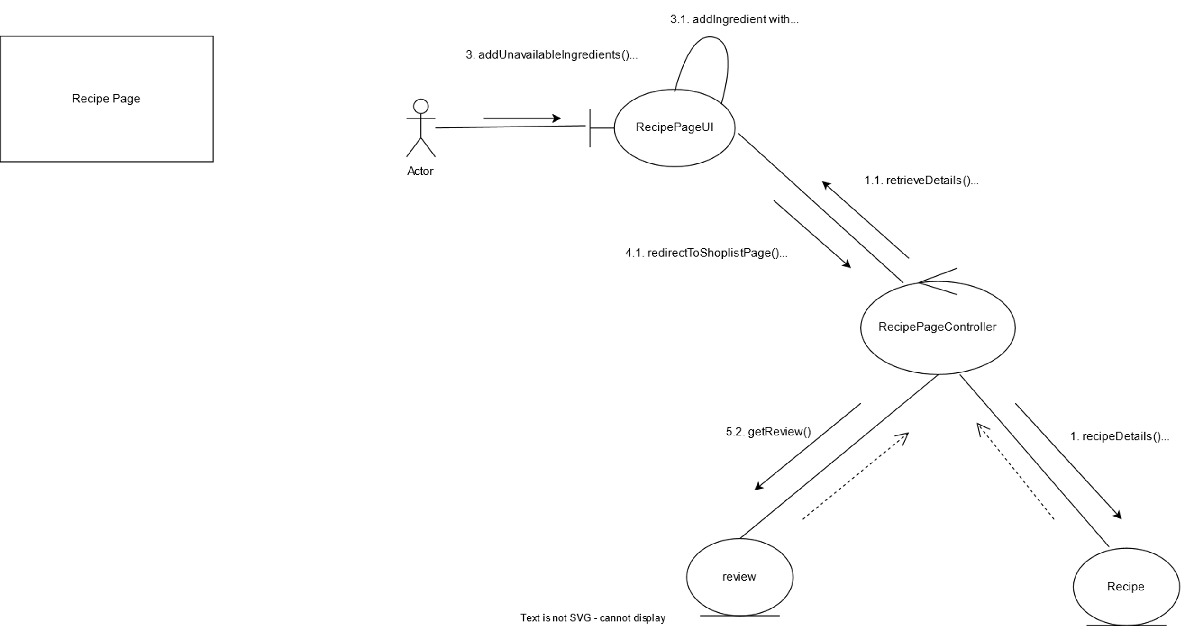

Slide 6
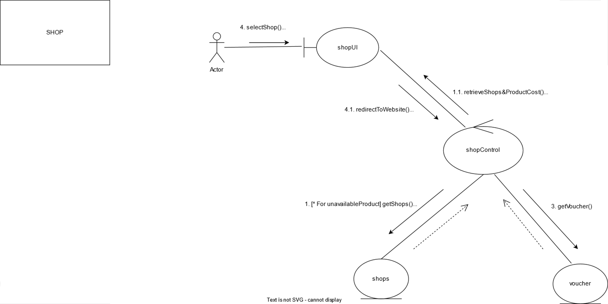

Slide 7
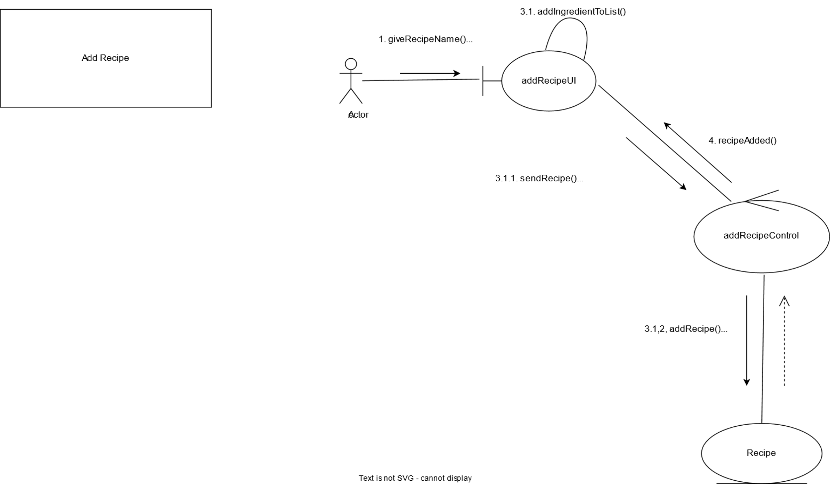

Slide 8


