Slide 1
Protein-Protein Interaction (PPI) Site Prediction Using ProtBERT, Cross Attention, MLP
CSE-472: Machine Learning Sessional
Group: B2_13
Team member:
1905111 – Zarif Ikram
1905113 – Anamul Hoque Emtiaj
Supervisor: Md Toki Tahmid

Slide 2
Problem Statement
Protein-protein interactions are physical contacts between proteins that are essential for biological processes like signaling, metabolism, and regulation.
Predicting PPI sites is crucial for understanding disease mechanisms and drug discovery.
Challenge: High-dimensional data, imbalanced labels, and the complexity of biological interactions make prediction difficult.

Slide 3
Objective
Predict the likelihood of interaction between residues in ligand-receptor protein pairs.
Use deep learning with attention mechanisms to model complex interactions.
Evaluate model performance with metrics such as accuracy, precision, recall, F1, PR-AUC, and ROC-AUC.

Slide 4
Dataset Overview
Training Dataset
Evaluation Dataset
Size: 2,360 protein pairs
Ligand Length: 22-1,622 (mean: 225)
Receptor Length: 22-785 (mean: 198)
Interactions per Pair: 319-8,492 (mean: 1,801)
Total Interactions: 4,249,603
Negative: 3,863,259 (90.91%)
Positive: 386,344 (9.09%)
Size: 787 protein pairs
Ligand Length: 25-2,130 (mean: 233)
Receptor Length: 22-526 (mean: 175)
Interactions per Pair: 363-6,105 (mean: 1,316)
Total Interactions: 1,035,485
Negative: 941,350 (90.91%)
Positive: 94,135 (9.09%)

Slide 5
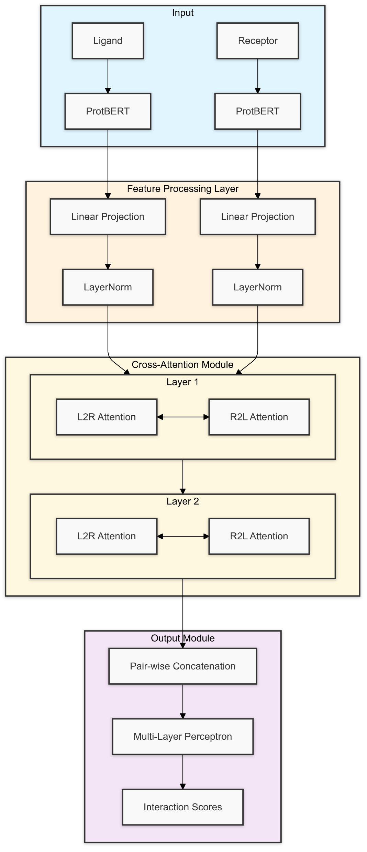
Model Architecture
Input: BERT-encoded protein features (1024-dimensional)
Dual-stream architecture with cross-attention mechanism
Bidirectional information flow between proteins
Multiple attention layers for complex interaction modeling
Residual connections and layer normalization prevent degradation
Hierarchical prediction network with dropout for regularization

Slide 6
Model Training Details
Weighted Binary Cross-Entropy Loss to handle class imbalance
Cosine Annealing Learning Rate Schedule
Gradient clipping to prevent exploding gradients
Comprehensive initialization strategy using Xavier initialization
Adam optimizer with weight decay for regularization.

Slide 7
Evaluation Metrics
Metrics Used:
Accuracy: Fraction of correct predictions.
Precision: Fraction of true positives among predicted positives.
Recall: Fraction of true positives among actual positives.
F1 Score: Harmonic mean of precision and recall.
PR-AUC: Area under the precision-recall curve (for imbalanced data).
ROC-AUC: Area under the receiver operating characteristic curve.
Purpose: Evaluate both classification performance and the model's ability to handle imbalanced data.

Slide 8
Experimental Results
Accuracy: 0.8583
Precision: 0.2292
Recall: 0.2363
F1 Score: 0.2327
PR AUC: 0.1998
ROC AUC: 0.6967

Slide 9
Comparison with Previous Studies
Method | AUROC | AUPRC
SPPIDER | 0.65 | --
MaSIF geom* | 0.68 | --
Ours | 0.6967 | 0.1998
PInet geom* | 0.75 | 0.30
MaSIF | 0.87 | --
PInet | 0.88 | 0.45
Pair-EGRET | 0.9583 | 0.5938

Slide 10
References
https://academic.oup.com/bioinformatics/article/40/10/btae588/7808856

Slide 11
Thank You

