Slide 1
Project Title Web-based Hospital Management System
Presented By,
Md. Anamul Haque
Roll: MUH2011035M
Session:2019-20
Year:4, Term:1
Department of ICE,NSTU
Supervised By,
Tanvir Zaman Khan
Assistant Professor
Department of ICE,NSTU

Slide 2
Outline
-Introduction
-Problem Statement
-Objectives
-Literature Review
-Methodology
-Expected Outcome
-Conclusion

Slide 3
Introduction
A Hospital Management System (HMS) is a software solution designed to manage hospital operations efficiently.
It integrates key functions like patient records, appointments, billing, and inventory management.
The system enhances workflow automation, reduces errors, and improves patient care.
Ensures secure and centralized access to hospital data for better decision-making.

Slide 4
Problem Statement
Traditional hospital management relies on manual processes, leading to inefficiencies and errors.
Key Challenges:
Delayed patient services due to slow registration and appointment processes.
Data inaccuracy and loss from fragmented record-keeping systems.
High operational costs caused by redundant paperwork and resource mismanagement.
Limited accessibility to critical data, affecting timely decision-making.

Slide 5
Objectives
To manage patient registration and record patient information efficiently.
To generate bills and manage financial transactions.
To ensure efficient patient data management
To ensure data security and compliance
To integrate with other healthcare systems
To provide decision support through analytics
To reduce paperwork and manual errors

Slide 6
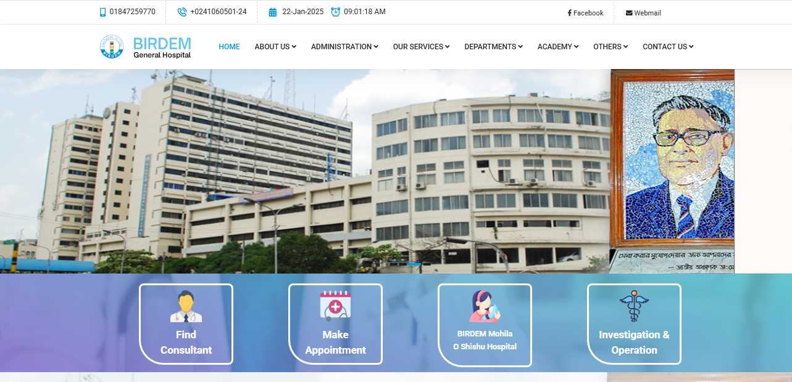
Literature Review
BIRDEM General Hospital, is the Bangladesh Institute of Research and Rehabilitation in Diabetes, Endocrine, and Metabolic Disorder. A website that serves most number of diabetes patients.

Slide 7
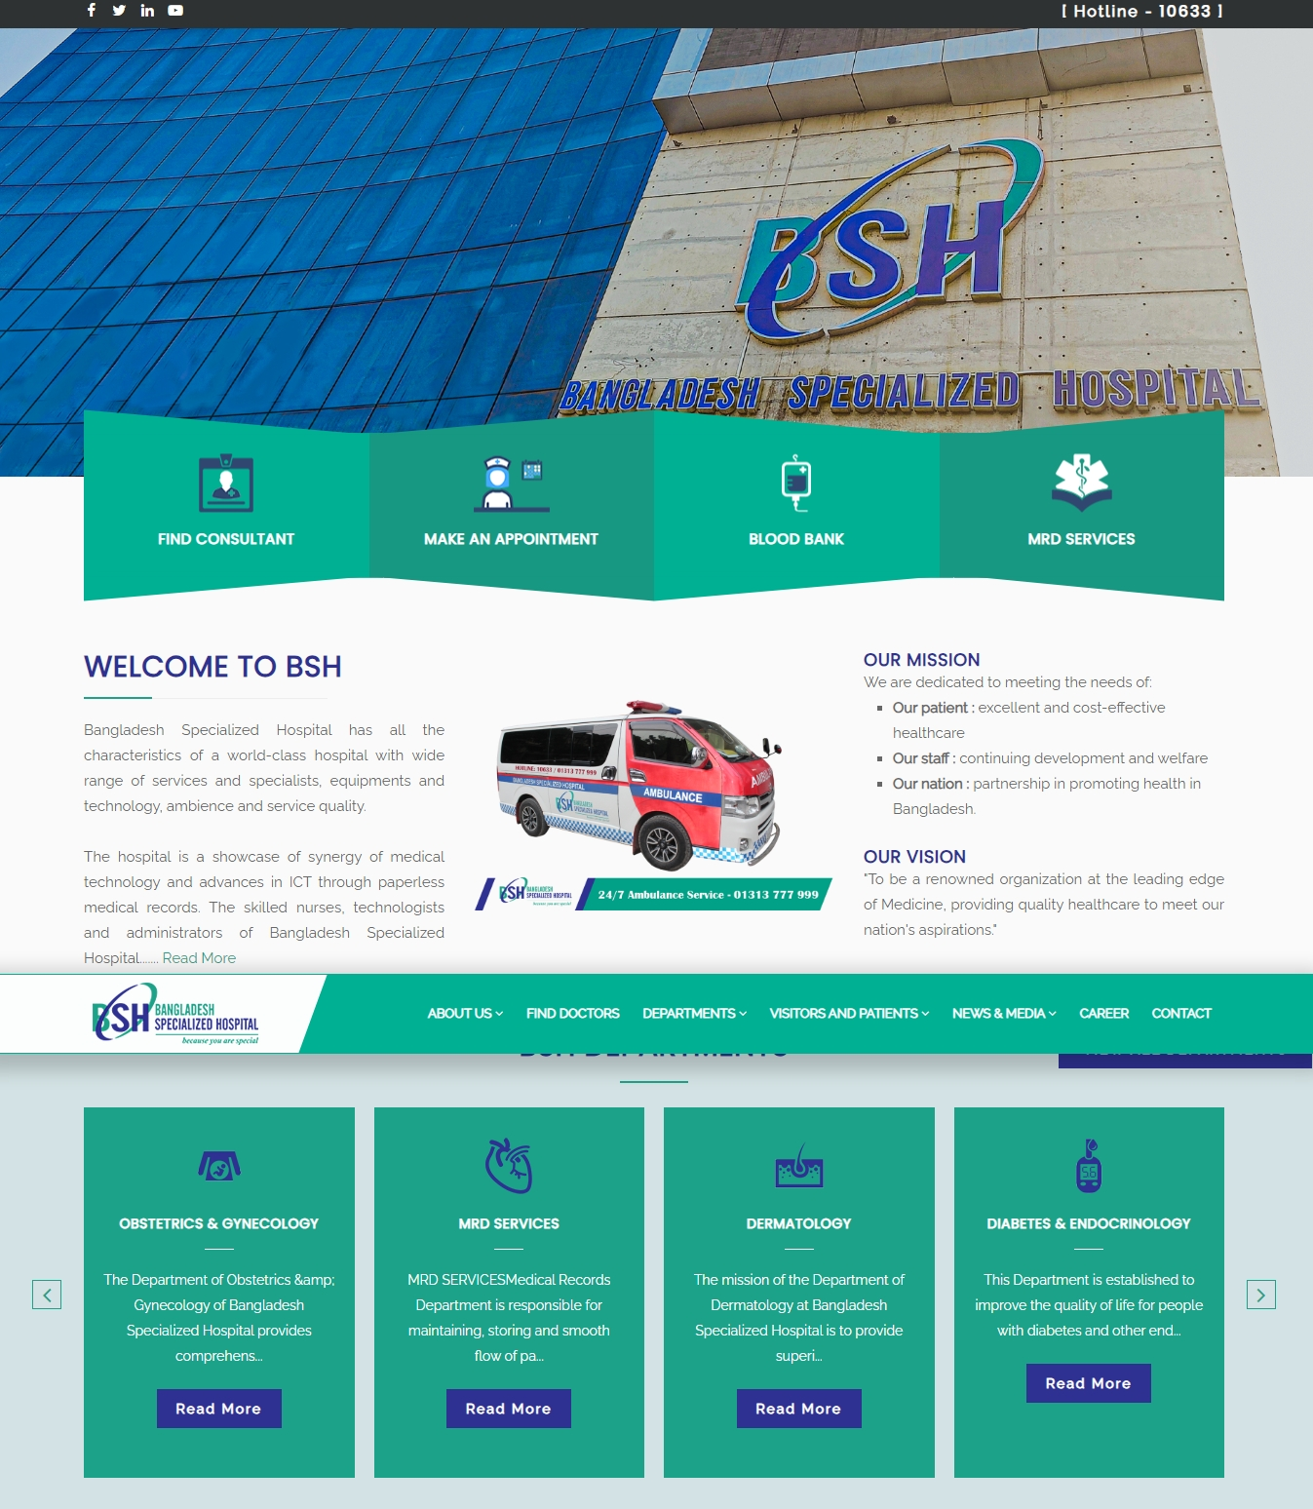
Bangladesh Specialized Hospital
As a world class hospital, BSH provides a wide range of services and specialists, excellent technology and equipment, a friendly atmosphere, and high-quality services.

Slide 8
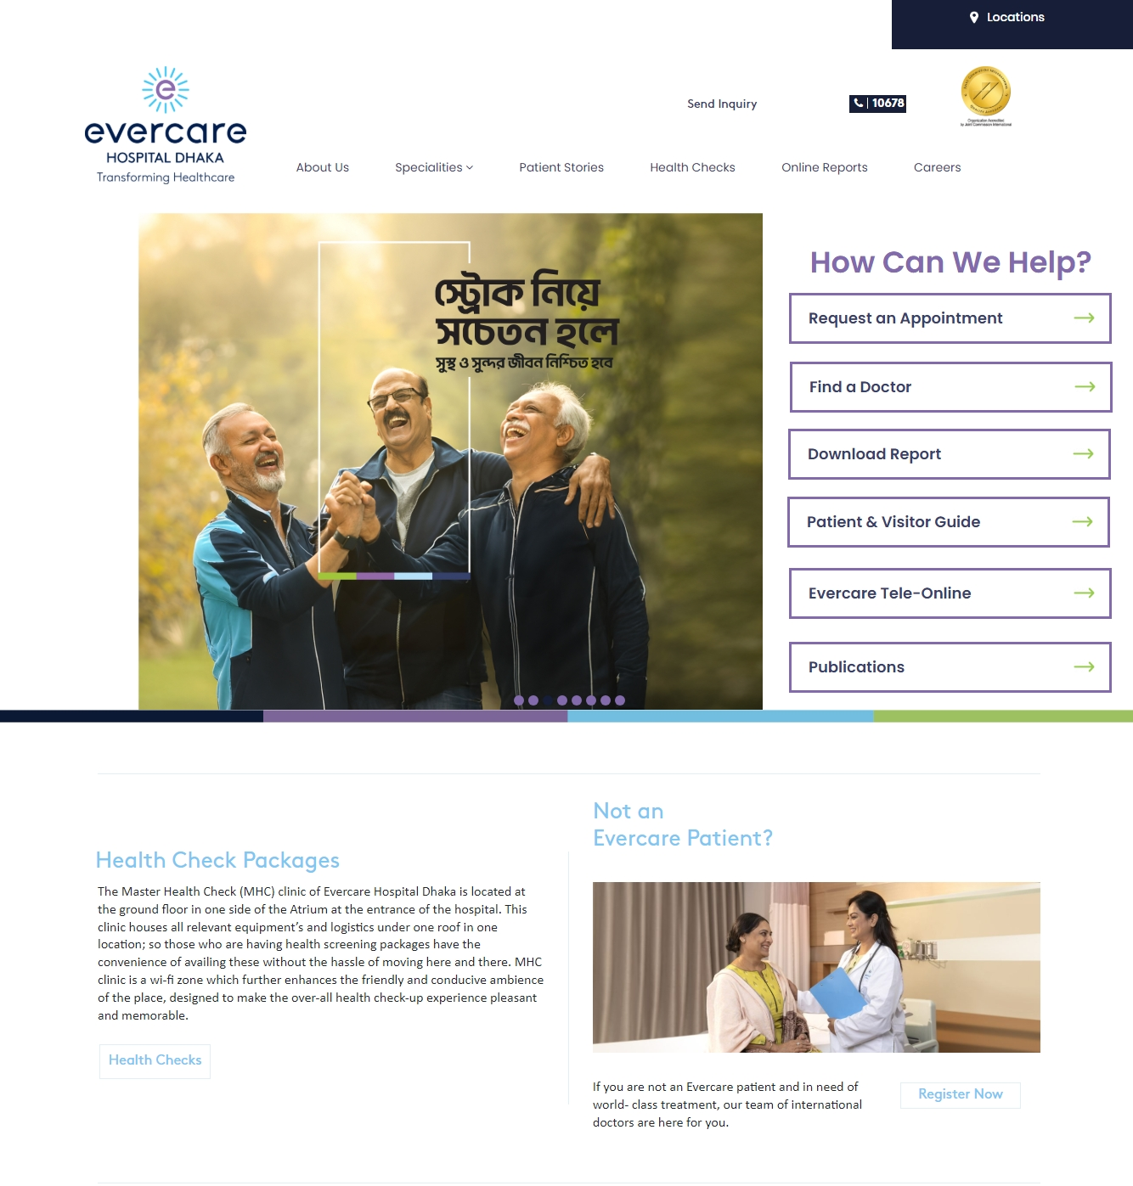

Slide 9
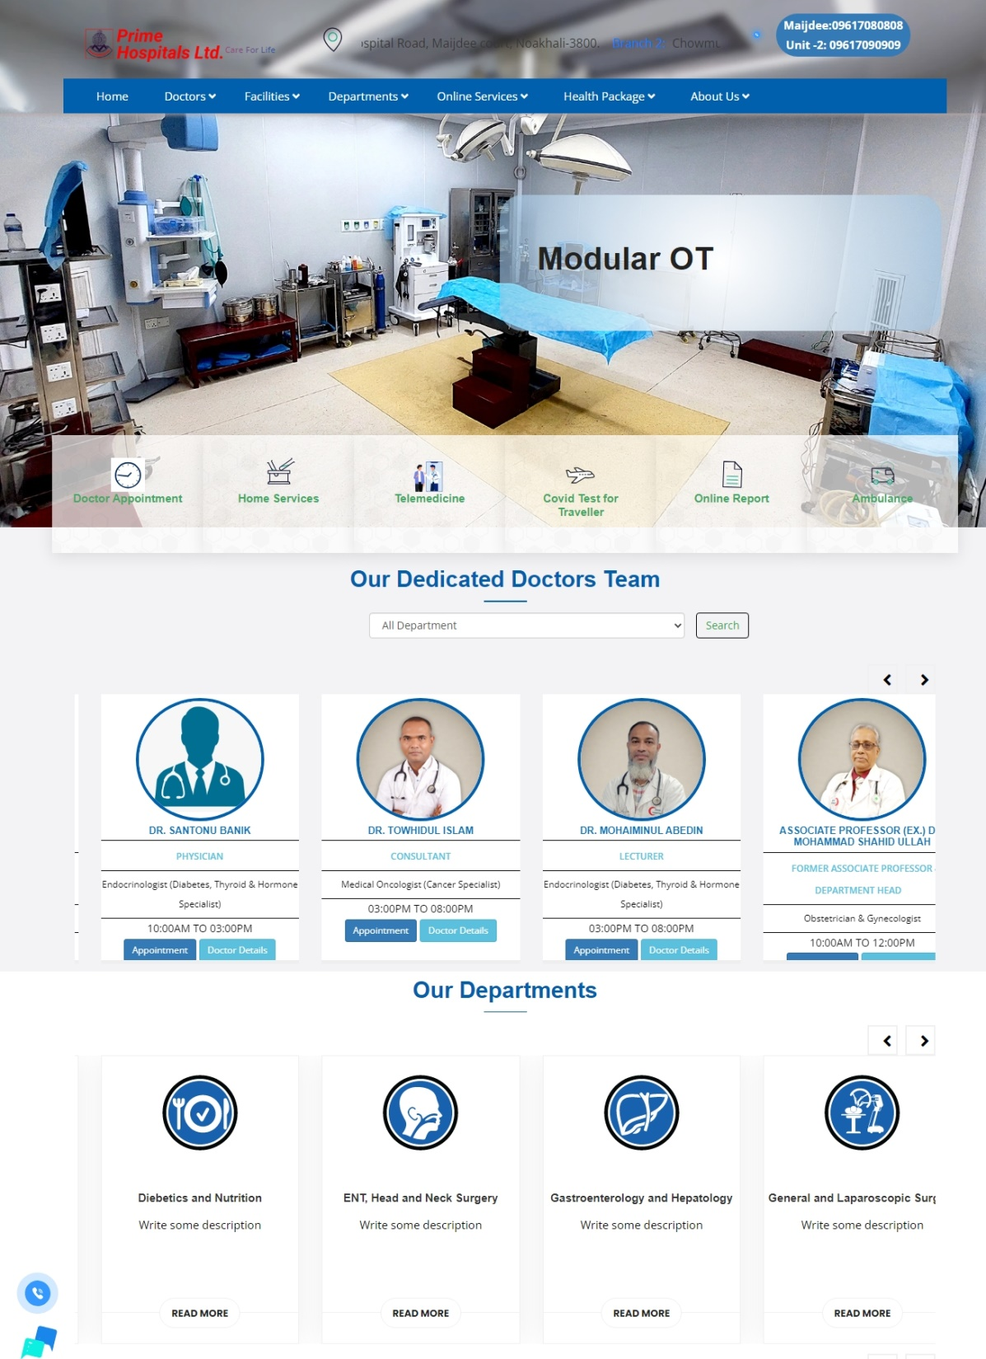

Slide 10
Methodology
1. Requirement Analysis
Identify hospital needs and challenges (e.g., patient record management, appointment scheduling, billing).
Conduct stakeholder interviews (doctors, nurses, admin staff) to gather requirements.
2. System Design
Use UML diagrams (Use Case, Class, Sequence) to visualize the system.
Database schema design for efficient patient data storage and retrieval.
Modular architecture design (e.g., user modules: Admin, Doctor, Patient).
3. Technology Stack
Server-side Technologies
Client-side Technologies
Database management

Slide 11
Methodology
4. Development Phases
Phase 1: Admin module (Manage doctors, nurses, schedules, and billing).
Phase 2: Patient module (Registration, appointment booking, medical history).
Phase 3: Doctor module (Patient records, diagnosis, prescriptions).
5. Testing
Unit Testing: Test individual modules.
Integration Testing: Ensure all modules work together seamlessly.
User Acceptance Testing (UAT): Test system usability with end users.
6. Maintenance and Updates
Monitor system performance.
Provide regular updates for bug fixes and feature enhancements.

Slide 12
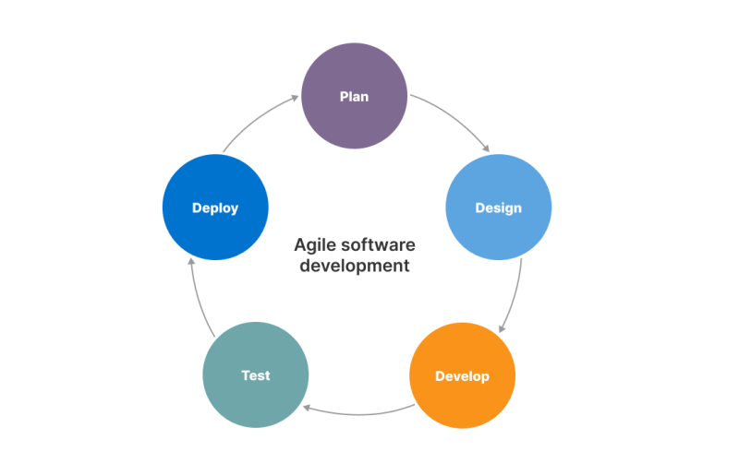
Used Model
The Agile Model is chosen to development of my project that was primarily designed to help a project adapt quickly to change requests. The main aim of the Agile model is to facilitate quick project completion. To accomplish this task,
agility is required.

Slide 13
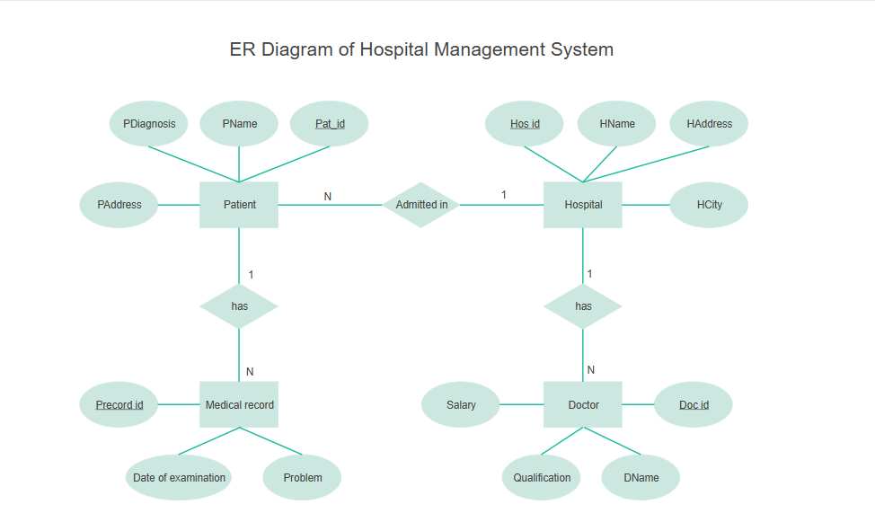
Design an ER Diagram

Slide 14
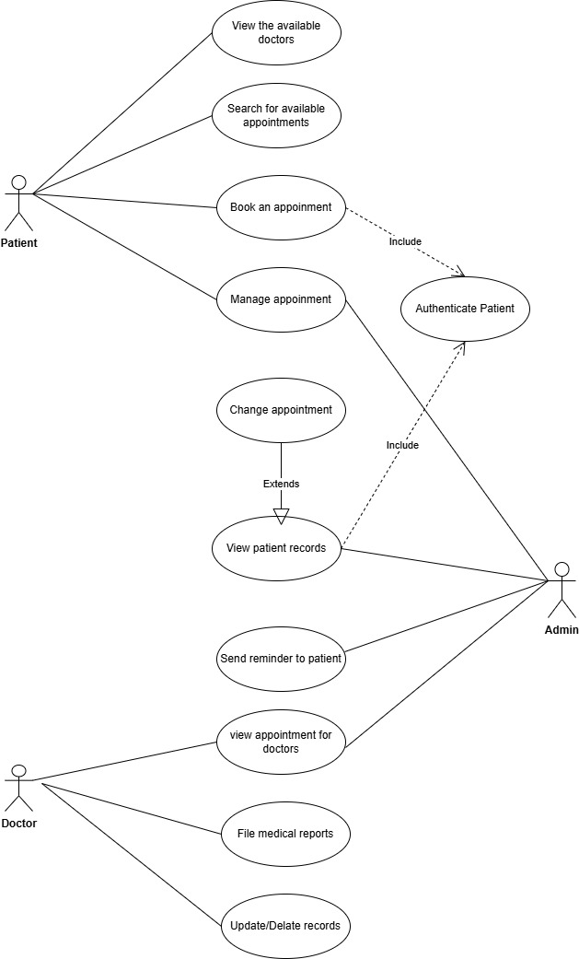
Design an Use case Diagram

Slide 15
Technologies and Tools
Client-Side Technologies:
HTML: Structuring web pages.
CSS: Adding styles for a consistent and visually appealing interface.
JavaScript: Enabling dynamic features like form validation and real-time updates.
React.js: Building reusable, interactive UI components.
Tailwind CSS: Ensuring a clean and responsive design using utility classes.

Slide 16
Technologies and Tools
Server-side Technologies:
Node.js: Server-side logic for efficient communication between client and server.
Express.js: Managing server operations and creating RESTful APIs.
Database Technologies:
MongoDB: Storing dynamic data like student records and attendance logs.
Mongoose: Schema-based modeling for MongoDB, simplifying CRUD operations.

Slide 17
Expected Output
Patient Management
Automatic cost estimation
Real time Bed management
Real time Update Doctors and staff & their availability
Real-Time Alerts
Appointment Scheduling
Billing and Payments
Doctor and Staff Management

Slide 18
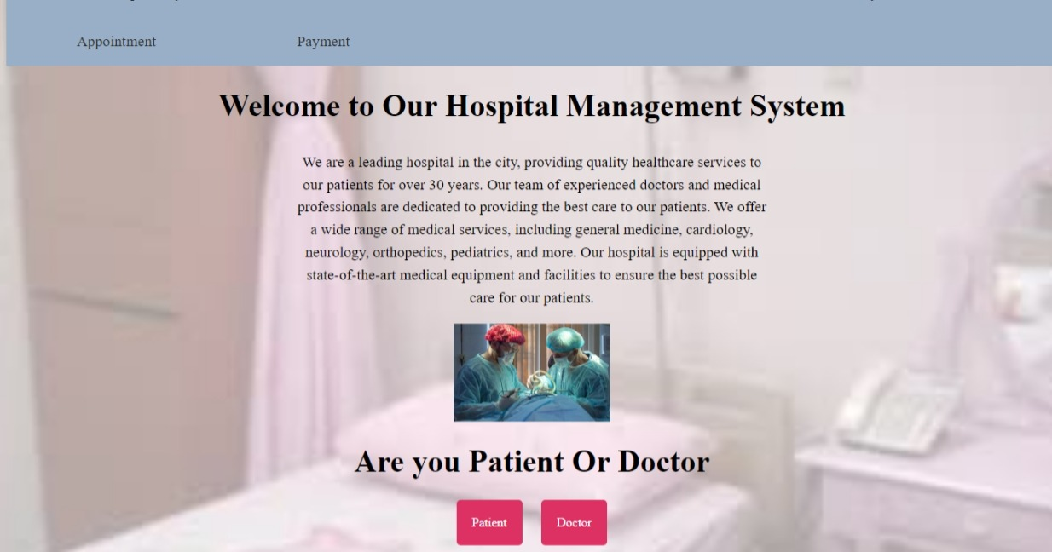
Current Work

Slide 19
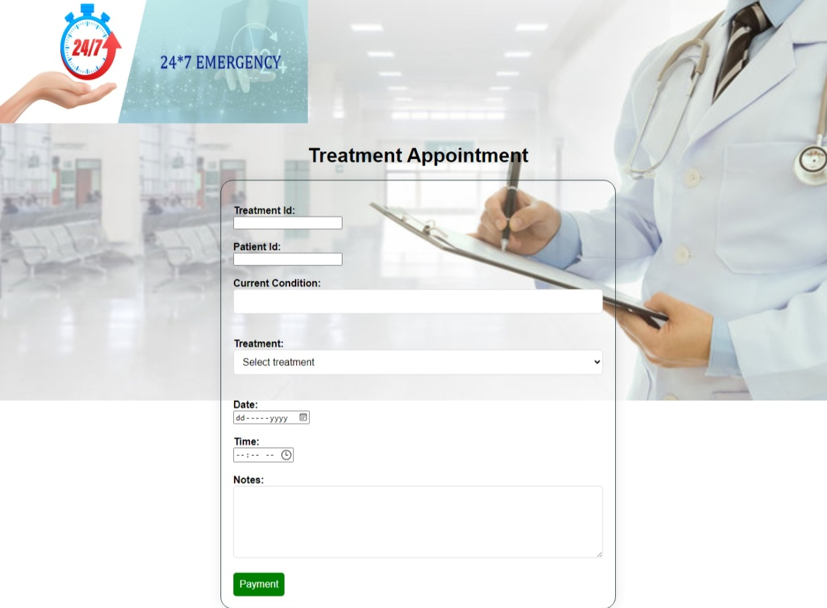
Current Work

Slide 20
Conclusion
The proposed Hospital Management System is designed to streamline hospital operations, improve patient care, and ensure efficient management of resources.
It provides a centralized platform for managing patient records, appointments, billing, and reporting.
Together, we can build a system that supports both healthcare professionals and patients, ensuring seamless and effective hospital management.

