Slide 1
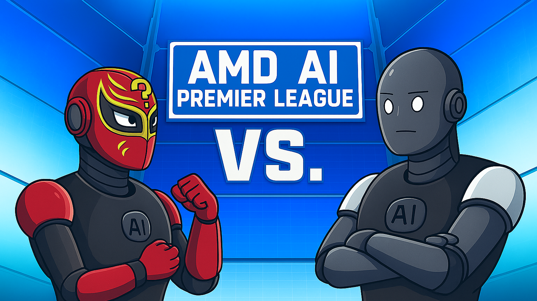
Finishers
Team47

Slide 2
Workflow
A-AGENT
Q-AGENT
Data generation using Qwen2.5-14B-Instruct
(300 samples for each topic)
Data generation using Qwen2.5-14B-Instruct
(300 samples for each topic)
SFT using LoRa for A-Agent
(Base: Unsloth--Llama-3.1-8B-Instruct)
SFT using LoRa for A-Agent
(Base: Unsloth--Llama-3.1-8B-Instruct)
Self-Play Evaluation Loop
(Q-Agent generates an MCQ ---> A-Agent answers ---> Reward/Score)

