Slide 1
Student Performance Classification using Machine Learning
Pearson VUE Project

Slide 2
Problem Statement
Pearson VUE aims to classify students into categories:
- High Performer
- Average Performer
- Needs Improvement
Dataset includes:
- MST Scores
- Quiz Results
- Attendance Records
- Assignment Performance

Slide 3
Project Workflow
1. Data Preprocessing
- Handle missing values
- Normalize features
- Encode labels
2. Train-Test Split
3. Train Models
- Logistic Regression
- Decision Tree
- Random Forest
- SVM
4. Evaluate & Compare

Slide 4
Data Preprocessing
- Missing values handled using mean imputation
- Features normalized with StandardScaler
- Labels encoded using LabelEncoder
- Prepared features (X) and target (y)

Slide 5
Model Training & Evaluation
- Multiple models trained:
Logistic Regression, Decision Tree,
Random Forest, SVM
- Evaluation metrics:
Accuracy, Confusion Matrix,
Precision, Recall, F1-score

Slide 6
Expected Outcome
- Best performing model selected
- Accurate student categorization
- Support for identifying students needing improvement
- Insights for teachers and administrators

Slide 7
Workflow Diagram
Data Preprocessing
Train-Test Split
Model Training
Evaluation & Comparison
Best Model Selection

Slide 8
Confusion Matrix Illustration
Predicted →
(0,0)
(0,1)
(0,2)
Actual ↓
(1,0)
(1,1)
(1,2)
(2,0)
(2,1)
(2,2)

Slide 9
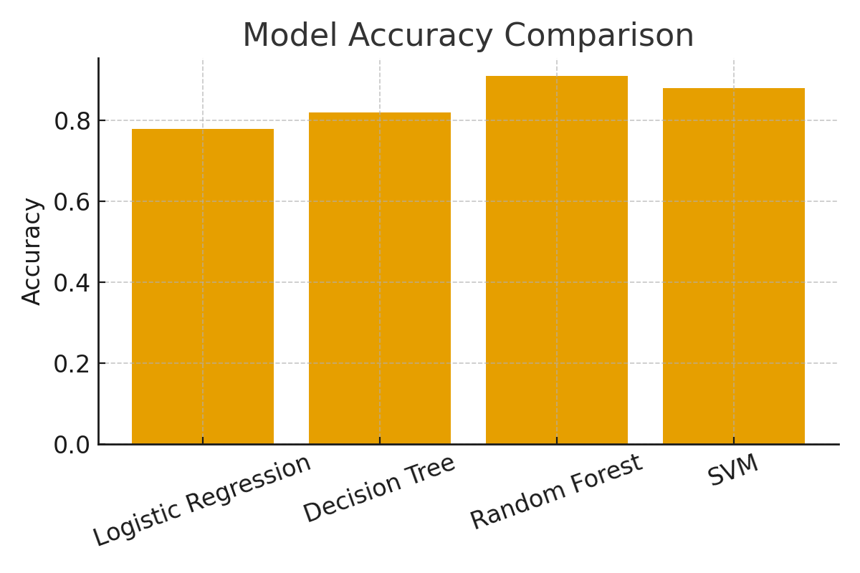
Model Accuracy Comparison

