Slide 1
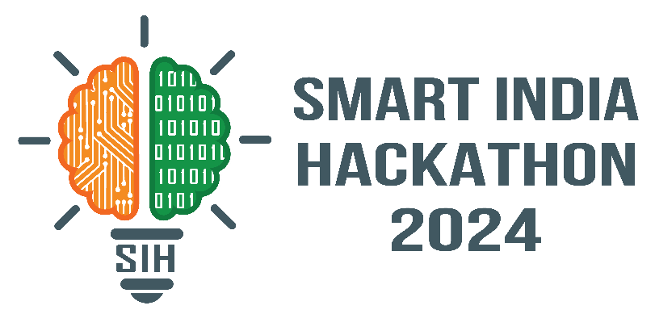
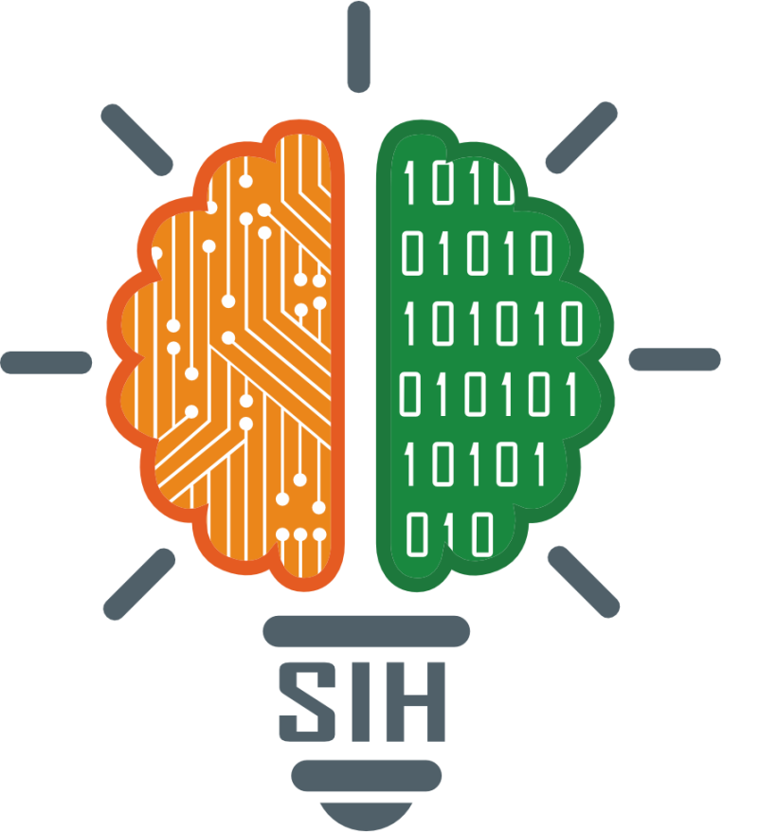
SMART INDIA HACKATHON 2024
TITLE PAGE
Problem Statement ID – SIH1586
Problem Title – Student Innovation
Theme- Smart Education
PS Category- Software
Team ID- MITADTSW325
Team Name- AirTech Innovators

Slide 2
Air Canvas
AirTech Innovators
Proposed Solution: Air Canvas for Teaching
The Air Canvas is an innovative tool that allows educators to draw and write in mid-air using hand gestures, with the content appearing on a digital screen in real-time. This enhances the teaching experience by making lessons more interactive and engaging, especially in both physical and virtual classrooms.
Addressing the Problem
Engagement: The Air Canvas makes lessons more dynamic, capturing students' attention more effectively.
Accessibility: It's easy to use with natural gestures and can be used in various teaching settings, including remote learning.
Innovation
Gesture-Based Interaction: Unlike traditional methods, the Air Canvas offers a unique, hands-free way to create content.
Versatility: It’s adaptable to different subjects and educational levels, making it a versatile tool for educators.
This concept could transform teaching by adding a new level of interactivity and accessibility.

Slide 3
TECHNICAL APPROACH
AirTech Innovators
Technologies to be Used
Programming Language: Python
Libraries: OpenCV, NumPy
Hardware: Webcam
Methodology and Process
Initialize Webcam: Use cv2.VideoCapture(0) to start the webcam for capturing real-time video frames.
Drawing Implementation: Calculate the center of the bounding box,
which represents the pen tip.
Draw a circle at the detected pen tip using cv2.circle().
Real-Time Display: Continuously display the processed video frame with
pen detection using cv2.imshow().
Exit the loop and close the application when the 'q' key is pressed.

Slide 4
FEASIBILITY AND VIABILITY
AirTech Innovators
Feasibility Analysis:
Technically Feasible: Utilizes well-established technologies like OpenCV and Python for real-time gesture tracking.
Accessible Hardware: Requires only a webcam and a computer, making it easy to implement.
Potential Challenges:
Lighting Conditions: Poor lighting might affect pen detection accuracy.
Gesture Precision: Accurate tracking of fine gestures can be difficult.
Strategies:
Adaptive Thresholding: Use dynamic color ranges based on lighting conditions.
User Calibration: Allow users to calibrate the system for better precision.
This approach ensures that the project is both feasible and viable with manageable risks.

Slide 5
IMPACT AND BENEFITS
AirTech Innovators
Potential Impact
Educational: Boosts interactive learning and accessibility.
Creative: Enables digital art and innovative expression.
Assistive: Supports diverse needs and alternative inputs.
Benefits:Social: Enhances interaction and inclusivity.
Economic: Lowers costs and spurs innovation.
Environmental: Reduces waste and promotes sustainability.

Slide 6
REFERENCES
AirTech Innovators
https://ai.google.dev/edge/mediapipe/solutions/guide
https://pyimagesearch.com/2018/07/30/opencv-object-tracking
https://www.tensorflow.org/federated

