Slide 1
Cloudera Spark and Hadoop Developer Certification

Slide 2
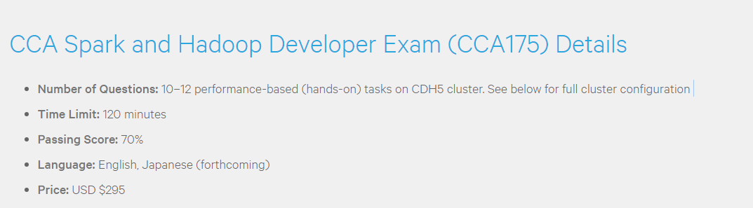
EXAM DETAILS

Slide 3
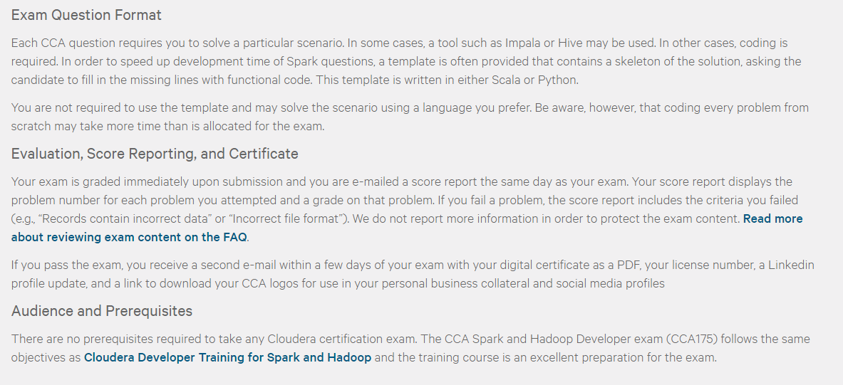
EXAM DETAILS cntd…

Slide 4
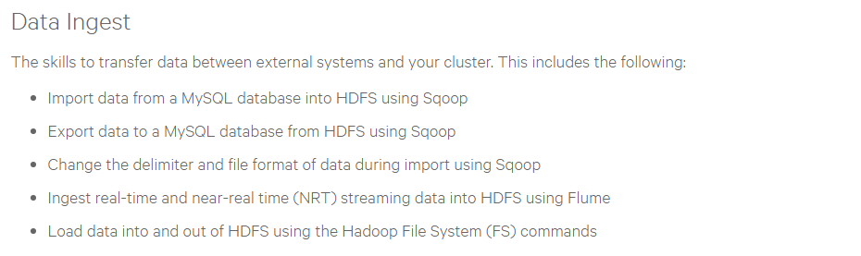
Calendar – DAY 1
Sqoop
Import
Export
Flume

Slide 5
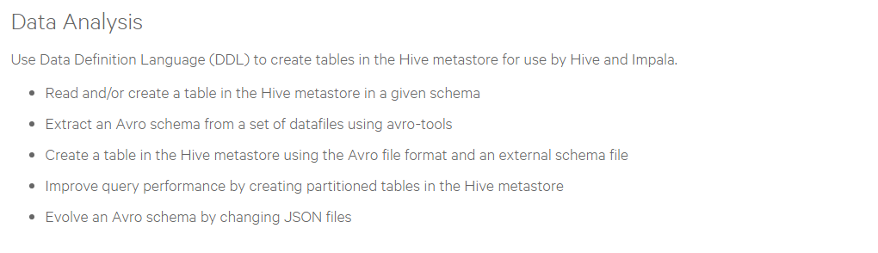
Calendar – DAY 2
Hive
Create/Read Hive table
Create/Read Hive table from Avro schema file
Create/Read Hive table in Parquet format
Partitioning
Impala
HUE – Hadoop User Experience

Slide 6
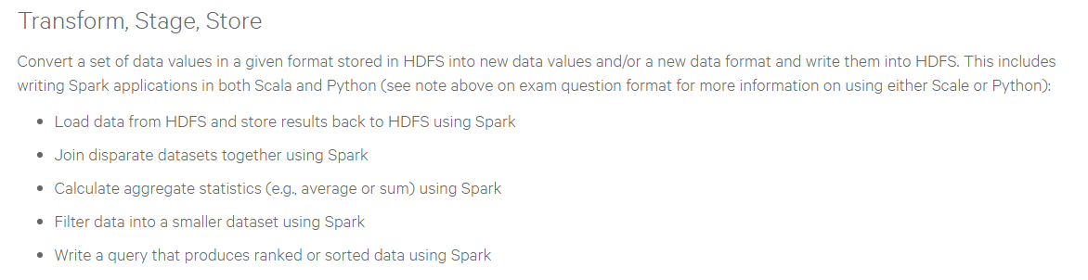
Calendar – DAY 3
Spark
Using Scala
Using python

Slide 7
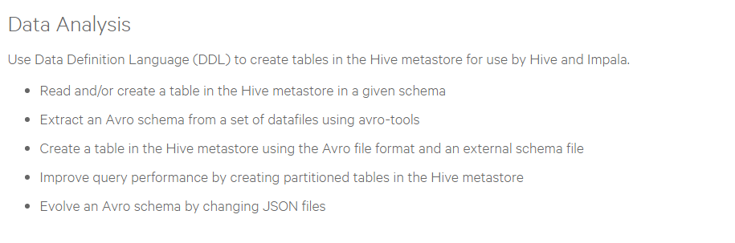
Calendar – DAY 4
Avro schema evolution
Avro tools
Exam hints and tips

Slide 8
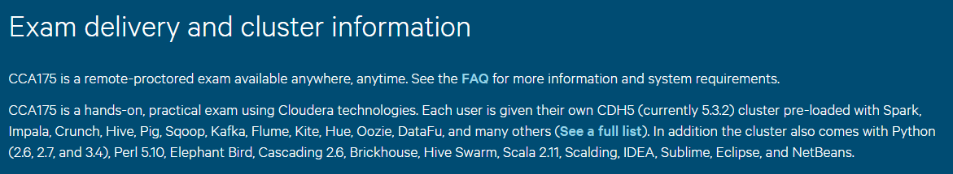
Cluster Environment
** Don’t be overwhelmed, you really need only a few…

Slide 9
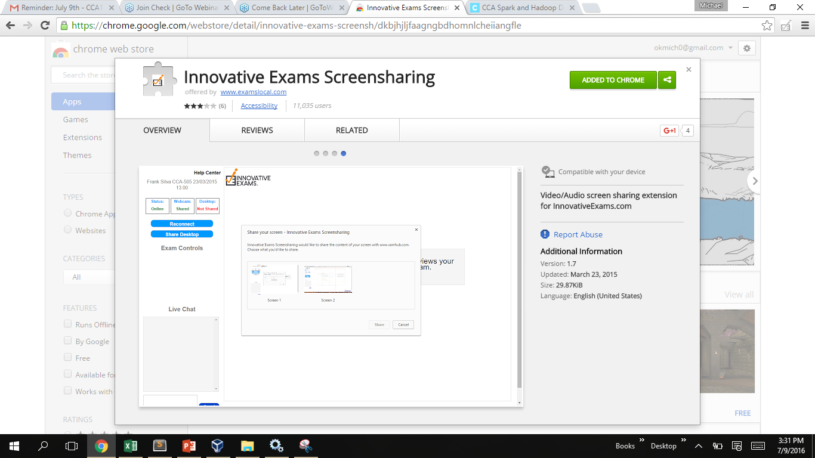
Exam Environment

