Slide 1
Path Planning for Treasure Hunting with Adversaries and Items
By Anand Patel
ENAE788V
Spring 2019

Slide 2
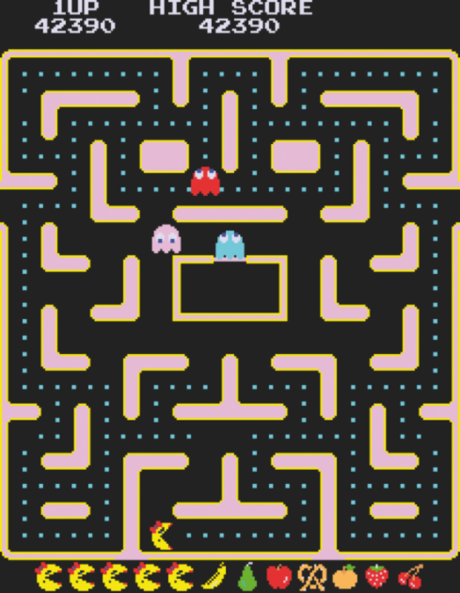
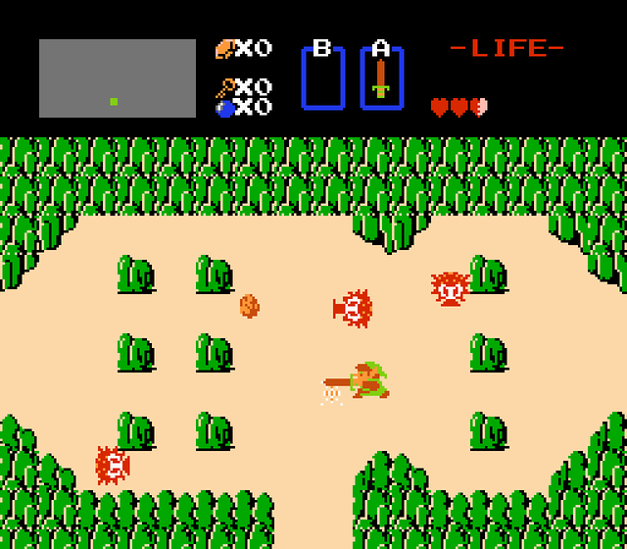
Background
Design & solve a treasure hunting game with adversaries, items, and exit door goal.
Games provide a complex, interesting testbed for motion planning
Unique rules
Actions alter environment
Motivation:
Pursuit/Evasion Motion Planning Problems
Applications for entertainment
Human vs Robot: Can we beat the machines?
Robot vs Robot: Who designed better agent?
https://www.retrogamer.net/retro_games80/the-making-of-ms-pac-man/
https://www.usgamer.net/articles/long-time-coming-finishing-the-original-legend-of-zelda-in-2016

Slide 3
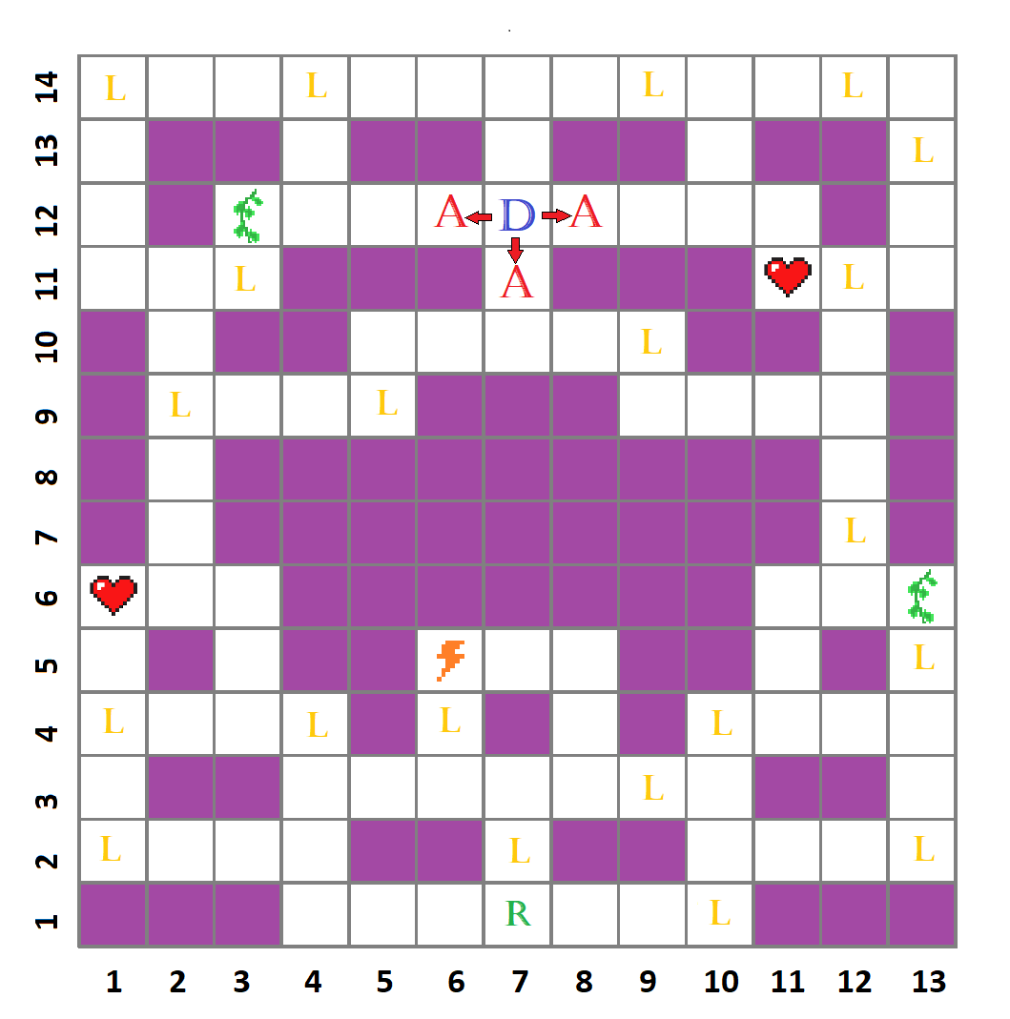



Concept Overview
Game Description:
2D static grid ➔Undirected Graph:
Rooms ➔ Nodes:
Connections between rooms ➔ Edges:
4 directions of movement, Turn-based
Explorer Agent R
R begins game at fixed start node v_{start}
Adversaries A move randomly
3 adversaries (A₁, A₂, A₃) begin game at exit door D
WIN: R reaches fixed exit door D
LOSE: R, A occupy same node
Loot L and Items I placed at unique nodes
Collected by R by traveling onto node
Total Loot value: L_{T} = 103
Loot collected by explorer: L_{C}

Slide 4
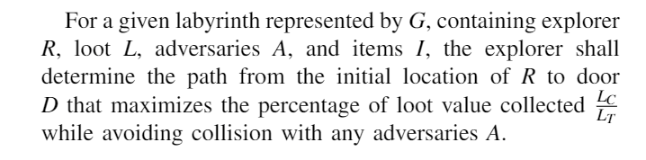
Problem Statement
Problem: Path Planning for Treasure Hunting with Adversaries and Items
➔ Algorithm Chosen: Q-Learning Explorer Agent

Slide 5

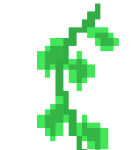

Items
Items are used upon collection by explorer
Item 1: I₁= Charm, 9 turns
Nearest adversary: harmless to explorer
Item 2: I₂= Root, 5 turns
All adversaries: Stationary, but harmful
Item 3: I₃= Lightning, permanent
Kills nearest adversary: harmless & stationary

Slide 6
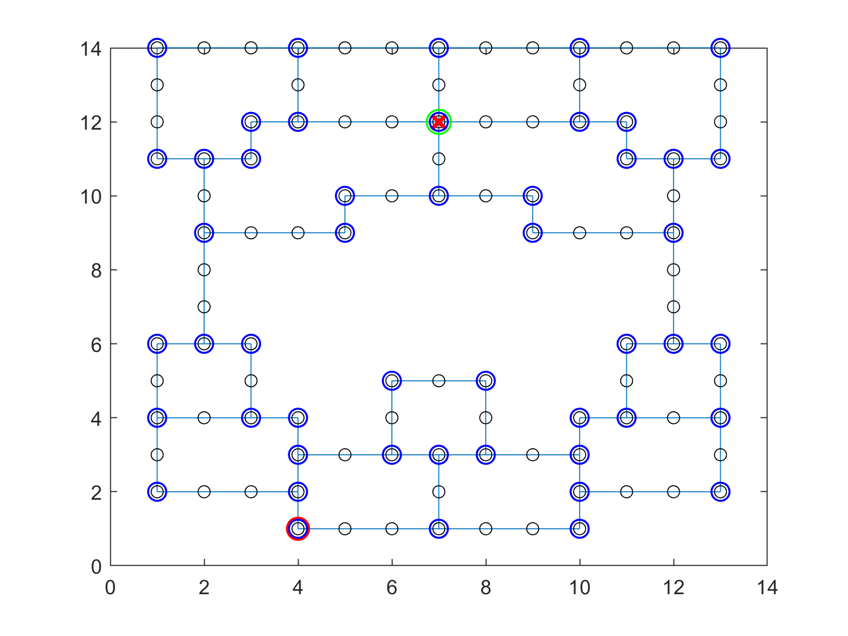
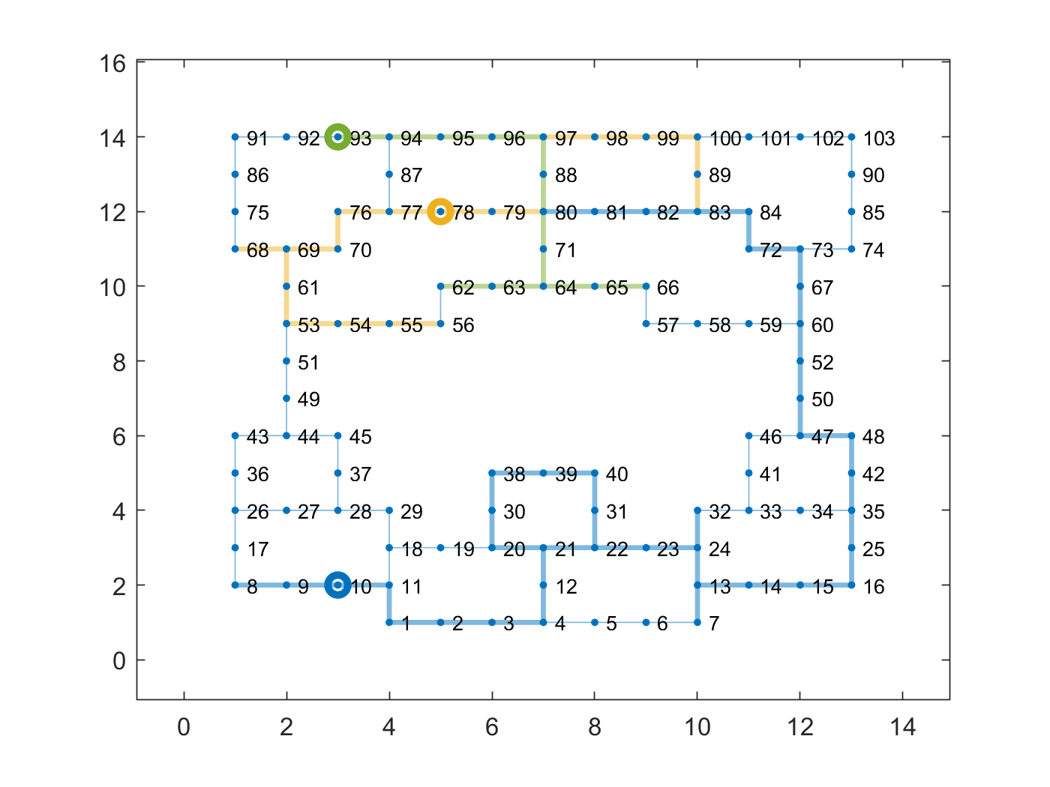
Adversary behavior
Each turn…
Random Walk:
If in hallway:
Continue in same direction of movement
If @ intersection:
Randomly pick from possible directions at current node
Non-Deterministic
Blue circles = intersection nodes

Slide 7
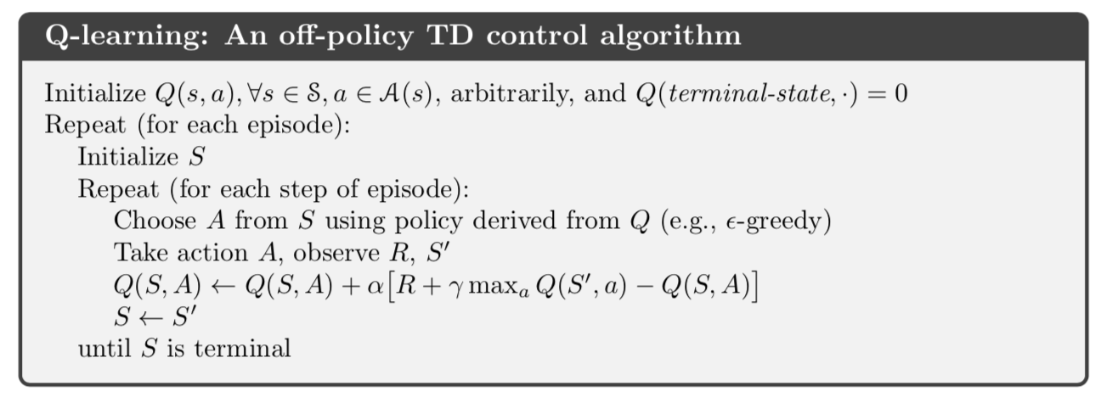
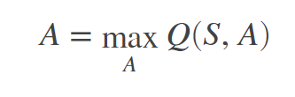
Q-learning
Q(s,A) = Q-Table (multi-dimensional array), initialized @ 0
Epsilon-greedy annealing:
For current observation S, select random action A with probability epsilon. Otherwise choose action based on greatest Q-value (greedy):
https://medium.com/deep-math-machine-learning-ai/ch-12-1-model-free-reinforcement-learning-algorithms-monte-carlo-sarsa-q-learning-65267cb8d1b4

Slide 8
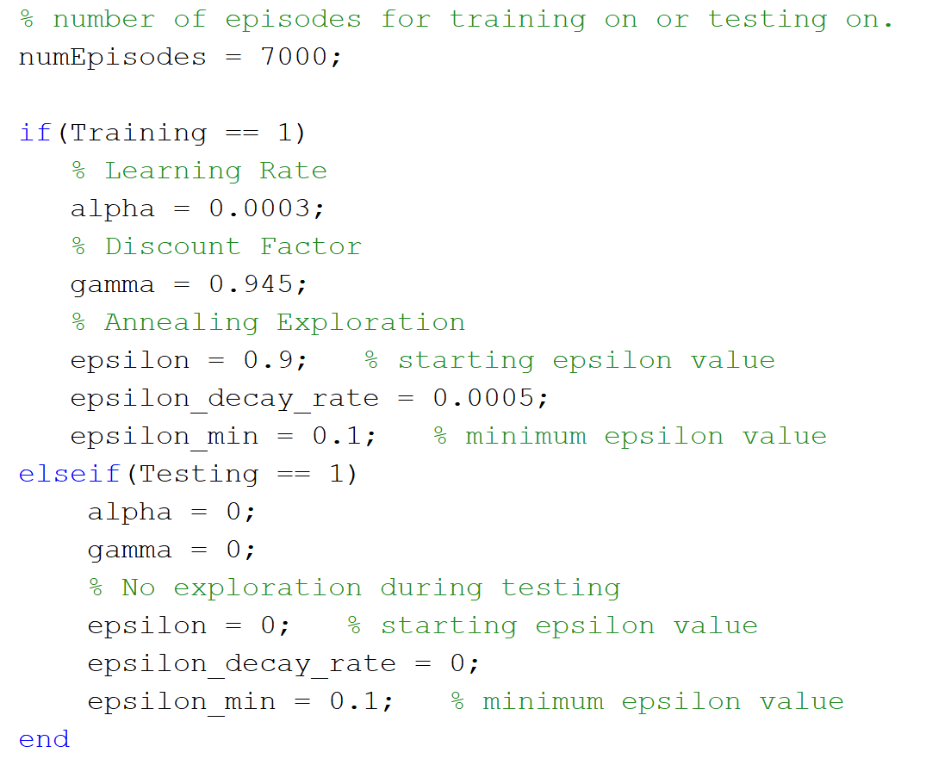
Parameters & Rewards used
Learning Rate alpha = 0.0003 [Segarro2017mspacman]
Discount Factor gamma = 0.945 [Segarro2017mspacman]
alpha & gamma need trial and error for fine tuning
Training = 7000 episodes, Testing = 500 episodes
Epsilon decays per episode
0.9 ➔0.1
Decay rate chosen based on 7000 training episodes

Slide 9
Representing the game environment
Avoid over-fitted exploring agent by representing states S with info that translates between G (intersection nodes, relative distances, etc.)
Q(S,A) = Q(A, a(A), b, c, d, e(A), f(A), g(A), h(A), i(A))
Actions + 9 Higher-order state/action inputs = 10-D Q-Table
Observe S in Q-Learning ➔ Calculate (S,A) for all actions available to the Explorer @ current node

Slide 10
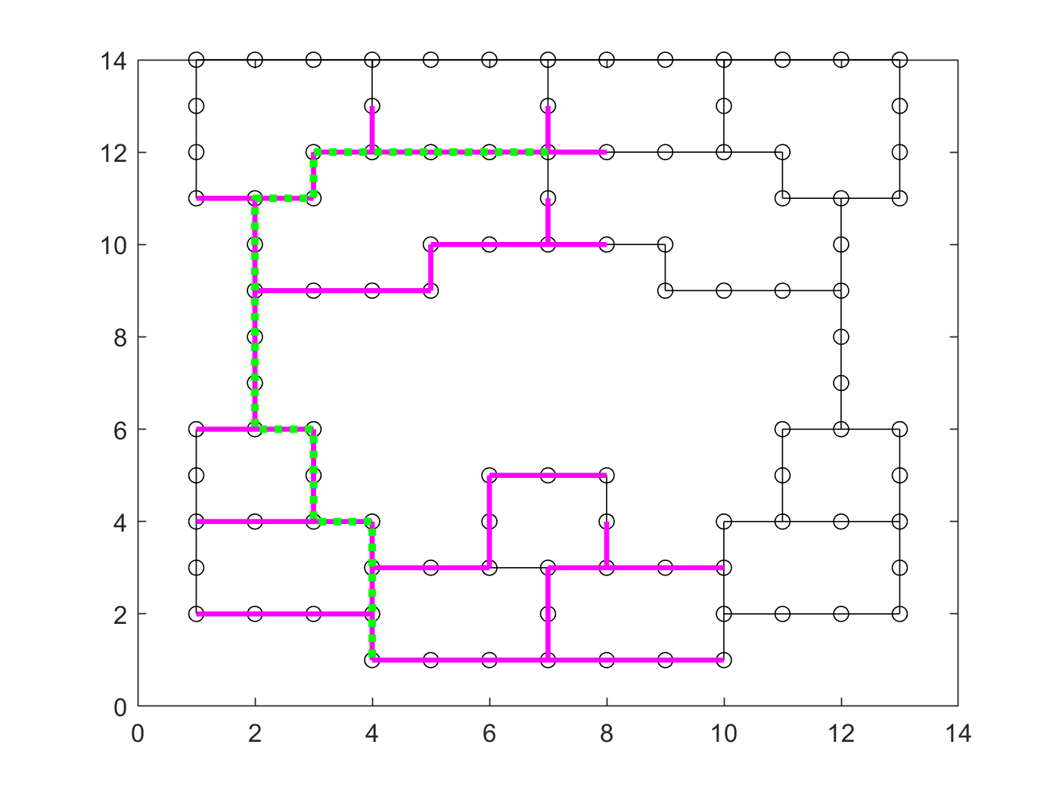
State/Action inputs
Q(S,A) = Q(A, a(A), b, c, d, e(A), f(A), g(A), h(A), i(A))
A: [down, left, right, up] = [1,2,3,4]
a(A): DoorInput(A) = distance to door [0,24]
Manhattan Distance used for all distances
24 is max distance between nodes in this G
b: LightningInput = if lightning has been used [0 or 1]
c: CharmInput = current duration of charm [0,9]
d: RootInput = current duration of root [0,5]

Slide 11
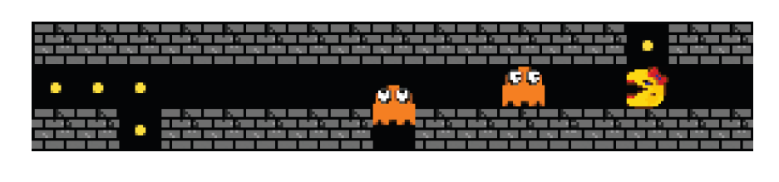
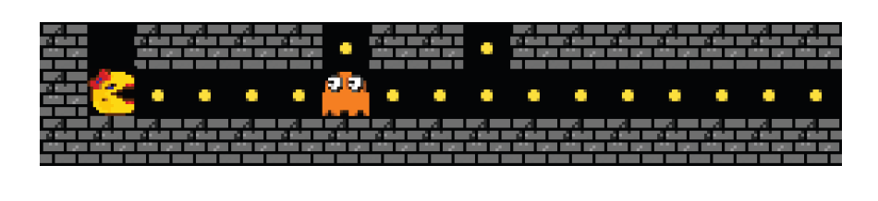
State/Action inputs
[bom2013]
Q(S,A) = Q(A, a(A), b, c, d, e(A), f(A), g(A), h(A), i(A))
e(A): EnemyInput(A) = (D_{max} – D_{i,explorer} + D_{i,adversary}) [0,24]
D_{max}: 24
D_{i,explorer}: distance between explorer and closest intersection along action A
D_{i,adversary}: distance between closest intersection along A and the nearest adversary
➔Input is capped at 24; equidistant is worst case threshold
Gives adversary threat for a given action A
Why nearest enemy only considered.
For the “left” action, even though 2 ghosts approach, only the closest one to Ms. Pacman determines danger since they share the worst input value.
[bom2013]
How input changes.
For the “right” action, the ghost being closer to the intersection than Ms. Pac-Man makes this the highest threat level (input = 24). If the ghost was further away from the intersection than Ms. Pacman, the input would be lower.

Slide 12
State/Action inputs
Q(S,A) = Q(A, a(A), b, c, d, e(A), f(A), g(A), h(A), i(A))
f(A): LootProxInput(A) = distance to nearest loot [0,24]
Tells which action gets explorer closer to loot
g(A): ItemProxInput(A) = distance to nearest item [0,24]
Tells which action gets explorer closer to item

Slide 13
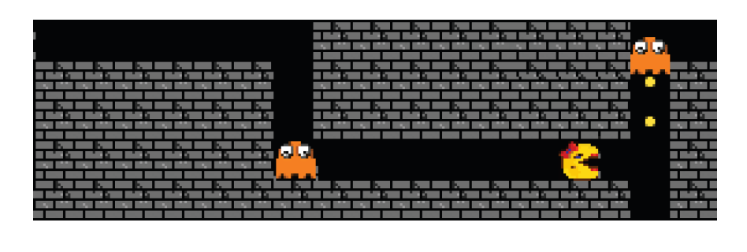
State/Action inputs
[bom2013]
Q(S,A) = Q(A, a(A), b, c, d, e(A), f(A), g(A), h(A), i(A))
h(A): EntrapmentInput(A) = (SafeRoutes –SafeRoutes(A))/SafeRoutes [0,10]
Safe route = Shortest path from explorer to 3 intersections away that can be reached before any adversary
SafeRoutes = number of safe routes from current node
SafeRoutes(A) = number of safe routes beginning with action A
If length(SafeRoutes) = 0, use 2 intersections away, 1 intersection away etc.
If 1 intersection away = 0, set input to worst case ➔ 10 (totally entrapped)
% of safe routes NOT along an action A
i(A): SameDirectionInput(A) = if explorer is traveling in same direction [0 or 1]
Shows entrapped Ms.Pacman approaching SafeRoute 1 intersection away as best chance for survival

Slide 14
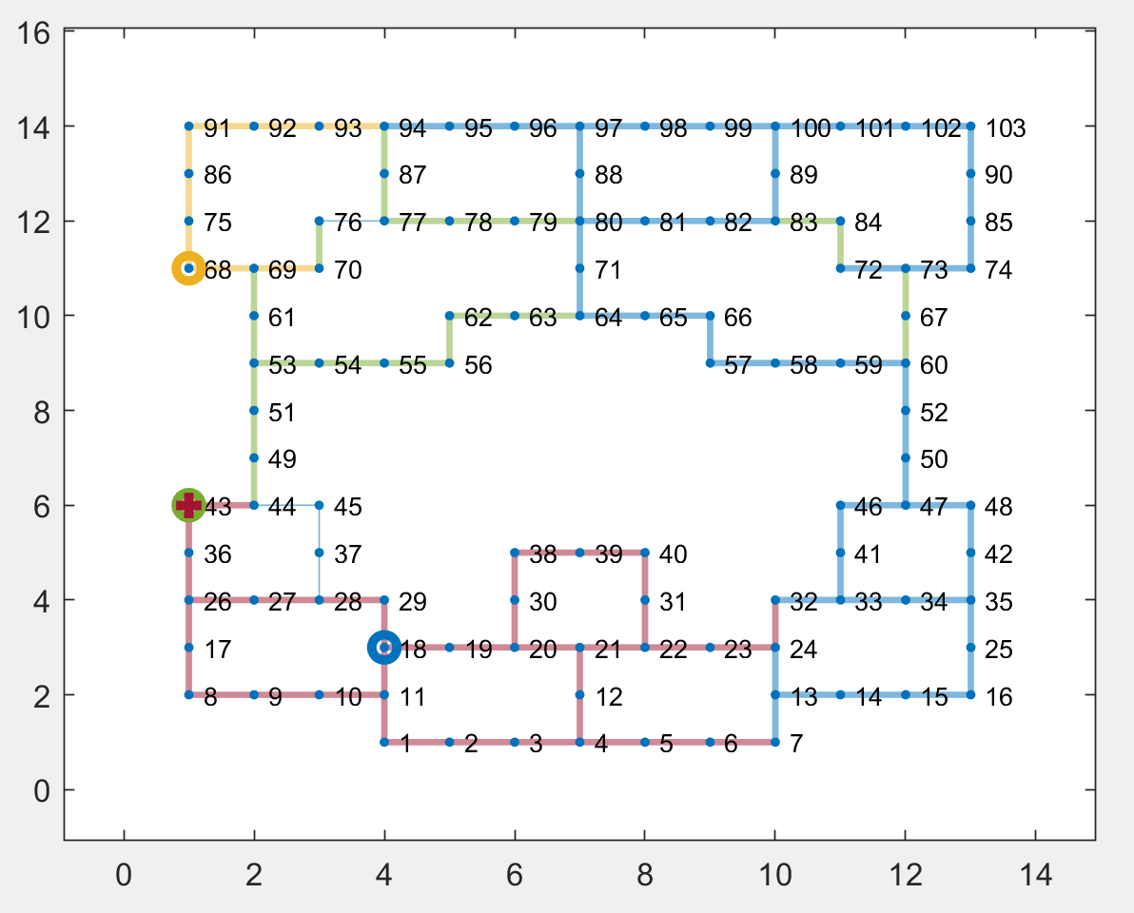
Training (In progress)
Training on 7000 episodes [bom2013], [segarro2017]
Started Monday night, still training
Fixed loot/item locations
No graphics ➔ visualization done post-training/testing
Training trial for 10 episodes:
Explorer (red) uses 1xLightning, 1xCharm.
Killed adversary (yellow) @ node 68.
LOSS: caught by adversary (green) @ node 43.

Slide 15
Testing (next steps)
When training completes…
Testing on 500 episodes [segarro2017]
On same G (fixed loot/items)
On G with random loot/item locations per episode ⬅assess policy transfer
Metrics to analyze:
Win %
% Loot Value collected per win
Items used per win ⬅ impact of items on success

Slide 16
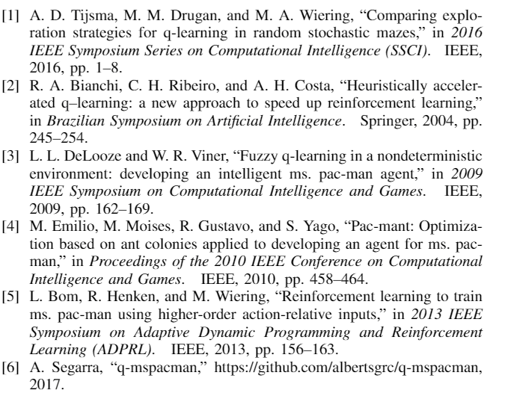
References

Slide 17
Questions?

