Slide 1
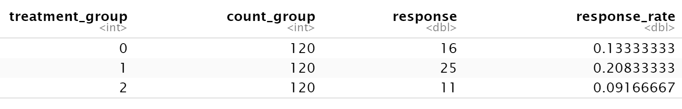

Slide 2
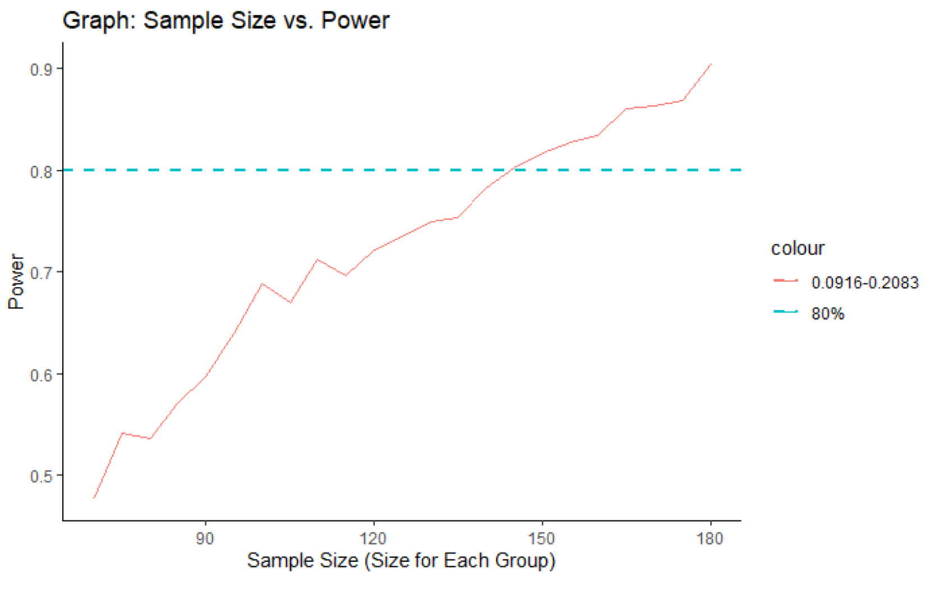
100 Lottery = 9.16%
5 Incentive = 20.83%
Simulation # | Sample Size | Power
1 | 70 | 0.477
2 | 75 | 0.541
3 | 80 | 0.536
4 | 85 | 0.571
5 | 90 | 0.597
6 | 95 | 0.64
7 | 100 | 0.689
8 | 105 | 0.67
9 | 110 | 0.712
10 | 115 | 0.696
11 | 120 | 0.721
12 | 125 | 0.735
13 | 130 | 0.75
14 | 135 | 0.754
15 | 140 | 0.783
16 | 145 | 0.803
17 | 150 | 0.817

Slide 3
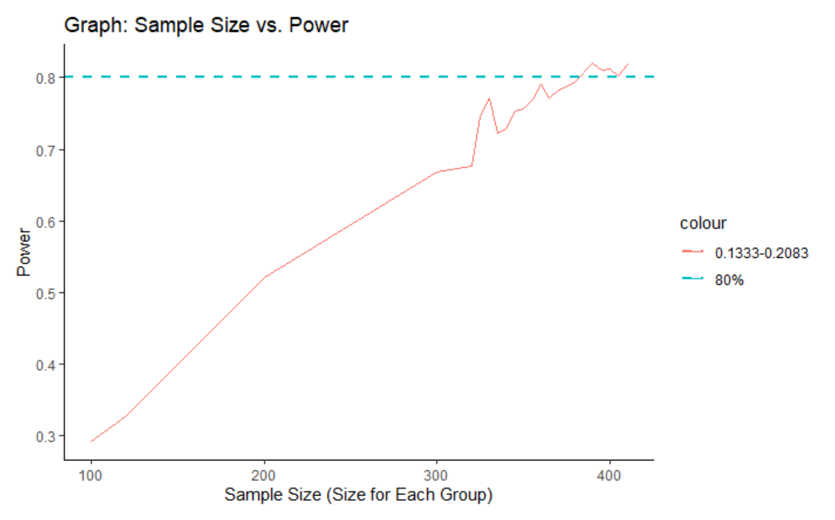
No Incentive = 13.33%
5 Incentive = 20.83%

Slide 4
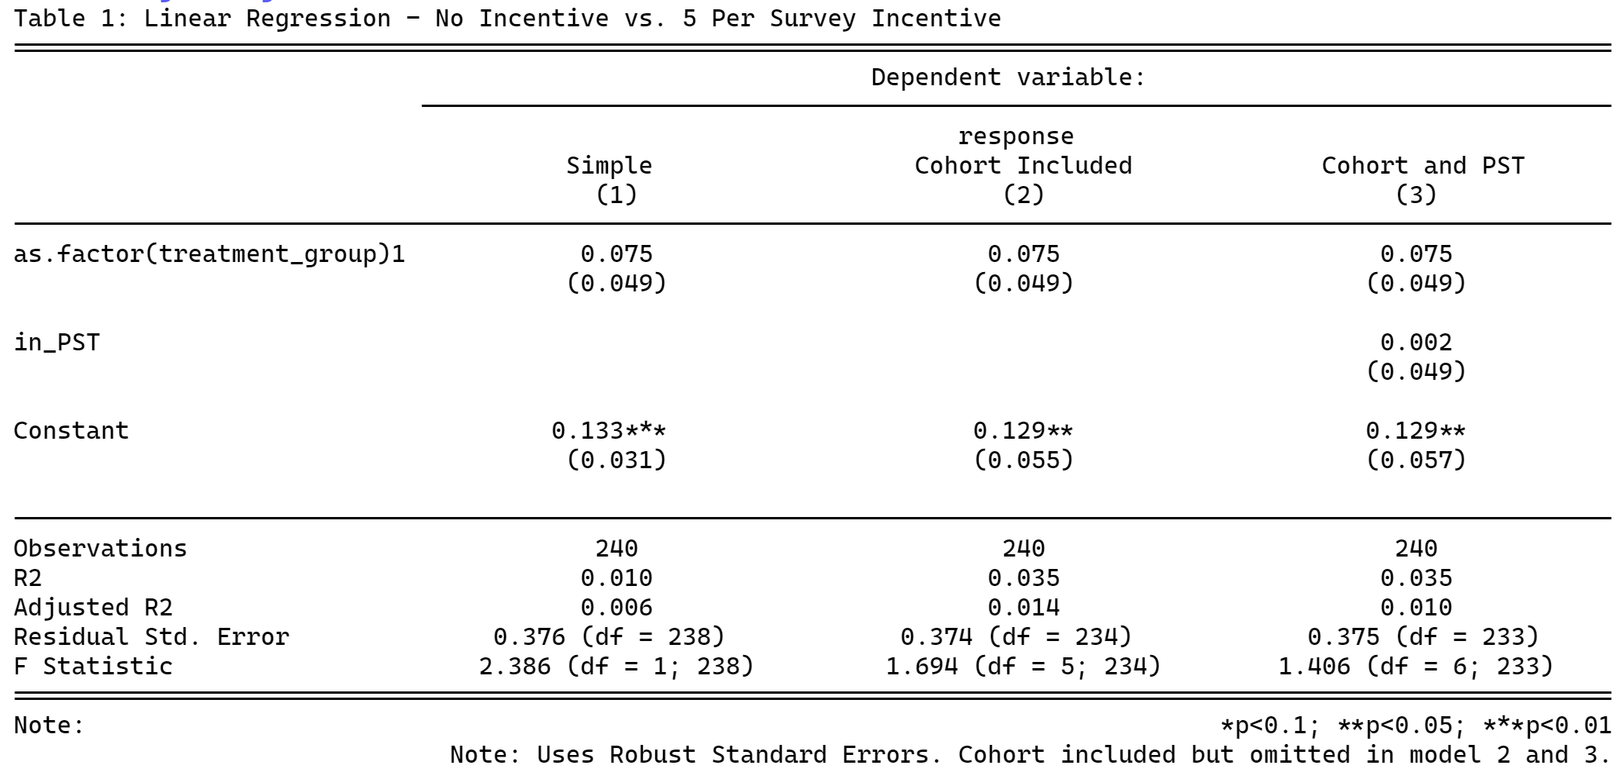
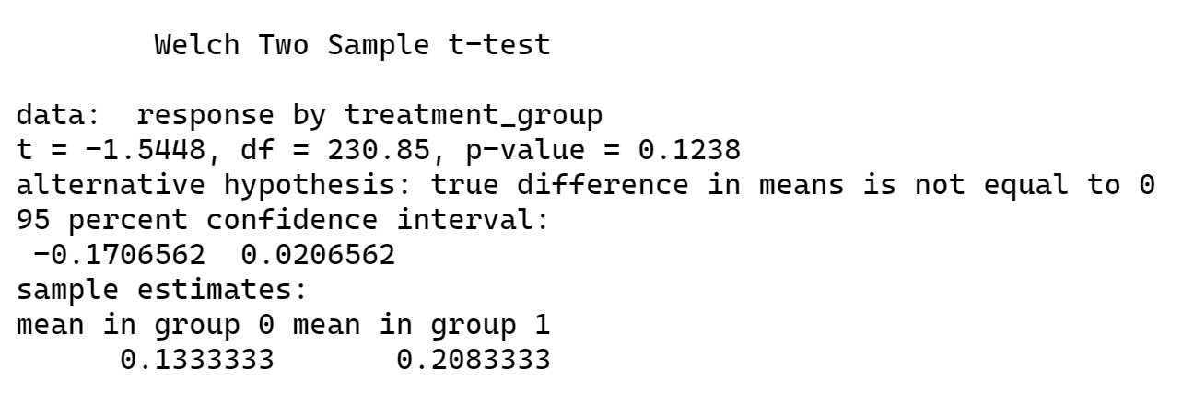
$5 Incentive
No Incentive

Slide 5
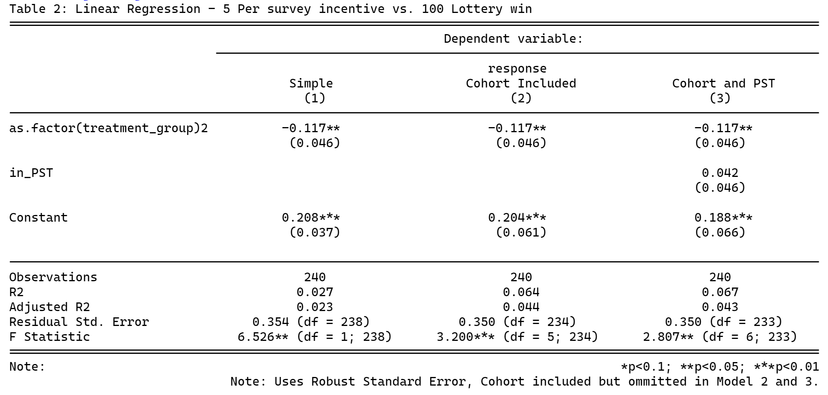
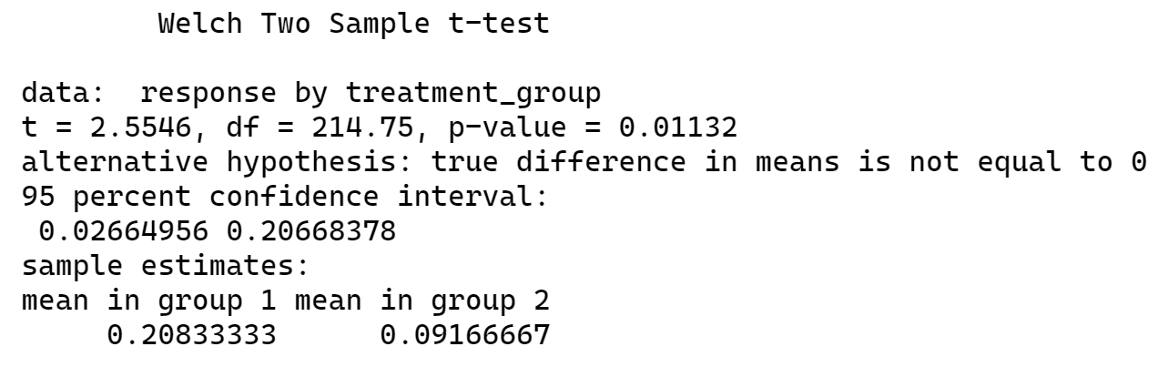
100 Lottery
$5 Incentive

Slide 6
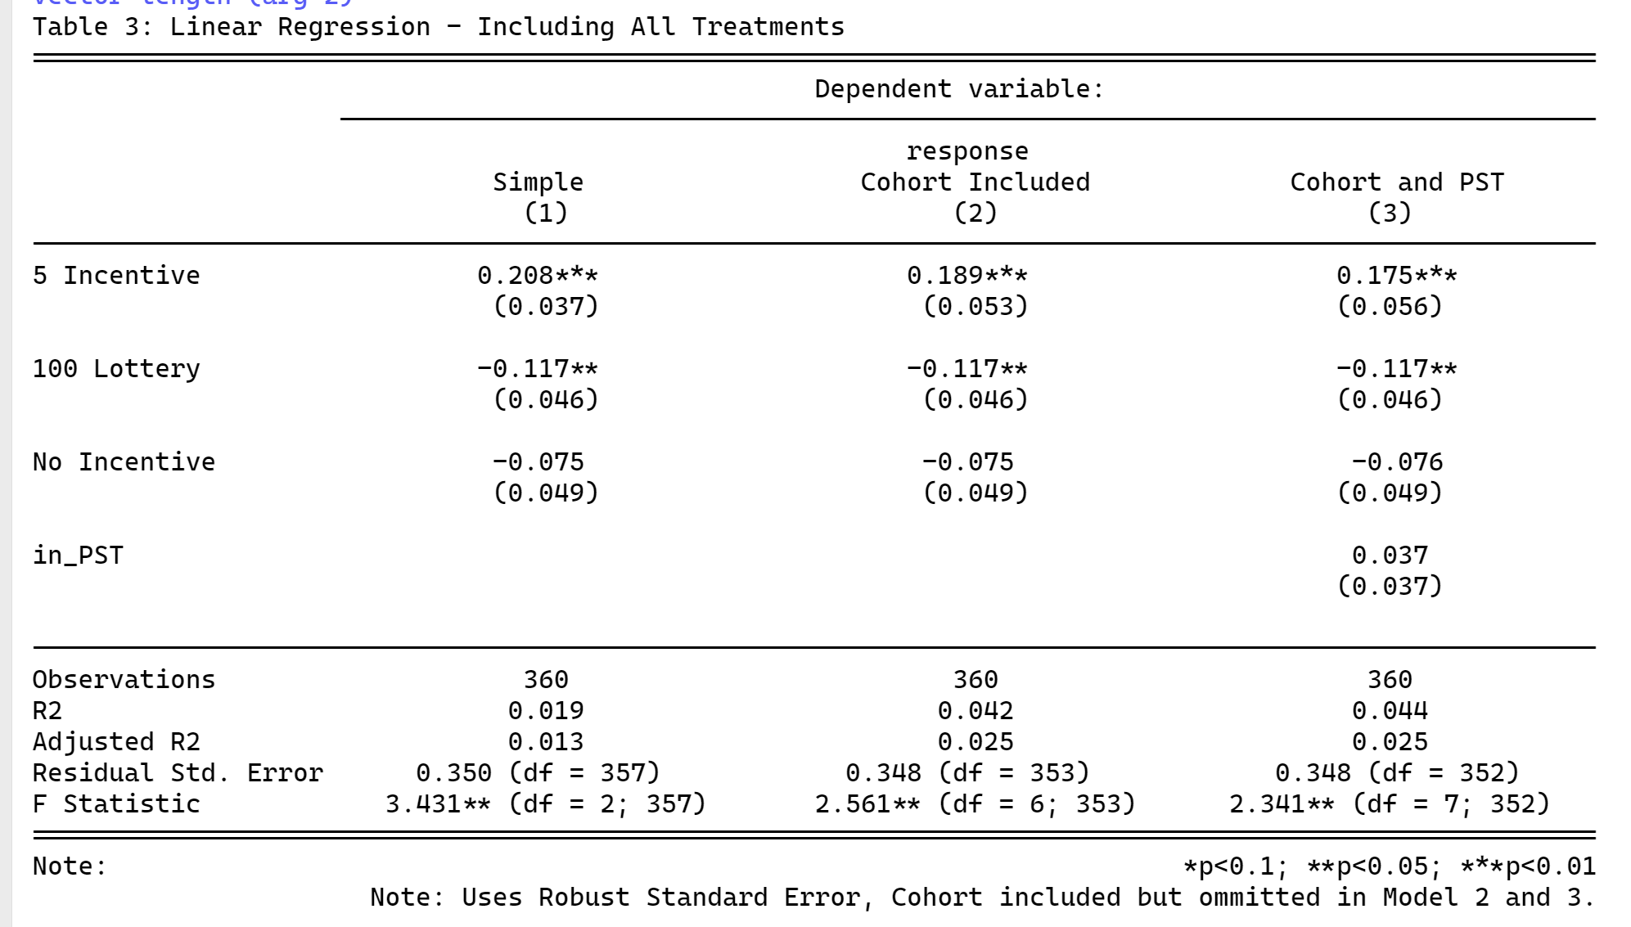
CONSOLIDATING ANALYSIS IN ONE REGRESSION:

Slide 7
BACKUP SLIDES

Slide 8
