Slide 1


AN ANALYSIS OF CAREER TRAJECTORIES - SALARY EXPERIENCE ACROSS GLOBAL INDUSTRIES
M1 Project – Data Analytics & Data Science
ANAND S

Slide 2

Analyze global salary trends by industry, gender, education, and experience.
PROJECT OBJECTIVE
Identify top-paying job roles and locations.
Examine the influence of education and experience on earnings.

Slide 3

DATASET DESCRIPTION
Salary Survey 2021 dataset
13 attributes, 27,927 cleaned records
Covers global industries, various education levels, genders, and experience ranges

Slide 4
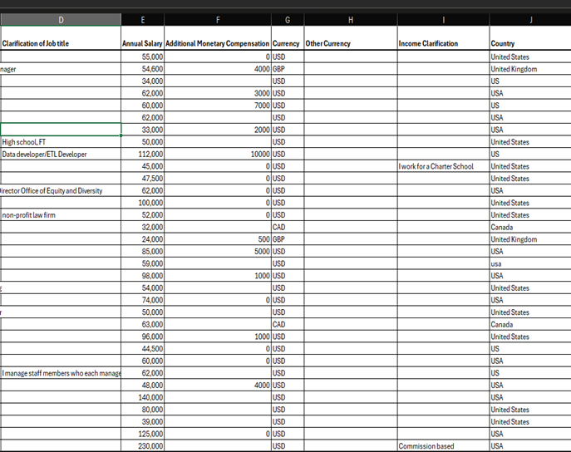
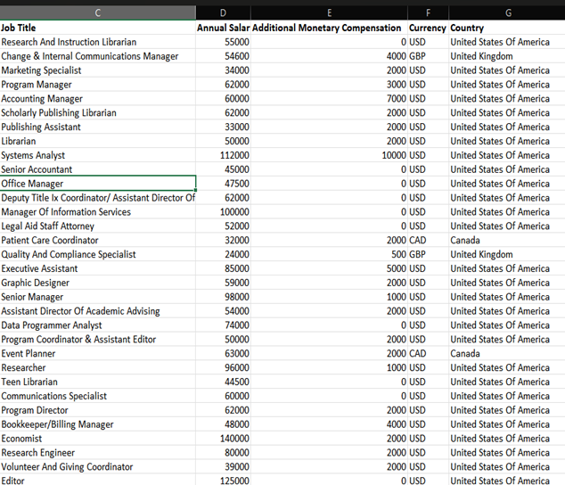
DATA CLEANING PROCESS
=

Slide 5
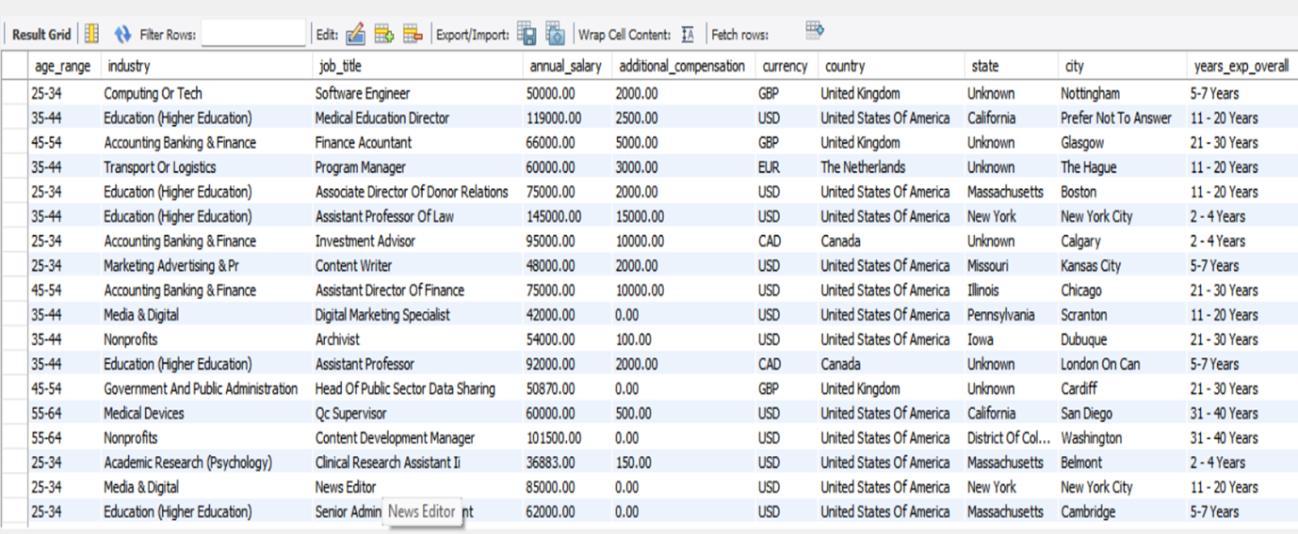
DATA IMPORT TO MYSQL
TABLE PREVIEW

Slide 6
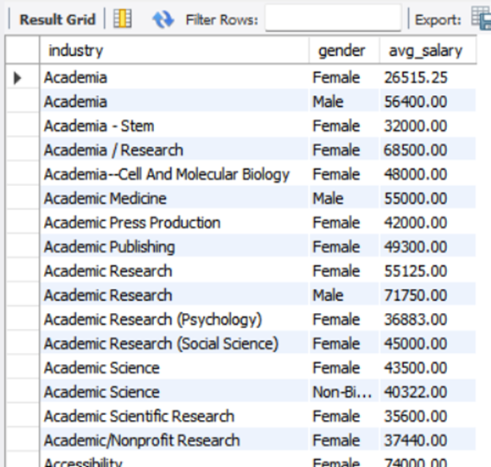
SAMPLE SQL QUERY
SELECT industry, gender, ROUND(AVG(annual_salary),2) AS avg_salary
FROM salaries
GROUP BY industry, gender
ORDER BY industry, gender;

Slide 7
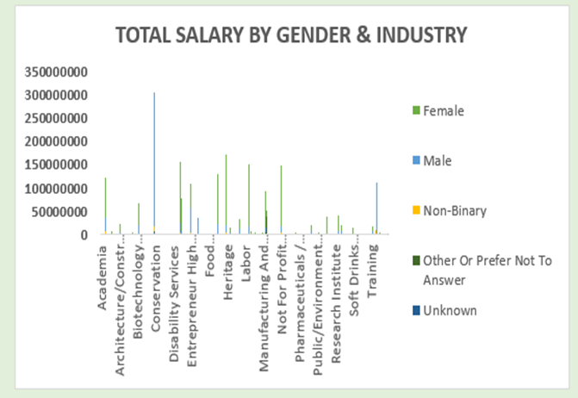
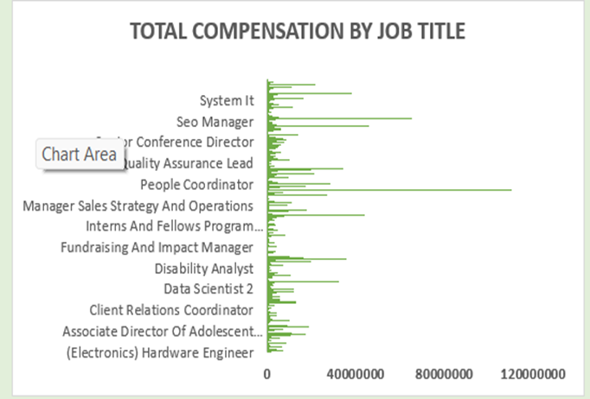
KEY INSIGHTS (PART 1)

Slide 8
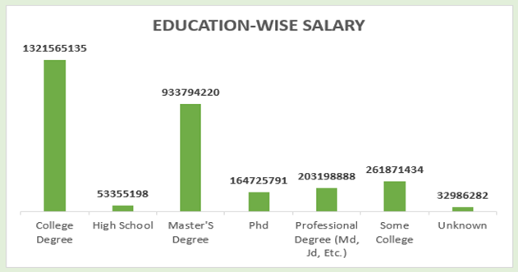
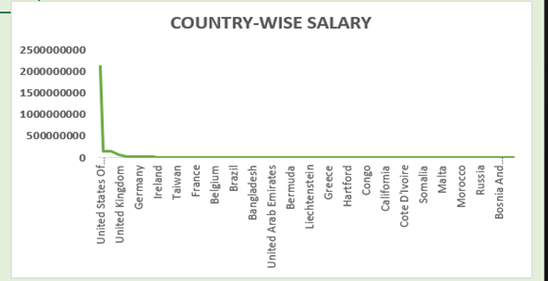
KEY INSIGHTS (PART 2)

Slide 9
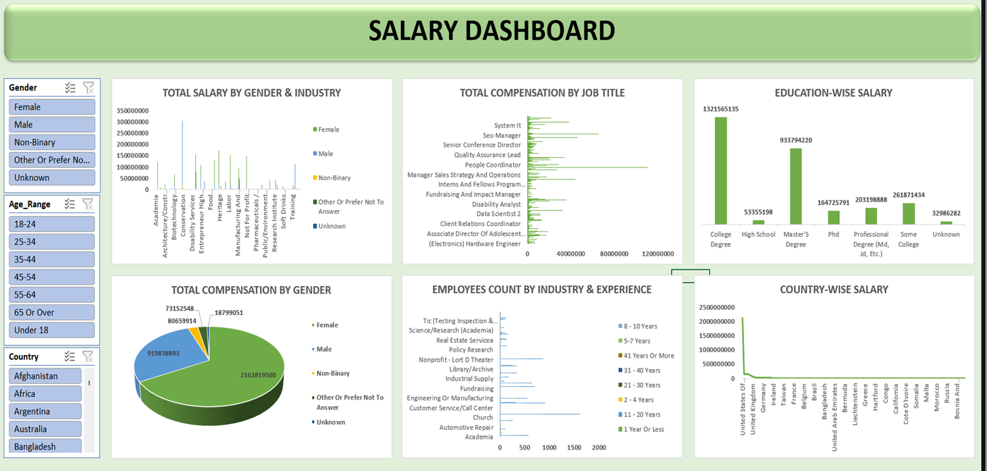
DASHBOARD OVERVIEW

Slide 10
Conclusion:
Salary varies greatly across industries, education, and regions; gender pay gaps still need addressing
CONCLUSION
Recommendations:
Industries should work towards pay equity; professionals can use insights for informed career moves

Slide 11

THANK YOU!

