Slide 1
ROAD SIGNS CLASSIFICATION USING CNN

Slide 2
Introduction
Road signs are standardized symbols and instructions placed along roads to regulate, warn, and guide drivers, cyclists, and pedestrians.
They play a vital role in road safety by providing essential information quickly and clearly even without language.
Recognizing and classifying road signs correctly helps reduce accidents, improve traffic management, and support autonomous driving technologies.

Slide 3
Objectives
Build a Convolutional Neural Network (CNN) model to classify road signs.
Automate recognition for real-world applications.
Evaluate performance using accuracy, precision, recall, and F1-score.
Provide an interactive Streamlit UI for testing.

Slide 4
Dataset Description
Contains labeled road sign images.
43 classes (e.g., Speed limit, Stop sign).
Split into Training (70%), Validation (15%), Testing (15%).
Preprocessing: resizing to 64x64, normalization, label encoding.
Data augmentation for robustness (rotation, scaling, flipping).

Slide 5
Model Architecture CNN
Input: 32×32×3 images.
Layers: Convolution + Pooling → Dense → SoftMax.
Activation: ReLU (hidden), SoftMax (output).
Optimizer: Adam.
Loss Function: Categorical Cross-Entropy.

Slide 6
Training Process
Interactive learning
1. Split data into Training, Validation,
and Testing sets
3. Monitor training and validation accuracy/loss
2. Train model with early stopping and checkpoints
4. Save the best performing model for future use.

Slide 7
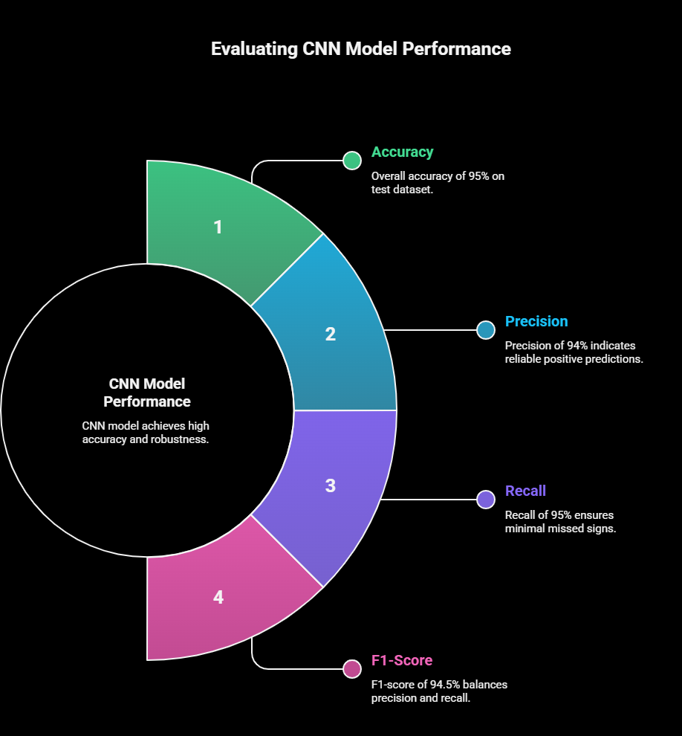
Model evalution
Accuracy: ~95%.
Metrics: Precision, Recall, F1-Score.

Slide 8

UI with Streamlit
Interactive web interface to test trained model.
Upload new images and get class predictions.
Display accuracy and probability scores.
Simple deployment for real-world usage.

Slide 9
Results and Insights
CNN accurately classifies 43 road sign classes.
Performs well on unseen test images.
Minor confusion between similar signs (e.g., speed limits).

Slide 10
Future improvements
1
Train on
larger datasets
2
Apply transfer learning
(VGG)
3
real-time deployment

Slide 11
Thank you

