Slide 1

Weekly Financial Insights Dashboard
Credit Card Data Analysis Weekly Report

Slide 2
Content in this Project
1. Project Objective
2. Data from SQL
3. Data Cleaning and Processing
4. Analysis using Power BI and DAX
5. Key Insights and Trends
6. Dashboards

Slide 3
Project Objective
Develop a comprehensive financial dashboard providing real-time insights into key performance metrics and trends through data analysis techniques, enabling stakeholders to make data-driven decisions.

Slide 4
Import Data to SQL
1. Ensure clean data importation into SQL for accurate analysis and reporting.
2. Perform data extraction, cleaning, and transformations to prepare the data for visualization and insights.

Slide 5
Credit card financial dashboard using Power BI:
• Developed an interactive dashboard using transaction and customer data from a SQL database, to provide real-time insights.
• Streamlined data processing & analysis to monitor key performance metrics and trends.
• Shared actionable insights with stakeholders based on dashboard findings to support decision-making processes

Slide 6
Project Insights - Week 53 (31st Dec)
WoW change:
• Revenue increased by 28.8%
• Total Transaction Amount & Count increased by 10% & 12%
• Customer count increased by 15%
Overview YTD:
• Overall revenue is 57M
• Total interest is 8M
• Total transaction amount is 46M
• Male customers contributed 31M, female 26M
• Blue & Silver credit cards contributed to 93% of overall transactions

Slide 7
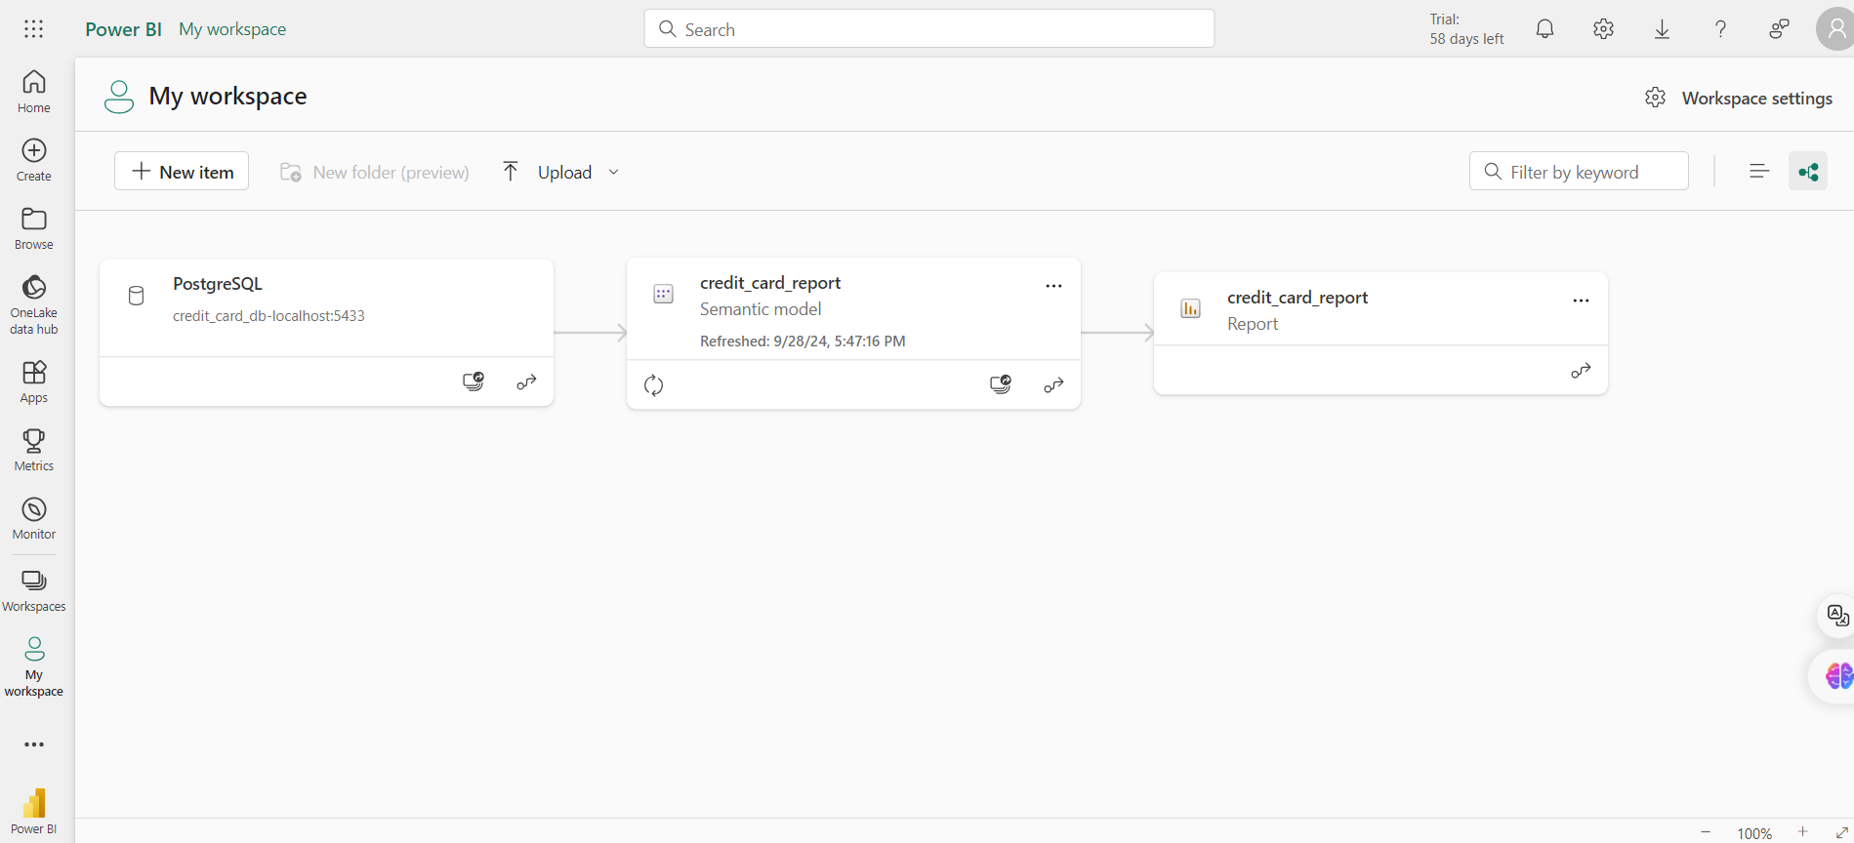

Slide 8
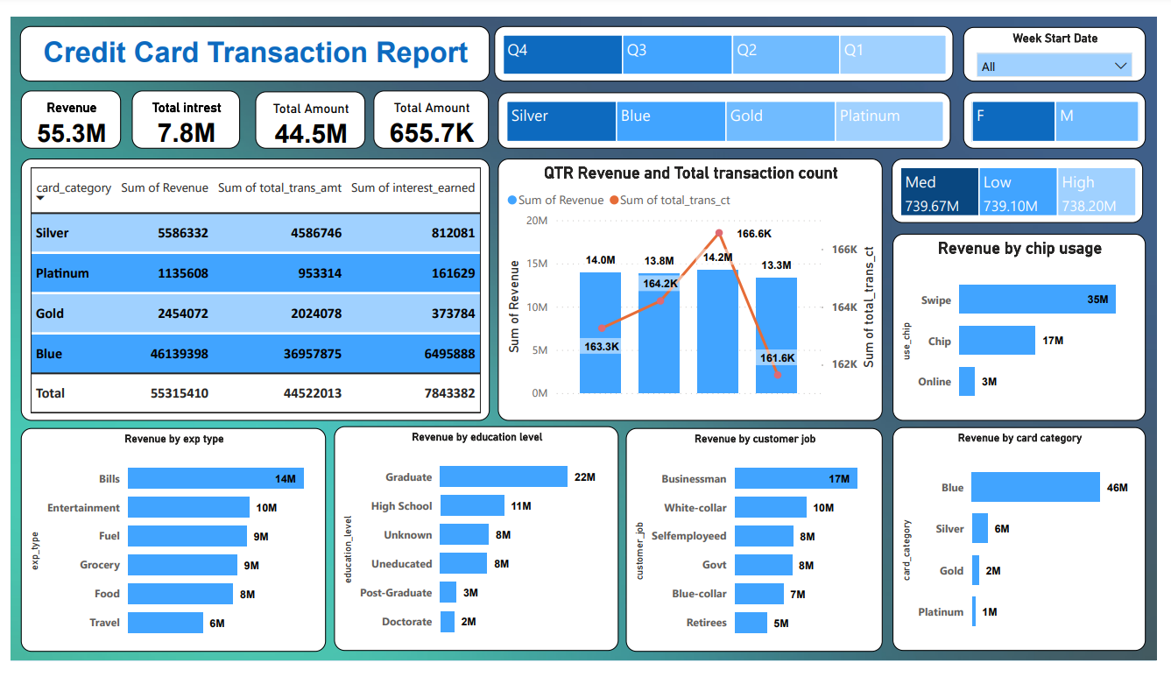

Slide 9
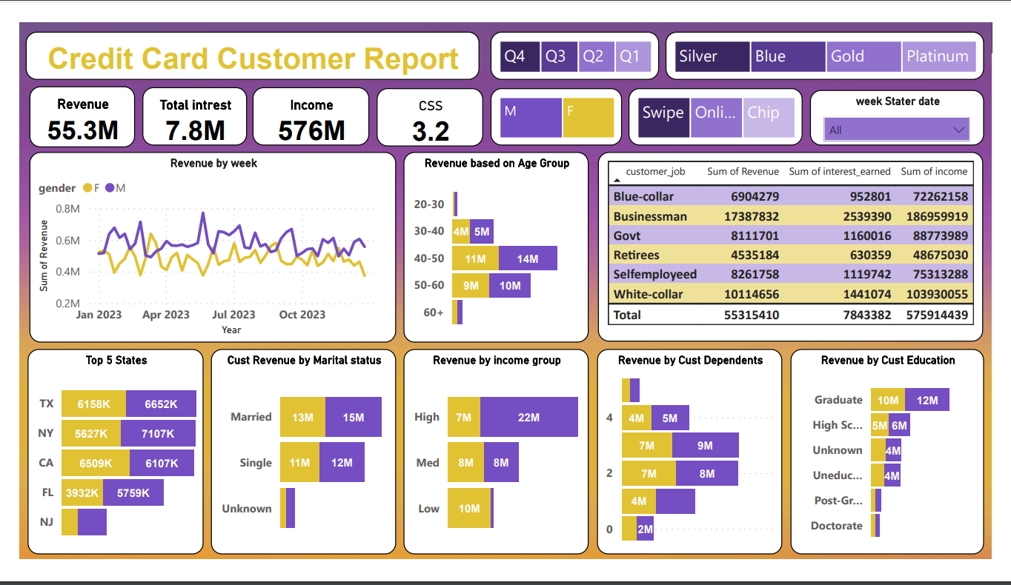

Slide 10
Download Data
GitHub: https://github.com/Anand-kishore-kalthuri/Credit_Card_Transactions
linkedIN: https://www.linkedin.com/in/anand-kalthuri/

