Slide 1
COURSE NOTES: HYPOTHESIS TESTING

Slide 2
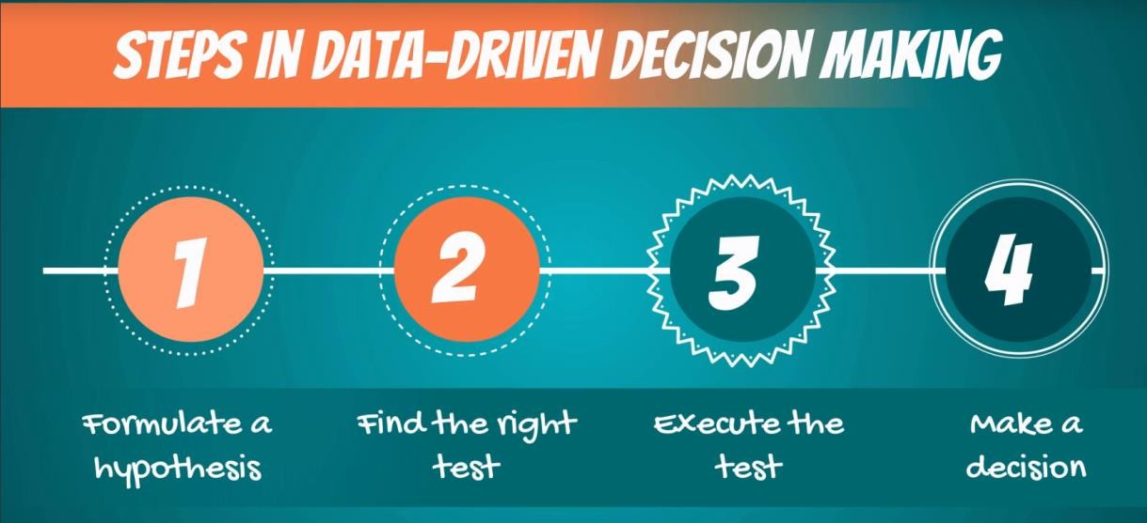
Scientific method
The ‘scientific method’ is a procedure that has characterized natural science since the 17th century. It consists in systematic observation, measurement, experiment, and the formulation, testing and modification of hypotheses.
Since then we’ve evolved to the point where most people and especially professionals realize that pure observation can be deceiving. Therefore, business decisions are increasingly driven by data. That’s also the purpose of data science.
While we don’t ‘name’ the scientific method in the videos, that’s the underlying idea. There are several steps you would follow to reach a data-driven decision (pictured).

Slide 3

Hypotheses
A hypothesis is “an idea that can be tested”
It is a supposition or proposed explanation made on the basis of
limited evidence as a starting point for further investigation.
Null hypothesis (H₀)
Alternative hypothesis (H₁ or H_{A})
The null hypothesis is the hypothesis to be tested.
It is the status-quo. Everything which was believed until now
that we are contesting with our test.
The concept of the null is similar to: innocent until proven guilty. We assume innocence until we have enough evidence to prove that a suspect is guilty.
The alternative hypothesis is the change or innovation that is contesting the status-quo.
Usually the alternative is our own opinion. The idea is the
following:
If the null is the status-quo (i.e., what is generally believed), then the act of performing a test, shows we have doubts about the truthfulness of the null. More often than not the researcher’s opinion is contained in the alternative hypothesis.

Slide 4
Question 1:
You want to check if your height is above average, compared to your classmates. State the null and alternative hypotheses of this test.
H0: My height is lower or equal to the average height in the class. H1: My height is higher than the average height in the class.
The null is the status quo (you are 'shorter'), while the alternative is the 'change or innovation' (you are looking for this answer). Therefore, the null hypothesis of the test is ‘lower or equal’. You have to include ‘equal’ in the null hypothesis, as conventionally, the equality sign is always included in the null.

Slide 5
Question 2:
You want to test if the Obama administration issued fewer executive orders than the Bush administration. State the null and alternative hypotheses of this test.
H0: The Obama administration issued at least as many executive orders as the Bush administration.
H1: The Obama administration issued fewer executive orders than the Bush administration.
We want to test if the Obama administration issued fewer executive orders than the Bush administration. Therefore, the null hypothesis is: ‘The Obama administration issued at least as many executive orders as the Bush administration.’ The alternative hypothesis encompasses everything else; therefore, the alternative is: The Obama administration issued fewer executive orders than the Bush administration.

Slide 6
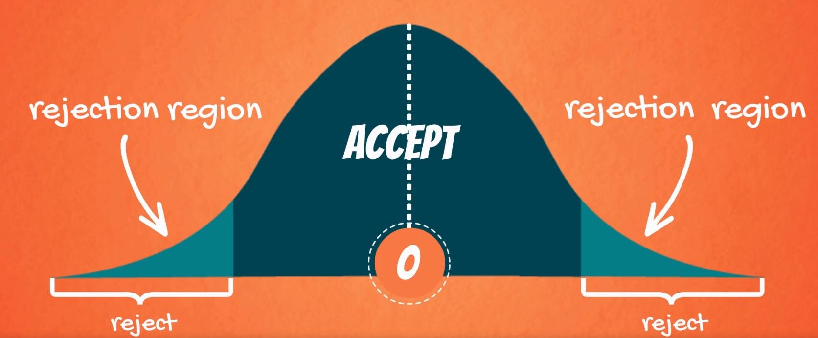
Decisions you can take
When testing, there are two decisions that can be made: to accept the null hypothesis or to reject the null hypothesis.
To accept the null means that there isn’t enough data to support the change or the innovation brought by the alternative. To reject the null means that there is enough statistical evidence that the status-quo is not representative of the truth.
Given a two-tailed test:
Graphically, the tails of the distribution show when we reject the null hypothesis (‘rejection region’).
Everything which remains in the middle is the ‘acceptance
region’.
The rationale is: if the observed statistic is too far away from 0 (depending on the significance level), we reject the null. Otherwise, we accept it.
Different ways of reporting the result:
Accept
At x% significance, we accept the null hypothesis
At x% significance, A is not significantly different from B
At x% significance, there is not enough statistical evidence that… At x% significance, we cannot reject the null hypothesis
Reject
At x% significance, we reject the null hypothesis
At x% significance, A is significantly different from B
At x% significance, there is enough statistical evidence… At x% significance, we cannot say that *restate the null*

Slide 7
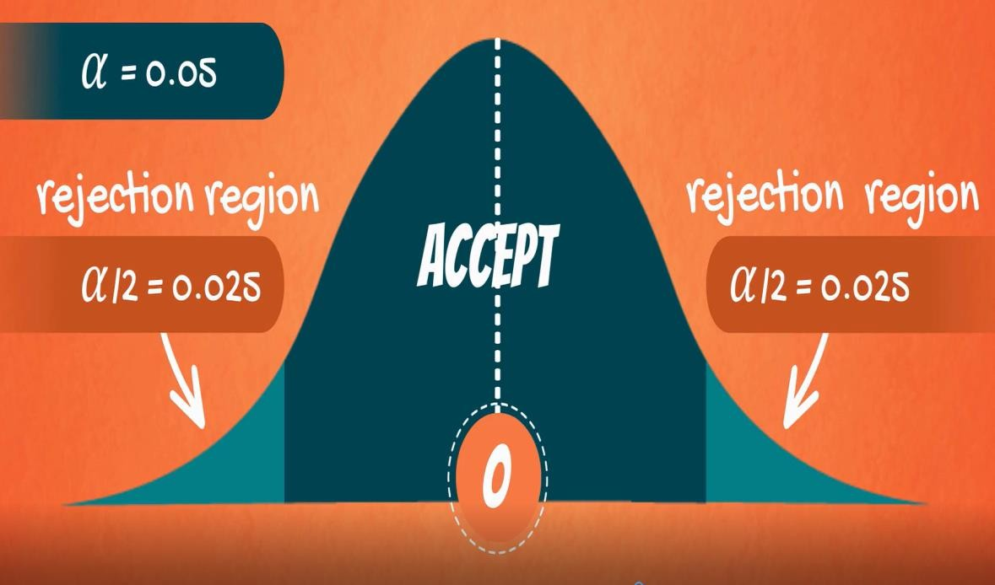
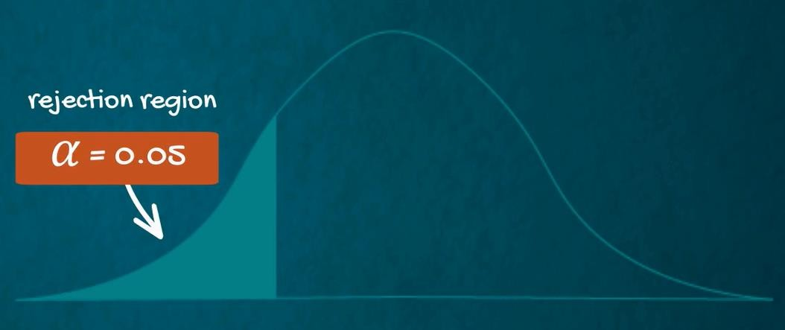

Level of significance and types of tests
Level of significance (α)
The probability of rejecting a null hypothesis that is true; the probability of making this error.
Common significance levels
0.10 0.05 0.01
One-sided (one-tailed) test
Used when the null doesn’t contain equality or inequality sign (<,>,≤,≥)
Two-sided (two-tailed) test
Used when the null contains an equality (=) or an inequality sign (≠)

Slide 8
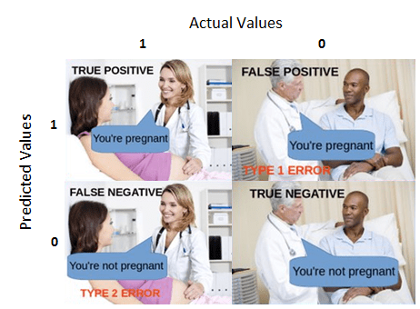
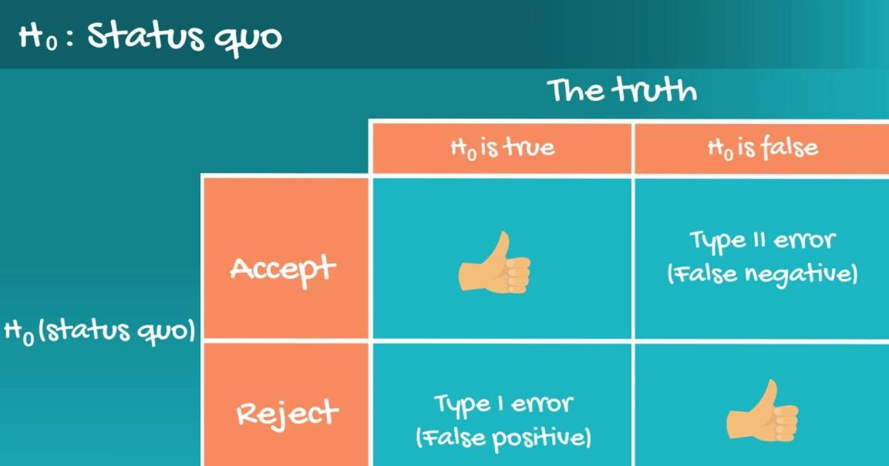
Statistical errors (Type I Error and Type II Error)
In general, there are two types of errors we can make while testing: Type I error (False positive) and Type II Error (False negative).
Statisticians summarize the errors in the following table: Here’s the table with the example from the lesson:
The probability of committing Type I error (False positive) is the probability of making this error is alpha (α).
The probability of committing Type II error (False negative) is the probability of making this error is denoted by beta (β) and is called ‘power of the test.
If you want to find out more about statistical errors, just follow this link for an article written by your instructor.

Slide 9
P-value
p-value
The p-value is the smallest level of significance at which we can still reject the null hypothesis,
given the observed sample statistic
0.000
When we are testing a hypothesis, we always strive for those ‘three zeros after the dot’. This indicates that we reject the null at all significance levels.
Notable p-values
0.05
0.05 is often the ‘cut-off line’. If our p-value is higher than 0.05 we would normally accept the null hypothesis (equivalent to testing at 5% significance level). If the p-value is lower than 0.05 we would reject the null.
Where and how are p-values used?
Most statistical software calculates p-values for each test
The researcher can decide the significance level post-factum
p-values are usually found with 3 digits after the dot (x.xxx)
The closer to 0.000 the p-value, the better
Should you need to calculate a p-value ‘manually’, we suggest using an online p-value calculator, e.g. this one.

Slide 10



Formulae for Hypothesis Testing
# populations | Population variance | Samples | Statistic | Variance |  | Formula for test statistic |  | Decision rule
One | known | - | z | _{𝜎}2 |  | 𝑥ҧ − 𝜇₀ 𝑍 = _{𝜎} ൗ _{n} |  | There are several ways to phrase the decision rule and they all have the same meaning. Reject the null if: |test statistic| > |critical value| The absolute value of the test statistic is bigger than the absolute critical value p-value < some significance level most often 0.05 Usually, you will be using the p-value to make a decision.
One | unknown | - | t | _{𝑠}2 |  | 𝑥ҧ − 𝜇₀ 𝑇 = _{𝑠} ൗ _{n}
Two | - | dependent | t | _{𝑠}2 𝑑𝑖𝑓𝑓𝑒𝑟𝑒𝑛𝑐𝑒 |  | 𝑑^{ҧ} − 𝜇₀ 𝑇 = _{𝑠𝑑ൗ} n
Two | Known | independent | z | σ² , σ² 𝑥 𝑦 |  | 𝑍 = | (𝑥ҧ − 𝑦ത) − 𝜇₀ _{σ2 σ}2 _{𝑥 +} 𝑦 𝑛_{𝑥} 𝑛_{𝑦}
Two | unknown, assumed equal | independent | t | 𝑠² = 𝑝 | 𝑛_{𝑥} − 1 𝑠² + 𝑛 − 1 𝑠² 𝑥 𝑦 𝑦 𝑛_{𝑥} + 𝑛_{𝑦} − 2 | 𝑇 = | (𝑥ҧ − 𝑦ത) − 𝜇₀ _{𝑠}2 _{𝑠}2 𝑝 ₊ 𝑝 𝑛_{𝑥} 𝑛_{𝑦}
𝝈
^{𝒛}𝑎/𝟐 ∗ _{𝒏}
𝒔
𝒕 ∗
𝒅.𝒇.,𝑎/𝟐 _{𝒏}

