Slide 1
Exploring Automobile Industry
Anand Kumar Singh

Slide 2
Content
Business Problem
Data Wrangling
Exploratory Data Analysis
Appendix

Slide 3
Problem Statement
Aim of the Project: To explore the dataset and find basic relationships of different features with an automobile’s price.
How the dataset is distributed?
Correlation between different features and how are they related.
Normalized loss of the manufacturer.
Factors affecting price of the automobile.

Slide 4
Data Wrangling
Data was very clean, almost no missing values, in a clean format.
Few columns had ‘?’ values like normalized-losses, num-of-doors, bore, stroke, horsepower, peak-rpm and price.
Convert object datatypes to float when applicable.

Slide 5
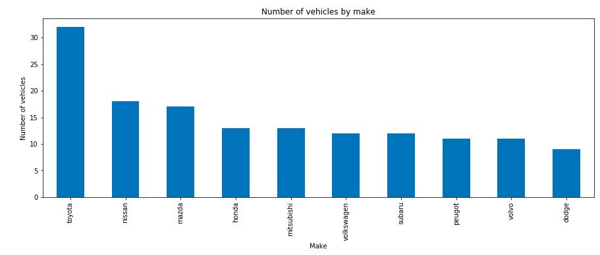
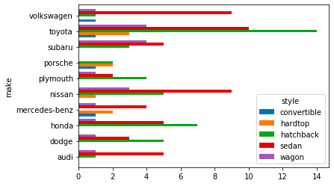
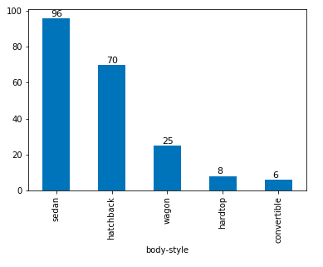
Exploratory Data Analysis(Univariate Analysis): Visualizations & Insights
Toyota is most popular car brand.
People prefer to buy sedan most.
Toyota is the largest manufacturer of hatchback
Volkswagen and Nissan makes sedan cars a lot.

Slide 6
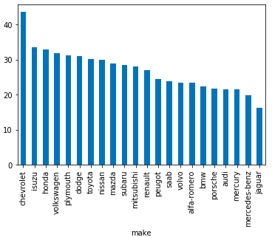
Exploratory Data Analysis(Univariate Analysis): Visualizations & Insights
Chevrolet gives highest avg mileage on city roads and highways and Jaguar the least.

Slide 7
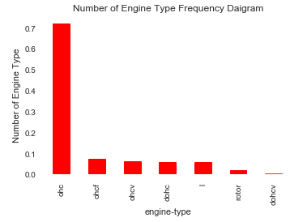
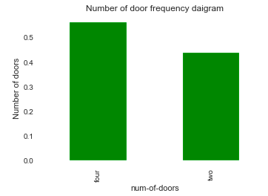
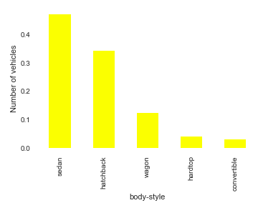
Exploratory Data Analysis(Univariate Analysis): Visualizations & Insights
More than 70 percent of vehicles have Dual Overhead Cam(dhc) engine type.
Almost 57 percent of the vehicle has 4 doors.
Most manufactured car type is sedan.

Slide 8
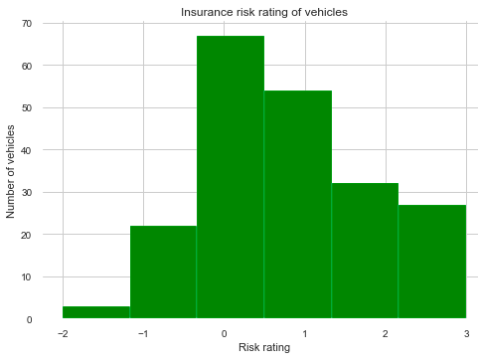
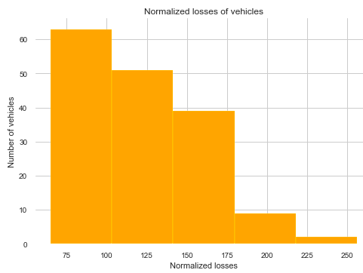
Exploratory Data Analysis(Univariate Analysis): Visualizations & Insights
Insurance risk rating have ratings between -3 and 3. There are more number of cars between 0 and 1.
Normalized losses which is the average loss payment per insured car per year has more number of cars in range between 65 and 150.

Slide 9
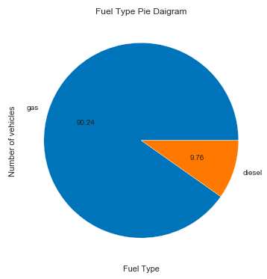
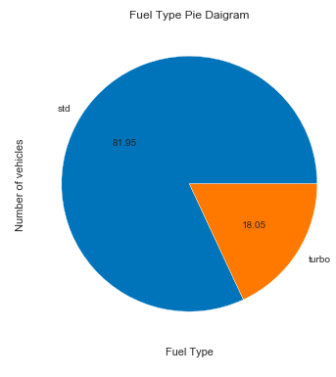
Exploratory Data Analysis(Univariate Analysis): Visualizations & Insights
Most of the cars use gas as the fuel and are mostly standard aspiration.

Slide 10
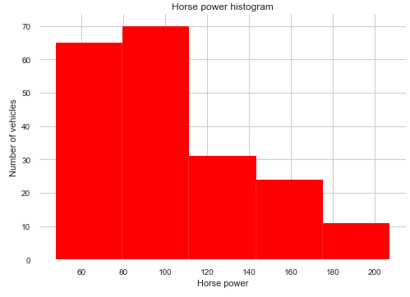
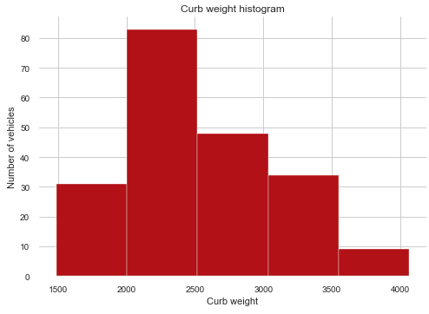
Exploratory Data Analysis(Univariate Analysis): Visualizations & Insights
Most of the cars have a horsepower between 60-100.
Curb weight of cars are distributed between 1500 and 4000.

Slide 11
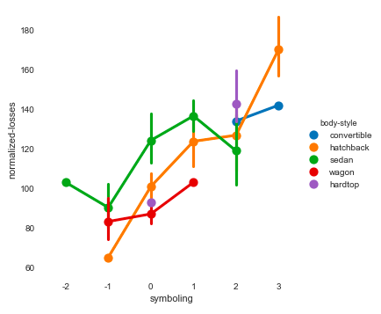
Exploratory Data Analysis(Bivariate Analysis): Visualizations & Insights
Increase in risk-rating increases normalized losses in vehicle.
Convertible and Hardtop car has mostly losses with risk rating above zero.
Hatchback cars has highest losses at risk rating 3.
Sedan and wagon car has losses even in less risk rating.

Slide 12
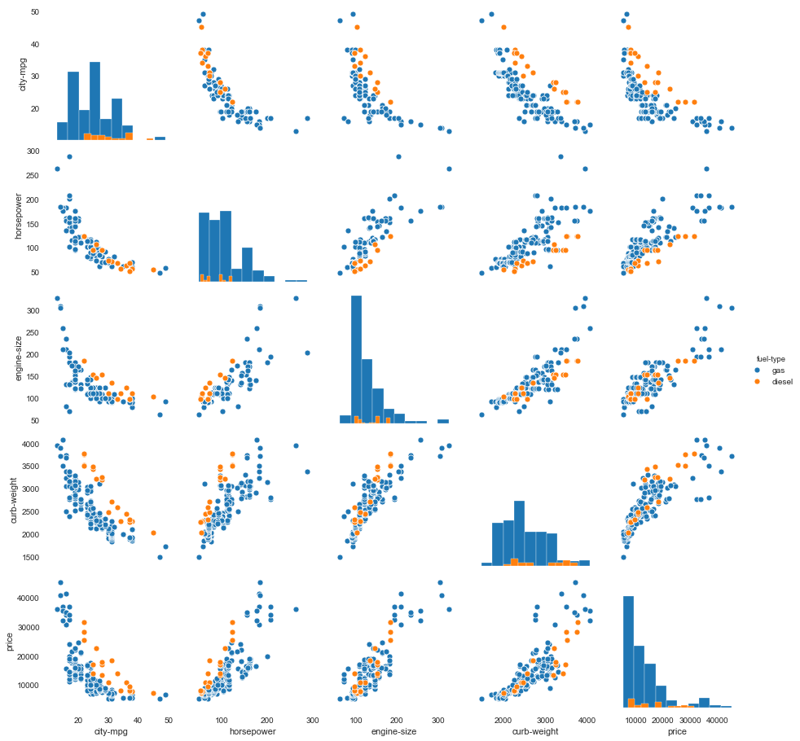
Exploratory Data Analysis(Bivariate Analysis): Visualizations & Insights
Vehicle mileage decreases as increase in HorsePower, engine-size, curb weight.
As Horsepower increases the engine size increases.
Curb-weight increases with increase in engine-size.
Engine-size and curb-weight are positively correlated with price.
City-mpg is negatively correlated with price as increase horsepower reduces mileage.

Slide 13
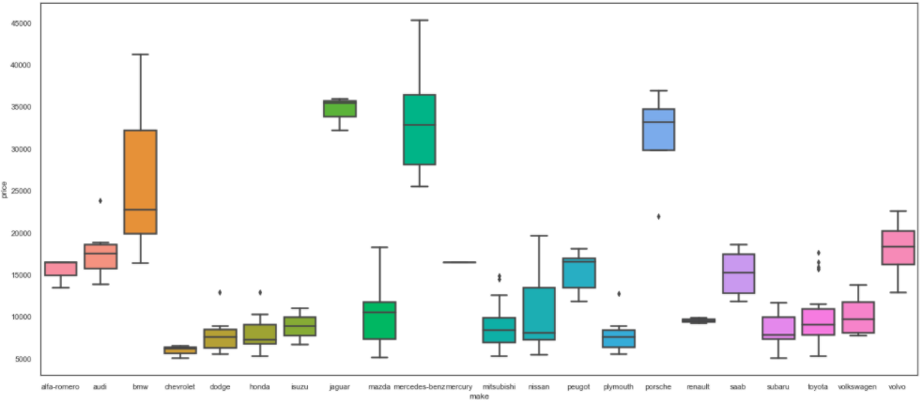
Exploratory Data Analysis(Bivariate Analysis): Visualizations & Insights
Price VS Make
The most expensive car is Mercedes Benz and least expensive is Chevrolet.
The premium car brands are BMW, Jaguar , Mercedes and Porshe which costs more than 20000.
Less expensive cars costing less than 10000 are Chevrolet, Dodge, Honda, Mitsubishi, Plymouth and Subaru.
Rest of the midrange cars are in between 10000 to 20000.

Slide 14
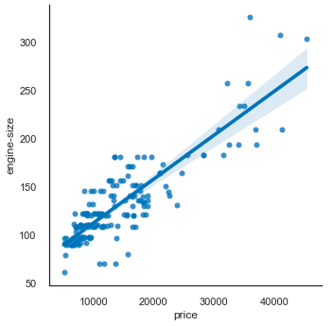
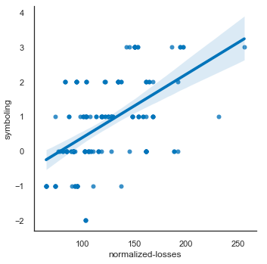
Exploratory Data Analysis(Bivariate Analysis): Visualizations & Insights
The more the engine price, more the price.
Lesser the rating of the car lesser the normalized losses. So we can infer that negative ratings are better for the car which has lesser losses.

Slide 15
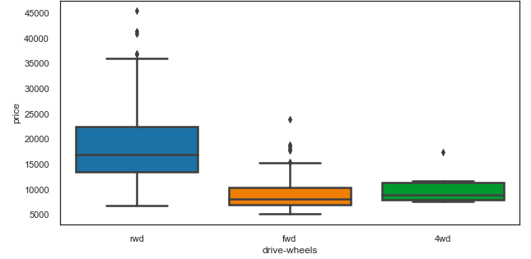
Exploratory Data Analysis(Bivariate Analysis): Visualizations & Insights
Rear wheel drives are most expensive and front wheel is least expensive cars.

Slide 16
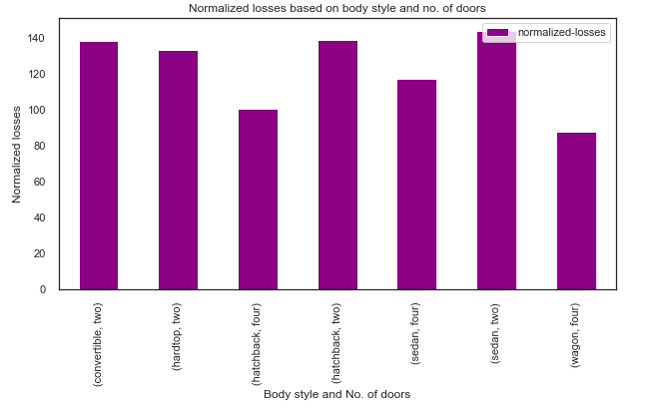
Exploratory Data Analysis(Bivariate Analysis): Visualizations & Insights
Normalized losses which is the average loss payment per insured vehicle is calculated with many features of the cars which includes body-style and number of doors.
Two door cars has a greater number of losses than the four door cars.

Slide 17
Appendix

Slide 18
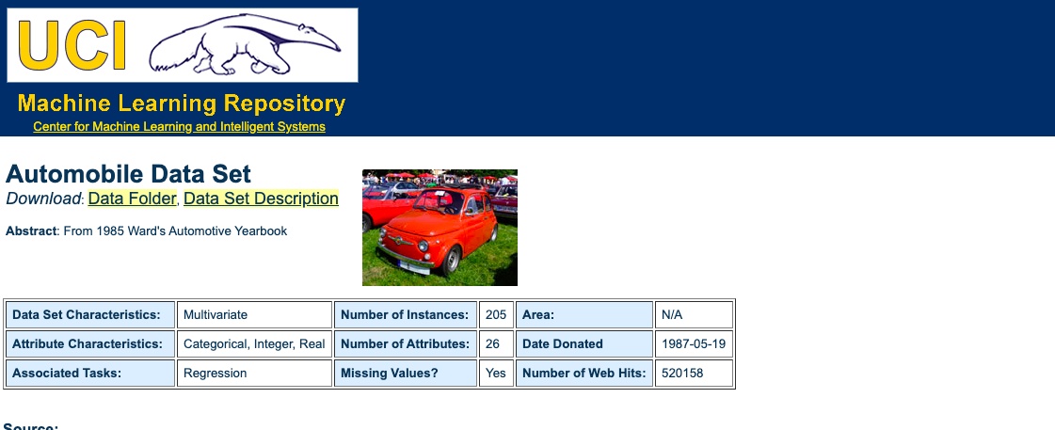
Data Dictionary

Slide 19
Data Dictionary
symboling: ratings of the vehicle from -3 to 3 which represents degree to which the vehicle is riskier than its price indicates.
Normalized-losses: continuous from 65 to 256.
make brand of the vehicle
Fuel-type: diesel and gas
Aspiration: standard and turbo
Num-of-doors: Either four or two door vehicle
Body-style: style of the vehicle like hatchback, sedan, hardtop, wagon, convertible
Drive-wheels: Either four-wheel-drive, two rear-wheel-drive, two forward-wheel-drive
Engine-location: front, rear
Wheel-base: continuous from 86.6 to 120.9
Length, width, height : length of the vehicle
Curb-weight: total mass of vehicle
Engine-type: Tells how the engine is assembled or designed. In this dataset, we have seven engine types: dhc(Dual Overhead Cam), dohcv(Dual Overhead Cam and Valve), l(L engine), ohc(Overhead cam), ohcf(Overhead Cam and Valve F Engine), ohcv(Overhead Cam and Valve), rotor(Rotatory engine)
Number-of-cylinders: The number of cylinders of a car is related to ow the engine works, more cylinders means more power of the car.
Number-of-doors: two or four doors
Engine-size: continuous feature
Fuel-system: 1bbl, 2bbl, 4bbl, idi, mfi, mpfi, spdi, spfi.
Bore: continuous feature
Stroke: continuous feauture
Compression ratio
Horse-power: continuous feature
Peak-rpm: continuos feature
City-mpg and highway mpg: car mileage on city roads and hoghways
Price: price of the car

Slide 20
THANK YOU

