Slide 1
From Fourier to Learnable Dynamic Wavelets
A Progressive Academic Journey toward PPG-Based Foundation Models
Fourier
STFT
Wavelet
Adaptive
Dynamic
Learnable
↓ PPG Foundation Model Application
Target: Learn WHY and HOW each transform evolved — and why Learnable Dynamic Wavelets are optimal for PPG-based Foundation Models.
Academic Reference Deck • Signal Processing & Deep Learning

Slide 2
Roadmap: Evolution of Signal Analysis
From global frequency to task-adaptive, learnable representations
1
Fourier Transform
2
STFT
3
Wavelet Transform
Global frequency — stationary signals
Time-frequency — fixed window resolution
Multi-resolution — fixed mother wavelet
→ PPG Foundation
→ PPG Foundation
→ PPG Foundation
4
Adaptive Wavelet
5
Dynamic Wavelet
6
Learnable Dynamic Wavelet
Tuned basis — signal-class specific
Instance-specific — varies per input
End-to-end trained — task + data driven
→ PPG Foundation
→ PPG Foundation
→ PPG Foundation

Slide 3
Fourier Transform (FT)
SECTION 1
Decomposing signals into global sinusoidal components
Core Idea
Properties & Notation
The Fourier Transform maps a time-domain signal into the frequency domain. Every signal is expressed as a sum of infinite sinusoids (complex exponentials). Assumes the signal is stationary — frequency content does not change over time.
x(t)
Input time-domain signal
X(f)
Frequency-domain spectrum
f
Frequency (Hz)
Continuous Fourier Transform (CFT)
j
Imaginary unit (√−1)
Forward: X(f) = ∫₋∞^∞ x(t) · e^{−j2πft} dt Inverse: x(t) = ∫₋∞^∞ X(f) · e^{+j2πft} df
N
Number of samples (DFT)
k, n
Frequency / sample index
Discrete Fourier Transform (DFT)
|X(f)|²
Power Spectral Density (PSD)
X[k] = Σ_{n=0}^{N−1} x[n] · e^{−j2πkn/N} x[n] = (1/N) Σ_{k=0}^{N−1} X[k] · e^{+j2πkn/N}
Limitation: No Time Localization
FT tells WHAT frequencies exist, not WHEN they occur. Fails for non-stationary signals like PPG.

Slide 4
Short-Time Fourier Transform (STFT)
SECTION 2
Introducing time localization via a sliding window
Core Idea
Segment the signal with a sliding window w(t), apply FT within each segment. Trades global frequency precision for local time-frequency information. Resolution is fixed: narrow window → good time res, poor freq res; wide window → vice versa (Heisenberg uncertainty).
Continuous STFT
Discrete STFT
𝒮(τ,f) = ∫₋∞^∞ x(t)·w(t−τ)·e^{−j2πft} dt τ = time shift (window center)w(t−τ) = analysis window function
𝒮[m,k] = Σₙ x[n]·w[n−mH]·e^{−j2πkn/N,
m = frame index, H = hop size, N = DFT length (FFT window size)
Spectrogram (Power):
Time–Frequency Resolution Trade-Off
Spec(τ,f) = |𝒮(τ,f)|²
Window Size | Time Res. | Freq. Res.
Narrow (Short) | ✔ High | ✘ Low
Wide (Long) | ✘ Low | ✔ High
Fixed — same for all f | No adaptability | Heisenberg limit
Key Limitation of STFT
Fixed window size = fixed resolution at ALL frequencies. Cannot simultaneously resolve high-freq transients AND low-freq trends — critical for PPG which has both respiratory (0.1–0.5 Hz) and cardiac (1–3 Hz) components.

Slide 5
Wavelet Transform
SECTION 3
Multi-resolution analysis with adaptive time-frequency tiling
Core Idea
Instead of sinusoids, wavelets use a localized oscillating 'mother wavelet' ψ(t). Scale a and translate b it: high scales capture low-freq content with high time precision, low scales capture high-freq transients. This gives multi-resolution analysis — the key advantage over STFT.
Continuous Wavelet Transform (CWT)
Discrete Wavelet Transform (DWT)
W(a,b) = (1/√|a|) ∫₋∞^∞ x(t)·ψ*((t−b)/a) dt
a = scale (∝ 1/frequency), b = translation
ψ*= complex conjugate of mother wavelet1/√|a| = energy normalization factor
ψ_{j,k}[n] = 2^{−j/2} · ψ(2^{−j}n − k) W[j,k] = Σₙ x[n] · ψ_{j,k}[n] j = octave (scale level), k = positionFilter bank: x → LPF → ↓2 → cA_j (approx) x → HPF → ↓2 → cD_j (detail)
Admissibility Condition
Cψ = ∫₀^∞ |Ψ(f)|²/f df < ∞ (zero mean)Ensures invertibility and energy preservation
Common Mother Wavelets
Haar:
Simplest; step function; poor freq resolution
Daubechies:
Compact support; orthogonal; db4 popular for biosignals
✔ Adaptive resolution: high time res at high freq, high freq res at low freq — unlike STFT!
Morlet:
Gaussian-modulated sinusoid; good TF localization
Symlet:
Near-symmetric; used in ECG/PPG analysis

Slide 6
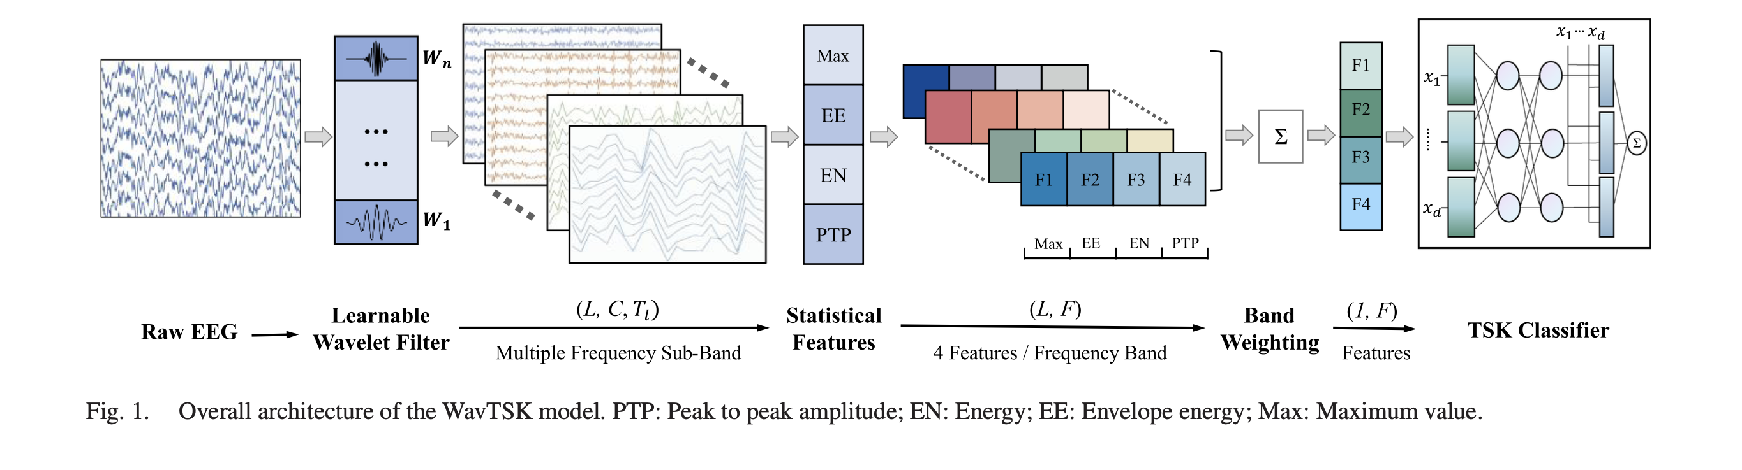
Paper Analysis
In learnable wavelets, the low-pass and high-pass filters are treated as trainable convolution weights.
The PPG signal is passed through these filters to obtain multi-scale components.
A task loss (e.g., heart rate, BP, or SSL loss) is computed from the model output.
Using backpropagation, gradients update the filter parameters to minimize this loss.
Over training, filters automatically adapt their frequency response and shape.
This allows the model to focus on relevant cardiac frequencies and waveform morphology.
Fixed filters assume predefined bands (e.g., 0.5–4 Hz), which may not match real signals.
PPG varies across subjects, conditions, and noise, so fixed filters are often suboptimal.
Learnable wavelets overcome this by discovering task-specific representations.
Hence, learning is needed because filters alone impose rigid assumptions, while learnable filters adapt to real physiological variability.

Slide 7
Paper Analysis
In learnable wavelets, the low-pass and high-pass filters are treated as trainable convolution weights.
The PPG signal is passed through these filters to obtain multi-scale components.
A task loss (e.g., heart rate, BP, or SSL loss) is computed from the model output.
Using backpropagation, gradients update the filter parameters to minimize this loss.
Over training, filters automatically adapt their frequency response and shape.
This allows the model to focus on relevant cardiac frequencies and waveform morphology.
Fixed filters assume predefined bands (e.g., 0.5–4 Hz), which may not match real signals.
PPG varies across subjects, conditions, and noise, so fixed filters are often suboptimal.
Learnable wavelets overcome this by discovering task-specific representations.
Hence, learning is needed because filters alone impose rigid assumptions, while learnable filters adapt to real physiological variability.

Slide 8
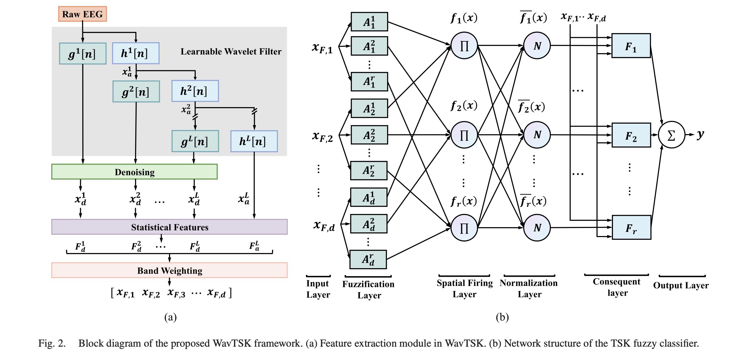
Paper Analysis
The diagram shows the WavTSK framework with two main parts: feature extraction (left) and fuzzy classification (right). The raw EEG signal is first passed through learnable wavelet filters, which perform multi-level decomposition into different frequency components.
These components are denoised and converted into statistical features such as energy and amplitude. A band weighting module then learns which frequency bands are most important.
The resulting feature vector is fed into a TSK fuzzy classifier, where features are converted into fuzzy memberships. Multiple fuzzy rules are activated, normalized, and combined to produce the final output. Overall, the model combines learnable signal processing with interpretable decision-making.

Slide 9
Paper Analysis
The paper proposes WavTSK, an end-to-end EEG decoding framework combining learnable wavelet feature extraction with a TSK fuzzy classifier.
It replaces fixed wavelet filters with trainable filters to learn task-specific time-frequency representations.
Includes statistical feature extraction and band weighting to highlight important frequency bands.
Uses a fuzzy rule-based classifier to provide interpretability alongside accuracy.
Evaluated on the BCI Competition IV-2a dataset for motor imagery classification.
Achieves about 71.6% accuracy (cross-validation) and 70.5% (cross-session).
Outperforms baseline models like EEGNet, FBCSP, and ShallowConvNet.
Ablation study shows the feature extraction module significantly boosts performance.
Learned band weights align with alpha and beta rhythms, matching neuroscience insights.
Overall, the model balances performance, adaptability, and interpretability effectively

