Slide 1
Ocular Disease Recognition
Date: 12-12-2022
Anand Kumar Sahu (201020405 - DSAI)
Kshitij Kumar (201020426 - DSAI)
Rajeev Ranjan (201020444 - DSAI)
Heera Singh (201020419 - DSAI)
International Institute of Information Technology, Naya Raipur

Slide 2
Problem Statement
According to the World Health Organization (WHO), there are around 2.2 billion people who are visually impaired worldwide, and at least 1 billion of these cases might have been prevented.
Ocular diseases can be very severe and lead to blindness. Therefore, early identification of the disease can lessen the severity of the condition.
Here, we have solved this problem using some Deep Learning models to predict whether an image belongs to Normal or Cataract category and also made a comparison among them.
*
International Institute of Information Technology, Naya Raipur
‹#›

Slide 3
Introduction
Ocular disorders have become more prevalent throughout time, with one of the causes being changes in human behaviour patterns brought on by technology and the creation of technological equipment.
The diagnosis of ocular pathology using fundus images is a significant difficulty in health care.
The aim of our project is to develop a combination of feature extraction methods and Neural Networks to recognize common types of visual disorders using the fundus images.
Fundus photographs are ocular documentation that record the appearance of a patient’s retina.
*
International Institute of Information Technology, Naya Raipur
‹#›

Slide 4
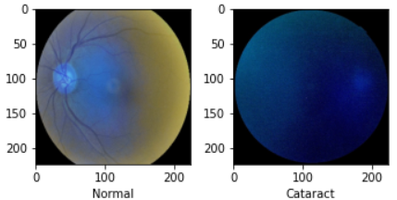
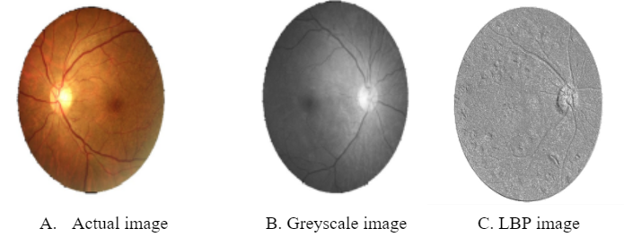
Dataset
This dataset contains 7000 images with 5000 training images and 1000 testing images.
This dataset contains various types of eye images such as Diabetes, Glaucoma, Cataract, Related Macular Degeneration, Myopia, Hypertensive Retinopathy and other ones.
The features of the image are extracted through lbp feature extractor.
*
International Institute of Information Technology, Naya Raipur
‹#›

Slide 5
Models
VGG19 : It is a convolutional neural network trained on a subset of the ImageNet dataset, a collection of over 14 million images belonging to 22,000 categories.It has 138 million parameters with a total of 19 layers including weights.
ResNet50 : It is a convolutional neural network that is 50 layers deep. A 7×7 kernel convolution alongside 64 other kernels with a 2-sized stride. A max pooling layer with a 2-sized stride. 9 more layers—3×3,64 kernel convolution, another with 1×1,64 kernels, and a third with 1×1,256 kernels.
*
International Institute of Information Technology, Naya Raipur
‹#›

Slide 6
Models
Vision Transformer : It applies a Transformer-like design to selected areas of the picture. A sequence of vectors is created by dividing a picture into fixed-size patches, linearly embedding each one, adding position embeddings, and then feeding the assembled vectors to a conventional Transformer encoder.
*
International Institute of Information Technology, Naya Raipur
‹#›

Slide 7
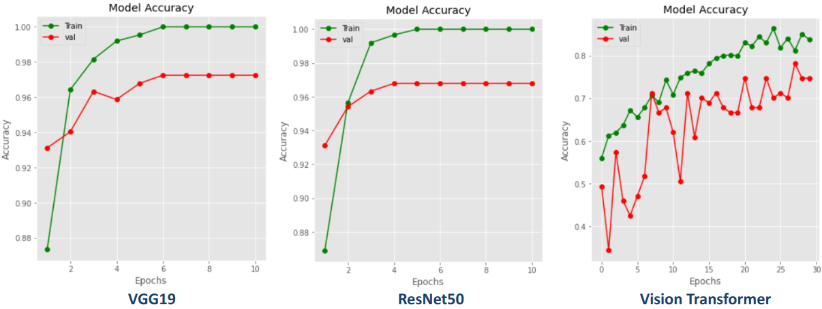
Accuracy vs Epoch (without LBP)

Slide 8
Loss vs Epoch (without LBP)

Slide 9
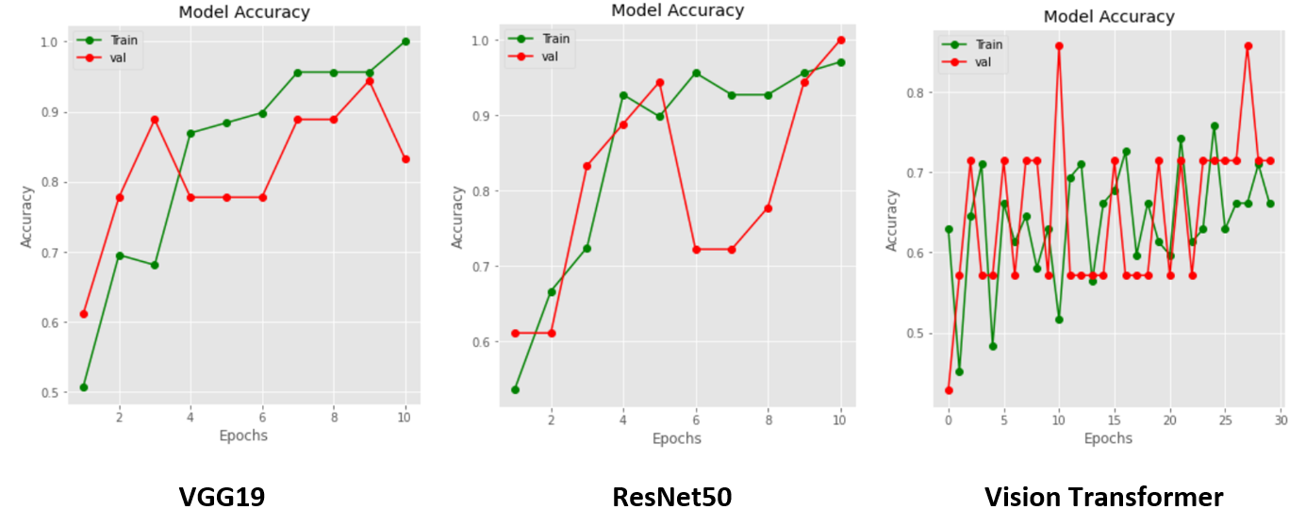
Accuracy vs Epoch (with LBP)

Slide 10
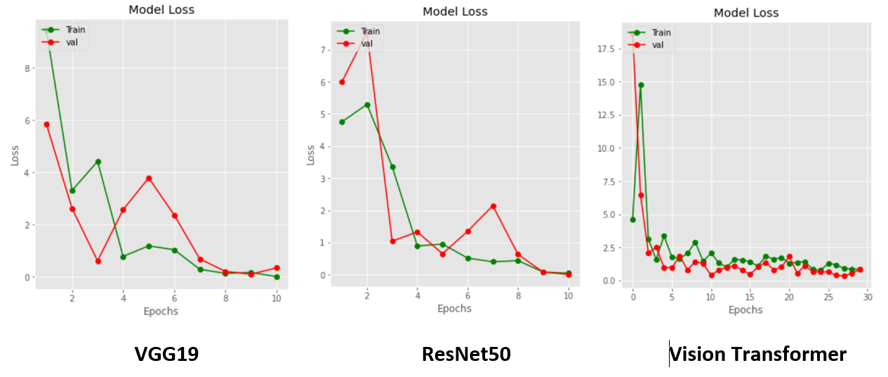
Loss vs Epoch (with LBP)

Slide 11
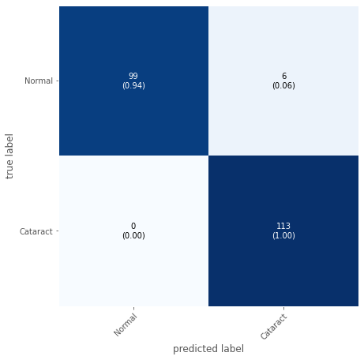

Confusion Matrix (Without LBP)
VGG19
ResNet50

Slide 12
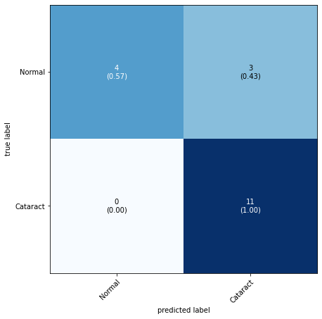
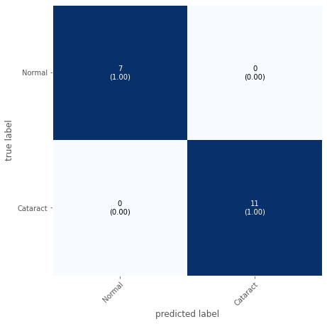
Confusion Matrix (With LBP)
VGG19
ResNet50

Slide 13
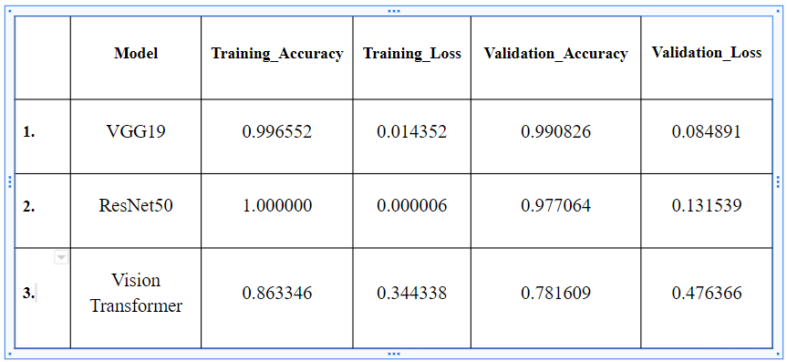
Result Comparison -without LBP

Slide 14
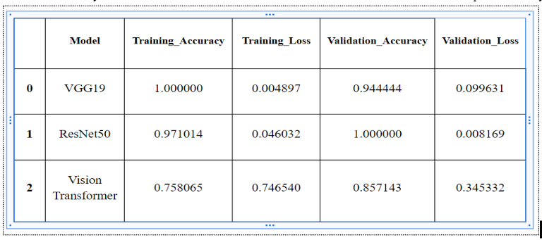
Result Comparison - with LBP

Slide 15
Novelty
Previously used techniques directly used the images without feature extraction.
But here we extracted the features using LBP(Local Binary Pattern) which helped in reducing the loss value.
The main idea behind LBP is to describe the neighborhood of image elements using binary codes. This method is usually used to study their local properties and identify the characteristics of individual parts of the image.

Slide 16

Thank You
..
Dr. Shyama Prasad Mukherjee International Institute of Information Technology, Naya Raipur
*
International Institute of Information Technology, Naya Raipur
‹#›

