Slide 1
LifeCapsule: An AI-Powered Memory Management Assistant
Empowering Emotional Awareness and Memory Management

Slide 2
Introduction
LifeCapsule is an innovative journaling platform designed to enhance emotional intelligence and memory management through AI. This presentation explores its architecture, functionalities, and future implications for mental wellness.

Slide 3
Project Overview
LifeCapsule is an AI-powered journaling and memory management application designed to help users reflect on their emotions, track mood patterns, and recall past experiences intelligently. Unlike conventional journaling tools, LifeCapsule uses on-device AI models to analyze user entries for sentiment, semantic meaning, and potential emotional health cues—all while maintaining complete data privacy. The system combines a clean React frontend with a Flask backend, integrates LLaMA 3.2 via LangChain for natural language understanding, and stores entries using PostgreSQL and Chroma for structured and vector-based memory recall. With a privacy-first approach and emotionally aware feedback, LifeCapsule redefines journaling as an interactive and self-reflective experience.

Slide 4
Main Features
AI-Powered Memory Recall: Uses LangChain + LLaMA 3.2 to retrieve and summarize relevant past entries contextually.
Sentiment Analysis: Analyzes emotional tone using TextBlob (polarity and subjectivity scoring) for each journal entry.
Mood & Symptom Tracking: Visualizes emotional trends and detects potential health cues (e.g., fatigue, anxiety) from natural language.
Semantic Search: Embeds journal content using vector representations (Chroma) for accurate, context-aware retrieval.
Privacy-First Architecture: All data is processed and stored locally—no cloud sync, ensuring full user control and security.

Slide 5
Technical Architecture
LifeCapsule follows a modular, privacy-first architecture divided into four key layers:
Frontend Layer: Built using React.js with Tailwind CSS, Zustand/Context API for state management, and Framer Motion for UI animations. It handles user input, form validation, and displays insights and trends.
Backend Layer: Developed using Flask, this layer manages journal entries, sentiment analysis (via TextBlob), symptom detection, semantic embedding, and API routing.
Storage Layer: PostgreSQL is used for structured journal entry storage, while Chroma (a vector database) stores high-dimensional semantic embeddings for contextual recall.
AI/Inference Layer: LangChain coordinates with LLaMA 3.2 (running locally via Ollama) to generate intelligent, emotionally aware responses based on user queries and memory embeddings.

Slide 6
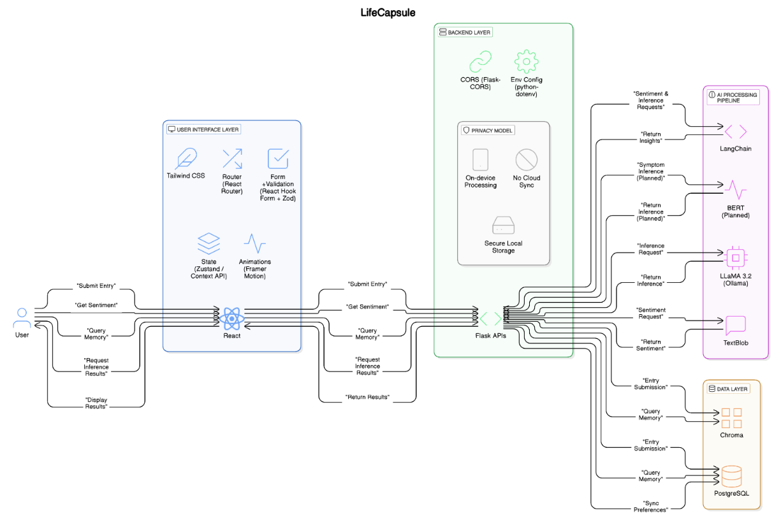
Technical Architecture

Slide 7
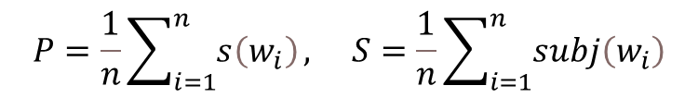
Sentiment Analysis and Memory Retrieval
Sentiment Analysis: LifeCapsule uses TextBlob to analyze each journal entry’s emotional tone, generating:
Polarity: Indicates if the sentiment is positive, negative, or neutral.
Subjectivity: Reflects how opinion-based or emotional the text is.
$$P=\frac{1}{n}\sum_{i=1}^{n}{s\left(w_{i}\right)}, S=\frac{1}{n}\sum_{i=1}^{n}{subj\left(w_{i}\right)}$$
Where:
s(wi​) = sentiment score of each word
subj(wi​) = subjectivity score
n = total words in the entry
These scores are visualized as mood trends over time, helping users track emotional patterns—all processed on-device to maintain privacy.

Slide 8

Sentiment Analysis and Memory Retrieval
Memory Retrieval:
Journal entries are embedded as vectors using a local model and stored in Chroma (vector database). When a user asks a question, it’s converted into a vector and compared to past entries using cosine similarity.
$$\text{similarity}\left(A,B\right)=\frac{A⋅B}{|A||B|}$$
Where:
A = query vector
B = journal entry vector
Relevant memories are passed to LLaMA 3.2 via LangChain, which generates an intelligent, emotionally aware response.

Slide 9
User Privacy and Security
Local-First Architecture All processing (AI inference, sentiment analysis, data storage) happens entirely on the user’s device—no cloud sync or external servers.
Secure Data Storage Journal entries are stored in a local PostgreSQL database, and semantic embeddings are handled via Chroma, ensuring full user control over data.
On-Device AI Models Language model (LLaMA 3.2) runs via Ollama, preventing any user data from leaving the system during query or response generation.
No Third-Party Tracking The system does not use APIs or analytics that send data externally, protecting user identity and emotional content.
Environment Isolation & CORS Protection Uses Flask-CORS and environment variables to ensure secure, isolated API communication within the local application stack.

Slide 10
Health Cue Detection
Non-Clinical Symptom Recognition LifeCapsule identifies emotional or behavioral patterns from journal entries by detecting phrases like “I’m always tired” or “I can’t sleep well.”
Rule-Based NLP Matching Uses natural language processing to semantically map user expressions to potential health cues such as:
Fatigue
Sleep disruption
Appetite loss
Anxiety
Depressive indicators
Local Processing All symptom detection is performed on-device to preserve user privacy and ensure offline operability.
Personal Wellness Awareness Helps users recognize recurring emotional states and reflect on their well-being—not intended for diagnosis, but for self-awareness and journaling insights.

Slide 11
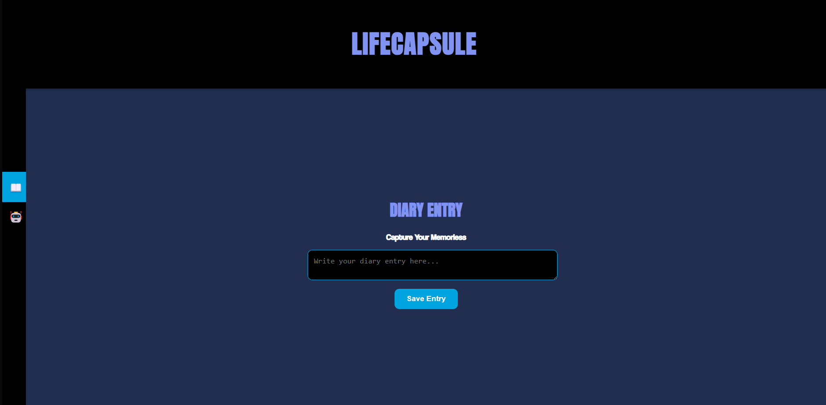
Output

Slide 12
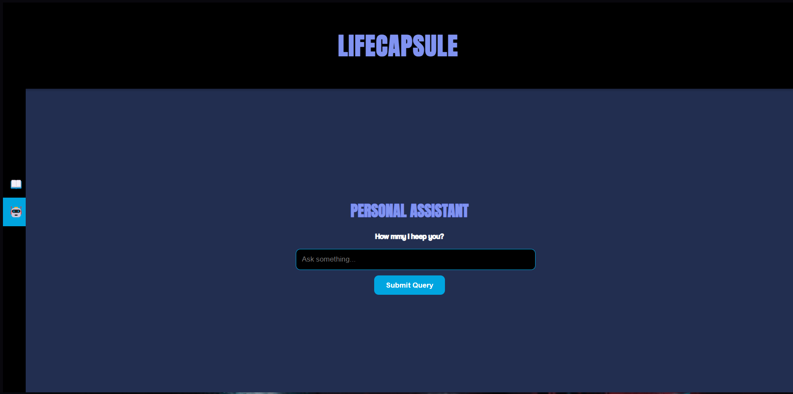
Output

Slide 13
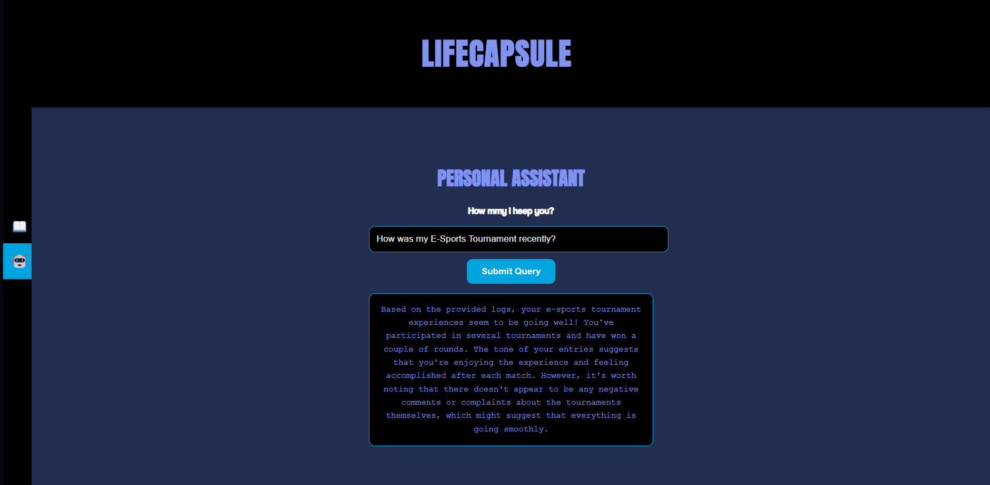
Output

Slide 14
Future Enhancements
Voice journaling integration for more natural reflections. Biometric data synchronization for deeper emotional insights. Predictive mood analysis to prepare users for emotional shifts.

Slide 15
Conclusion
LifeCapsule transforms the journaling experience into an emotionally intelligent and secure platform. Its local processing architecture not only secures personal data but also fosters meaningful reflections and insights.

