Slide 1
Azure Deltalake

Slide 2
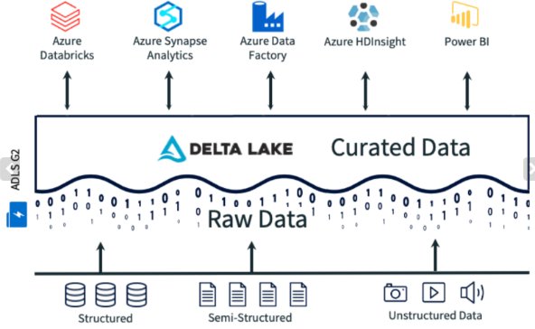
Delta Lake
An open-source storage layer on top of data lake
Brings ACID transaction capabilities
Enables Delta Lake to overcome challenges in terms of delete, upserts, merge, etc
Once the data in the data lake is stored in Delta Format it can be accessed by a variety of Azure services.

Slide 3
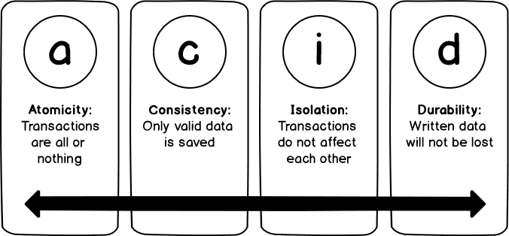
Delta Lake
Its core functionalities bring reliability to the big data lakes by ensuring data integrity with ACID transactions

Slide 4
Lambda architecture
It can take a long time to run the queries.
So it require MapReduce that operate in parallel across the entire data set.
The results are then stored separately from the raw data and used for querying.
It introduces latency
If processing takes a few hours, a query may return results that are several hours old
The lambda architecture is a big data processing architecture that addresses this problem by combining both batch- and real-time processing methods.

Slide 5
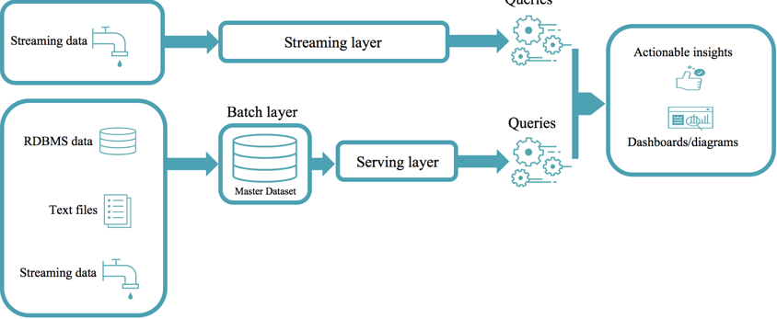
Lambda architecture

Slide 6
Delta Lake architecture
Vast improvement upon the traditional Lambda architecture
At each stage, we enrich our data
Allows us to combine batch and streaming workflows
Bronze tables contain raw data ingested from various sources
Silver tables will provide a more refined view of our data
Can join fields from various bronze tables to enrich streaming records, or
Update account statuses based on recent activity.
Gold tables provide business level aggregates often used for reporting and dashboarding
This would include aggregations such as daily active website users, weekly sales per store, or gross revenue per quarter by department.
The end outputs are actionable insights, dashboards, and reports of business metrics.

Slide 7
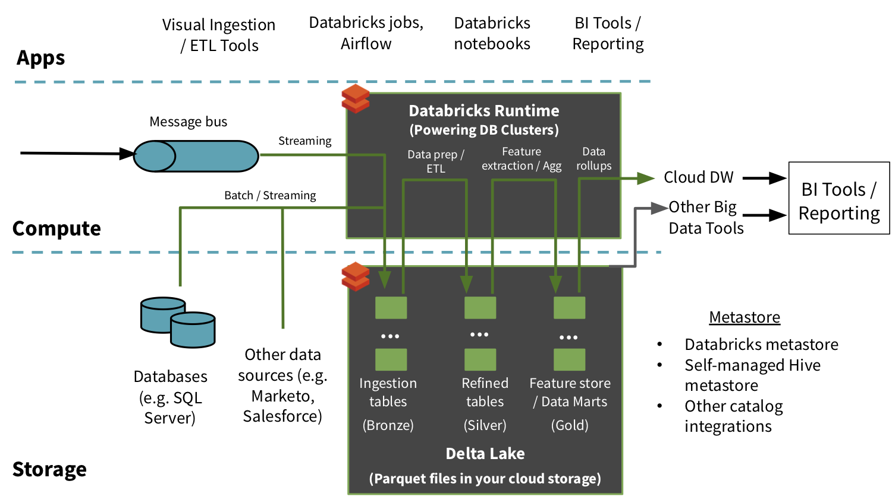
Delta Lake architecture

Slide 8
Table batch reads and writes
Supports most of the options provided by Apache Spark DataFrame read and write APIs for performing batch reads and writes on tables.

Slide 9
Create a table
Delta Lake supports creating two types of tables
Tables defined in the metastore and
Tables defined by path
You can create tables in the following ways.
SQL DDL commands
CREATE OR REPLACE TABLE events (
date DATE,
eventId STRING,
eventType STRING,
data STRING)
USING DELTA
CREATE IF NOT EXISTS TABLE events (
date DATE,
eventId STRING,
eventType STRING,
data STRING)
USING DELTA

Slide 10
Create a table
In Databricks Runtime 7.0 and above, SQL also supports a creating table at a path without creating an entry in the Hive metastore
-- Create or replace table with path
CREATE OR REPLACE TABLE delta.`/mnt/delta/events` (
date DATE,
eventId STRING,
eventType STRING,
data STRING)
USING DELTA

Slide 11
DataFrameWriter API
To simultaneously create a table and insert data into it, can use the Spark DataFrameWriter
# Create table in the metastore using DataFrame's schema and write data to it
df.write.format("delta").saveAsTable("events")
# Create or replace partitioned table with path using DataFrame's schema and write/overwrite data to it
df.write.format("delta").mode("overwrite").save("/mnt/delta/events")

Slide 12
Partition data
Partition data to speed up queries
df.write.format("delta").partitionBy("date").saveAsTable("events")
DeltaTable.create(spark) \
.tableName("event") \
.addColumn("date", DateType()) \
.addColumn("eventId", "STRING") \
.addColumn("eventType", StringType()) \
.addColumn("data", "STRING") \
.partitionedBy("date") \
.execute()

Slide 13
Control data location
For tables defined in the metastore, you can optionally specify the LOCATION as a path
Tables created with a specified LOCATION are considered unmanaged by the metastore
Unlike a managed table, where no path is specified, an unmanaged table’s files are not deleted when you DROP the table
CREATE TABLE events
USING DELTA
LOCATION '/mnt/delta/events'

Slide 14


