Slide 1
AI DENOISOR FOR BRAIN TUMOR MRI’S
PAAR DENOISORS
(Ryan Tran, Anand Sabnis, Pasang Sherpa, Allen Maredia)

Slide 2
CONTENTS
Introduction | Aim, Scope
Data Prep | Dataset selection
Implementing Network | Implementing U-Net and AutoEncoder Networks
Evaluation Metrics | Defining and understanding metrics
Training and Analysis | Training the dataset and running images
Results | Conclusion!

Slide 3
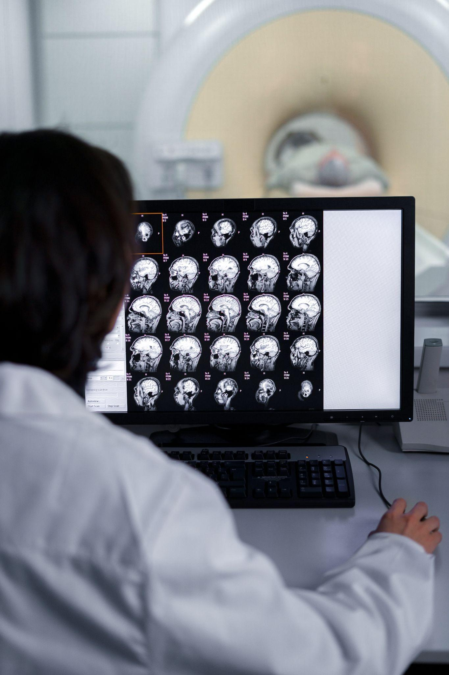
01
Introduction

Slide 4

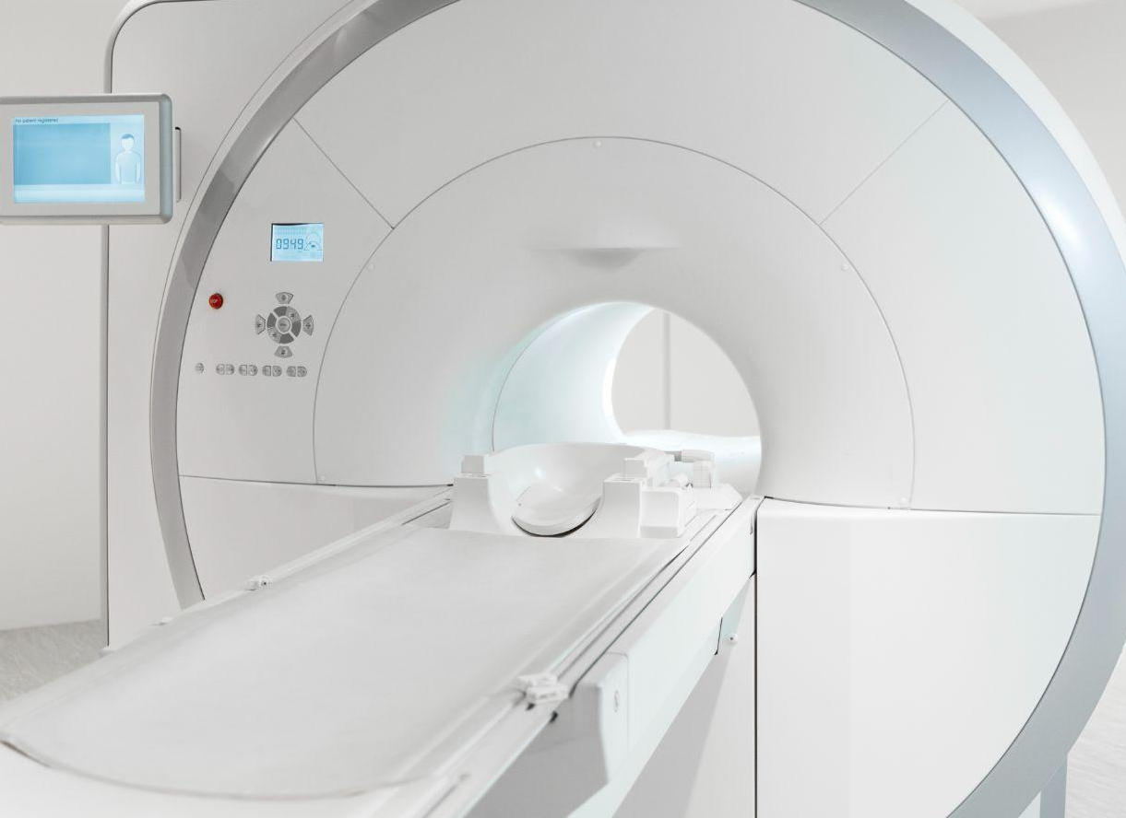
Why this project?
Image denoising with AI is an engaging and impactful project idea that blends technological advancements with real-world applications.
Enhancing images by removing noise leads to clearer and more interpretable images which helps in better analysis and decision making.
In healthcare and medical imaging such as MRI, CT scans, reducing noise can lead to clearer diagnostic images and treatment planning.

Slide 5
02
Data Preparation

Slide 6
METHODS
Data Preparation:
We had to obtain images to test our U-net and AutoEncoder framework on, and we wanted a lot.
We picked a dataset that contained 7023 MRI brain images. The dataset was imported from Kaggle(.jpeg form) and the images were used to train our model.
We didn’t remove any images, as we wanted as many as possible. We made a 80-20 training-testing split of the images obtained.
Link to Dataset: https://www.kaggle.com/datasets/masoudnickparvar/brain-tumor-mri-dataset/code

Slide 7
03
Implementing Network

Slide 8
METHODS
Implementing Network:
There are a lot of deep learning architectures such as U-Net, GANs, CNN, auto encoders or other denoising models.
Before we implemented the model, we used image normalization to make sure that the images were in a similar format.
We decided to go with U-Net and AutoEncoder model. U-Net is widely known for its effectiveness in image segmentation tasks where it excels at capturing contextual information while preserving spatial details. Autoencoder is versatile and adaptable even on a small dataset and is based on unsupervised learning.
This helps us keep the PSNR levels high and MSE levels low.

Slide 9
04
Evaluation Metrics

Slide 10
METHODS
Evaluation Metrics:
Evaluation Metrics are used to help us refine and determine what a good model is. These will show us how close to the actual image our denoised image is.
Common metrics for image denoising include PSNR (Peak Signal-to-Noise Ratio), SSIM (Structural Similarity Index), or MSE (Mean Squared Error).
We decided to compare all the metrics across both models to have a better grasp on the efficiency of models.

Slide 11
EVALUATION METRICS
PSNR
SSIM
MSE
PSNR stands for "Peak Signal-to-Noise Ratio." It is a metric used to measure the quality of an image or a video signal. It quantifies the difference between the original image and the compressed or processed image by comparing the maximum possible power of a signal to the power of corrupting noise.
SSIM stands for "Structural Similarity Index Measure." It is another metric used to evaluate the similarity between two images. SSIM measures the perceived change in structural information, luminance, and contrast of images. Higher SSIM values generally indicate greater similarity between the images being compared.
MSE stands for "Mean Squared Error." It is a common measure used in image processing or signal processing to quantify the average squared differences between corresponding pixels or values in two images. Lower MSE values indicate less difference between the images being compared, suggesting higher similarity or better quality.

Slide 12
05
Training and Analysis

Slide 13
METHODS
Training and Analysis:
We trained the U-net and AutoEncoder model using the images in the brain tumor mri dataset(mentioned on slide 6).
This dataset contains 7023 images of human brain MRI images which are classified into 4 classes: glioma - meningioma - no tumor and pituitary.
We picked the glioma subset to train our model. The glioma subset contains 1321 images that all show a glioma tumor in the brain.
The training and testing data split was 80-20(80% of images were used for training, whereas 20% were used for testing). This allowed us to extensively train and test our model.

Slide 14
06
Results

Slide 15
Note:
The choice between U-Net and AutoEncoder for image denoising may depend on various factors such as the nature of noise in the images, the level of detail preservation required, computational resources, and the specific requirements of the denoising task.
Experimentation and evaluation using both architectures on a particular dataset or problem can help determine which model performs better for a given scenario.
With that being said, here are the results:

Slide 16
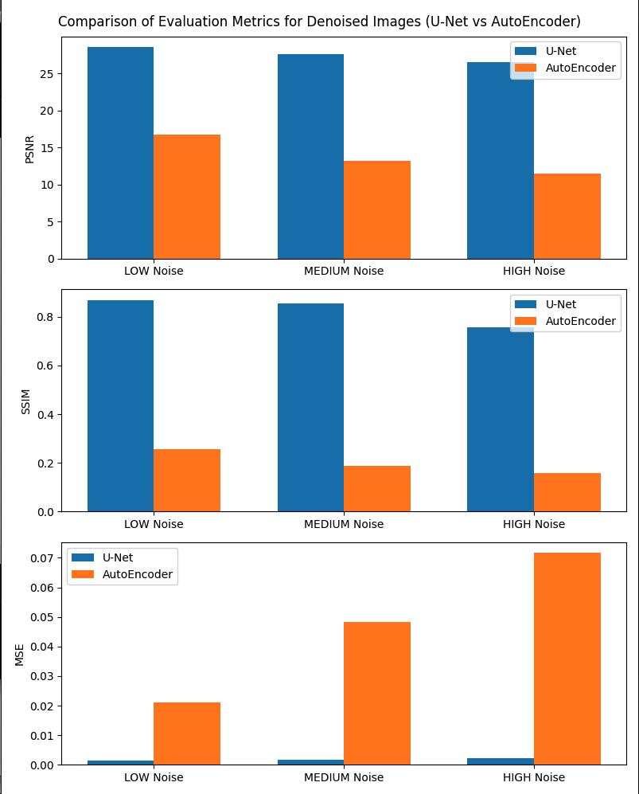
Metrics:
As seen on the right, the U-Net model is better at denoising images with all levels of noise
On average, PSNR is higher across all noises, as well as the SSIM. The MSE is higher for the AutoEncoder model.
In conclusion, the U-Net model generated better denoised images when given brain tumor MRIs.

Slide 17
THANKS
PAAR DENOISORS
(Ryan Tran, Anand Sabnis, Pasang Sherpa, Allen Maredia)

