Slide 1


Inheritance
The objectives of this chapter are:
To explore the concept and implications of inheritance
  Polymorphism
To define the syntax of inheritance in Java
To understand the class hierarchy of Java
To examine the effect of inheritance on constructors

Slide 2
Terminology
Inheritance is a fundamental Object Oriented concept
A class can be defined as a "subclass" of another class.
  The subclass inherits all data attributes of its superclass
  The subclass inherits all methods of its superclass
  The subclass inherits all associations of its superclass
The subclass can:
  Add new functionality
  Use inherited functionality
  Override inherited functionality
superclass:
Person
- name: String
subclass:
Employee
- employeeID: int
- salary: int

Slide 3
What really happens?
When an object is created using new, the system must allocate enough memory to hold all its instance variables.
  This includes any inherited instance variables
In this example, we can say that an Employee "is a kind of" Person.
  An Employee object inherits all of the attributes, methods and associations of Person
Person
- name: String
Person
name = "John Smith"
Employee
name = "Sally Halls"
employeeID = 37518
salary = 65000
is a kind of
Employee
- employeeID: int
- salary: int
-

Slide 4
Inheritance in Java
Inheritance is declared using the "extends" keyword
  If inheritance is not defined, the class extends a class called Object
public class Person
{
private String name;
[...]
Person
- name: String
- dob: Date
public class Employee extends Person
{
private int employeID;
private int salary;
[...]
Employee
- employeeID: int
- salary: int
Employee anEmployee = new Employee();

Slide 5
Inheritance Hierarchy
Each Java class has one (and only one) superclass.
  C++ allows for multiple inheritance
Inheritance creates a class hierarchy
  Classes higher in the hierarchy are more general and more abstract
  Classes lower in the hierarchy are more specific and concrete
There is no limit to the number of subclasses a class can have
There is no limit to the depth of the class tree.
Class
Class
Class
Class
Class
Class
Class
Class

Slide 6
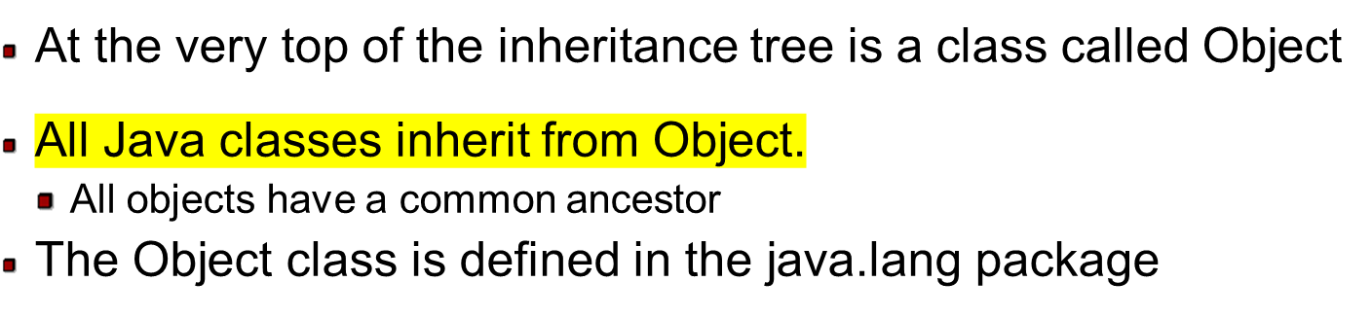
The class called Object
Object

Slide 7
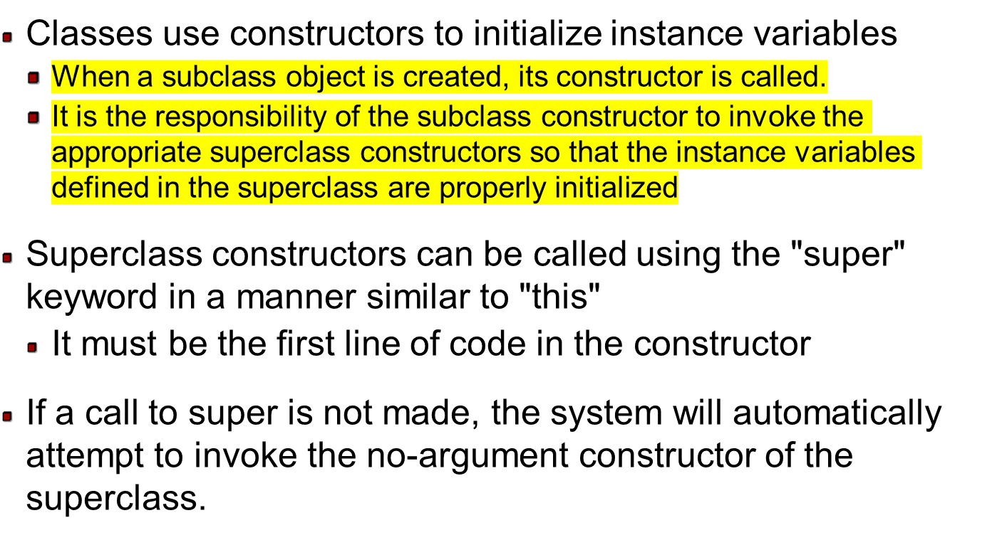
Constructors and Initialization

Slide 8
IS-A Relationship
Class B inherits all of the data and operations defined in the class A.
In other words, it can be said that inheritance is from Generalization to Specialization.

Slide 9
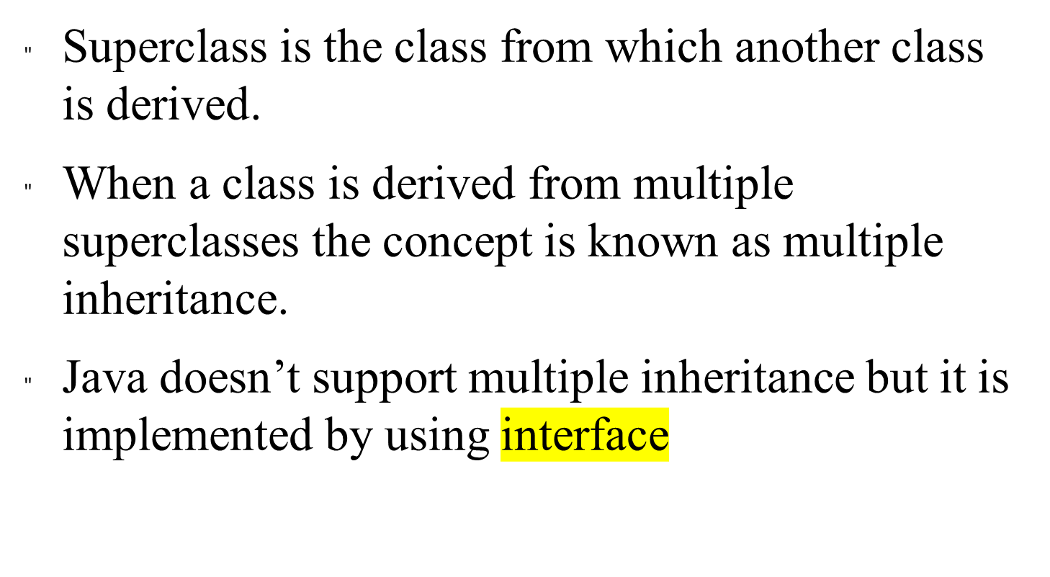
Super Class

Slide 10
Subclass
Class derived from super class is known as subclass.
Superclass is called parent class or base class.
Subclass is called as child class or derived class.

Slide 11
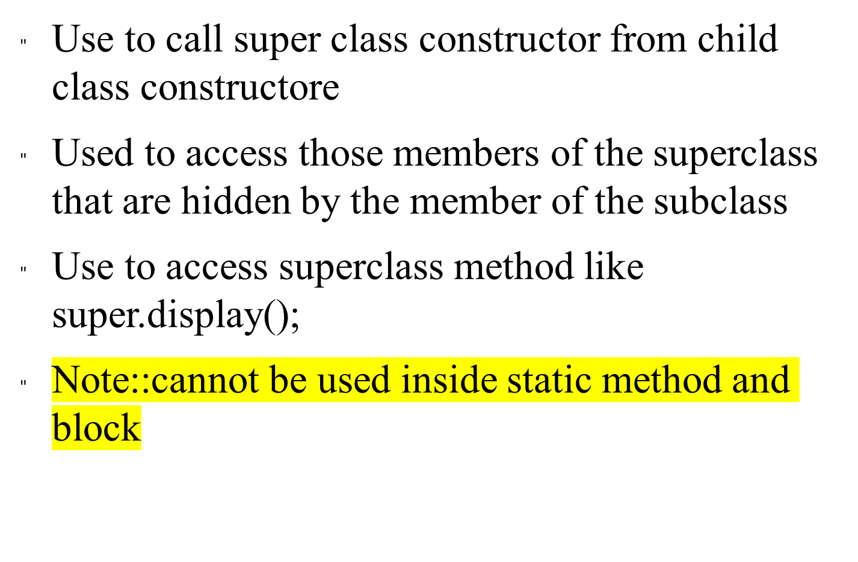
Use of Super Keyword

Slide 12
Type of inheritance
Simple
Multilevel
Simple
When a subclass is derived from its parent class then this mechanism is known as simple inheritance

Slide 13
Multilevel Inheritance
When a class is derived from a derived class
A→B→C→D

Slide 14
Method Overriding and Dynamic Method Dispatch
Subclasses inherit all methods from their superclass
  Sometimes, the implementation of the method in the superclass does not provide the functionality required by the subclass.
  In these cases, the method must be overridden.
To override a method, provide an implementation in the subclass.
  The method in the subclass MUST have the exact same signature as the method it is overriding.

Slide 15
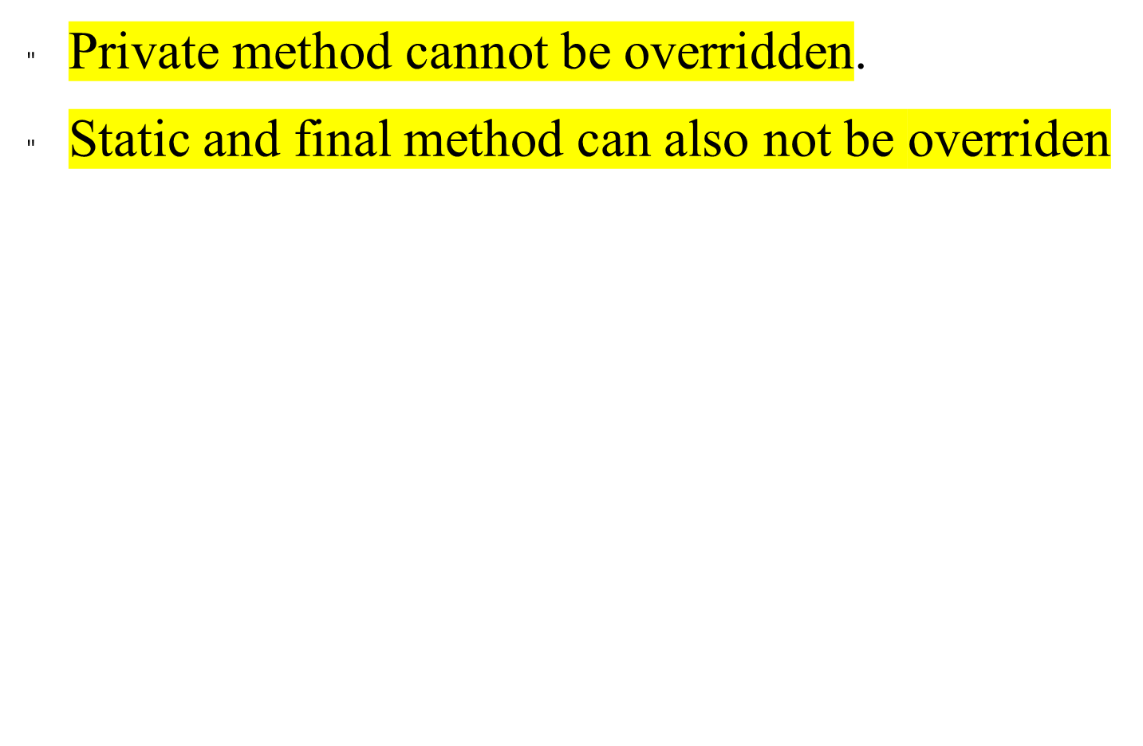

Slide 16
DMD
Is the mechanism by which a call to an overridden method is resolved at runtime rather then at compile time.
Help to implement run time polymorphism
A(parent)
B(child)
A a1;//valid
a1=new B();//valid
Note::B b1;//valid b1=new A();//invalid

Slide 17
A→fun()
B extends A→fun()
B b1=new B();b1.fun()//fun of child(B)will be called whereas fun of Parent(A)is overridden
Dynamic Method Dispatch
A a1=new B();a1.fun();//B class fun()
a1=new A(); a1.fun();//A class fun()

Slide 18
Polymorphism
.
Polymorphism is: The method being invoked on an object is determined AT RUNTIME and is based on the type of the object receiving the message.
It is the capability of a method to do different things based on the object through which it is invoked or object it is acting upon.
Overloading and Overriding are the two types of polymorphism.
Java uses Dynamic method Dispatch mechanism to decide at runtime which overridden function will be invoked.

Slide 19
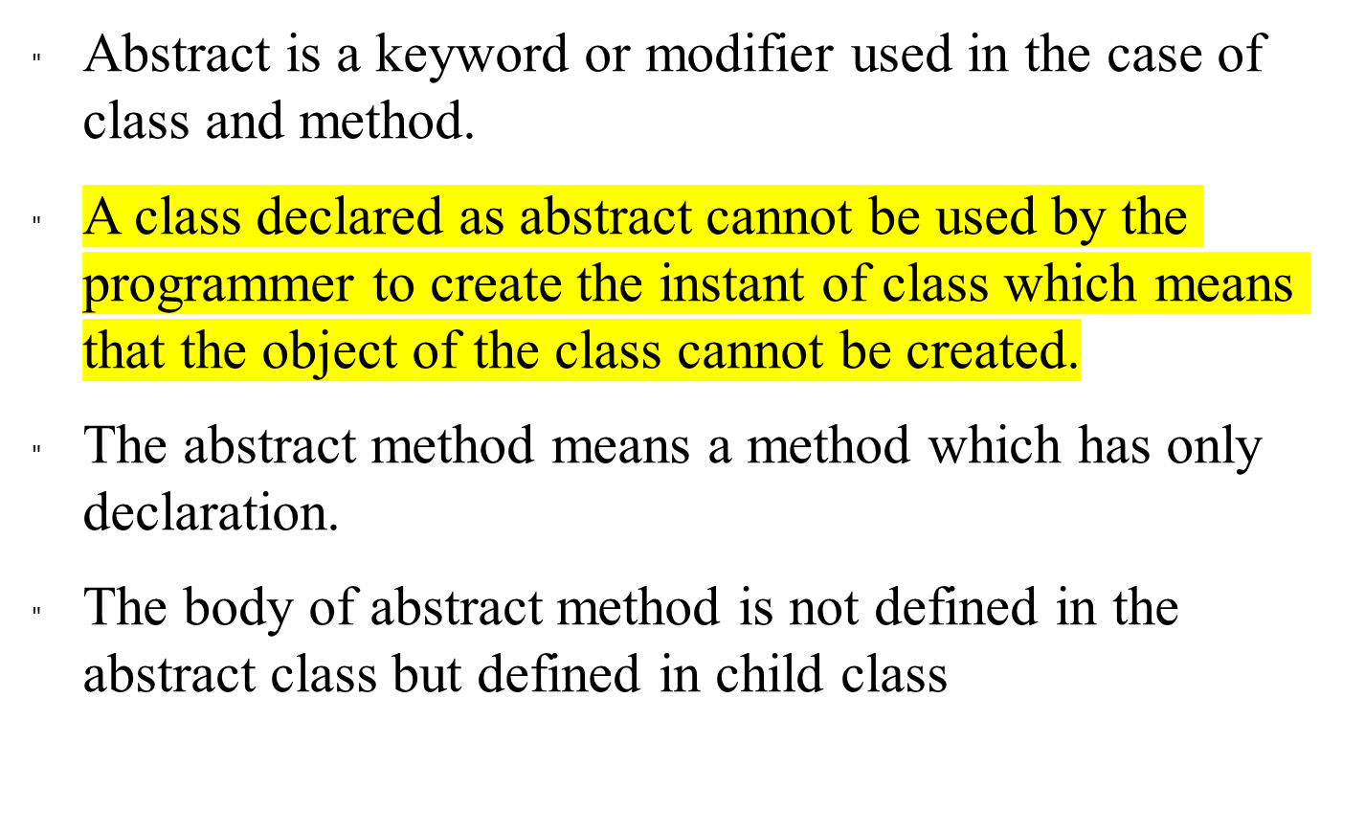
Abstract class or Methods

Slide 20
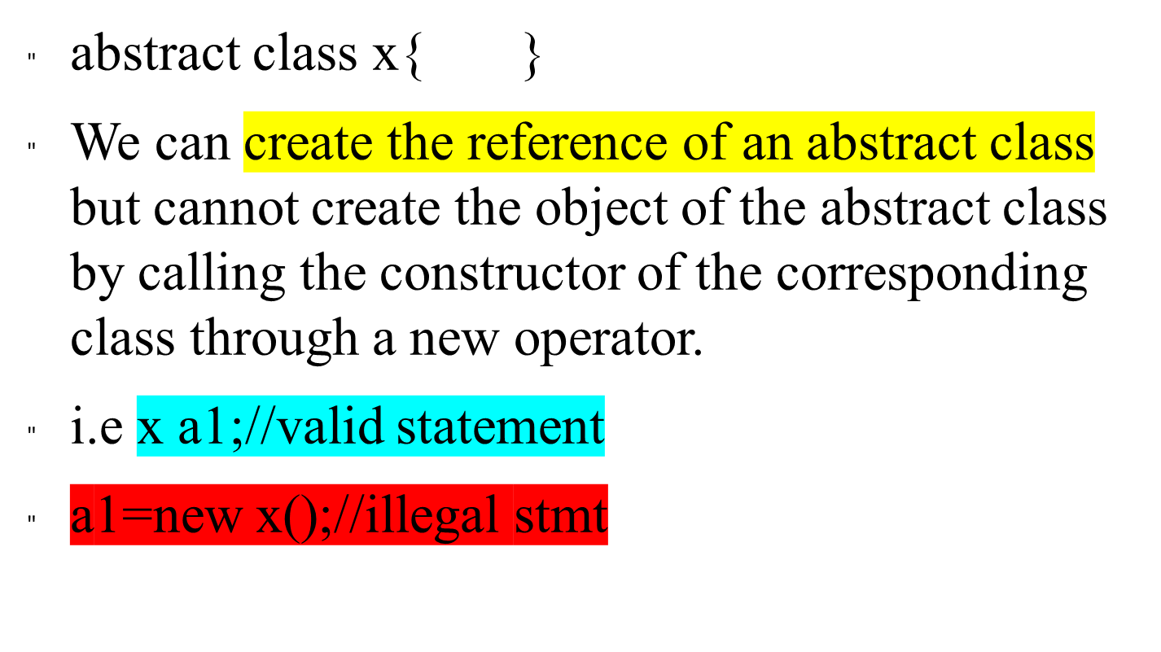
The syntax to declare abstract class is

Slide 21
NoTE
Constructor cannot be abstract
We can define constructor in the abstract class but they will be invoked by using the constructor of the child class

Slide 22
Final Keyword
Making constant
Preventing method to be overridden
Preventing a class to be inherited

Slide 23
Final Methods and Final Classes
Methods can be qualified with the final modifier
  Final methods cannot be overridden.
  This can be useful for security purposes.
public final boolean validatePassword(String username, String Password)
{
[...]
Classes can be qualified with the final modifier
  The class cannot be extended
  This can be used to improve performance. Because there an be no subclasses, there will be no polymorphic overhead at runtime.
public final class Color
{
[...]

Slide 24
Review
What is inheritance? What is a superclass? What is a subclass?
Which class is at the top of the class hierarchy in Java?
What are the constructor issues surrounding inheritance?
What is method overriding? What is polymorphism? How are they related?
What is a final method? What is a final class?

Slide 25
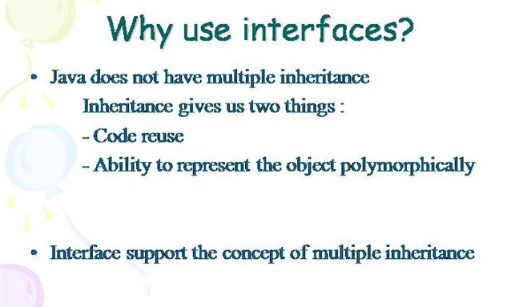

Slide 26
Interface is same class but
Abstract method and
Final ,static fields(data variable)
Interface don’t have instance variable
All methods and fields are public by default

Slide 27
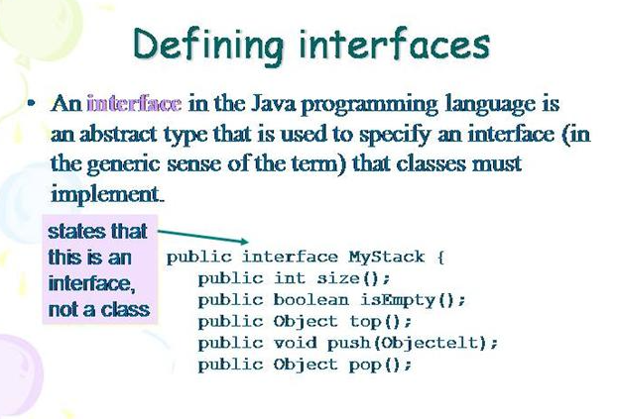

Slide 28
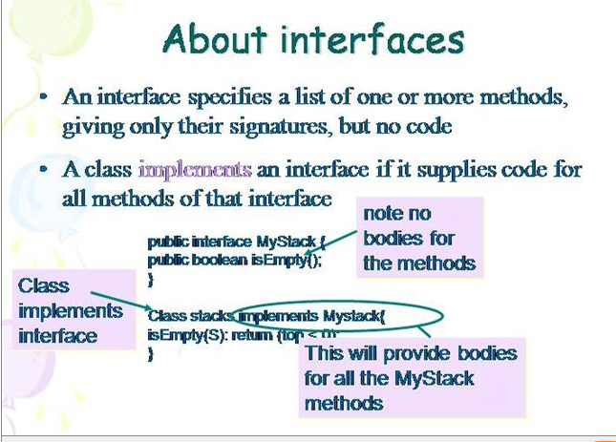

Slide 29
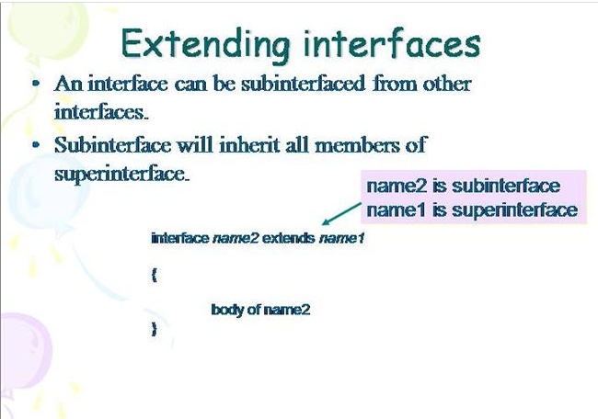

Slide 30
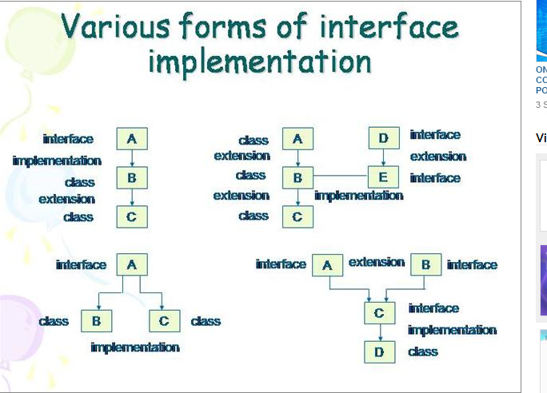

Slide 31
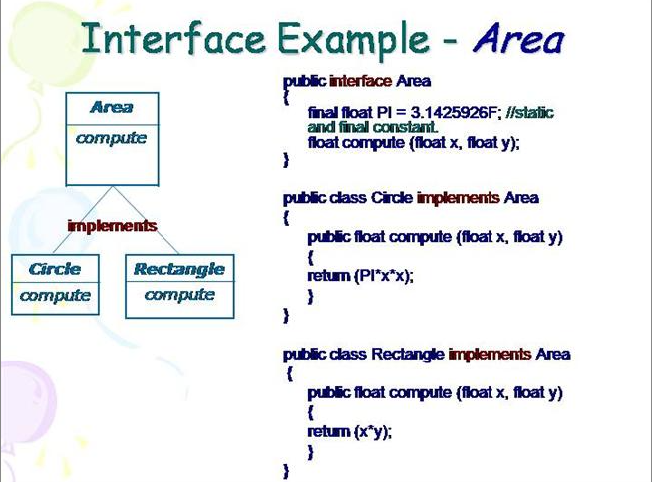

Slide 32
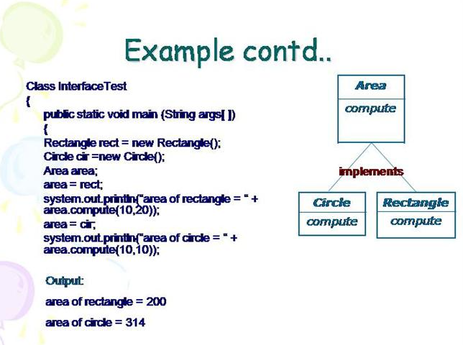

Slide 33
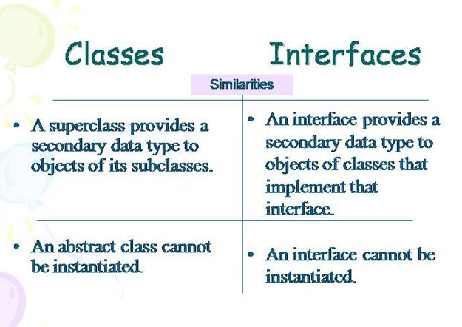

Slide 34
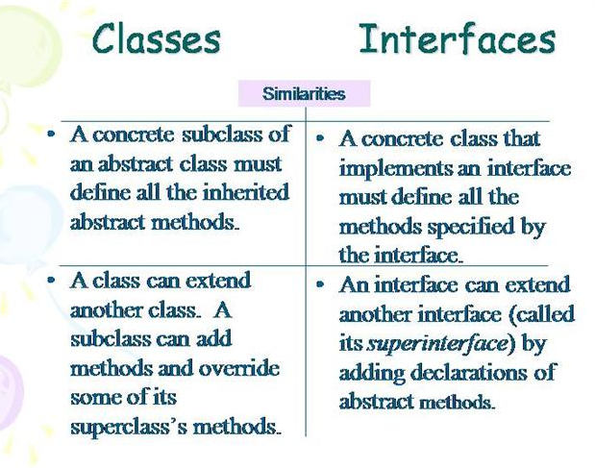

Slide 35
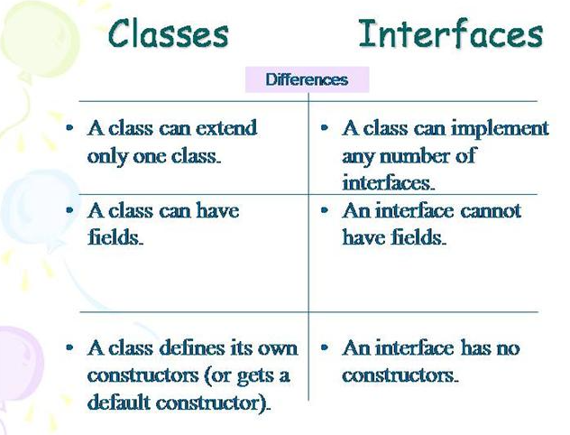

Slide 36
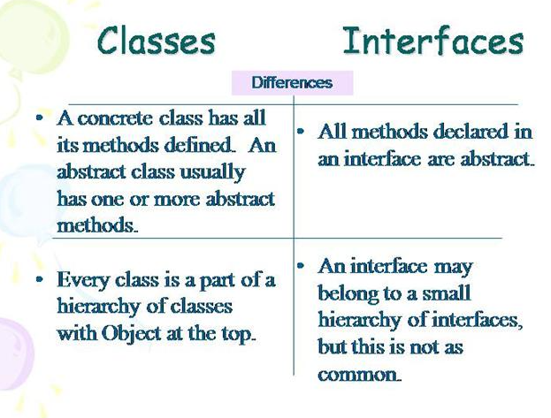

Slide 37
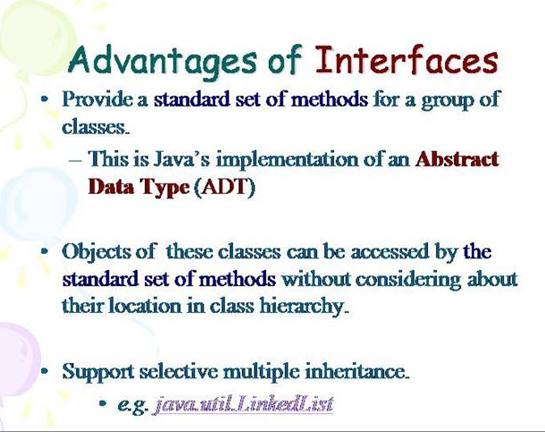

Slide 38
Note
An interface can only extend interface
An interface cannot extend a class
A class can implement more then one interface and can extend only one class
An interface cannot implement an interface
An interface can extend more then one interface by using extend keyword and comma
Interface A extends C,B

Slide 39


