Slide 1
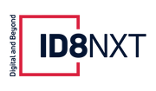
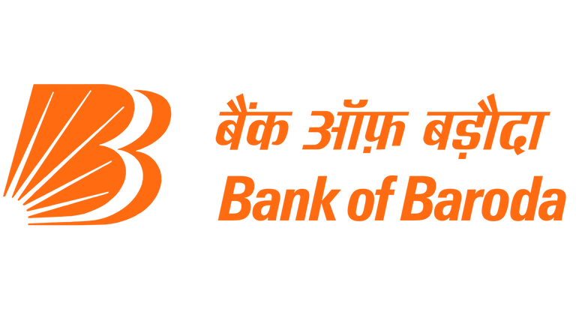

Bank of Baroda Hackathon 2024
Your Team Name : Attention Mavericks
Your team bio : We are an enthusiastic group of Web app developers , Machine Learning and Gen AI junkies who would love to approach Problem Statement 5 and come up with a unique efficient scalable solution to the problem of personalized finance using LLMs, RAG systems and GenAI
Date : 30/06/24

Slide 2
Problem Statement?
Why did you decide to solve this Problem statement?
More and more people need personal assistants to help them through complicated financial situations these days In the current economic environment, it’s hard for individuals to make sense of their options in different financial items such as loans and investments since there are many of them. Such advisors give custom-made recommendations depending on an individual’s financial status, objectives and inclinations. They also simplify details that are difficult to comprehend by giving live feedback at any time among other things.

Slide 3
Pre-Requisite
What are the alternatives/competitive products for the problem you are solving?
Many financial advisory chatbots deploy Large Language Models (LLMs) for furnishing tailored and individualized financial advice. Some of them are:
Scripbox: This utilizes AI for propelling custom-tailored investment counsel that aids its users in creating and handling their investment portfolios. It takes into account the person’s financial goals and willingness to take risks while giving suggestions.
Kuvera: It offers robo-advisory services based on AI that give customized financial planning and investment recommendations. The robot assists users in investing with goals in mind, planning their taxes, and managing their portfolios.
Fisdom: It offers a financial advisory bot that provides personalized mutual fund recommendations, tax-saving strategies, and retirement planning advice. The bot uses customer data to tailor its suggestions.
ETMONEY: This advisory bot in ETMONEY is admired for its helping in investment planning, money monitoring, tax-saving techniques. Its recommendations are always based on your financial targets and the whole history.

Slide 4
Tools or resources
Data Collection and Management:
Banking APIs: Integrate with banking APIs (e.g., Plaid, Yodlee) to securely access customer financial data.
Market Data Providers: Utilize services like Bloomberg, Alpha Vantage, or Quandl for real-time market data.
Data Warehousing: Use cloud-based data warehouses (e.g., Amazon Redshift, Google BigQuery) for efficient storage and processing.
Deployment Platforms: Deploy models and applications on cloud platforms like AWS, Azure, or Google Cloud Platform (GCP).
Azure Cognitive Search: This service is essential for the retrieval part of the RAG system. It allows you to index large datasets and perform powerful search queries to retrieve relevant documents based on user inputs.
Azure OpenAI Service: Utilize this service to integrate models like GPT-3 or GPT-4 for the generation part of your RAG system. These models can generate coherent and contextually relevant responses based on the retrieved documents.
Azure Blob Storage: This service will be useful for storing large datasets, documents, and any other
These are a few of the services that we plan to use. Other services will also most likely come in handy such as Azure Cognitive Search, Azure OpenAI Service, Azure Blob Storage, Azure Functions, Azure Machine Learning, Azure Data Factory, Azure SQL Database, Cosmos DB, Azure API Management, Azure Kubernetes Service (AKS), Azure Monitor, Azure Log Analytics.

Slide 5
Any Supporting Functional Documents
Our solution leverages generative AI to integrate customer banking data and market data to generate real-time, adaptive investment strategies.
Key- Features:
Personalized Financial Advice: Customized investment strategies based on individual risk profiles and financial objectives.
Real-Time Updates: Dynamic advice that adapts to market changes and evolving customer goals.
Explainable AI: Transparent recommendations with clear, understandable explanations to build trust and confidence.
Data Collection:
Customer Data: Securely access and analyze transaction histories, balances, credit scores, and other relevant financial information through banking APIs.
Market Data: Gather real-time market information, including stock prices, interest rates, and economic indicators from reliable data providers.
Generative AI:
Strategy Generation: Develop generative AI models to create personalized investment strategies that optimize for risk and return based on the customer's profile.
Explainability: Use LLMs to generate human-readable explanations for AI-driven recommendations.

Slide 6
Key Differentiators & Adoption Plan
Key Differentiators:
Personalization: Use customer-specific data to generate highly personalized financial advice and investment strategies.
Transparency and Explainability: Provide clear, understandable explanations for AI-generated recommendations, fostering trust.
Generative AI: Leverage state-of-the-art generative AI models to create unique, data-driven strategies.
Interactive Interface: Design an intuitive and user-friendly interface for seamless interaction with the AI advisor.
Educational Resources: Include resources to help users understand financial concepts and make informed decisions, using the ‘Learn’ feature of the application.
Adoption Plan
Pilot Launch: Start with a limited group of users to gather initial feedback.
Full Launch: Launch a comprehensive marketing campaign to promote the service and attract new users. Provide robust customer support to assist with onboarding and troubleshooting.
Continuous Improvement: Continuously update the system based on user feedback and changing market conditions.
Scaling: Establish partnerships with esteemed institutions like the Bank of Baroda to expand the service's reach.

Slide 7
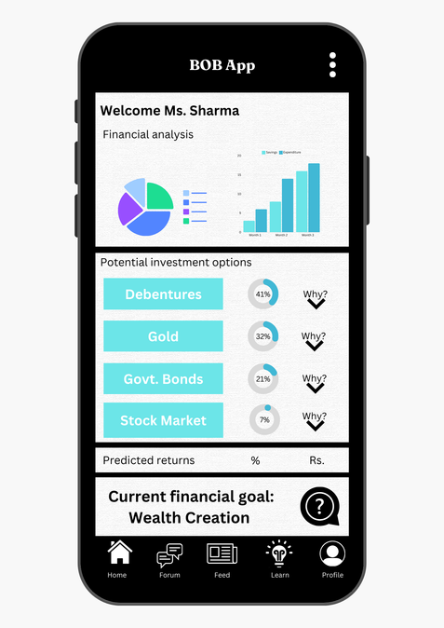
GitHub Repository Link & supporting diagrams, screenshots, if any
How far it can go?
BANK GUIDELINES
Retrieve documents
EMBEDDING MODEL
VECTOR DB
documents
document embeddings
USER DOCUMENTS
Retrieve documents
documents
document embeddings
ENTERPRISE APP
Query and embedded
query
User Query
LLM(Prompt tuned)
Financial Advice
Forum

Slide 8
Business Potential and Relevance
Tailored Financial Guidance: Based on each customer's unique financial objectives and risk tolerance, LLMs can use customer data analysis to give tailored retirement planning, savings plans, and investment advice.
Customer Service Automation: LLM-enabled chatbots free up human advisers for more difficult jobs by answering standard questions, setting up appointments, and providing information on financial goods and services.
Enhanced Interaction with Clients:LLMs can identify chances for proactive interaction, including recommending new investment choices or refinancing options, by examining client behaviour and financial activities.
Data Analysis and Reporting : LLMs can assist advisers make more informed decisions by analysing vast amounts of financial data to find possible risks and possibilities.
Continuous monitoring and timely alerts can be obtained through automated analysis of market circumstances and investment performance.

Slide 9
Uniqueness of Approach and Solution
What is the unique aspects of the proposed idea?
Real-Time Financial Insights: LLMs can provide customers with real-time financial insights and notifications, allowing them to make informed decisions, by continuously monitoring the financial markets and the client's portfolio.
Automation of Routine processes: LLMs can free up human advisors to concentrate on more complex and individualised client engagements by automating routine processes like data entry, report preparation, and simple consumer questions.
Tailored Financial advise: To help clients make well-informed decisions, LLMs can examine a client's financial information, spending habits, and personal objectives. This allows them to offer highly customised financial advise.
Quick Data Analysis: LLMs are capable of processing and analysing enormous volumes of financial data rapidly, spotting patterns, dangers, and opportunities that human advisors would overlook. Real-time information and more proactive financial management are made possible by this.

Slide 10
User Experience
How will your idea enhance the user experience?
Time-saving: By automating repetitive processes like report preparation, transaction monitoring, and portfolio rebalancing, users and advisors can dedicate more of their time to making more strategic decisions.
Personalised Recommendations: To provide tailored investment possibilities and financial plans, LLMs can examine each user's unique financial profile, objectives, and risk tolerance. This ensures that the advise is pertinent and unique to each user.
Instant Feedback: In order to respond quickly to changes, users can get real-time information and updates on their financial situation, the state of the market, and the performance of their investments.
Reliability and Consistency: Automated procedures minimise the possibility of human error, assuring accurate and reliable completion of regular activities.

Slide 11
Scalability
How effectively can your solution be scaled to accommodate growth without compromising performance?
Ways to scale the solution to accommodate growth without compromising performances are:-
Cloud Infrastructure :
Elastic Scaling- Use of cloud based solutions such as Azure.
Load Balancing- Use of load balancer to distribute traffic over multiple servers for smooth functioning.
Model Optimization :
Model Distillation- Use to create smaller and faster models by retaining most of the accuracy .
Quantization- To reduce computational load as well memory footprint of the model.
Distributed Computing :
Parallel Processing- To process large datasets and complex computations using Apache Spark or TensorFlow Distributed.
Microservices Architecture- Breaking large system into smaller independent chunks and that can be scaled individually.

Slide 12
Ease of Deployment and Maintenance
How simple is your solution to implement and maintain on an ongoing basis?
Implementation
Leverage Pre-trained Models : Using pre-trained LLMs from providers like Google, Hugging Face etc. These models can be fine-tuned for financial advisory.
Cloud-based Deployment : Use of cloud services such as Azure Machine Learning for managing and deploying models.
APIs : Use APIs provided by cloud services for integration of LLM models in existing banking applications.
Modular Design : System designing using microservices architecture which components to be developed, scaled and deployed individually.
Maintenance
CI/CD : CI/CD pipelines to automate the deployment of new features and updates, ensuring system must me updated with less manual procedures.
Admin Dashboard : User-friendly dashboard for monitoring and managing the system.
Managed Cloud Services : Use of cloud services helps in upgrading software or hardware system automatically according to the needs.
Comprehensive Documentations : Maintaining complete documentation for installation, integration, usage and troubleshooting.

Slide 13
Security Considerations
What measures are incorporated to ensure the security and integrity of your solution?
Monitoring and Incident Response
Intrusion Detection and Prevention (monitoring and preventing suspicious and potential threats)
Logging and Monitoring
Incident Response Team
Data Security
Data Encryption
Access Control (Role Based Control and multi-factor authentication)
Data Masking and Anonymization
System Integrity
Secure Development Process (Code Reviews and Audits, Maintaining Coding Standard)
Regular Patching and Updates

Slide 14
Thank You
Anand Kumar Singh
Anish Kumar Sinha
Ankur De
Nupur Sangwai

