Slide 1
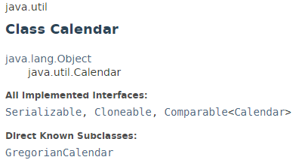
java.util.calendar
The java.util.calendar class is an abstract class that provides methods for converting between a specific instant in time and a set of calendar fields such as YEAR, MONTH, DAY_OF_MONTH, HOUR, and so on, and for manipulating the calendar fields, such as getting the date of the next week. Following are the important points about Calendar:
This class also provides additional fields and methods for implementing a concrete calendar system outside the package.
Calendar defines the range of values returned by certain calendar fields.

Slide 2
java.util.Date
https://docs.oracle.com/javase/8/docs/api/index.html?java/util/Calendar.html

