Slide 1
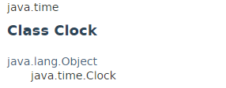
Clock
The java.time.Clock class provides access to the current instant, date and time using a time-zone.

Slide 2
Java Date and Time
https://docs.oracle.com/javase/8/docs/api/index.html?java/time/Clock.html

