Slide 1
ThreadGroup in Java
Java provides a convenient way to group multiple threads in a single object. In such way, we can suspend, resume or interrupt group of threads by a single method call.
Java thread group is implemented by java.lang.ThreadGroup class
A thread group represents a set of threads. In addition, a thread group can also include other thread groups. The thread groups form a tree in which every thread group except the initial thread group has a parent.
A thread is allowed to access information about its own thread group, but not to access information about its thread group's parent thread group or any other thread groups.
ThreadGroup
ThreadGroup
ThreadGroup A
ThreadGroup B
ThreadGroup C
T1
T2
T3

Slide 2
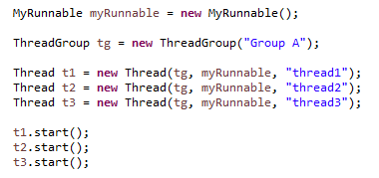
ThreadGroup in Java
Now all 3 threads belong to one group[Group A]. Here, tg is the thread group name, MyRunnable is the class that implements Runnable interface and “thread1", "thread2" and "thread3" are the thread names.
Thread.currentThread().getThreadGroup().interrupt();
Now we can interrupt all threads by a single line of code only.

Slide 3
ThreadGroup in Java
https://docs.oracle.com/javase/8/docs/api/index.html?java/lang/ThreadGroup.html

