Slide 1
ThreadGroup in Java
Java provides a convenient way to group multiple threads in a single object. In such way, we can suspend, resume or interrupt group of threads by a single method call.
Java thread group is implemented by java.lang.ThreadGroup class
ThreadGroup
T1
T2
T3

Slide 2
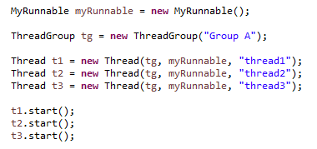
ThreadGroup in Java
Now all 3 threads belong to one group[Group A]. Here, tg is the thread group name, MyRunnable is the class that implements Runnable interface and “thread1", "thread2" and "thread3" are the thread names.
Thread.currentThread().getThreadGroup().interrupt();
Now we can interrupt all threads by a single line of code only.

Slide 3
ThreadGroup in Java
https://docs.oracle.com/javase/8/docs/api/index.html?java/lang/ThreadGroup.html

