Slide 1
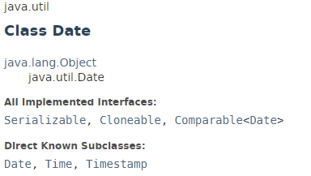
java.util.Date
The java.util.Date class represents a specific instant in time, with millisecond precision.
The java.util.Date class represents date and time in java. It provides constructors and methods to deal with date and time in java.
The java.util.Date class implements Serializable, Cloneable and Comparable<Date> interface. It is inherited by java.sql.Date, java.sql.Time and java.sql.Timestamp interfaces.
After Calendar class, most of the constructors and methods of java.util.Date class has been deprecated.

Slide 2
java.util.Date
https://docs.oracle.com/javase/8/docs/api/index.html?java/util/Date.html

